Slide 1

Jenkins
Pipelines

Slide 2
Jenkins Pipeline
Devops.Course

Slide 3
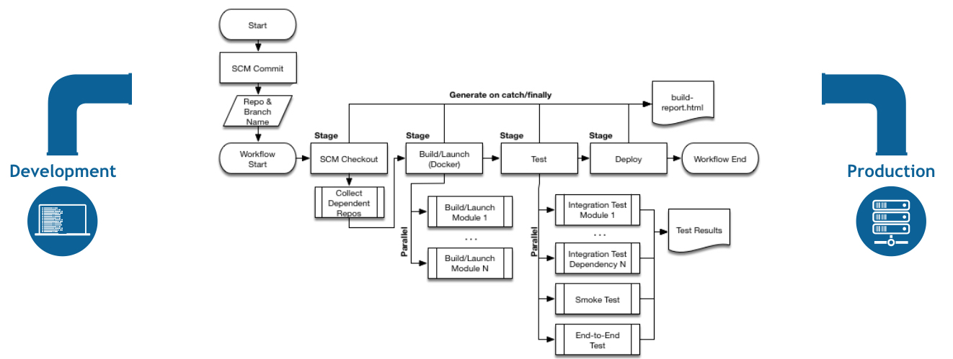
Jenkins Pipeline
Devops.Course

Slide 4
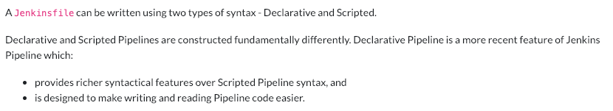
Jenkins Pipeline
Devops.Course

Slide 5
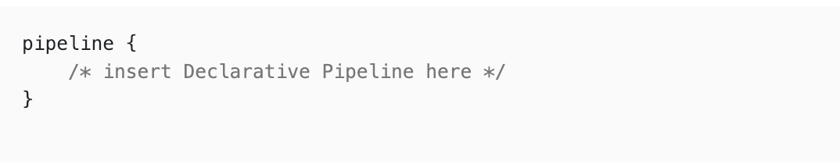
Declarative Pipeline
Devops.Course

Slide 6
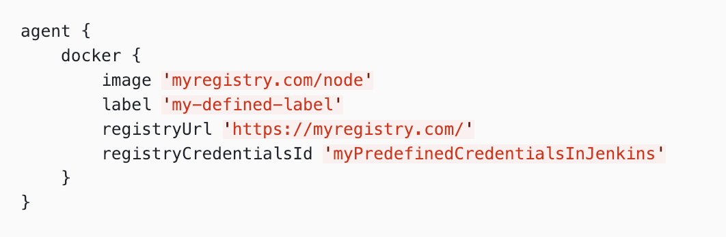
Declarative Pipeline
Devops.Course

Slide 7
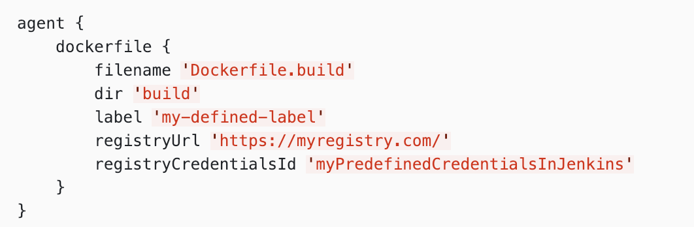
Declarative Pipeline
Devops.Course

Slide 8
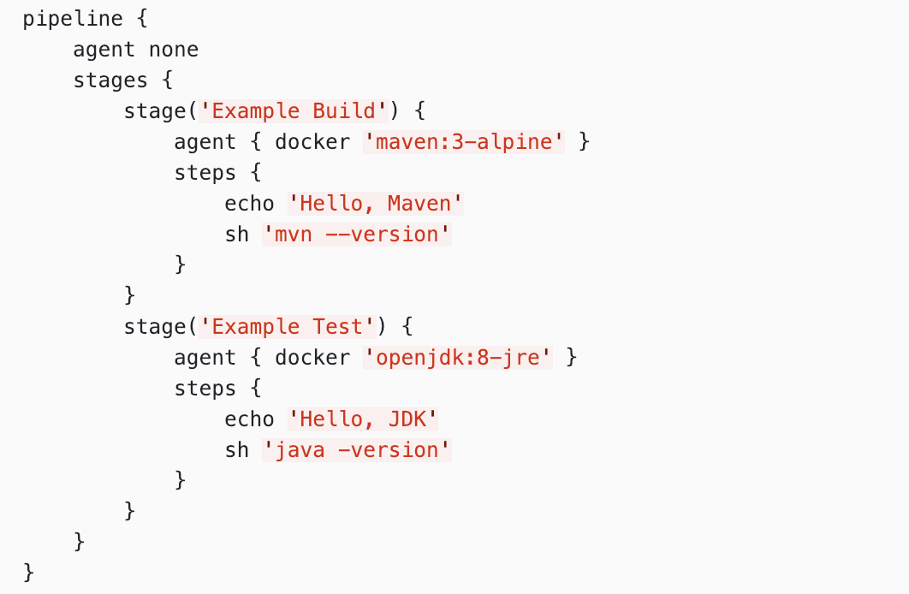
Declarative Pipeline
Devops.Course

Slide 9
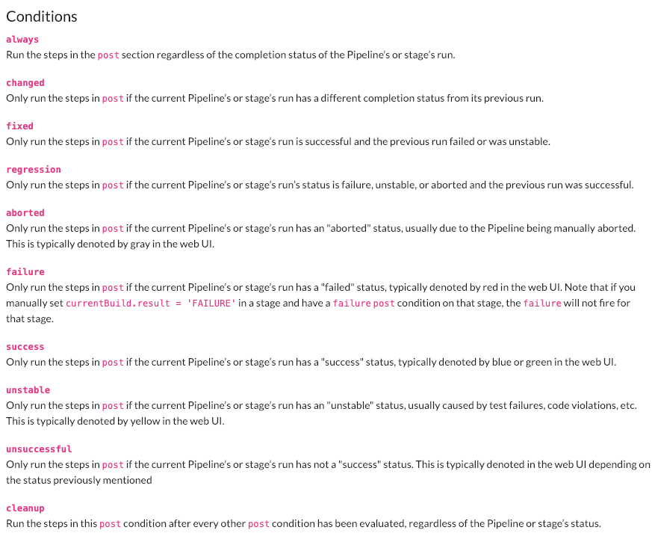
Declarative Pipeline

Slide 10
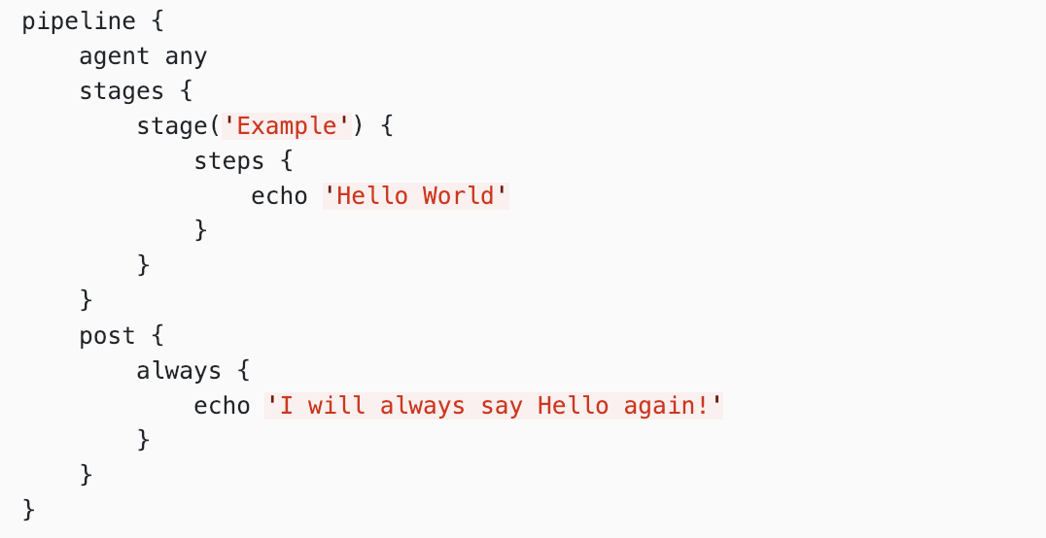
Declarative Pipeline
Devops.Course

Slide 11
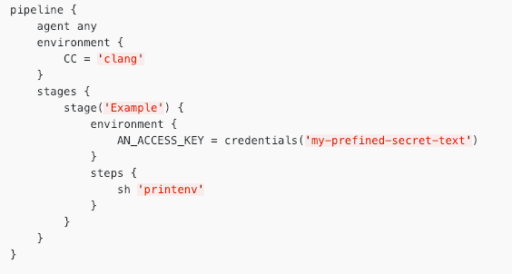
Declarative Pipeline
Devops.Course

Slide 12
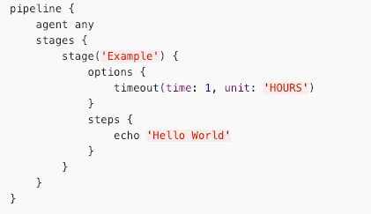
Declarative Pipeline
Devops.Course

Slide 13
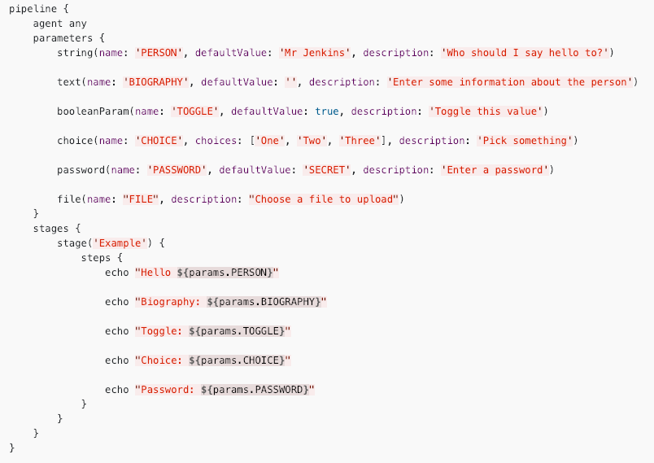
Declarative Pipeline

Slide 14
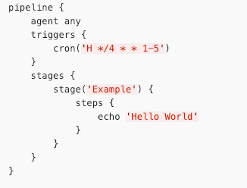
Declarative Pipeline
Devops.Course

Slide 15
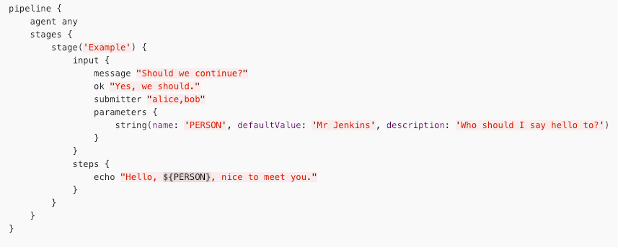
Declarative Pipeline
Devops.Course

Slide 16
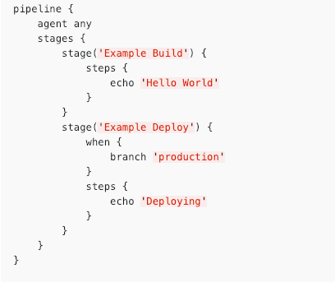
Declarative Pipeline
Devops.Course

Slide 17
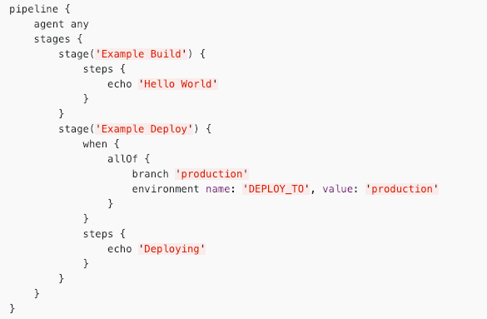
Declarative Pipeline
Devops.Course

Slide 18
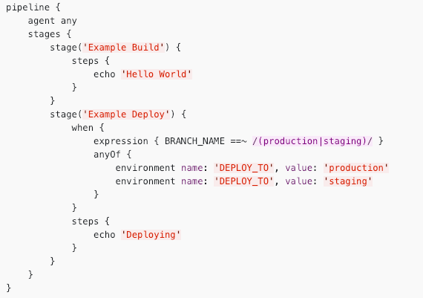
Declarative Pipeline
Devops.Course

Slide 19
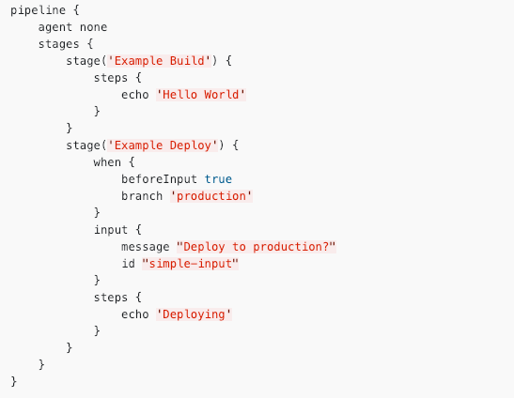
Declarative Pipeline
Devops.Course

Slide 20
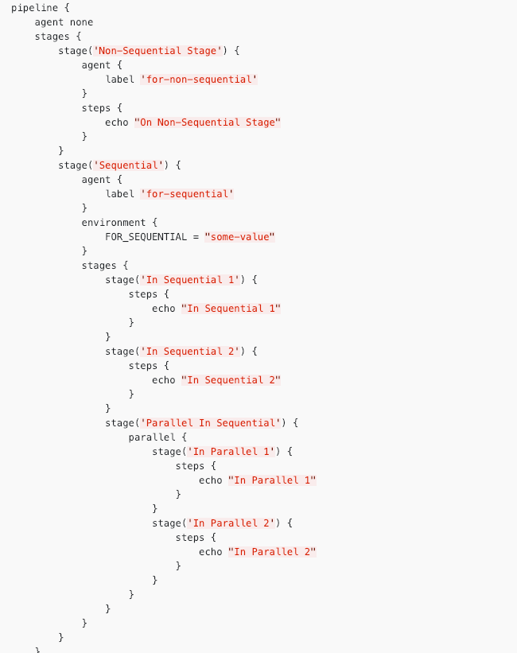

Slide 21
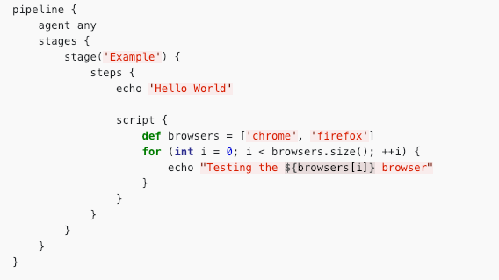
Declarative Pipeline
Devops.Course

Slide 22
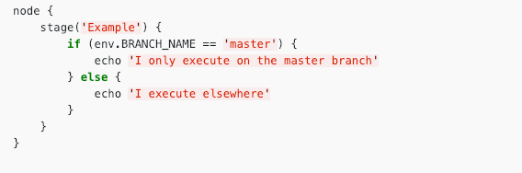
Scripted Pipeline
Devops.Course

Slide 23
Shared Libraries
Devops.Course

Slide 24
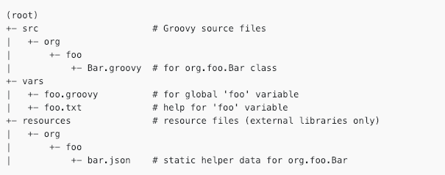
Shared Library Repository
Devops.Course

Slide 25
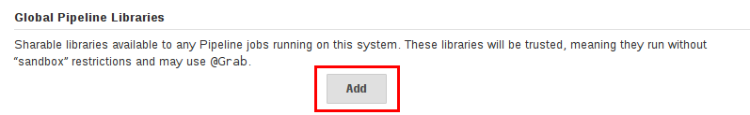
Global Shared Libraries
Devops.Course

Slide 26
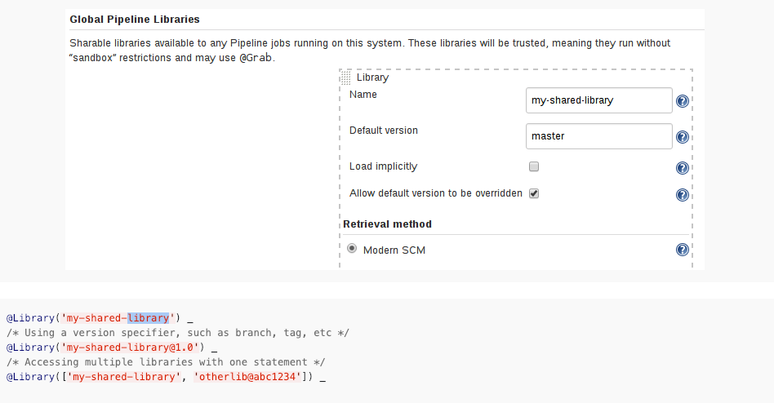
Using Libraries
Devops.Course

Slide 27
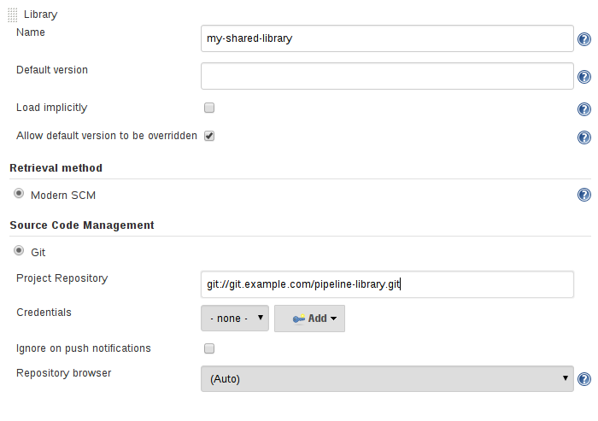
Library versions
Devops.Course

Slide 28
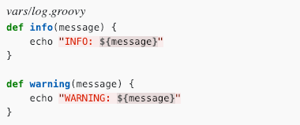
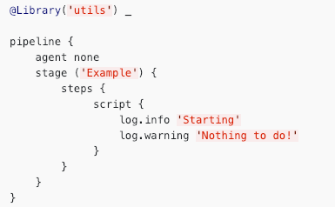
Library in action

Slide 29
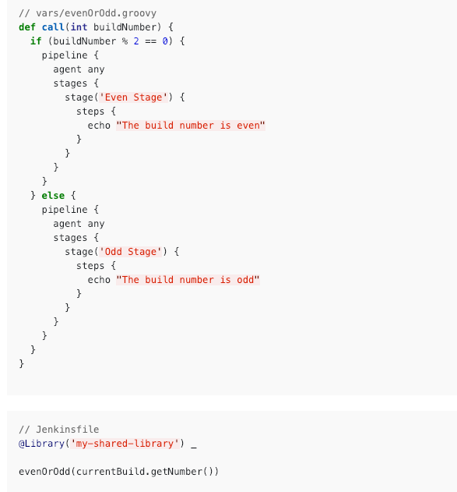
Library pipelines

Slide 30

Questions ?
Devops.Course

Slide 31
Thanks for attentions!
Devops.Course

