Slide 1

Vault
Devops.Course

Slide 2
MODERN SECRETS MANAGEMENT
Devops.Course

Slide 3
WHAT IS A SECRET?
Security-sensitive information
Personally-identifiable information (PII)
DB User/Pass, AWS IAM Credentials, SSL Keys, Encryption Keys
Anything that would make the news
Devops.Course

Slide 4
HOW DO I DISTRIBUTE SECRETS?
How do applications get secrets?
How do operators get secrets?
How do secrets get updated?
How do secrets get revoked?
Devops.Events

Slide 5
VAULT GOALS
Single source for Secrets
Programmatic Application Access (Automated)
Operator Access (Manual)
Practical Security
Modern Data Center Friendly
Devops.Course

Slide 6
VAULT FEATURES
Secure Secret Storage (in-memory, Consul, file, and more)
Dynamic Secrets
Leasing, Renewal, and Revocation
Auditing
Rich ACLs
Multiple Client Authentication Methods
Devops.Course

Slide 7
SECURE SECRET STORAGE
Data is encrypted in transit and at rest
256bit AES in GCM mode
TLS 1.2 for clients
No HSM required
Devops.Course

Slide 8
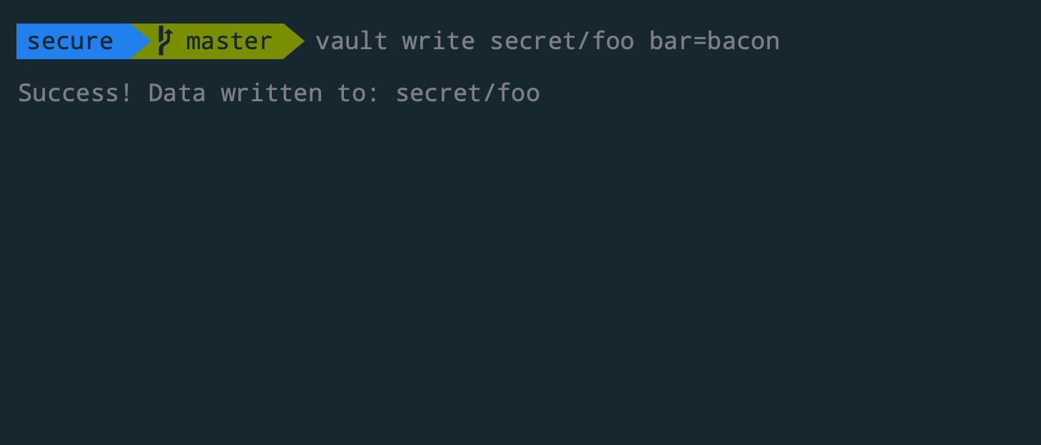
SECURE SECRET STORAGE
Devops.Course

Slide 9
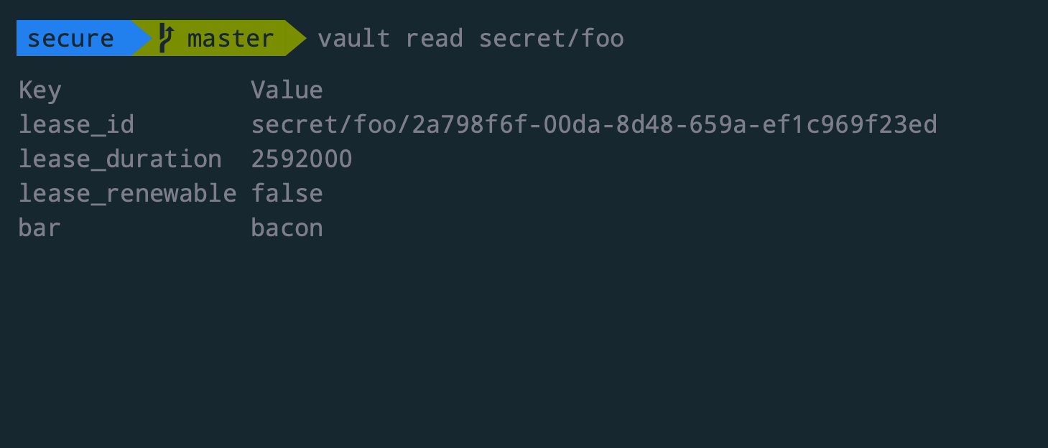
SECURE SECRET STORAGE
Devops.Course

Slide 10
UNSEALING THE VAULT
Data in Vault encrypted
Vault requires encryption key
Must be provided online
Devops.Course

Slide 11
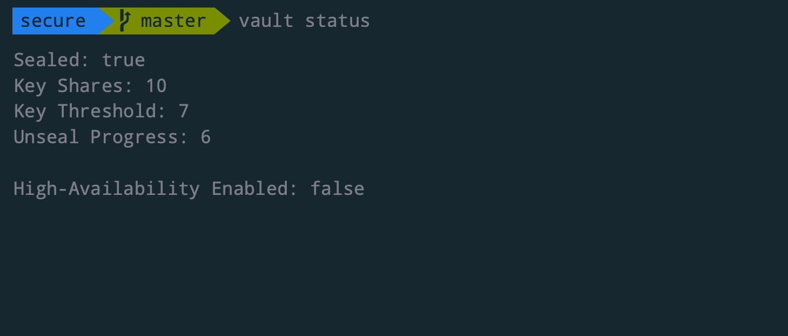
UNSEALING THE VAULT
Devops.Course

Slide 12
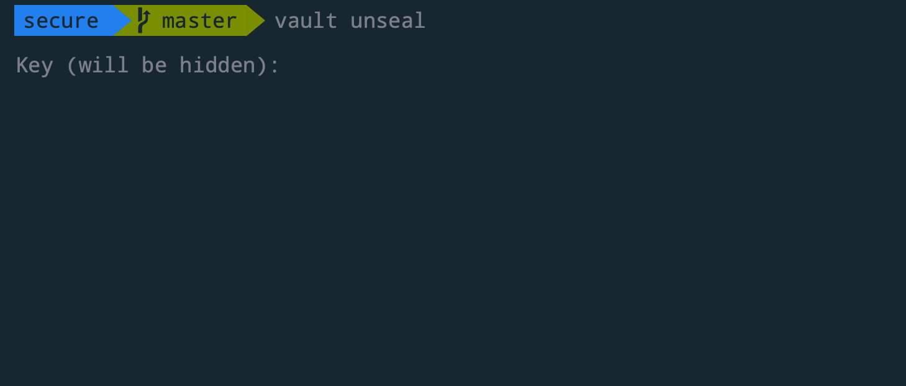
UNSEALING THE VAULT
Devops.Course

Slide 13
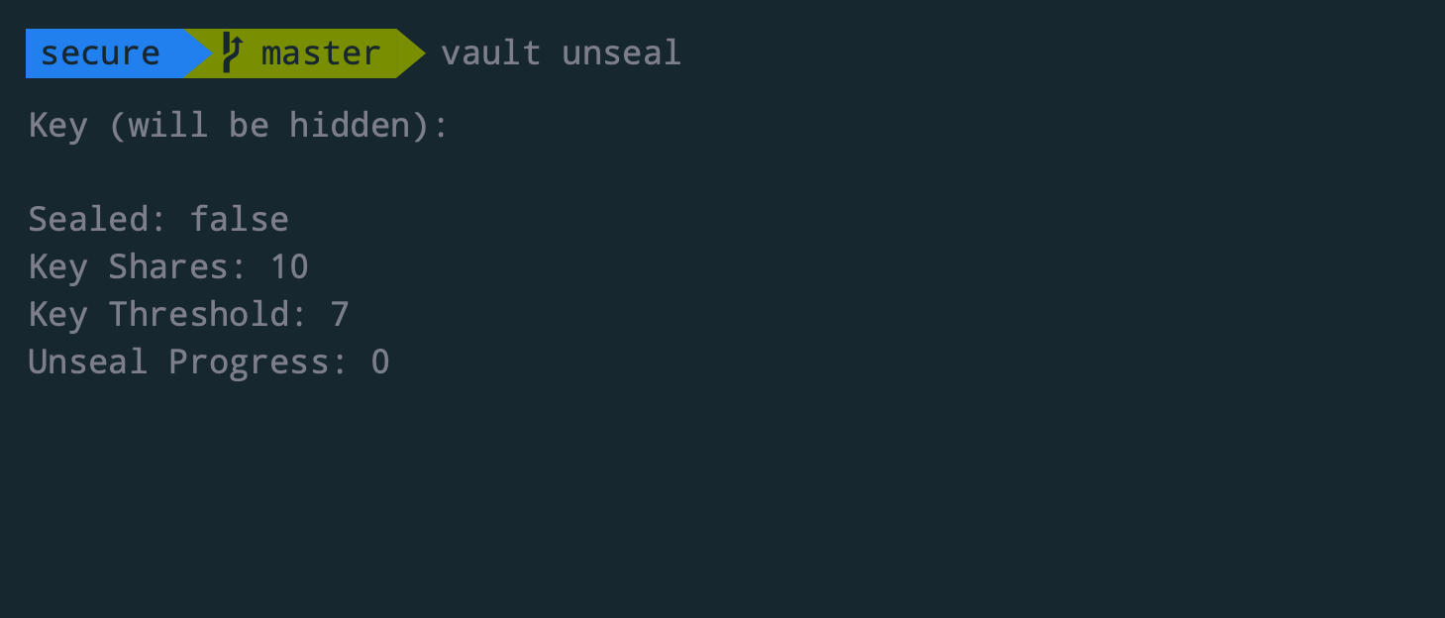
UNSEALING THE VAULT
Devops.Course

Slide 14
DYNAMIC SECRETS
Never provide “root” credentials to clients
Provide limited access credentials based on role
Generated on demand when requested
Leases are enforceable via revocation
Audit trail can identify point of compromise
Devops.Course

Slide 15
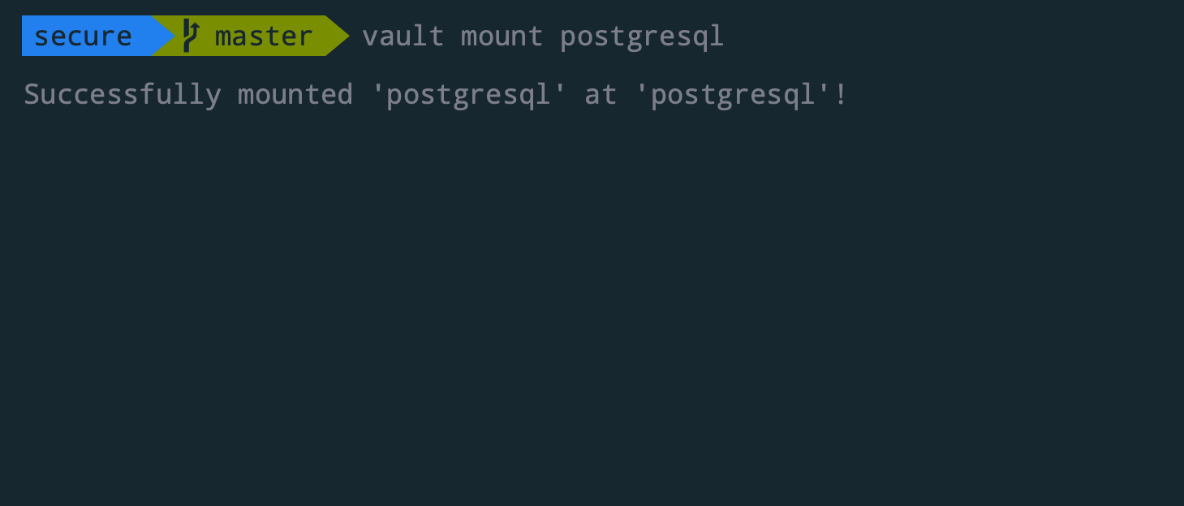
DYNAMIC SECRETS
Devops.Course

Slide 16
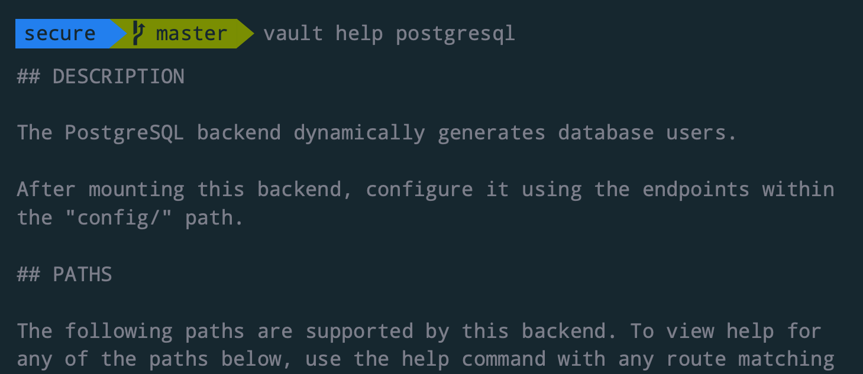
DYNAMIC SECRETS
Devops.Course

Slide 17
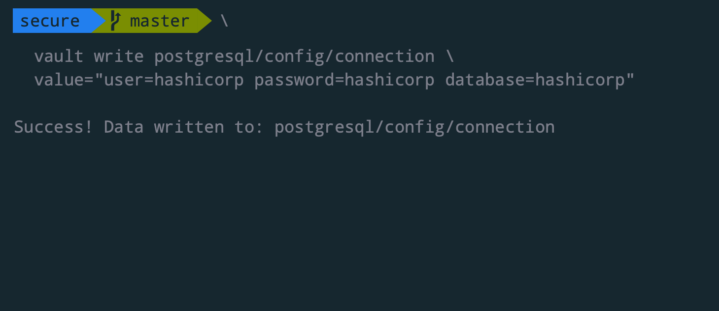
DYNAMIC SECRETS
Devops.Course

Slide 18
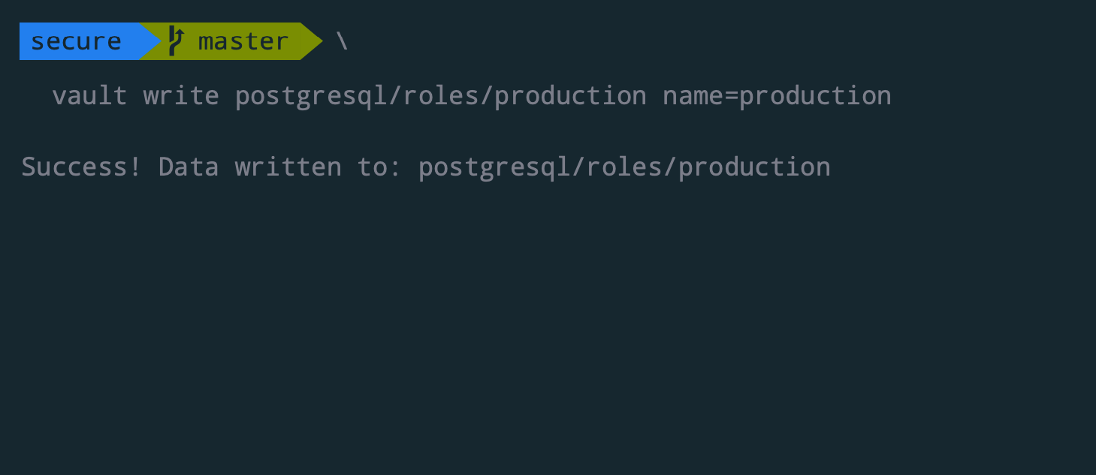
DYNAMIC SECRETS
Devops.Course

Slide 19
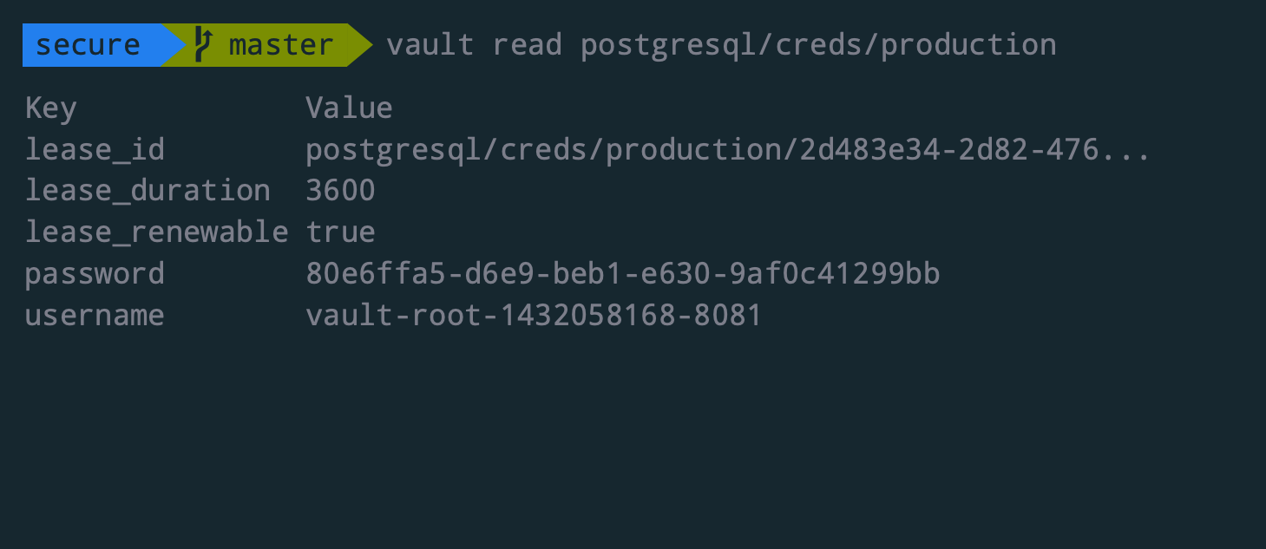
DYNAMIC SECRETS
Devops.Course

Slide 20
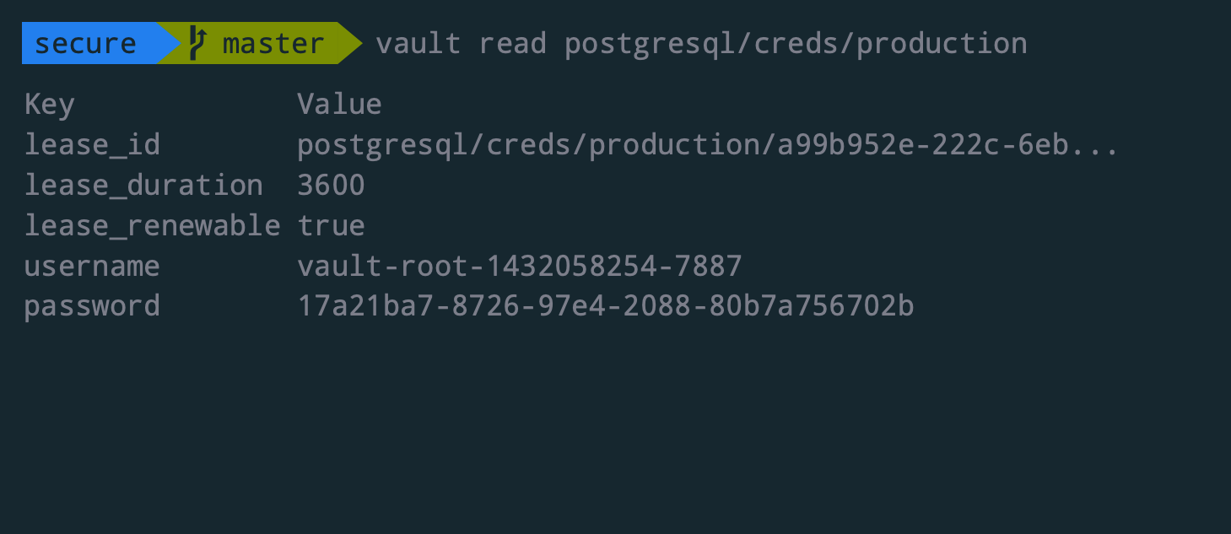
DYNAMIC SECRETS
Devops.Course

Slide 21
DYNAMIC SECRETS
Pluggable Backends
AWS, Consul, PostgreSQL, MySQL, Transit, Generic
Grow support over time
Devops.Course

Slide 22
LEASING, RENEWAL, AND REVOCATION
Every Secret has a Lease
Secrets are revoked at the end of the lease unless renewed
Secrets may be revoked early by operators
“Break Glass” procedure
Dynamic Secrets make leases enforceable
Not possible for arbitrary secrets
Not possible for transit backend
Devops.Course

Slide 23
AUDITING
Pluggable Audit Backends
Request and Response Logging
Prioritizes Safety over Availability
Secrets Hashed in Audits
Searchable, but not reversible
Devops.Course

Slide 24
RICH ACLS
Role Based Policies
Restrict access to “need to know”
Default Deny, must be explicitly allowed
Devops.Course

Slide 25
FLEXIBLE AUTH
Pluggable Backends
Tokens, GitHub, AppID, User/Pass, TLS Certs
Machine-Oriented vs Operator-Oriented
Devops.Course

Slide 26
HIGH AVAILABILITY
Consul used for leader election
Active/Standby
Automatic failover
Devops.Course

Slide 27

Questions ?
Devops.Course

Slide 28
Thanks for attentions!
Devops.Course

