Slide 1

AWS Basic
Devops.Events

Slide 2
Services Road Map
Devops.Events

Slide 3
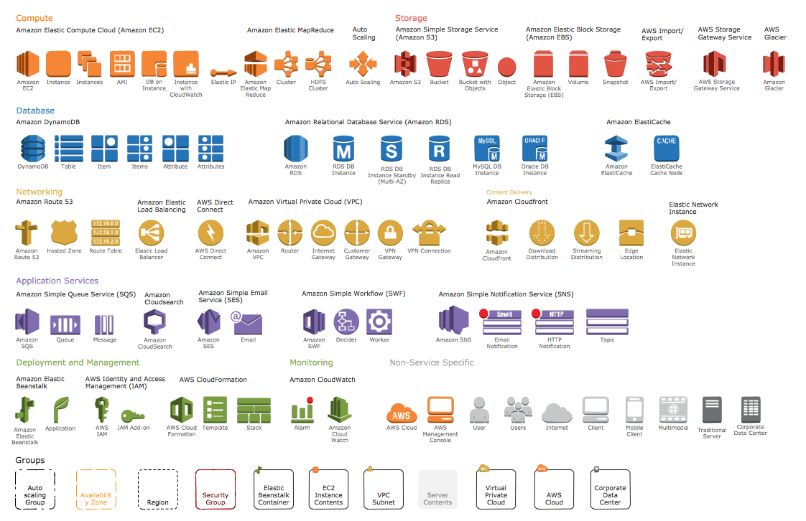
Docker Commands

Slide 4
Compute Services
Devops.Events

Slide 5
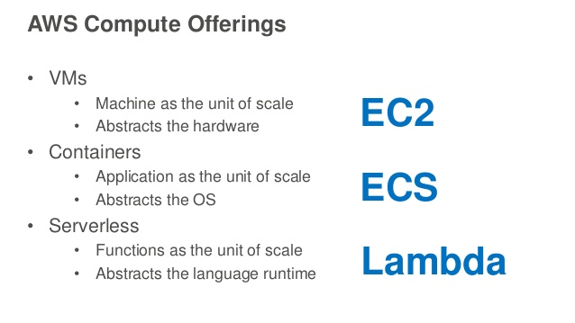
Compute Services
Devops.Events

Slide 6
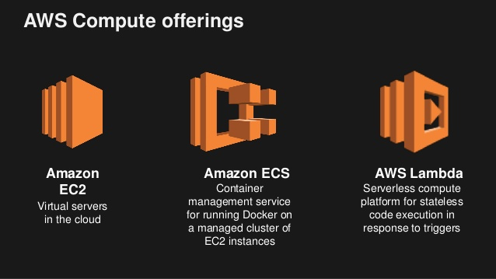
Compute Services
Devops.Events

Slide 7
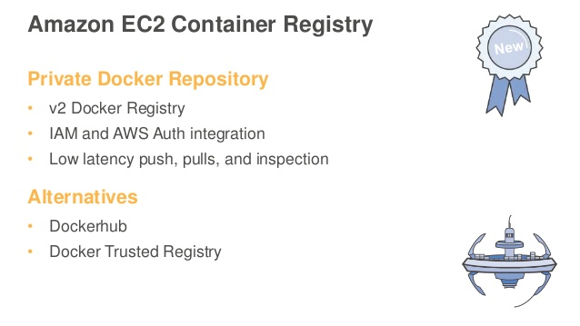
Compute Services
Devops.Events

Slide 8
Storage
Devops.Events

Slide 9

Storage
Devops.Events

Slide 10
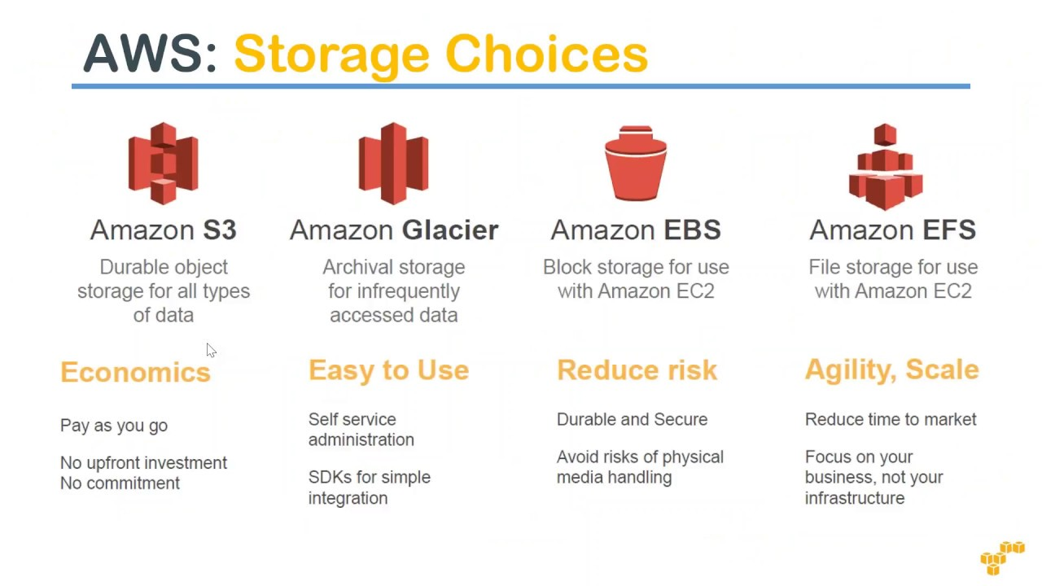
Storage
Devops.Events

Slide 11
Databases
Devops.Events

Slide 12
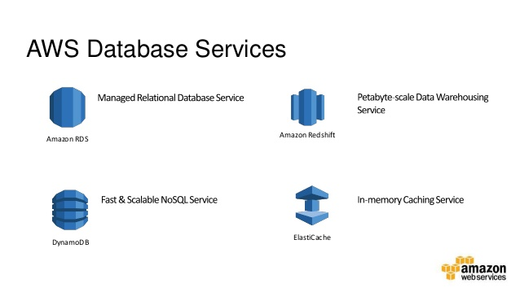
Databases
Devops.Events

Slide 13
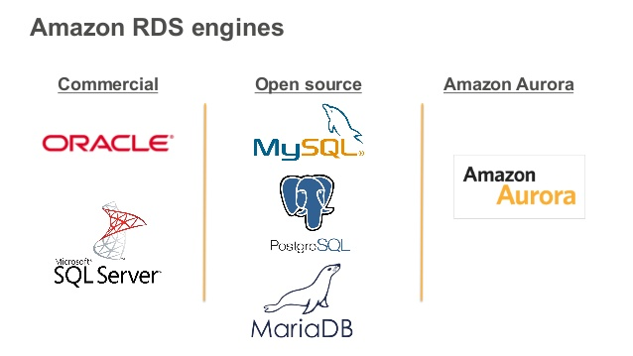
Databases
Devops.Events

Slide 14
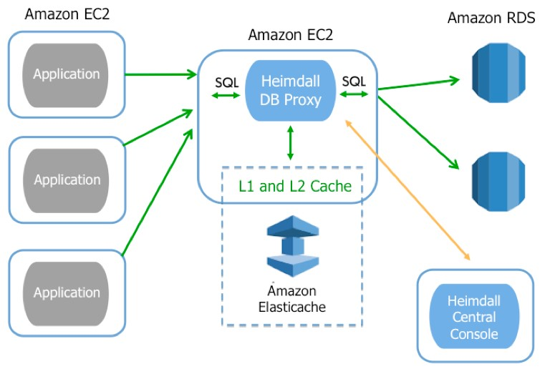
Databases
Devops.Events

Slide 15
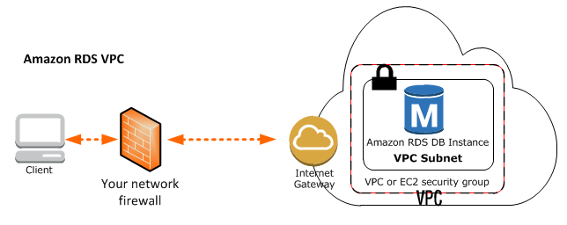
Databases
Devops.Events

Slide 16
Networking
Devops.Events

Slide 17
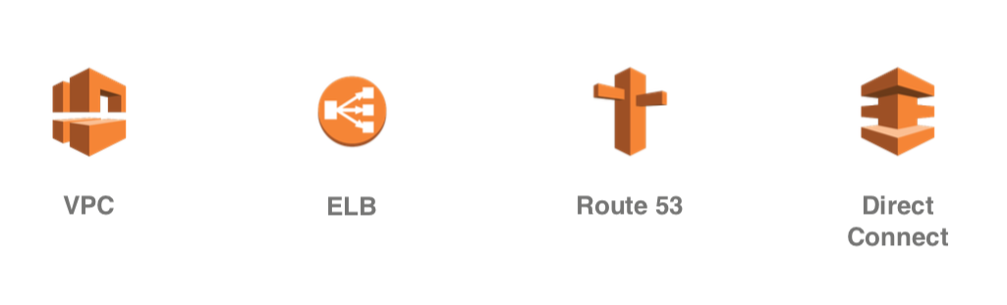
Networking
Devops.Events

Slide 18
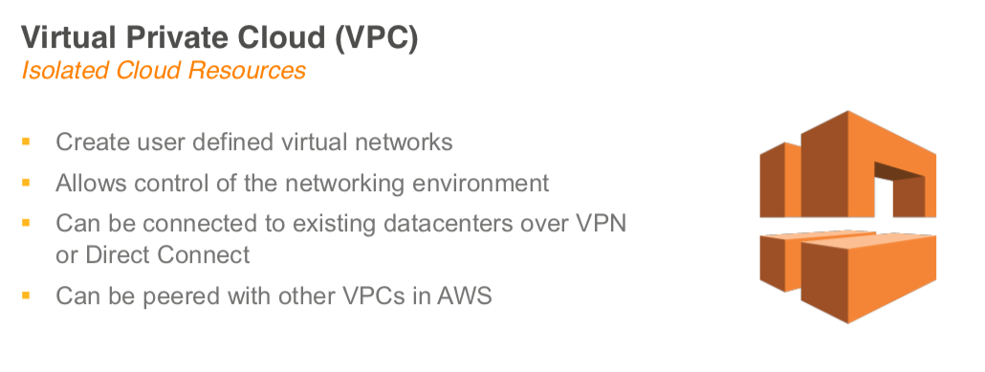
Networking
Devops.Events

Slide 19
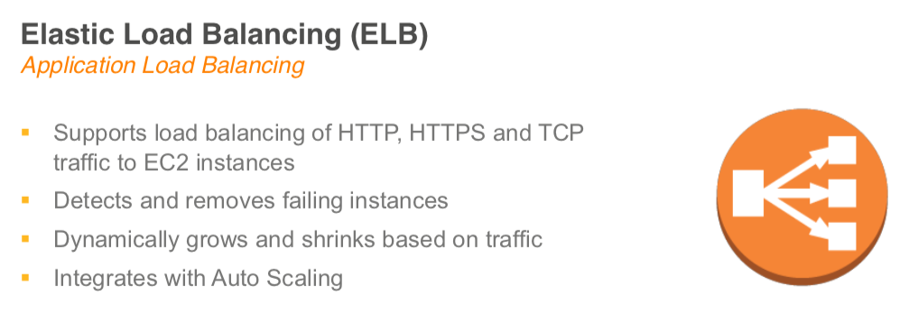
Networking
Devops.Events

Slide 20
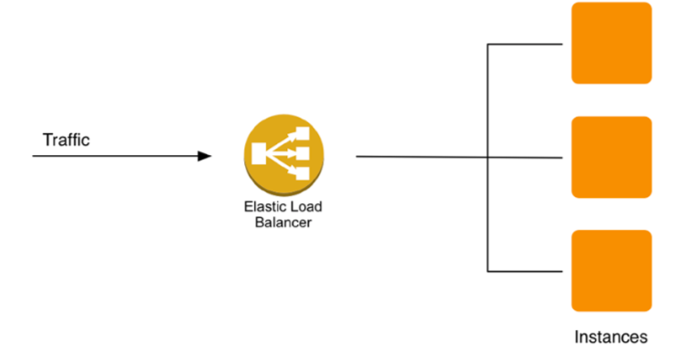
Networking
Devops.Events

Slide 21
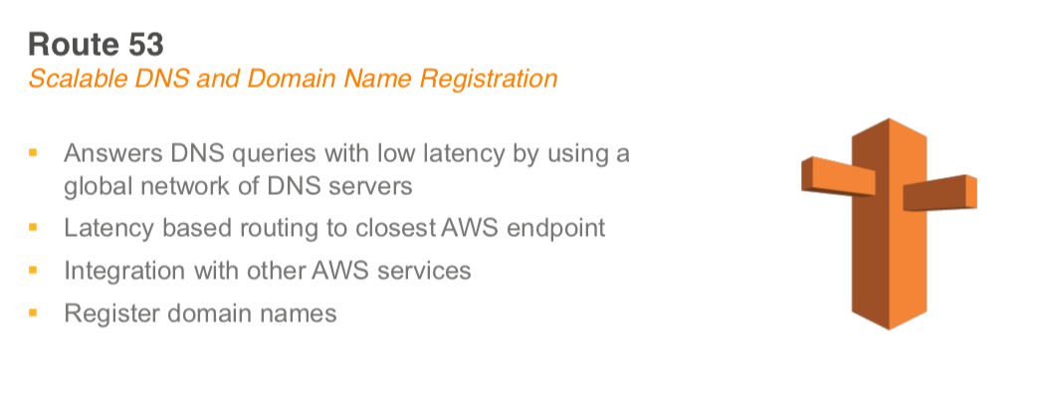
Networking
Devops.Events

Slide 22
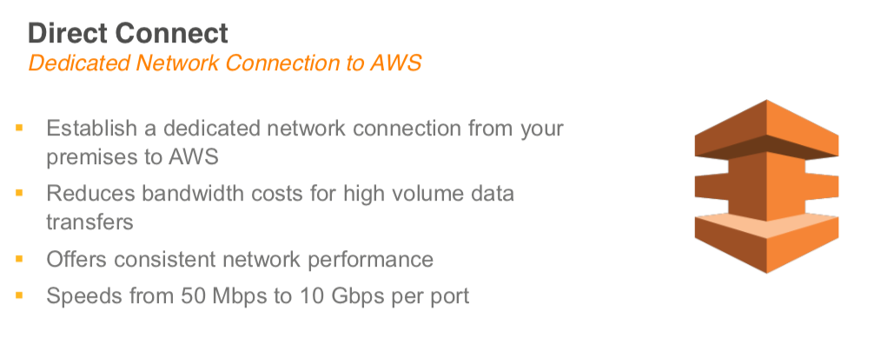
Networking
Devops.Events

Slide 23
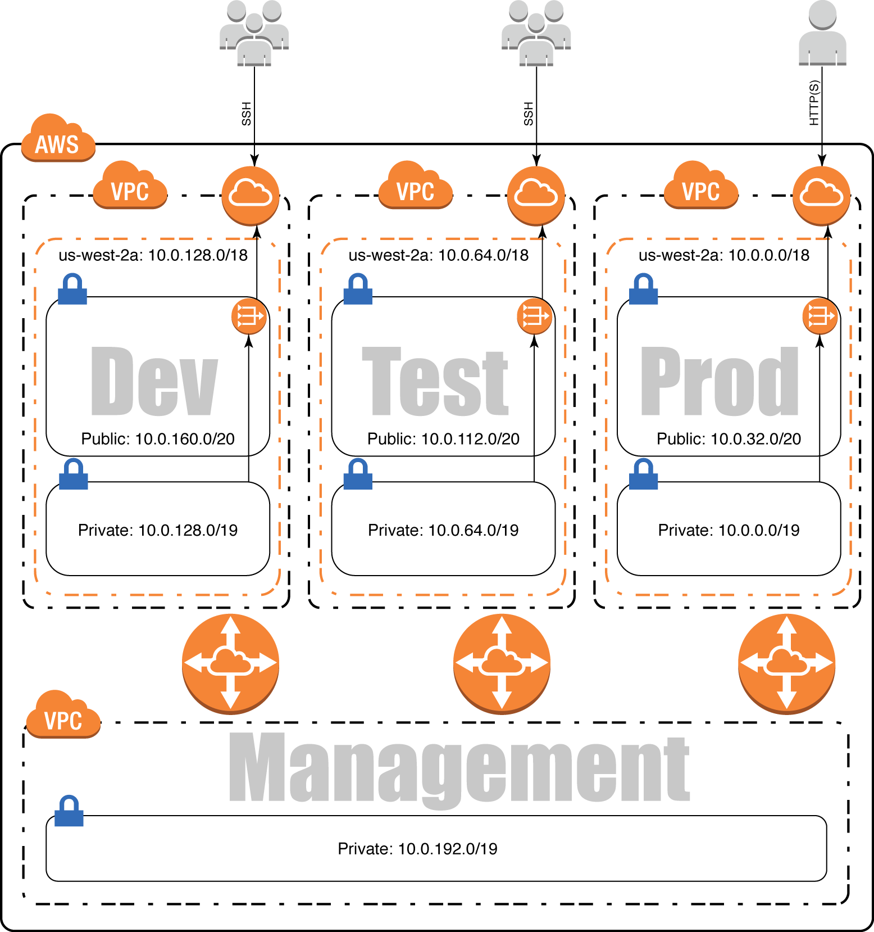
Networking
Devops.Events

Slide 24
Application services
Devops.Events

Slide 25
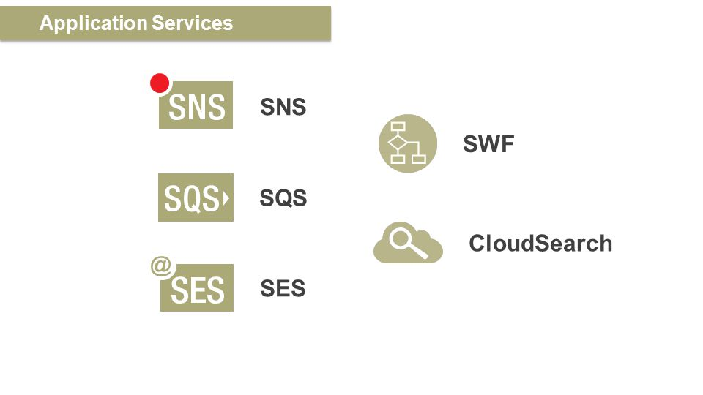
Application services
Devops.Events

Slide 26
Logging, administration and security
Devops.Events

Slide 27
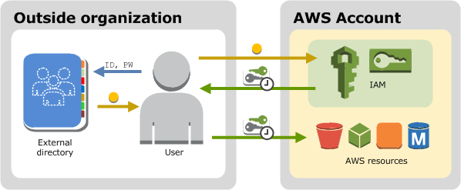
Amazon AIM
Devops.Events

Slide 28
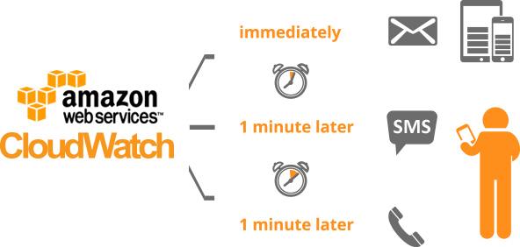
Amazon Cloud Watch
Devops.Events

Slide 29
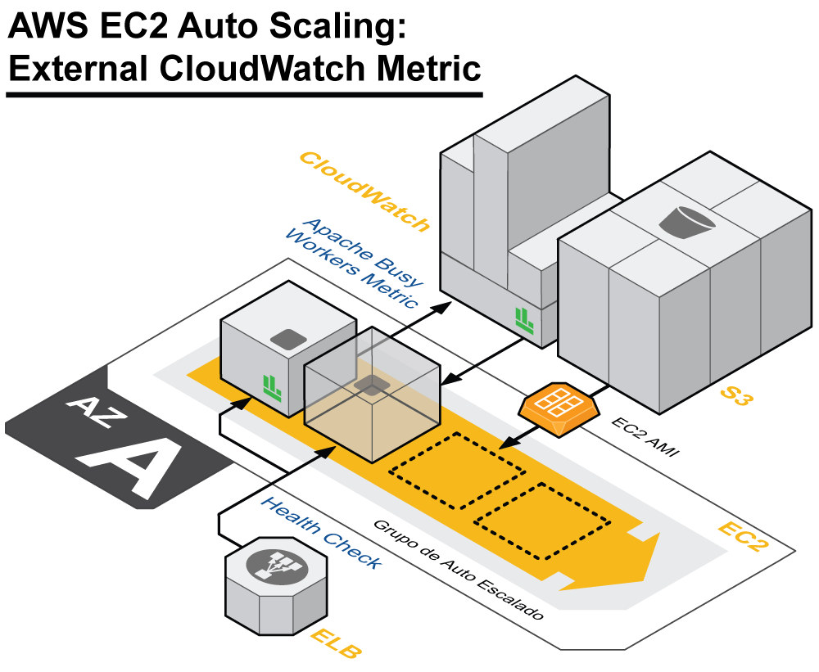
Amazon Cloud Watch
Devops.Events

Slide 30
Regions
Devops.Events

Slide 31
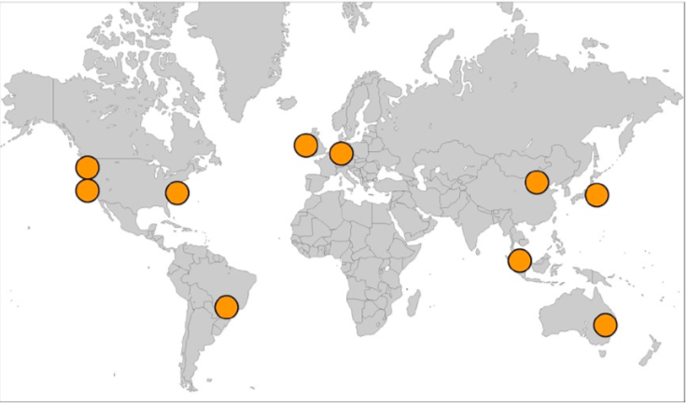
Regions
Devops.Events

Slide 32
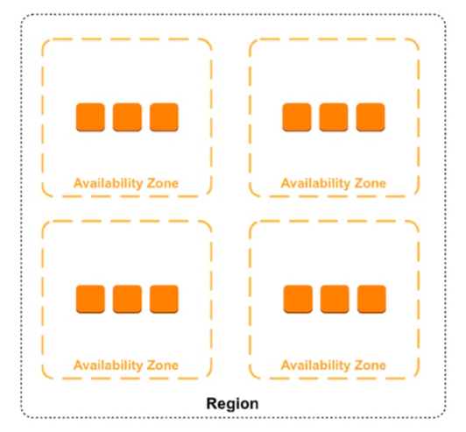
Availability zones
Devops.Events

Slide 33

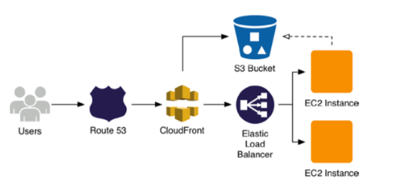
Devops.Events

Slide 34
Questions?
Devops.Events

Slide 35
Thanks for attentions!
Devops.Events

