Slide 1
An Introduction to Python & Basic Python Syntax
By Aksadur Rahman
aksadur@yahoo.com

Slide 2
Agenda
A Brief History of Python Versions Installing Python Variables
Data Types Dynamic Types Python Reserved Words Naming Conventions
Instruction/Statement
Basic Syntax Comments
Receiving Input
Type Conversion/Casting
Numeric Data Types
Boolean Data Types
Swapping
Strings

Slide 3
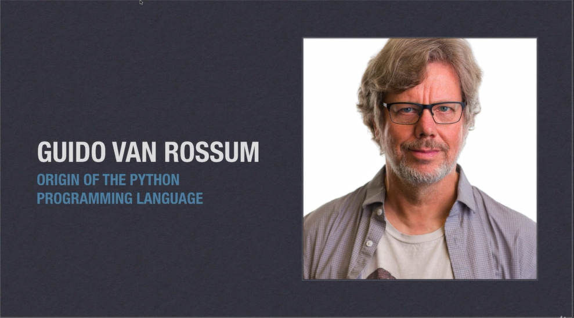
An Introduction to Python

Slide 4
An Introduction to Python
What is Python?
Python is a high-level object-oriented programming language that was created by Guido van Rossum. It is also called general-purpose programming language as it is used in almost every domain we can think of as mentioned below:
Web Development
Software Development
Game Development
AI & ML
Data Analytics

Slide 5
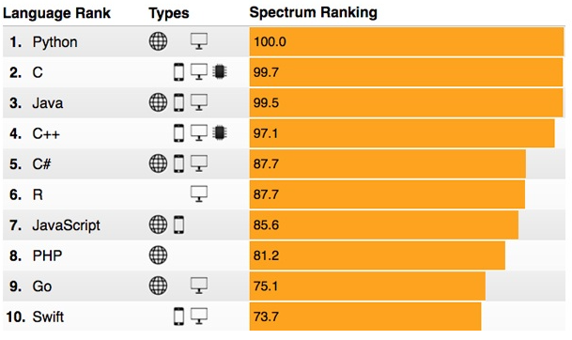
An Introduction to Python
Why Python Programming?
IEEE spectrum list of top programming language 2021. The list of programming languages is based on popularity.

Slide 6
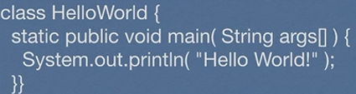
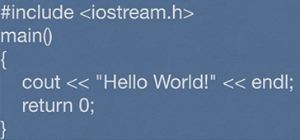
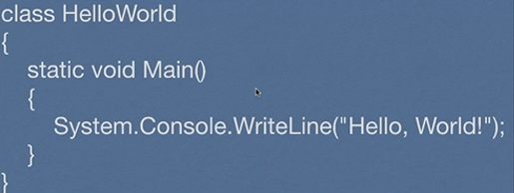

An Introduction to Python
Python is easy to understand
Java
C++
C#
Python

Slide 7
A Brief History of Python Versions
Python Version | Released Date
Python 1.0 | January 1994
Python 1.5 | December 31, 1997
Python 1.6 | September 5, 2000
Python 2.0 | October 16, 2000
Python 2.1 | April 17, 2001
Python 2.2 | December 21, 2001
Python 2.3 | July 29, 2003
Python 2.4 | November 30, 2004
Python 2.5 | September 19, 2006
Python 2.6 | October 1, 2008
Python 2.7 | July 3, 2010
Python 3.0 | December 3, 2008
Python 3.1 | June 27, 2009
Python 3.2 | February 20, 2011
Python 3.3 | September 29, 2012
Python 3.4 | March 16, 2014
Python 3.5 | September 13, 2015
Python 3.6 | December 23, 2016
Python 3.7 | June 27, 2018
Python 3.8 | October 14, 2019

Slide 8
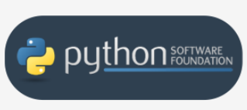
Python Software Foundation
First of all, there are the Pythons which are maintained by the people gathered around the PSF (Python Software Foundation), a community that aims to develop, improve, expand, and popularize Python and its environment. The PSF's president is Guido von Rossum himself

Slide 9
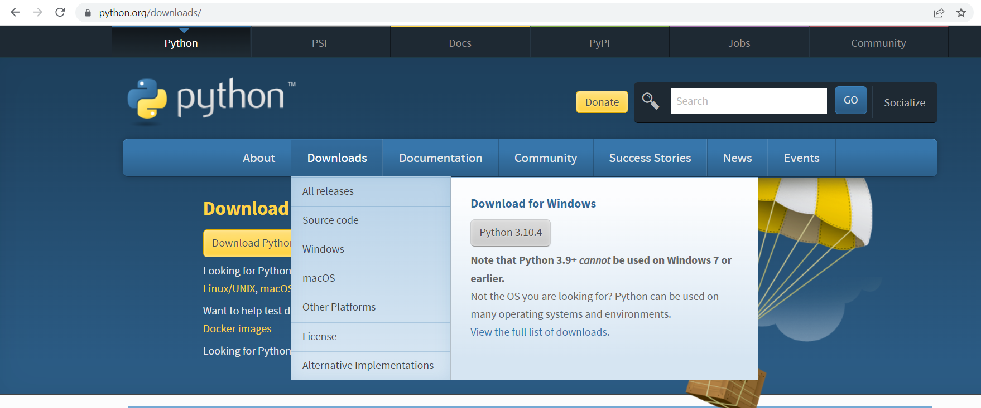
Installing Python

Slide 10
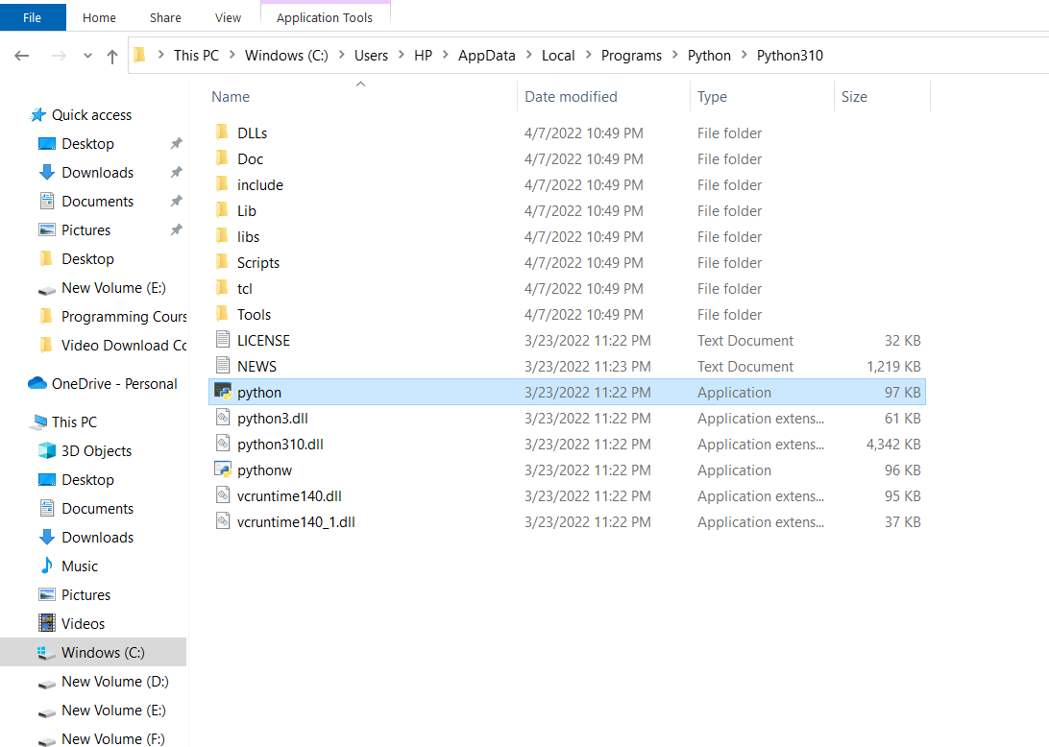
Installing Python

Slide 11
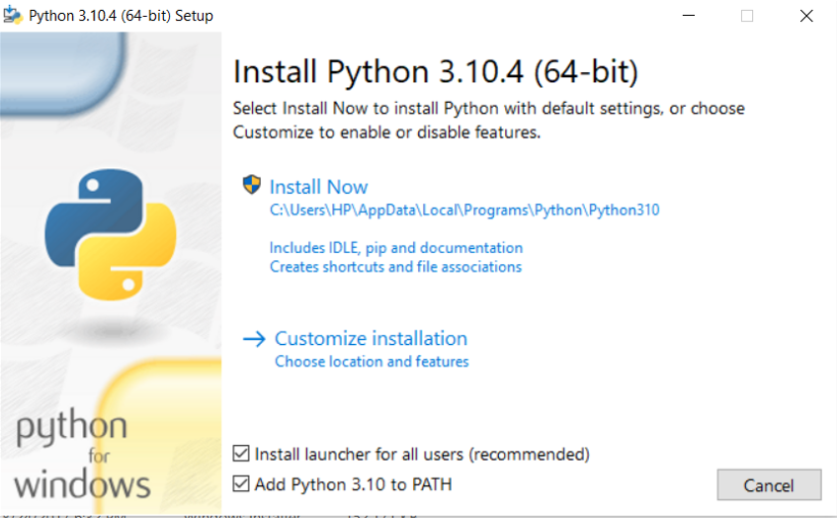
Installing Python

Slide 12
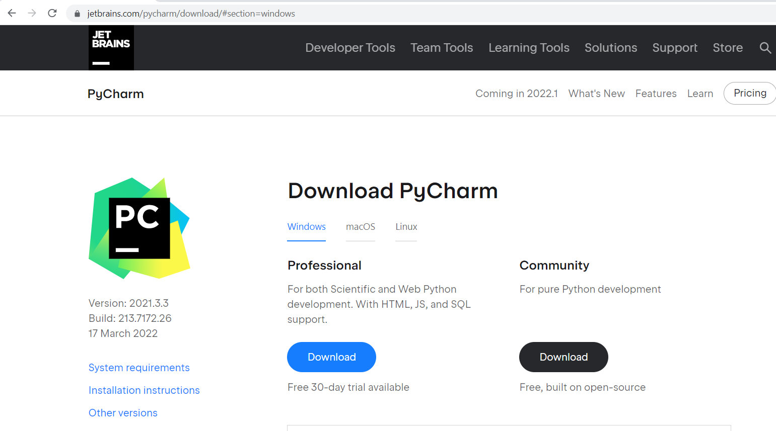
Installing PyCharm

Slide 13
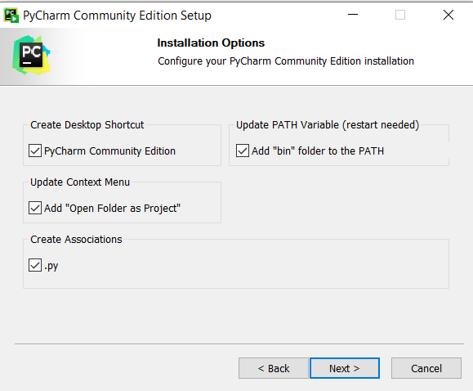
Installing PyCharm

Slide 14
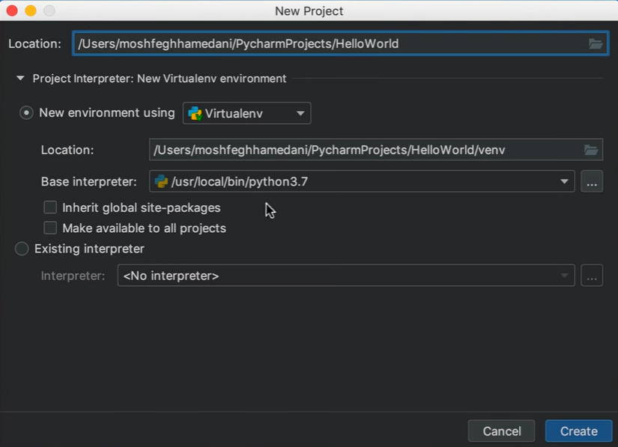
Your First Python Program

Slide 15
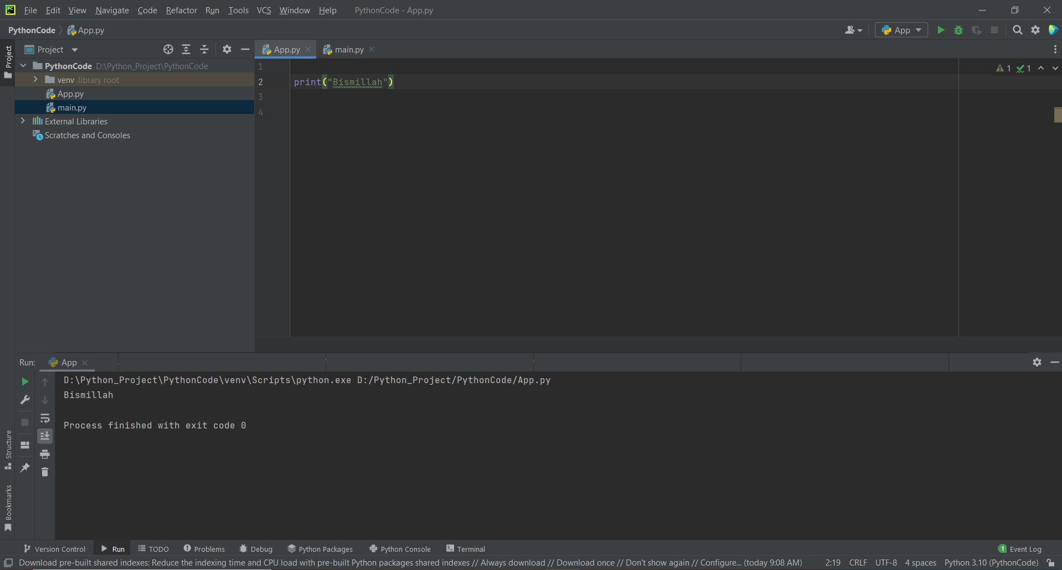
Your First Python Program

Slide 16
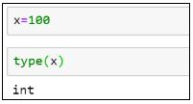

Variables
Variable is a name that is used to refer to memory location. It stores and manipulates data.
Variables are entities of a program that holds a value. Here is an example of a variable:
x=100
In the below diagram, the box holds a value of 100 and is named as x. Therefore, the variable is x, and the data it holds is the value.

Slide 17
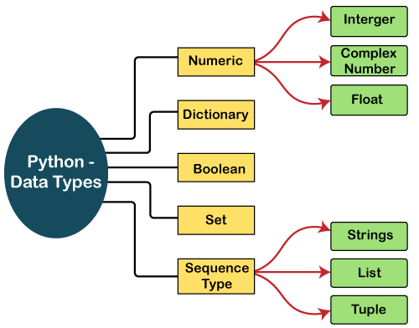
Data Types

Slide 18
Dynamic Types
Python is a dynamically typed language. It doesn’t know about the type of the variable
until the code is run.
x = 6
print(type(x))
x = 'hello'
print(type(x))

Slide 19
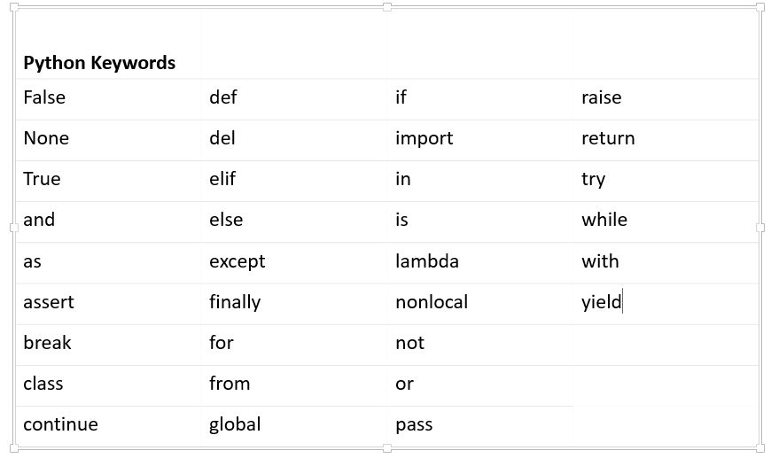
Python Reserved Keywords

Slide 20
Naming Conventions
Variable Names
A variable can have a short name (like x and y) or a more descriptive name (age, carname, total_volume).
Rules for Python variables:
A variable name must start with a letter or the underscore character
A variable name cannot start with a number
A variable name can only contain alpha-numeric characters and underscores (A-z, 0-9, and _ )
Variable names are case-sensitive (age, Age and AGE are three different variables)
https://pythonguides.com/python-naming-conventions/

Slide 21
Instruction/Statement
A statement is an instruction that a Python interpreter can execute. So, in simple words, we can say anything written in Python is a statement.
Python statement ends with the token NEWLINE character. It means each line in a Python script is a statement.
# Statement 1
print('Hello')
# Statement 2
x = 20
# Statement 3
print(x)
# Statement 1
print('Hello', end=' ')
# Statement 2
x = 20
# Statement 3
print(x)
print("+" + 10 * "-" + "+")
print(("|" + " " * 10 + "|\n") * 3, end="")
print("+" + 10 * "-" + "+")
print("My", "name", "is", "Monty", "Python.", sep="-")

Slide 22
Basic Syntax Comments
print('Bismillah')
# print('Bismillah')
'''
print('Bismillah')
print('Bismillah')
'''
"""
print('Bismillah')
print('Bismillah')
"""
print('Alhamdulillah')

Slide 23
Receiving Input
Get user input with Python using the input() function. The user can enter keyboard input in the console
print("Enter your first name: ")
name = input()
print("Nice to meet you", name)
name = input("Enter your first name: ")
print("Nice to meet you", name)

Slide 24
Type Conversion/Casting
Type Conversion
The process of converting the value of one data type (integer, string, float, etc.) to another data type is called type conversion. Python has two types of type conversion.
Implicit Type Conversion
In Implicit type conversion, Python automatically converts one data type to another data type. This process doesn't need any user involvement.
num_int = 123
num_flo = 1.23
num_new = num_int + num_flo
print("datatype of num_int:",type(num_int))
print("datatype of num_flo:",type(num_flo))
print("Value of num_new:",num_new)
print("datatype of num_new:",type(num_new))

Slide 25
Type Conversion/Casting
Explicit Type Conversion
In Explicit Type Conversion, users convert the data type of an object to required data type. We use the predefined functions like int(), float(), str(), etc to perform explicit type conversion.
num_int = 123
num_str = "456"
print("Data type of num_int:",type(num_int))
print("Data type of num_str:",type(num_str))
print(num_int+num_str)
num_int = 123
num_str = "456"
print("Data type of num_int:",type(num_int))
print("Data type of num_str before Type Casting:",type(num_str))
num_str = int(num_str)
print("Data type of num_str after Type Casting:",type(num_str))
num_sum = num_int + num_str
print("Sum of num_int and num_str:",num_sum)
print("Data type of the sum:",type(num_sum))

Slide 26
Numeric Data Types
Python Number Types: int, float, complex
Int
In Python, integers are zero, positive or negative whole numbers without a fractional part
num=0b11011000 # binary
print(num) # 216
num=0o12 # octal
print(num) # 10
num=0x12 # hexadecimal
print(num) # 18
Float
In Python, floating point numbers (float) are positive and negative real numbers with a fractional part denoted by the decimal symbol . or the scientific notation E or e
num=100.25
print(num)
num=123_42.222_013
print(num)
num=1e3
print(num)

Slide 27
Boolean Data Types
boolean
The boolean value can be of two types only i.e. either True or False. The output <class ‘bool’> indicates the variable is a boolean data type.
a = True
print(a)
print(type(a))
b = False
print(b)
print(type(b))

Slide 28
Swapping
a = 10
b = 20
temp = a
a = b
b = temp
print(a, b)
a = 10
b = 20
a = a+b
b = a - b
a = a -b
print(a, b)
a = 10
b = 20
a, b = b, a
print(a, b)

Slide 29
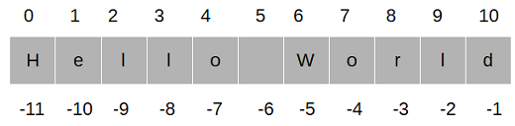
Strings
Strings are List like many other popular programming languages. Python does not have a character data type, a single character is simply a string with a length of 1. Square brackets can be used to access elements of the string.
a = "Hello World"
print(a)
print(a[0])
print(a[-1])
print(a[0:3])
print(a[0:])
print(a[1:])
print(a[:4])
print(a[0:-1])

