Slide 1
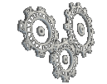
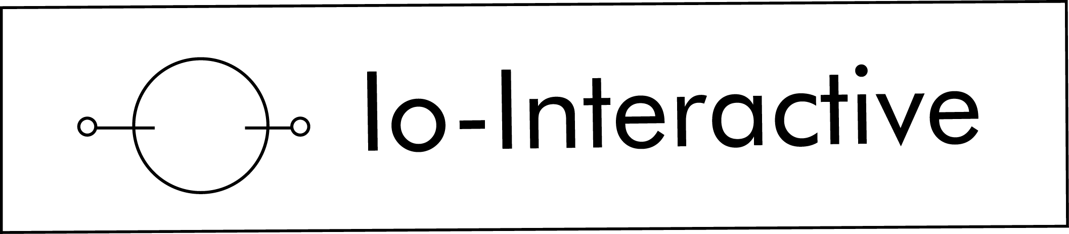
Advanced Character Physics
– the fysix engine
Thomas Jakobsen
Head of R&D
Game Developers Conference San Jose, March 20-24, 2001

Slide 2

Introduction
Hitman: Codename 47
The fysix engine
  Particle systems
  Cloth
  Plants
  Rigid bodies
  Articulated bodies / rag dolls
  Water
Advanced Character Physics – the fysix engine
Notes:
I’ll assume that you know about the basic 3D mathematics.
Articulated bodies: Falling human corpses
Water: Full Navier-Stokes

Slide 3
Overview
Introduction & overview
Demos
Drawbacks of other methods
The approach used in fysix
  Integration techniques
  Solving for constraint forces
  Handling friction, contact, singularities etc.
  Optimizations
Improvements
  Algorithms from molecular dynamics
Notes:
Verlet: A velocity-less particle model
Constraints: Handled by projection
Under development: I’ll explain how dynamics worked in Hitman – since then I have developed the system further and made it better. Not done implementing yet..
Try keeping it as easy to understand as possible.

Slide 4
Drawbacks of Other Methods
Speed issues
Time usage varies unpredictably
Scales poorly with the number of objects in contact
Instability
Unphysical behavior (elastic constraints)
Drift
Unresolvable (illegal) configurations exist
Contact, collision, and penetration are separate cases
Complex mathematics
Notes:
Other methods: Penalty-based, Baraff-like, Mirtich-like
Other methods can be ”too accurate”, sort of.
Slow: Rewinding time (binary search)
Instability: Integration method, Runge-Kutta 4th order helps but still slow
Time usage varies: Some of the methods for solving large systems of linear equations are slow
Drift: Baumgarte or something else is required. Also objects that are supposed to lie still
Illegal:
Different cases: This means that the implementation will be more complex
Complex: Quaternions, solving linear systems, inertia tensors

Slide 5
Advantages of the fysix Approach
Simplicity
  Basic implementation does not involve complex mathematics
  Local approach to solving a global problem
Speed
  Possible to trade off speed vs. accuracy
Stability
  Jittering or ”exploding” systems are rare
Generality
  A unified system for cloth, soft bodies, rigid bodies, articulated bodies, and inverse kinematics
  Handles contact, collision, and penetration
Notes:
Engineering solved these problems a long time ago.
However, we need something different. We want the animation to look good – it doesn’t need to be precise.
Simple: No need for hairy mathematics, although firmly based in a mathematical sense
Global problem: The problem of determining forces in a configuration of several objects in contact with each other
Local solution: Makes it easier to implement (object oriented)
Fast: Possible to trade off speed vs. Accuracy. Possible since the algorithm is iterative. For our purposes it is not necessary to have high accuracy – no space shuttles will fall down if we calculate incorrectly. We just want it to look nice. In any case,
General: Cloth, plants, rigid bodies, articulated bodies, soft bodies
Handles stacked boxes. Resting contact.
(Counter-intuitive that these problems are hard) Penalty method with spring constants going towards infinity

Slide 6
A Combination of Several Techniques Working Together
Verlet integration
Solving constraints by relaxation
Handling contacts, collisions, and penetrations by projection
Rigid bodies simulated by constrained particles
(A fast square root approximation)
Notes:
The success of the method comes from the right combination of several techniques that are all working together benefiting from each other.
Each method can be left out.
But they fit nicely together.
They complement each other.
I will be talking about each of these areas during the talk.

Slide 7




Two Approaches to
Particle Systems
Standard approach – Euler integration:
Particle state:
Update rule:
Simple. Used often. Unstable. Low precision.
The fysix approach – Verlet (or Störmer) integration:
Particle state:
Update rule:
Simple. Symplectic! Stable.
Notes:
Position and velocity. ”a” is acceleration.
Euler can be unstable, low precision.
Euler can be extended to 4th-order Runge-Kutta with adaptive step size for example. But it turns out that this is not at all necessary.
Symplectic: Preserves 2D projected areas in the phase space. As a consequence it also preserves volumes.
Optimization: Swap array pointers.
Doesn’t look very groundbreaking yet, but when we add constraints and so on, the nice properties will show.
Verlet: (The one we’re using) Somewhat related to the method used in the demo effect for creating ripples in water
Why does Verlet work? (x’=2x-x*=x+x-x*)
Verlet: It is harder for position and velocity to come out of sync.
Verlet: Easy to implement constraints. (But: Fixed timestep, but ok. Easy to inherit motion from preanimated sequences).
Verlet: Drawback: Fixed timestep (it is possible to work around this, however)

Slide 8
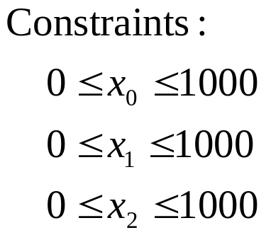
Example – Box World, Part 1
(C1)
Time-step procedure:
  Call Verlet integrator
  Satisfy constraints (in this example clamp positions in order to respect box limits)
Notes:
The particle positions are simply clamped all they time, such that they are always in the allowed intervals
The particle velocities are automatically adjusted by the Verlet integrator such that the normal speed disappears
Note that the Verlet approach automatically handles the contact situation.
No friction (this is why the particles slide on the surface)

Slide 9

Example: Stick Constraint
Dist. too large
Simulate a stick by constraining two particles to have a fixed distance between them
Pull particles directly together or push them away from each other to fix an invalid configuration
Move particles a distance inversely proportional to their respective masses (such that the constraint is satisfied)
Set the inverse mass of a particle to zero to make it immovable
Other constraints can be implemented by considering the constraint Jacobian
(C2)
Correct distance
Dist. too small
Notes:
r=restlength
(In this way a particle which weighs double the amount of another particle, will only move half the distance).
In fact, the inverse mass is stored.
If set to zero, the particle becomes immovable

Slide 10
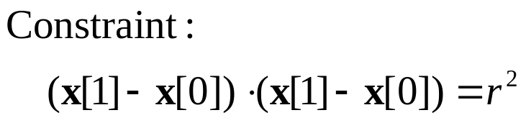
Example – Box World, Part 2
(C2)
// Pseudo-code for satisfying
// the stick constraint (C2)
delta = x2-x1;
deltalength = sqrt(delta*delta);
delta *= (deltalength-restlength)
/(deltalength*(invmass1+invmass2));
x1 += invmass1*delta;
x2 -= invmass2*delta;
Notes:
Demonstrates rotation+translation
The grey crosses represent the positions of the particles before the constraints have been enforced.
Note that the Verlet approach automatically handles the contact situation.

Slide 11
Relaxation – Handling Multiple Simultaneous Constraints
Idea:
  Satisfy constraints locally (one at a time)
  Iterate over all constraints
  Hope that the result converges globally
  Indirectly solves a system of (linearized) equations
  By stopping the iterations early, one can trade off speed vs. accuracy
Relaxation algorithm
Input: Particles x[0],..., x[i-1]
Constraints c[0],..., c[j-1]
repeat
for k=0,..., j-1
change particle positions
such that c[k] is satisfied
next
until convergence
Notes:
Assume that we want to satisfy both the stick and the box constraints at the same time.
This actually calls for solving a system of equations.
Also called Gauss-Seidel iteration or Jacobi iteration depending on how you do it exactly
Other methods solve this step in an exact way by inverting matrices
Stopping early works fine because of the Verlet integration

Slide 12
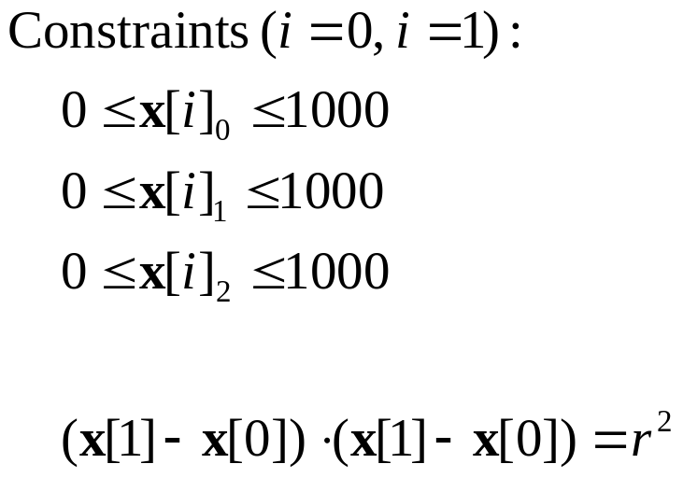
Example – Box World, Part 3
(C1)
(C2)
Notes:
Note that the Verlet approach automatically handles the contact situation.
Now assume that we still want the particles to satisfy the cube constraints. By satisfying the stick constraint, however, we may have invalidated one or more of the cube constraints by pushing a particle out of the cube. This situation can be remedied by immediately projecting the offending particle position back onto the cube surface once more – but then we end up invalidating the stick constraint again.
Really, what we should do is solve for all constraints at once, both (C1) and (C2). This would be a matter of solving a system of equations. However, we choose to proceed indirectly by local iteration. We simply repeat the two pieces of pseudo-code a number of times after each other in the hope that the result is useful.

Slide 13
Stick-in-a-box Code
// Implements simulation of a stick in a box
void ParticleSystem::SatisfyConstraints() {
for(int h=0; h<NUM_ITERATIONS; h++) {
// First satisfy the box constraint (C1)
for(int i=0; i<NUM_PARTICLES; i++) { // For all particles
Vector3& x = m_x[i];
x = vmin(vmax(x, Vector3(0,0,0)), Vector3(1000,1000,1000));
}
// Then satisfy the stick constraint (C2)
Vector3& x1 = m_x[0];
Vector3& x2 = m_x[1];
Vector3 delta = x2-x1;
float deltalength = sqrt(delta*delta);
diff *= (deltalength-restlength)
/(deltalength*(invmass1+invmass2));
x1 += invmass1*diff;
x2 -= invmass2*diff;
}
}

Slide 14
Simulation of Cloth
Standard approach (spring system)
  Stiff springs: Instability or slow integration
  Weak springs: Gives cloth an elastic appearance
Using constraints (the fysix approach)
  Stable (no visible vibrations or jittering)
  Fast (only one division per edge per frame)
  Not necessarily physically accurate but it looks nice
Notes:
Slow integration: Either due to small timesteps or the use of implicit integrators (there are fast versions of these, I know, but they aren’t fast compared to the approach presented here)
An interesting thing happens when we let the stiffness of the springs go to infinity
Corresponds to using springs with exactly the right spring and damping coefficients, such that in one timestep the spring will contract or expand to its restlength
In Hitman the number of faces in the cloth simulated was limited mostly by the rendering system – that is, how many triangles it was possible to push through the pipeline
Stable: [no visible vibrations or jittering]

Slide 15
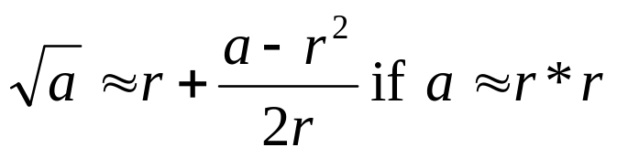
A Square-root Approximation
Works nicely together with the Verlet integrator
Complex calculations are automatically spread over several frames
Expensive operations are down to only one division (!) per edge per frame
// Cloth simulation inner loop
// (pseudo-code)
for all pairs of neighbors (x1, x2)
r = orig. dist. between x1 & x2;
// Code for satisfying
// the stick constraint (C2)
// using sqrt approximation
delta = x2-x1;
delta*=r*r/(delta*delta+r*r)-0.5;
x1 += delta;
x2 -= delta;
next
Notes:
Explain what happens (with the triangle edges in a piece of cloth)
First-order Taylor approximation of the square root function expanded around a neighborhood of r*r.
One iteration of Newton-Raphson with initial guess r
If the length of the delta vector equals the restlength, r, then nothing happens (which is what we want)
r*r can even be precalculated and stored instead of r
The loop can be iterated several times inside the relaxation loop if needed (often in Hitman, one iteration was enough (not for his tie, though))

Slide 16
Rigid Bodies = Constrained Particles
4 particles + 6 constraints = one rigid body
Degrees of freedom 4*3-6 = 6
No need for using quaternions, inertia tensors, torque calculations etc.
3 length constraints
3 perpendicularity constraints
6 length constraints
Notes:
Length constraints = stick constraints
To get the correct inertia tensor, the positions or weights of the four particles should be varied.
Tetrahedron, and a sort of coordinate system (3 length constraints, 3 perpendicularity constraints)
No need to calculate torques and so on to make objects rotate. Simply move a particle and the Verlet integrator together with the relaxation will then make the object spin.

Slide 17
Articulated Bodies
Pin joint:
Hinge:

Slide 18


Angular Constraints
x1
Constrain the distance between x1 and x2 to be above (or below) some fixed value:
Or satisfy the following dot product constraint:
x0
x2
Notes:
Invalid configurations are fixed by projection (i.e. Moving the particles as little as possible, or to be more precise, the particles are moved using as little energy as possible such that the constraint is satisfied – usually this involves moving the particles perpendicularly to the constraint)
As mentioned other constraints can be implemented as well.
Consider the constraints Jacobian (=sort of projection)

Slide 19
Human Bodies
Angular constraints
Unilateral distance constraints for simple self collision
The physics of rotation around the length axes of limbs is not simulated (as an optimization)
The actual mesh is attached to the skeleton by following a twist minimization strategy
Notes:
Unilateral: Only pulls or pushes

Slide 20
Motion Control
With the Verlet integrator it is easy to
control the motion of objects by bombs, bullet hits etc. – simply move the particle positions proportionally to the force inflicted on them and the velocities will be adjusted automatically
To inherit velocities from an underlying animation system simply record the particle positions for two frames and let the Verlet integrator take over

Slide 21
Inverse Kinematics (IK)
Used in Hitman to animate the main character’s arms and legs and for dragging dead bodies
Accomplished by simply setting a particle’s inverse mass to zero (this makes the particle immovable) and appropriately adjusting the particle position
Notes:
[Explain the difference between forward kinematics and inverse kinematics]
Very useful in games. Here we sometimes want objects to be placed at specific positions or move at fixed speeds – the rest is secondary animation which should just follow the main movements.

Slide 22
Collision Detection
Optimized code for collision check and
penetration depth+penetration point calculations
were implemented:
  Between triangles and lines
  Between triangles and capped cylinders
Background triangles inside the object bounding box are culled and a special structure for fast collision checks against static objects is constructed
Various collision ”cheats” were used to speed things up
Notes:
Capped cylinders are used for rag dolls
Cheats: See paper

Slide 23
Collision and
Contact Handling
Traditional approaches:
  Penalty-based methods
  Rewinding to the time of collision
  Impulse-based simulation
The approach taken by fysix (projection):
  Offending points or edges are simply projected out of the obstacle
  Works in cooperation with the Verlet approach
Notes:
Rewind: Rewind, handle collision analytically, then restart the simulation. Slow. An even worse, it can be unpredictably slow
Penalty-based: Unphysical (objects might penetrate – more the heavier they are), difficult to find good parameters
Projection: What happens if we let the stiffness of the springs in the penalty-based approach go to infinity? Answer: Projection
Has a problem handling stacked boxes.

Slide 24
Collision and
Contact Handling
Offending features are simply projected out
of the obstacle (in a way that makes physical sense) in the relaxation loop:
Requires a subsystem for the computation of penetration distance and penetration points
d_{p}
Notes:
Features = points, edges, triangles (or other simplices)
Translate and rotate depending on how the mass is distributed
All configurations can be resolved (no invalid configurations)
The Verlet integrator then takes care of the rest (such that the normal speed is correct)
The fysix approach is position-based. That is, there is no need to directly manipulate forces or even velocities. Only positions.
Some of you may have heard about this in Gino van der Bergen’s talk (right before this talk)
[Define penetration distance and penetration points]

Slide 25
Handling Friction
After projection, the tangential velocity is reduced by an amount proportional to the penetration distance:
The tangential velocity should not reverse its direction, however – in this case, set it to zero
d_{p}
v’_{t}
v_{t}
Notes:
Can be improved upon. Static and dynamics friction.
This is how it worked in Hitman, however.
The correct amount of friction is sometimes applied over several frames (an object that barely penetrates might have a high normal velocity – this will be handled in the next frame)

Slide 26
Embedding the Tetrahedron
Inside Other Objects
Kinetically, a rigid body behaves like a tetrahedron but not collision-wise
Solution: It is possible to embed the tetrahedron inside an arbitrary object
Notes:
[Explain figure (world + object)]
The outer object is used for collision detection.
The penetration point on the object is then attached temporarily to the tetrahedron and moved outside the obstacle.
For details see the paper.

Slide 27
Miscellaneous
The number of relaxation iterations can be
varied at different levels
Soft constraints give soft bodies
Singularities (=> division by zero) can be handled simply by slightly dislocating particles at random
The cloth algorithm can be extended to simulate plants by strategically placing support sticks between vertices sharing a neighbor
To toy with the ragdoll system in Hitman press shift+F12 in debug mode to blow people up

Slide 28
The Underlying
Mathematical Model
Mathematically, fysix is using a symplectic
time-stepping method for solving differential inclusions
The system state is continually projected onto the manifold described by the constraints
The relaxation approach implicitly inverts the system matrix
Relaxation as used in fysix is actually a sort of interior-point algorithm for solving LCP-like problems
Notes:
If you don’t know the subjects I’m talking about on this slide, don’t worry – it not important to understand this for implementation purposes.
But they’re nice to know if want to analyze what’s going on and why the methods work.
I have tried to make it as intuitive as possible. If some of these things have sounded straight forward, my task is completed.
But before we end, I’ll like to state that the methods are well-founded mathematically. It is actually a quite accurate method if used with enough iterations.
No need to explicitly invert the Jacobian

Slide 29
Possibilities for Improvements
The SHAKE/RATTLE algorithms from
molecular dynamics
  Leapfrog integration, velocity Verlet
Relaxation sometimes converges slowly
  Remember values from last frame (exploit frame coherence)
  Use successive overrelaxation (SOR) or other iterative, sparse matrix techniques
  Use other interior-point algorithms (LCP solvers and similar)
Coulomb friction
  static and dynamic
  linearize the friction cone to form LCPs
Notes:
Not the simplex-like, pivotalgorithms. They are not iterative in the way we want them – their response can be unphysical.
It’s easier to make interior-point algorithms robust.

Slide 30
Water
Full Navier-Stokes equations
Many behaviors are possible: Breaking waves, mass transport, vortices etc.
Multigrid relaxation
Demo
Notes:
Relaxation: Gives the possibility to trade off speed versus accuracy
Even a siphon is possible (put a filter on the end, and you have a well-known game)

Slide 31
Conclusion
The goal in physics simulation for games is
not necessarily the same as the goal in mechanical engineering and other related scientific areas.
The field of physically-based modeling in computer graphics (and games) could really benefit from cross-disciplinary experiences from areas such as molecular dynamics and mechanical engineering. In particular, check publications by Ben Leimkuhler and J. C. Trinkle for inspiration.
Notes:
We want believable behavoir, not necessarily accuracy
Cross-disciplinary
Already used experience from robotics and related areas.

Slide 32
Conclusion
If done correctly, many aspects of
advanced physics simulation are not that hard to implement.
Go out and do it!

Slide 33
Errata to the Article in the Proceedings
”Verlet Integration” section: To introduce drag,
the update rule should be changed to x’=1.99x-0.99x*+... or something similar, not x’=1.99x-x*+... .
”Relaxation” section (sign error, appears 5 times):
x1 -= ...; x2 += ... should read x1 += ...; x2 -= ... .
”Cloth simulation” section: The Taylor approximation is in a neighborhood of the squared resting distance, not the resting distance.
”Comments” section: Shift+F9 should read Shift+F12.
Slides and a revised version of the paper is available at www.ioi.dk/~tj. Future articles will also be posted here.
Notes:
Revised: Without the errors mentioned.

