Slide 1


Git
Guide pratique de démarrage (presque) en douceur
Guillaume Moigneu | guillaume@agence-soon.fr | v1.0

Slide 2
Planning
Rapide introduction
Quel intérêt ?
Workflows types
Processus SOON
Questions ?
1
2
3
4
5

Slide 3
pronconciation : [ɡít]
“guite”

Slide 4

système de gestion du Kernel Linux crée par Linus Torvalds

Slide 5
Des utilisateurs de SVN ?

Slide 6
master != trunk

Slide 7
branch, branch, branch. merge, merge, merge. tag.

Slide 8









origin
décentralisé mais centralisé

Slide 9
Pourquoi Git ?
git is forgiving
git works on your OS
git is fast
git is easy
git is geekier (aka CLI)
git ♥ branches
http://whygitisbetterthanx.com

Slide 10
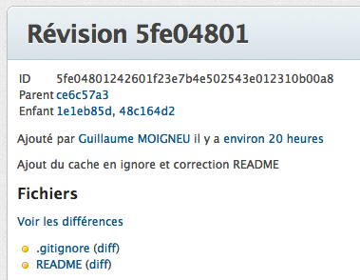
commit ?
lot de modifications
identifié par un hashtag unique
référence d’un arbre de blob
relations entre les commits

Slide 11
tag ? alias de commit
Tag
Commit
Tree
Blob

Slide 12
Workflow de base Git
$ git clone git@git.agence-soon.fr:/repo-test.git
$ vim README
$ git add .
$ git commit -m “Ajout du README”
$ git push
$ vim README
$ git commit -m “Modification du README”
$ git push

Slide 13

Cycle de vie d’un fichier
New
Untracked
Staging Area
Staged
Commit #a
Unmodified
Edit
Modified
Staging Area
Staged
Commit #b
Unmodified
Création du
BLOB
Push
Unmodified

Slide 14
Diff
git status
git diff (Compares working directory with staging area)
git diff --staged
git diff HEAD
git diff v1.0 v1.1
git diff master feature-1

Slide 15
.gitignore
niels@idunn ~/Documents/Projets/en-bon-pere-de-famille [master *]± % cat .gitignore local-config.php.DS_Storesitemap.xml.gzsitemap.xmlcontent/themes/bpf/.sass-cache/*

Slide 16
Modèle de branches

Slide 17
master
Projet
Tag
0.1
Tag
0.2
Tag
1.0

Slide 18

hotfixes
master
Projet
Tag
0.1
Severe bug fixed for production:
hotfix 0.2
Tag
0.2
Tag
1.0

Slide 19


release branches
hotfixes
master
Projet
Tag
0.1
Severe bug fixed for production:
hotfix 0.2
Tag
0.2
Start of release branch for
1.0
From this point on, “next release” means the release after 1.0
Only bugfixes!
Tag
1.0

Slide 20

develop
release branches
hotfixes
master
Projet
Tag
0.1
Severe bug fixed for production:
hotfix 0.2
Incorporate bugfix in develop
Tag
0.2
Start of release branch for
1.0
From this point on, “next release” means the release after 1.0
Only bugfixes!
Bugfixes from rel. branch may be continuously merged back into develop
Tag
1.0

Slide 21


features
develop
release branches
hotfixes
master
Projet
Tag
0.1
Major feature for next release
Severe bug fixed for production:
hotfix 0.2
Incorporate bugfix in develop
Tag
0.2
Start of release branch for
1.0
Only bugfixes!
Bugfixes from rel. branch may be continuously merged back into develop
Tag
1.0

Slide 22

features
develop
release branches
hotfixes
master
Projet
Tag
0.1
Major feature for next release
Severe bug fixed for production:
hotfix 0.2
Feature for future release
Incorporate bugfix in develop
Tag
0.2
Start of release branch for
1.0
From this point on, “next release” means the release after 1.0
Only bugfixes!
Bugfixes from rel. branch may be continuously merged back into develop
Tag
1.0
http://nvie.com/posts/a-successful-git-branching-model/

Slide 23


Numéroter les versions
v x . y . z
major
releases
minor
releases
hotfix

Slide 24
Votre
Workflow de base Git
$ git clone git@git.agence-soon.fr:/repo-test.git
(master) $ git checkout develop
(develop) $ git checkout -b task-666
(task-666) $ vim README
(task-666) $ git add .
(task-666) $ git commit -m “Ajout du README”
(task-666) $ git checkout develop
(develop) $ git merge --no-ff task-666

Slide 25



merge, oui, mais en douceur :
features
develop
features
develop
git merge
git rebase

Slide 26


Slide 27
Conflits ?
(develop) $ git commitAuto-merged file.txtCONFLICT (content): Merge conflict in file.txtAutomatic merge failed; fix conflicts and then commit the result.
<<<<<<< HEAD:file.txtHello world=======Goodbye>>>>>>> 77976da35a11db4580b80ae27e8d65caf5208086:file.txt
(develop) $ git add file.txt(develop) $ git commit

Slide 28
merge gone wrong ?
# Pas encore commit
(develop) $ git reset --hard HEAD
# Déja commit
(develop) $ git reset --hard ORIG_HEAD

Slide 29
Setup
http://help.github.com/set-up-git-redirect
http://git-scm.com/download

Slide 30
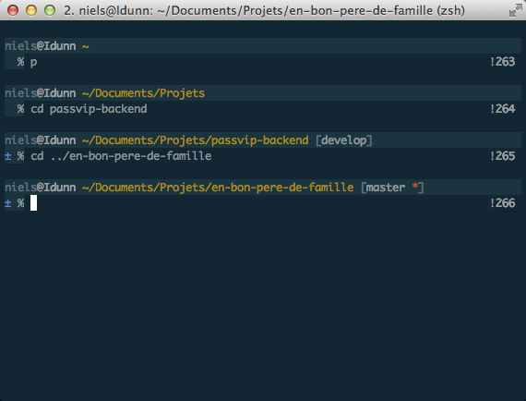
Configurer votre shell Debian
aptitude install git-core git-completion zsh
chsh => /bin/zsh
wget --no-check-certificate https://github.com/robbyrussell/oh-my-zsh/raw/master/tools/install.sh -O - | sh
vim .zshrc => ZSH_THEME="blinks"

Slide 31
Outils
http://code.google.com/p/gitextensions/
http://book.git-scm.com/
Desktop clients : Tower (Mac), SmartGit (Windows & Linux)
(Bonus) git clone https://github.com/Marak/The-Git-Rap.git

Slide 32
Notre workflow
Centralisation des repos sur vmtest
Développement en local sur vos machines
Tests sur VMs à dispositions
Recette client centralisée
Automatisation des déploiements
1
2
3
4
5

Slide 33
Démo & exemples

Slide 34
== Clone ==
git clone git@git.agence-soon.fr:/projet-test.git
cd projet-test/
ls
git status
== Commit ==
git checkout develop
git checkout -b feature-1
mate .gitignore
git add .
git commit -m "#1 feature-1 : Thème SASS"
== Merge ==
git checkout develop
git merge feature-1
git branch -d feature-1
git push
== Test ==
git clone git@git.agence-soon.fr:/projet-test.git
cd projet-test/
ls
git log
git tag stable-1 id_commit
== Deploy ==
cd /home/httpd/
git clone git@git.agence-soon.fr:/projet-test.git projet-test.vmtest.agence-soon.fr== Hotfix ==
git checkout -b feature2
vim index.html
git checkout master
git pull
git checkout -b hotfix1
vim index.html
git add .
git commit -m "#2 hotfix1"
git merge hotfix1
git branch -d hotfix1== Deploy Hotfix ==
git pull== Revert ==
git checkout id_commit

Slide 35
Compléments
# Activer la compression
(develop) $ git gc
# Sous-modules (a.k.a SVN External)
(develop) $ git submodule add git@github.com:myPlugin lib/myPlugin

Slide 36
Q & A ?

Slide 37

Fork me on GitHub.
git@github.com:gmoigneu/git-keynote-presentation.git
Thanks !

