Slide 1
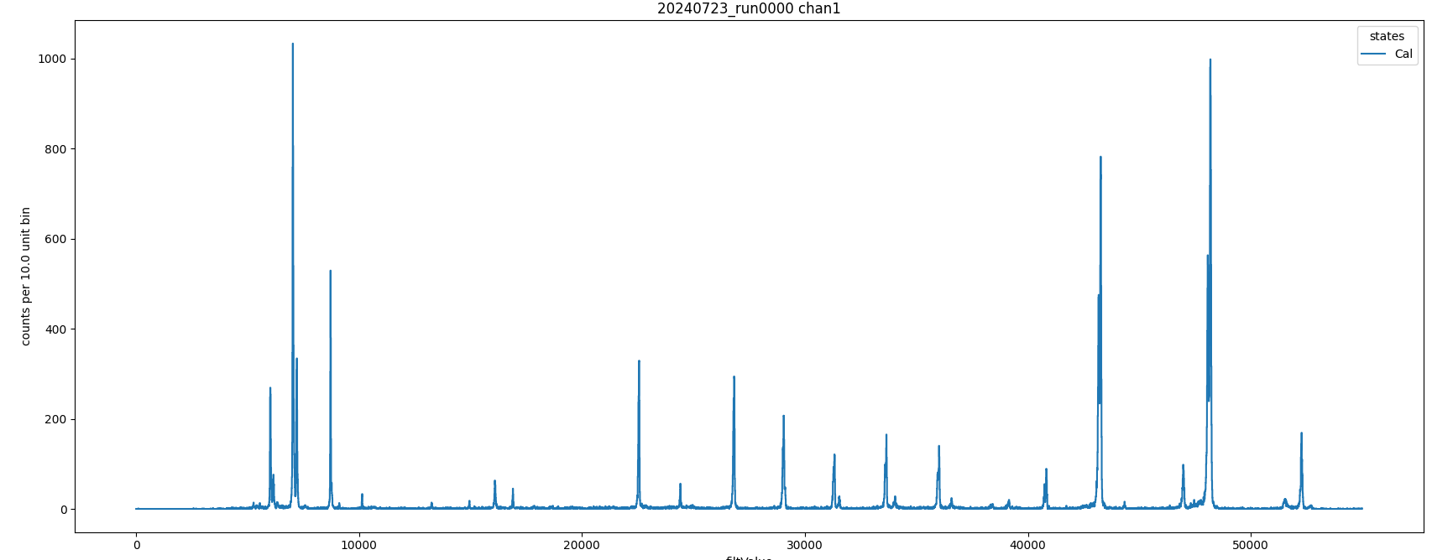
Calibration holder #3: Zn, Ge, Fe, Sc, V, Mn, Cu(?)

Slide 2
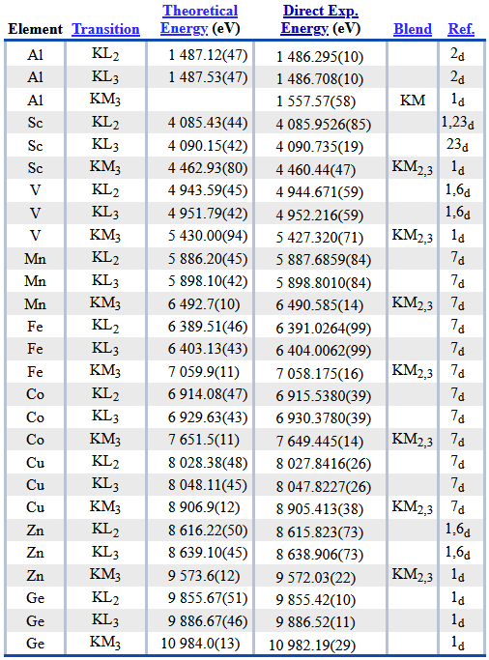
https://physics.nist.gov/cgi-bin/XrayTrans/search.pl?element=Sc&element=V&element=Mn&element=Fe&element=Cu&element=Al&element=Zn&element=Co&element=Ge&trans=KL2&trans=KL3&trans=KM3&lower=&upper=&units=eV

Slide 3
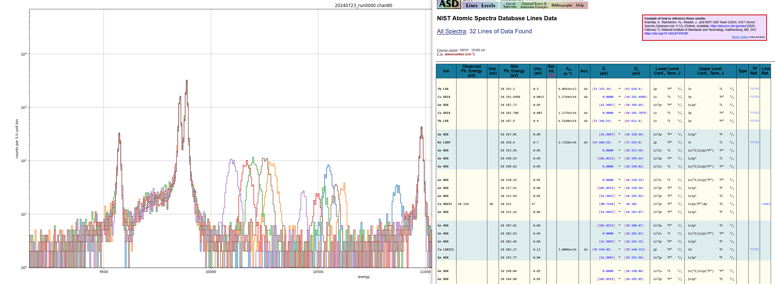

Slide 4
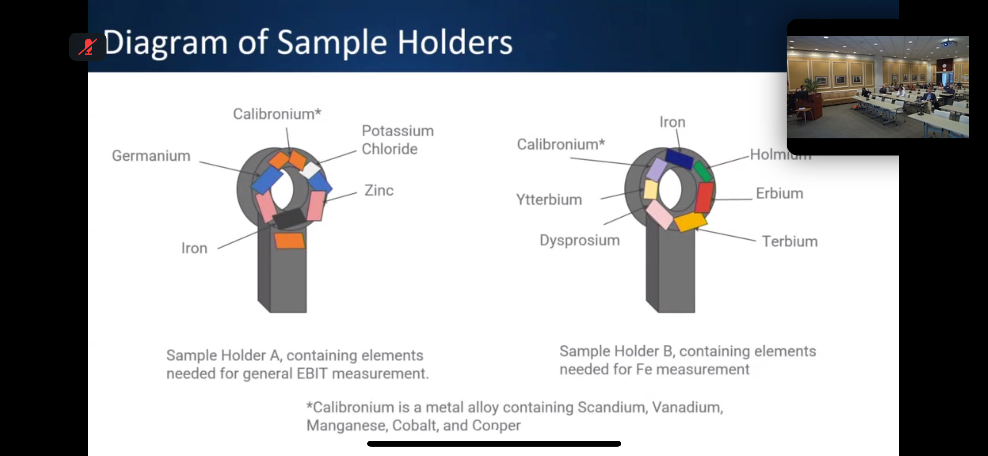

Slide 5
Notes
Seems to be two unidentified features near 10200 and 10500 eV. There is a lot of variance between channels, even when the calibration includes lines on either side within 1 keV. There are some Li-like Ge lines that agree with these energies, but I’m not sure how that would be produced.

Slide 6
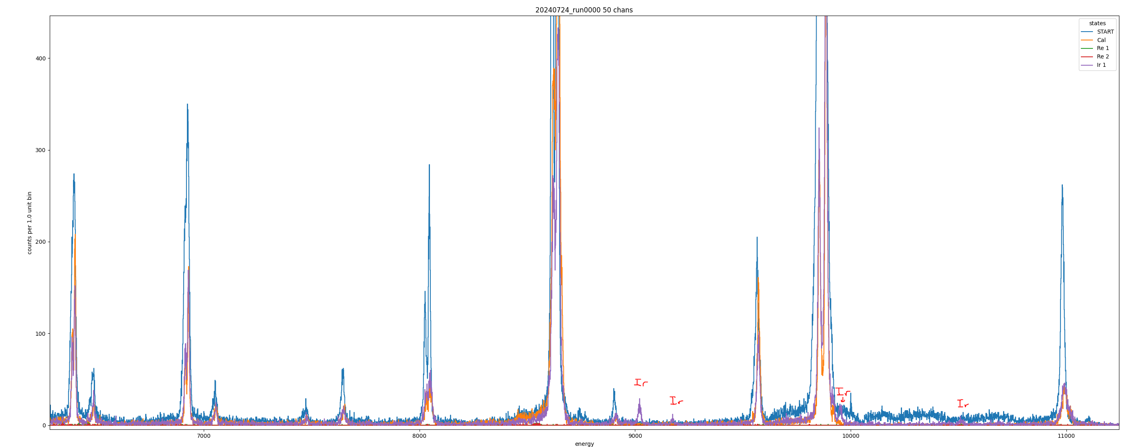
Ir: 9020, 9174, 9952, 10510 eV

Slide 7
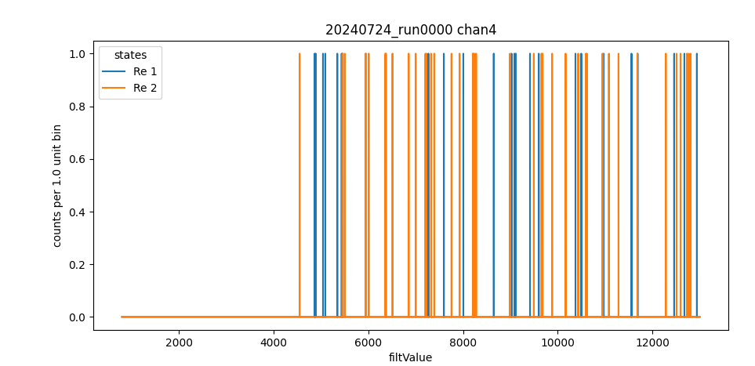
No Re data?

Slide 8
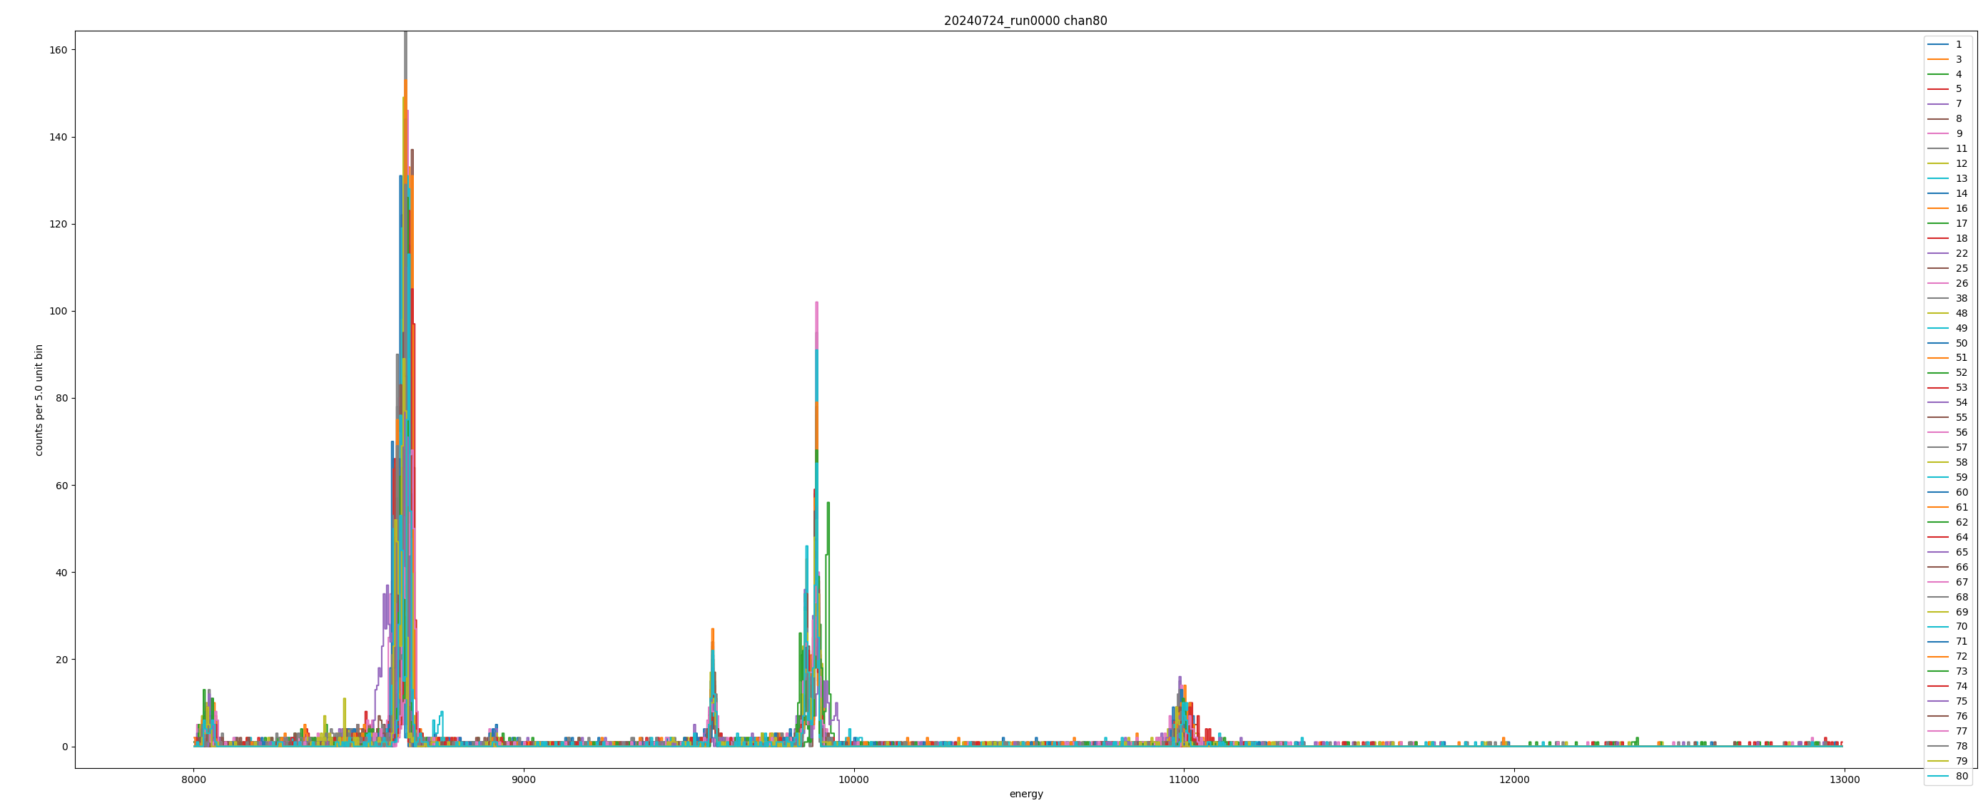

Diffraction feature is gone after sample holder swap

