Slide 1
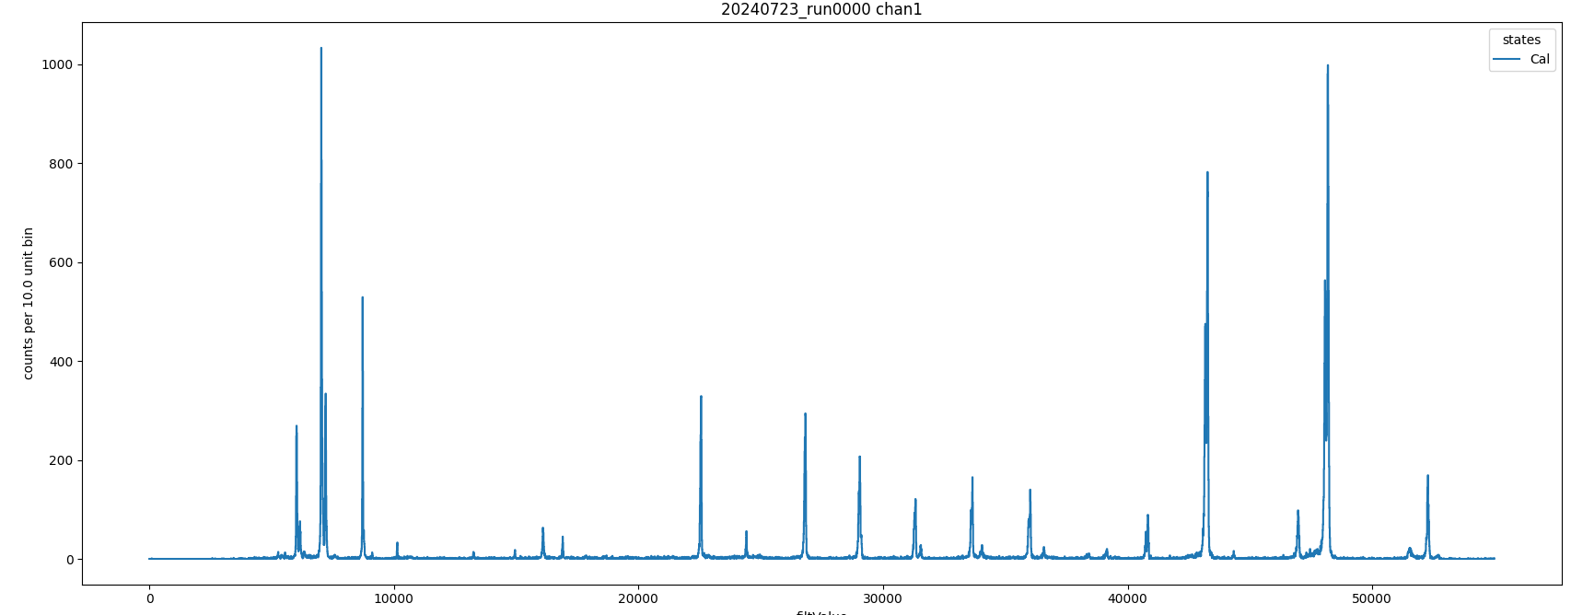
Calibration holder #3: Zn, Ge, Fe, Sc, V, Mn, Cu(?)

Slide 2
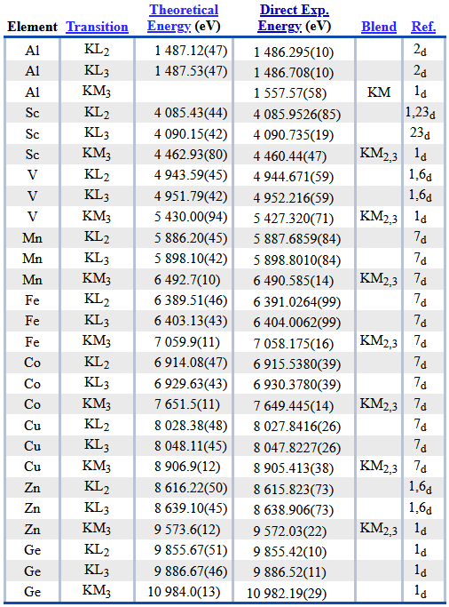
https://physics.nist.gov/cgi-bin/XrayTrans/search.pl?element=Sc&element=V&element=Mn&element=Fe&element=Cu&element=Al&element=Zn&element=Co&element=Ge&trans=KL2&trans=KL3&trans=KM3&lower=&upper=&units=eV

Slide 3
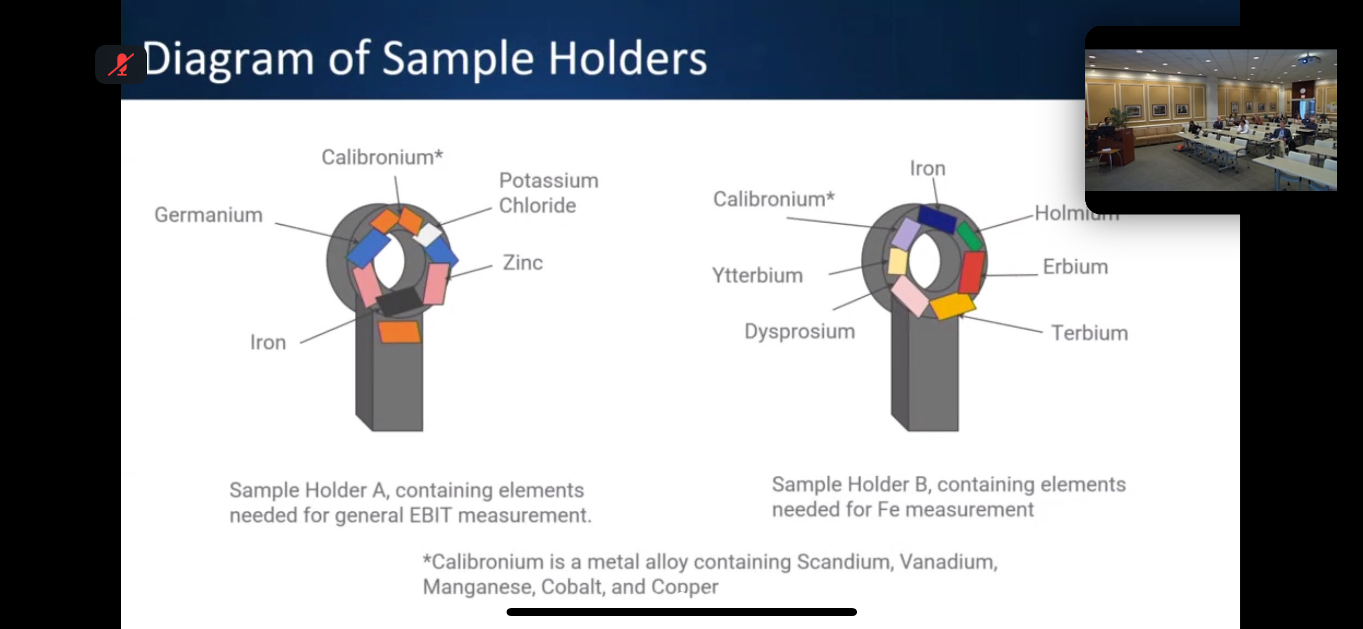

Slide 4
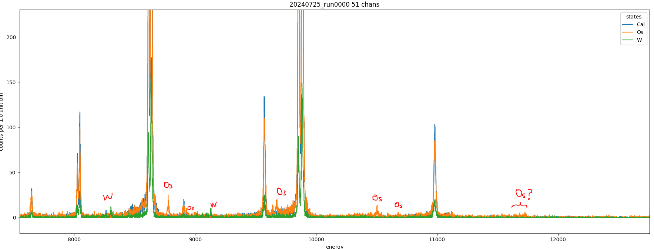
W: 8315, 9060, 9128 eV
Os: 9640, 9674, 10502, 10676, 11727 eV

Slide 5
Lines
W: 8315, 8458?, 9070, (9105, 9128, 9140), 10419? eV
Re: 8554, 9381, 9413 eV
Os: 9640, 9674, (10502, 10530), 10676, 11727 eV
Ir: 9020, 9174, 9952, 10510 eV

