Slide 1
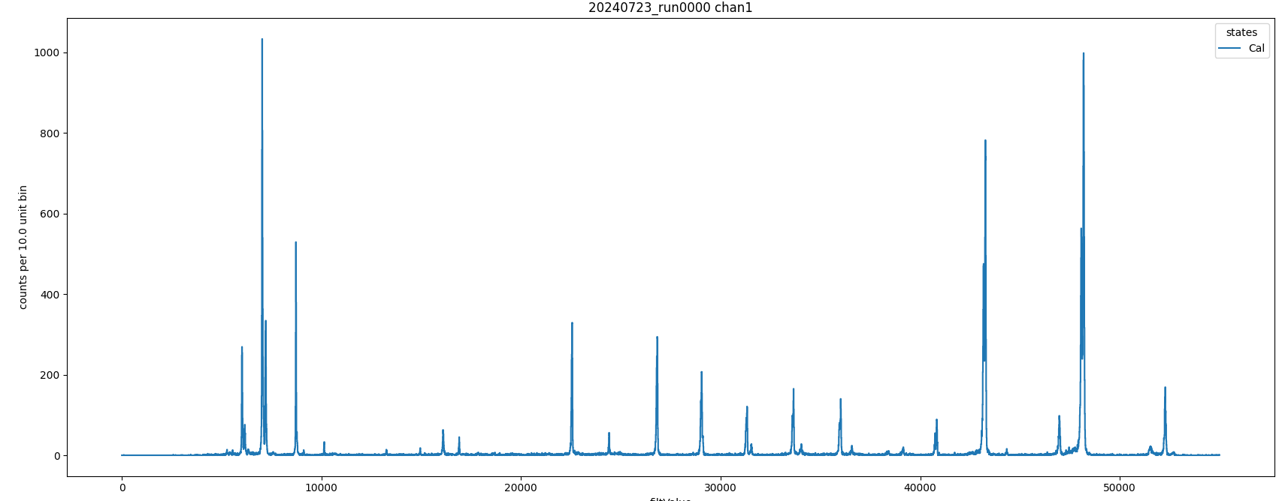
Calibration holder #3: Zn, Ge, Fe, Sc, V, Mn, Cu(?)

Slide 2
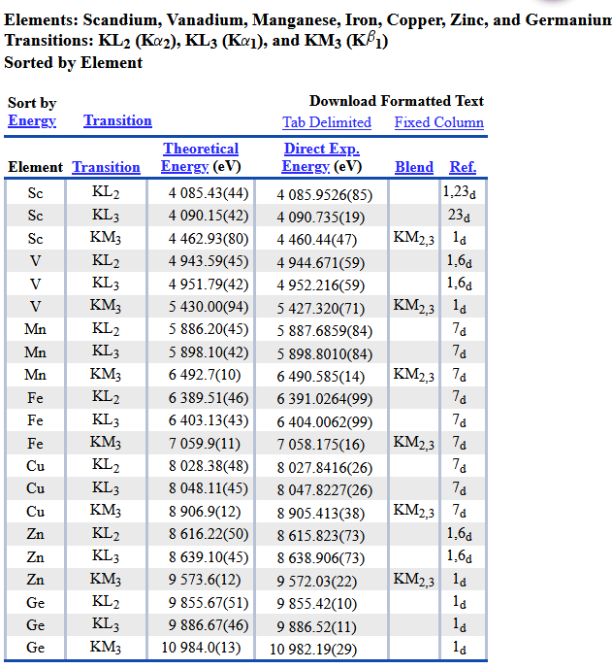
https://physics.nist.gov/cgi-bin/XrayTrans/search.pl?element=Sc&element=V&element=Mn&element=Fe&element=Cu&element=Zn&element=Ge&trans=KL2&trans=KL3&trans=KM3&lower=&upper=&units=eV

