Slide 1
FTP
FTP – File Transfer Protocol
It is the simplest and most secure way to exchange files over Internet.
Transferring files,
From client computer to a server computer
- Uploading
From server computer to a client computer
- Downloading

Slide 2
To access an FTP server, users must be able to connect to the internet.
FTP doesn’t not really move, it copies files from one computer to another.
An FTP Client is software that is designed to move files back-and-forth between two computers over the Internet.

Slide 3
Connect to a FTP site
$ ftp IP/hostname
or
$ ftp
ftp> open IP/hostname
You can directly open connection with a remote host using it’s IP or host name from the command line.

Slide 4
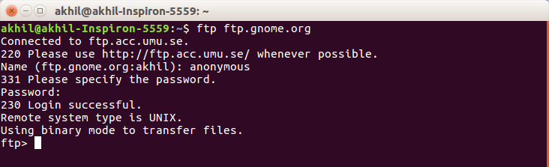
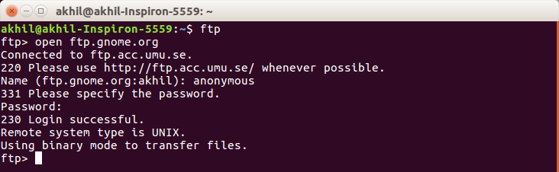

Slide 5
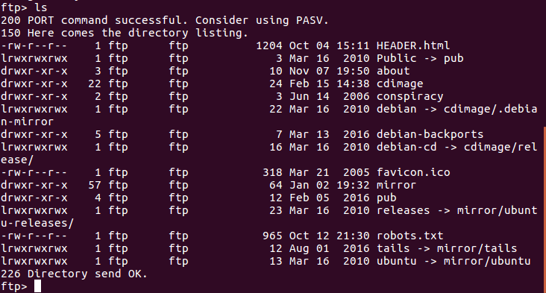
Listing the contents
ftp> ls
You can view the content of a remote directory using the ls / dir coomand

Slide 6
Changing Directory
ftp> cd
To navigate into the sub directory of a remote directory.
ftp> cd ..
To navigate to parent directory of a remote directory.

Slide 7
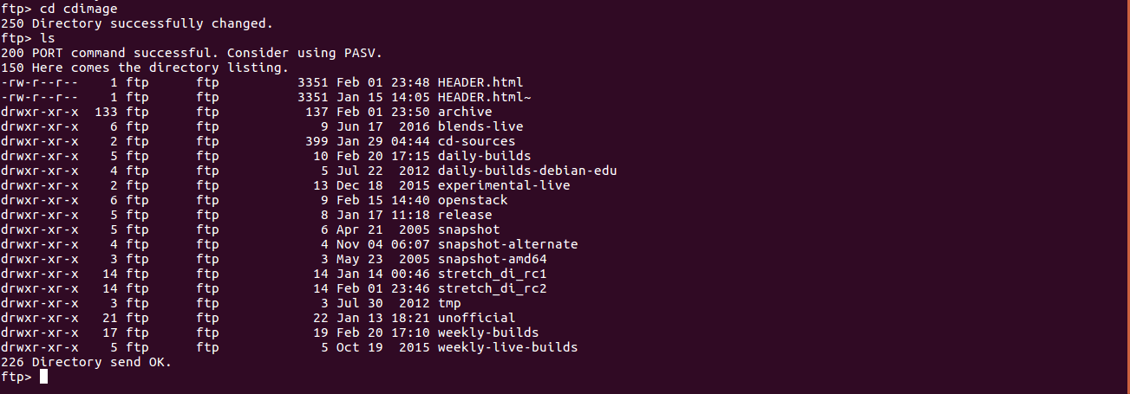

Slide 8
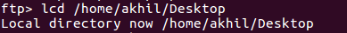
Set a download directory
ftp> lcd /home/user/yourdirectoryname
Before downloading a file, we should set the local ftp file download directory by using lcd command

Slide 9
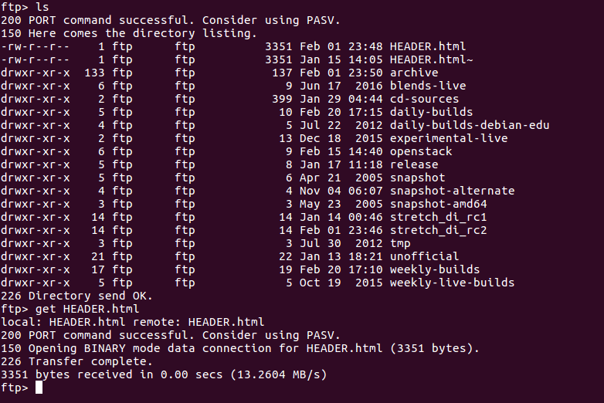
Download a file
ftp> get FILENAME
Using the get command to download file from a remote ftp server

Slide 10
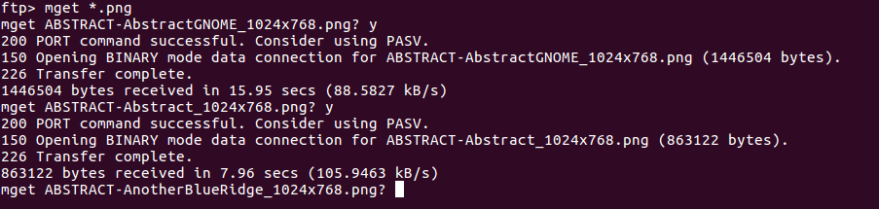
Download multiple files
ftp> mget *.file extension
mget command helps to download multiple files with same file extension.

Slide 11
Uploading file to FTP server
ftp> put FILENAME
To upload a file we can use put command.
ftp> put /path/FILENAME
When the file you want to upload is not in local directory.
ftp> mput *.file extension
To upload multiple files of same file extension, we can use mput command.

Slide 12
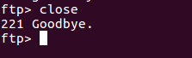
Closing the FTP connection
ftp> close
Without exiting the ftp prompt you may want to open a connection to another server. In that execute close command

Slide 13
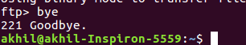
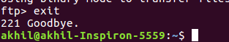
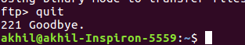
ftp> bye
ftp> exit
ftp> quit
To exit the ftp prompt

Slide 14
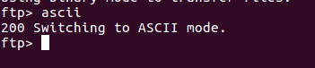
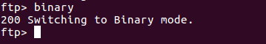
FTP mode to Binary or Ascii
ftp> ascii
Go to ftp Ascii mode.
ftp> binary
Go to ftp Binary mode.

