Slide 1
GREP
GREP – Global Regular Expression Print
Searches for text in a file
Can search for simple words.
Can look for “regular expression”;more complex charecter strings( words followed by any no of spaces, followed by a digit or lowercase letter).

Slide 2
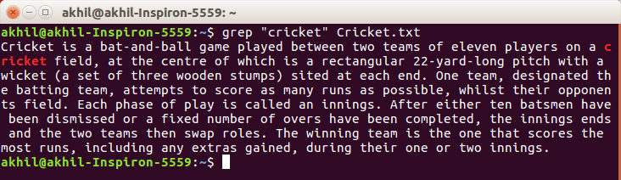
Searching the given string
$ grep “literal_string” filename
To search a specific string in a specified file

Slide 3
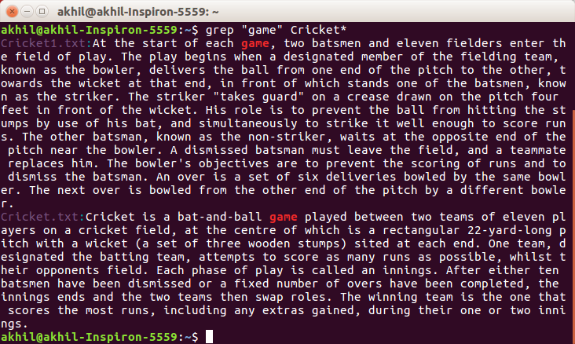
$ grep “string” FILE_PATTERN*
Checking for the given string in multiple files.

Slide 4
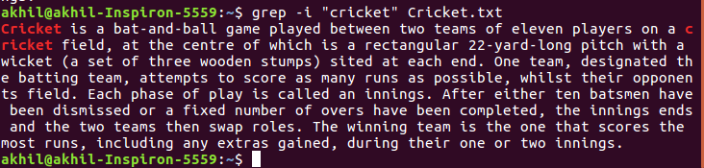
Case insensitive search
$ grep -i “string” filename
$ grep -i “string” FILE_PATTERN*
This searches for given string/pattern case insensitively.

Slide 5
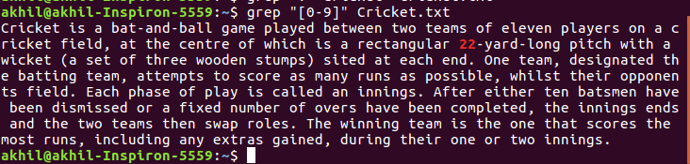
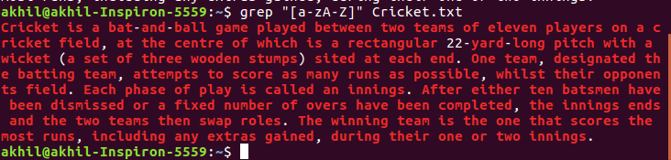
Simple regular expressions
“[0-9]” look for any digit
“[a-zA-Z]” look for one upper or lower case letter

Slide 6
“.” look for one charecter
“.*” any number of charecters
“\.” a literal decimal point
“\.161:” dot, then 161,then colon
“\.161[: ]” dot, then 161, then colon or space

Slide 7
Advanced regular expressions
Look for lines that hold either string1 or string2
$ grep -E ‘(string1|string2)’ filename
Lines that have string1 followed by string2 on the same line, but possibly with other charecters in between.
$ grep ‘string1.*string2’ filename

Slide 8
String1 has to be at the beginning of the line.
$ grep ‘^string1’ filename
Look for it at the end of the line.
$ grep ‘string1$’ filename

