Slide 1
SSH(secure shell)

Slide 2
SSH features
Command line terminal connection tool
Replacement for rsh, rcp, telnet, and others
All traffic encrypted

Slide 3
Brief History
SSH.com's SSH1, originally completely free with source code, then license changed with version 1.2.13
SSH.com's SSH2, originally only commercial, but now free for some uses.

Slide 4
To install type
sudo apt-get install openssh-server
The most basic form of the command is:
ssh remote_host
The remote_host in this example is the IP address or domain name that you are trying to connect to.
If your username is different on the remote system, you can specify it by using this syntax:
$ ssh remote_username@remote_host

Slide 5
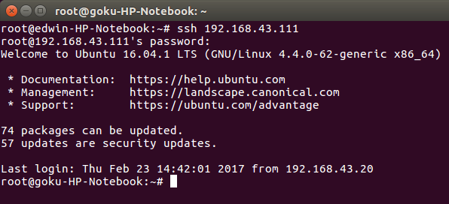
LOGING IN USING SSH

Slide 6
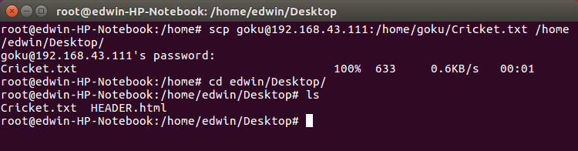
TO COPY FILES
$ scp source destination
Copy a file from local to host
Code:
$scp jsmith@remotehost.example.com:/home/jsmith/remotehostfile.txt
remotehostfile.txt

Slide 7
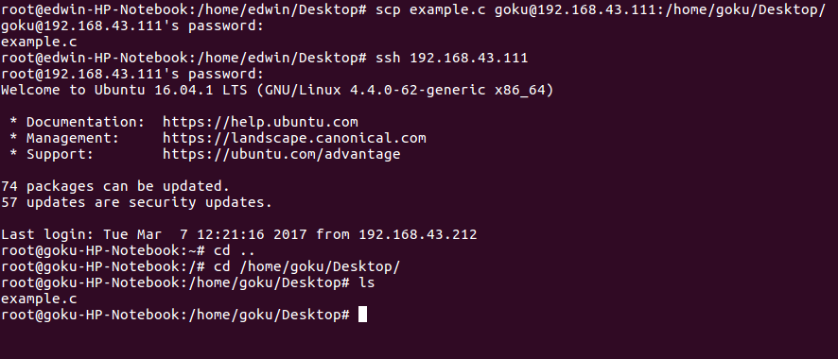
Copy file from host to local
Code:
$scp localhostfile.txt
jsmith@remotehost.example.com:/home/jsmith/localhostfile.txt

Slide 8
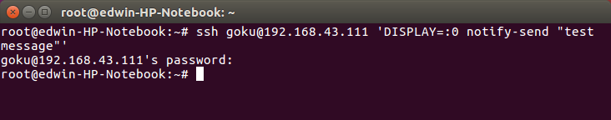
SENDING MESSAGE WITH SSH
code
$ssh ip address ‘DISPLAY=:0 notify-send “test message”

Slide 9
TO SHUTDOWN CONNECTED COPMUTER
$ssh user@remote_computer
$sudo poweroff
$sudo reboot

Slide 10
THANK YOU

