Slide 1
ADVANCE LINUX COMMAND
WGET:
wget stands for "web get". It is a command-line utility which downloads files over a network.

Slide 2
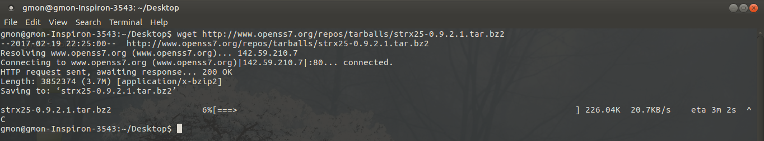
Single file download
The command will download single file and stores in a current directory. It also shows download progress, size, date and time while downloading.
Command
  wget http://www.openss7.org/repos/tarballs/strx25-0.9.2.1.tar.bz2

Slide 3
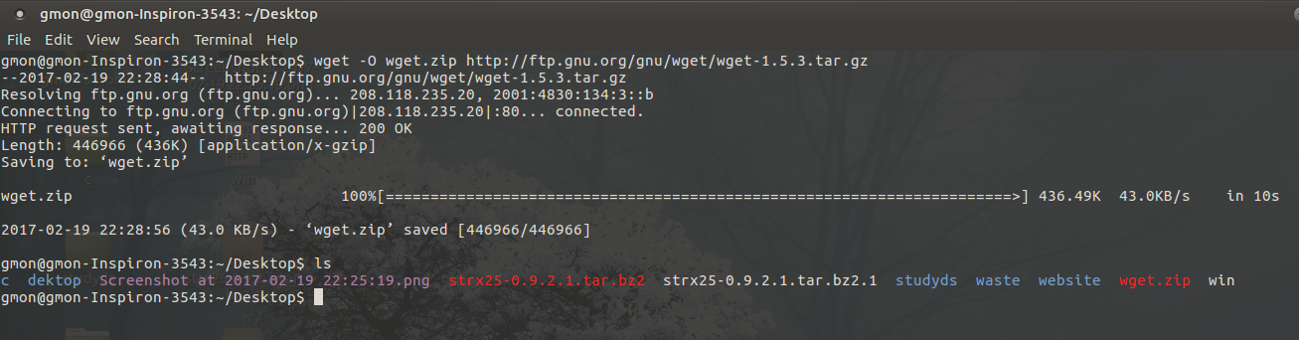
Download file with different name
Using -O (uppercase) option, downloads file with different file name. Here we have given wget.zip file name as show below.
  Command:
  wget -O wget.zip http://ftp.gnu.org/gnu/wget/wget-1.5.3.tar.gz

Slide 4
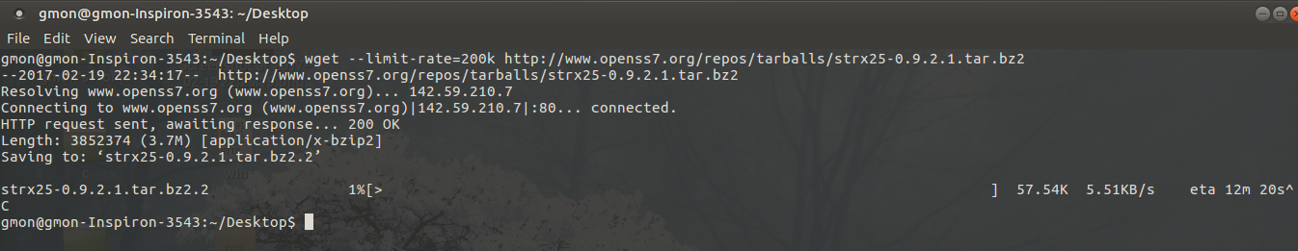
Specify Download Speed / Download Rate Using wget –limit-rate
Add a suffix "k" for jilobytes or "m" for megabytes. e.g. "--limit-rate = 2m" to limit the max download speed to 2Mbyte/sec.
Command: wget --limit-rate=[VALUE] [URL]

Slide 5
Continue the Incomplete Download Using wget -c
Restart a download which got stopped in the middle using wget -c option as shown below.
Command:
Wget -c http://www.openss7.org/repos/tarballs/strx25-0.9.2.1.tar.bz2

Slide 6
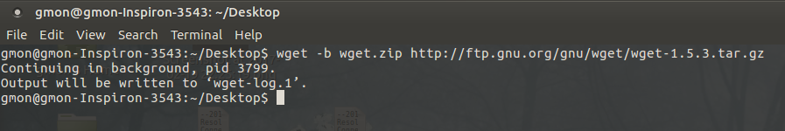
Download in the Background Using wget -b
Command:
wget -b http://www.openss7.org/repos/tarballs/strx25-0.9.2.1.tar.bz2

Slide 7
Resuming a Stopped/Interrupted Download
In case you face any system interruptions post starting the download of a massive file from the web using wget , you will be absolutely delighted to know if the command given below that shall help you resume the download process from where it stopped (without the hassle of starting the tedious process all over again!):All you need to do is execute the basic wget command with option "-c".
Command:
wget -c [URL]

Slide 8
Download Multiple Files / URLs Using Wget -i
First, store all the download files or URLs in a text file
Command:
  wget -i download-file-list.txt

Slide 9
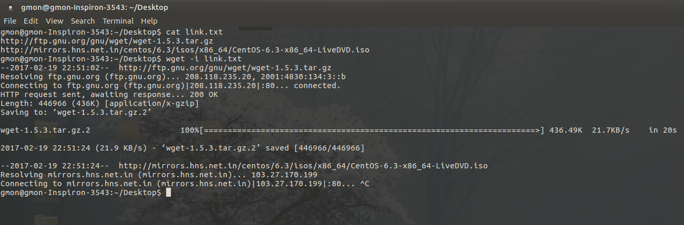

Slide 10
Emulating a Complete Website
If you wish to retain a copy of any website that you may like to refer to/read locally, or maybe save a copy of your blog to the hard disk as back up, you may execute the wget command with mirror option, as follows:
Command:
wget --mirror [Website Name]

