Slide 1
LINUX COMMANDS
PRESENTED BY
BLESSY BOBY
JANAKI KEERTHI

Slide 2
CONTENTS
Redirection
Pipes
Filters
Job control
File permission
File ownership
Links
File system hierarchy

Slide 3
REDIRECTION
Method of directing data between files or programs in useful ways
Output redirection:
The o/p of a program is saved in another file using > operator
Input redirection:
We can read data from a file and give it to another file using < operator

Slide 4
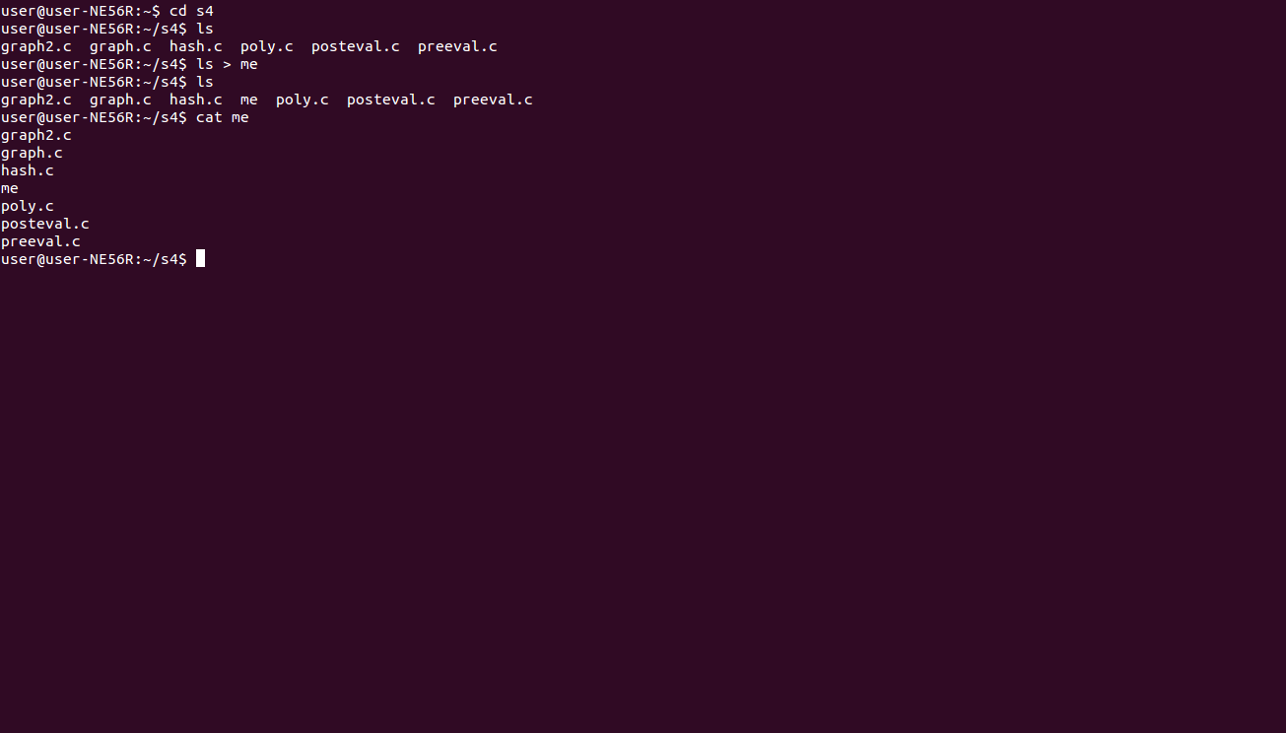
O/p redirection

Slide 5
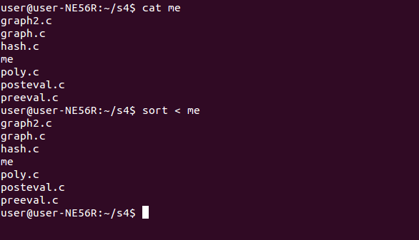
I/p redirection

Slide 6
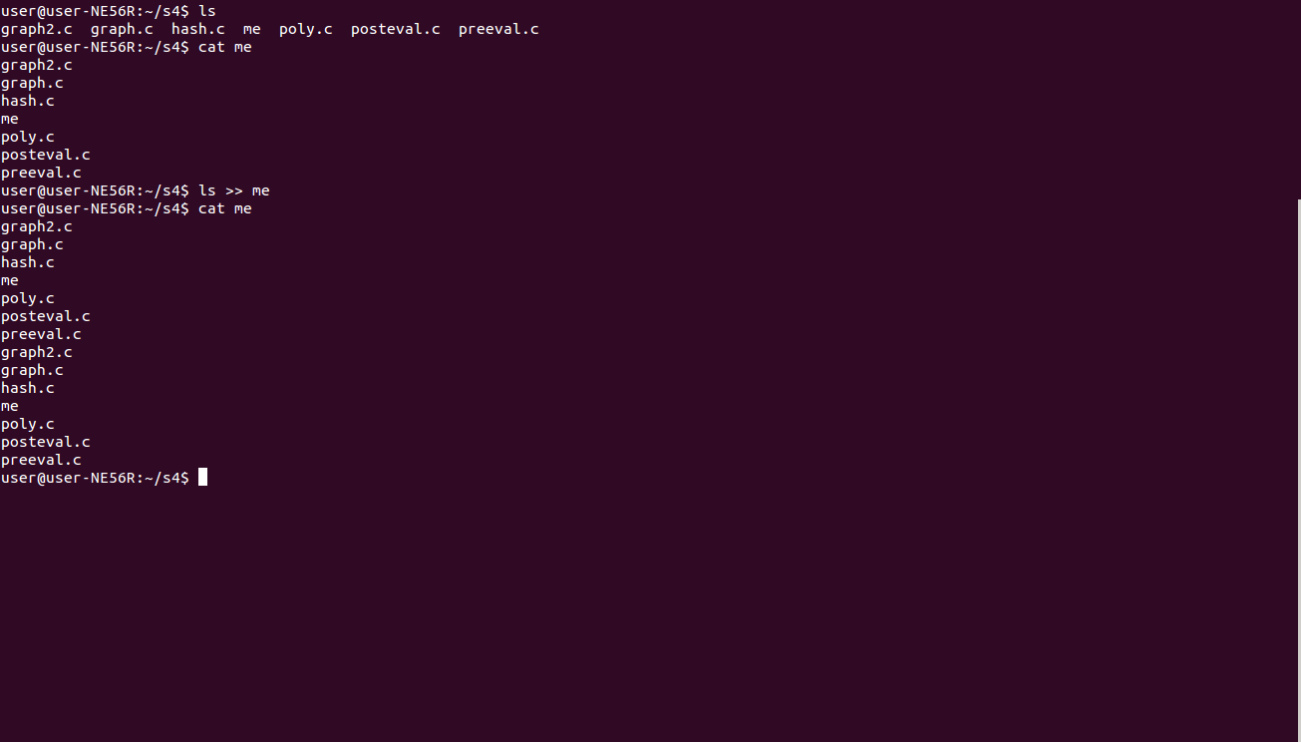
Append (use >>)

Slide 7
PIPING
The output from the program on the left is fed as input to the program on the right
The operator we use is |
Eg :
$who
user :0 2017-02-15 16:45 (:0)
user pts/0 2017-02-15 21:38 (:0)
$who | wc -l #shows no of lines of output generated by who
2
#shows no of logged in users

Slide 8
FILTERS
A filter is a program that accepts textual data and then transforms it in a particular way. They take raw data, either produced by another program, or stored in a file, and manipulate it to be displayed in a more suitable way.
Eg:
$ ls
barry.txt bob example.png firstfile first1
$ ls | head -3
barry.txt
bob
example.png

Slide 9
Filter commands
head
view the first n lines of data.
tail
view the last n lines of data.
sort
organise the data into order.
nl
print line numbers before data.
wc
print a count of lines, words and characters.

Slide 10
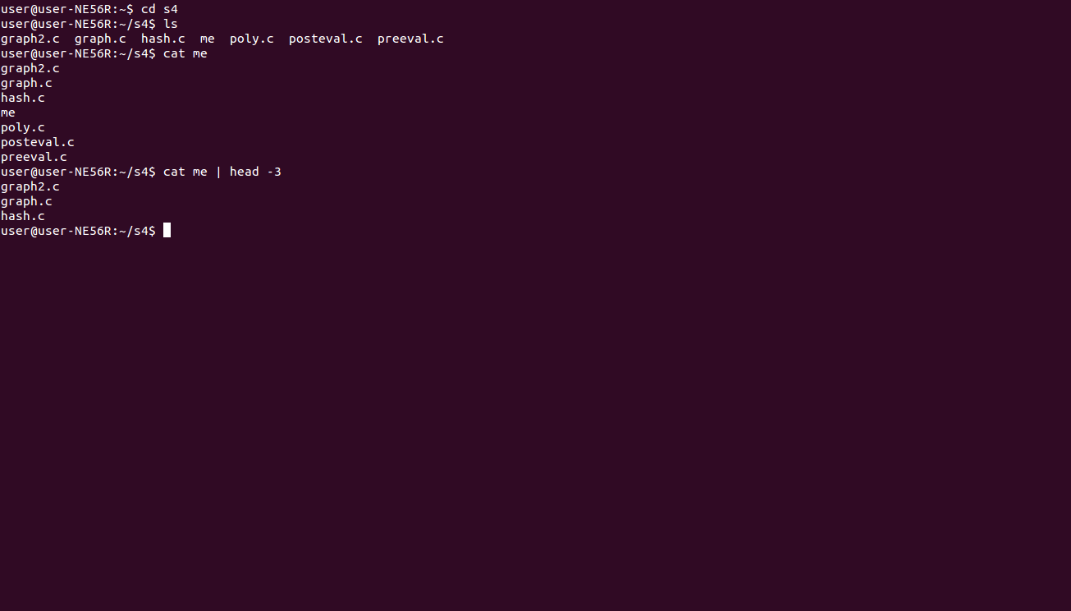
Filter command

Slide 11
JOB CONTROL
A job is defined as a task or command that has started running but not yet finished what it is doing.
jobs - List all the jobs that are running or suspended.
fg - Bring the job to the foreground.
bg - Send the job to the background.
stop or Ctrl + z - Suspend the job.
kill or Ctrl + c - Terminate the job.

Slide 12
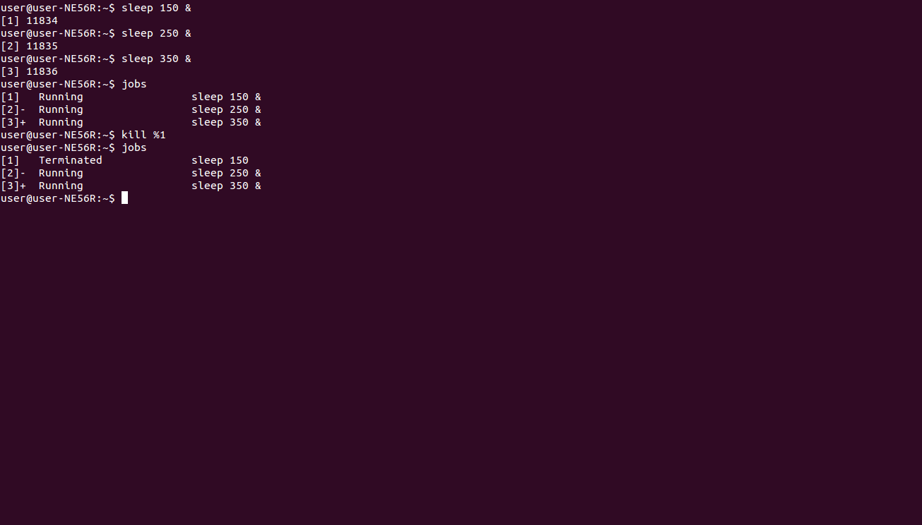

Slide 13
FILE PERMISSION
Linux is a multiuser OS
For example, if your computer is attached to a network, or the Internet, remote users can log in via telnet or ssh (secure shell) and operate the computer
Chmod
The chmod command is used to change the permissions of a file or directory

Slide 14
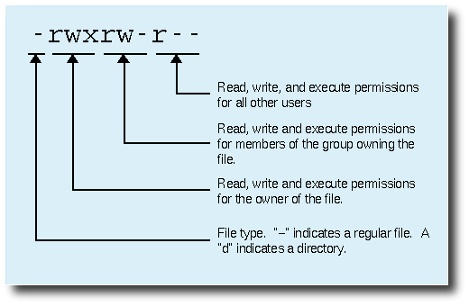

Slide 15
It is easy to think of the permission settings as a series of bits (which is how the computer thinks about them). Here's how it works:
rwx rwx rwx = 111 111 111
rw- rw- rw- = 110 110 110
rwx --- --- = 111 000 000
and so on...
rwx = 111 in binary = 7
rw- = 110 in binary = 6
r-x = 101 in binary = 5
r-- = 100 in binary = 4

Slide 16
777 (rwxrwxrwx) : No restrictions on permissions.
755 (rwxr-xr-x) :The directory owner has full access. All others may list the directory, but cannot create files nor delete them.
eg: $ chmod 600 some_file
(600 stands for rw-------)

Slide 17
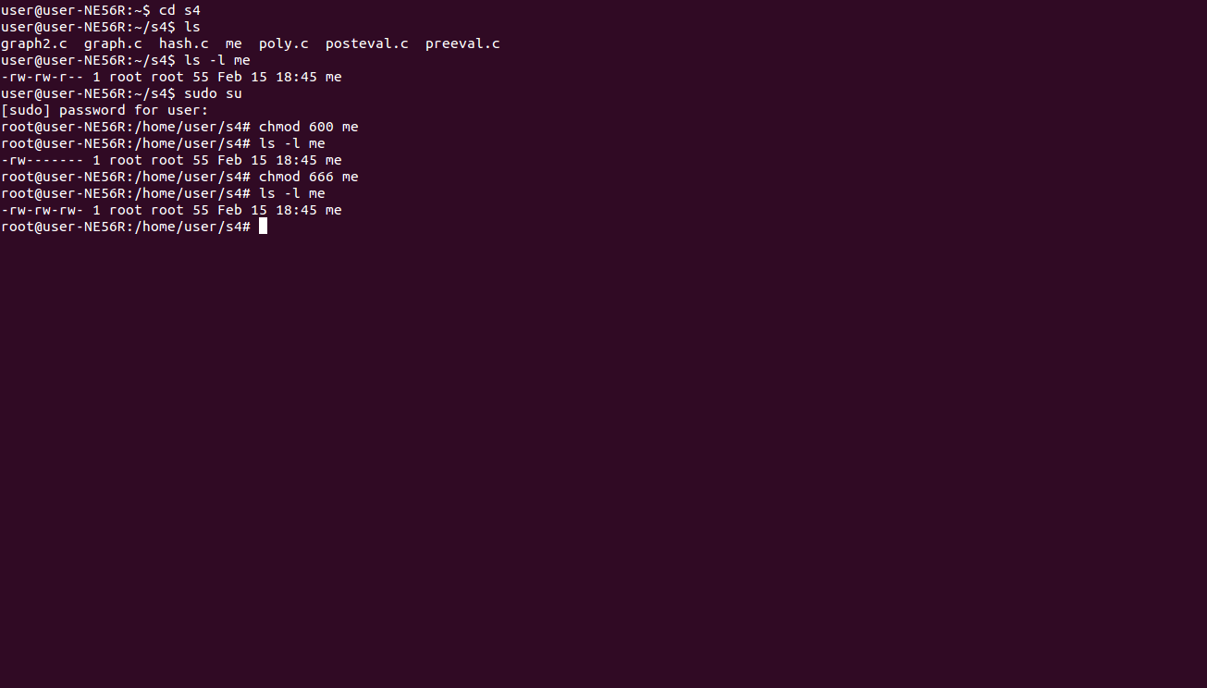

Slide 18
FILE OWNERSHIP
You can change the owner of a file by using the chown command
eg: $ su
Password:
$ chown new some_file
(suppose new stands for the new owner)

Slide 19
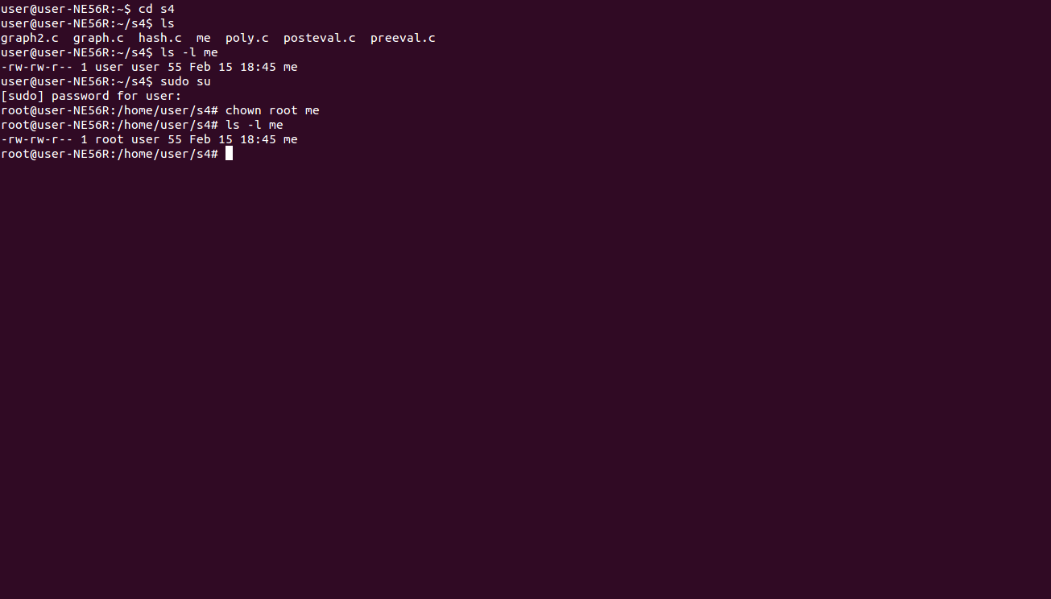
(changing owner)

Slide 20

(changing group)

Slide 21
FILE LINKS
A link is a connection between a file name and the actual data on the disk,ie we can have access to file using multiple names by creating a link.
Two types of links
symbolic links: Refer to a symbolic path indicating the abstract location of another file
hard links : Refer to the specific location of physical data

Slide 22
Hard links
Hard link to a file named test.sh is given by command
$ln test.sh test.sh.save
The file test.sh.save is the hard link to the file test.sh. This means if we change the content of anyone of the file then the other one will also change.
If we accidently delete test.sh file then other file test.sh.save still exists , ie only one of the links is cut off. The data on the disk is removed only if no links remain to that file.
Hard links cannot be made to directories.
Even if original file is moved or deleted, the link exists.

Slide 23
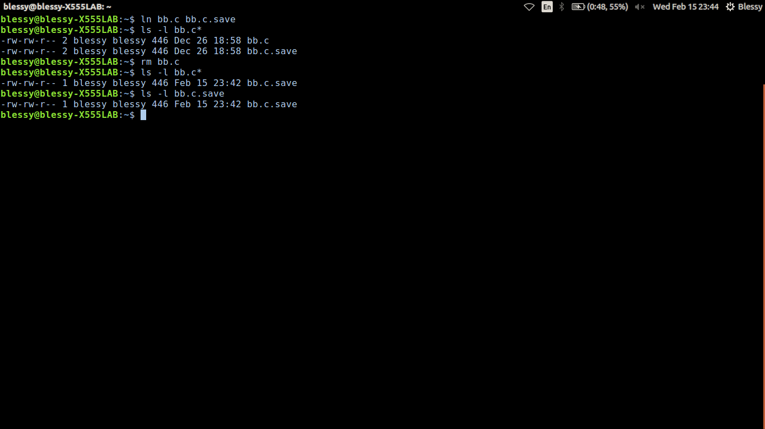

Slide 24
Symbolic links
Hard links cannot be used for directories. So we use symbolic links. It can be used for files as well.
Here if you delete or move the original file, the link will break.
It acts as a shortcut or pointer to original file.
Symbolic link to a file named test.sh is given by
$ ln -s test.sh direc , where direc is a directory to which
the link is made.

Slide 25
File System Hierarchy
The linux file system is structured as a tree. The leaf of the tree are ordinary files. The internal nodes of the tree are directories. A subdirectory is the child of another directory.
File system break files down into two logical categories.
  shareable vs unshareable files
      Shareable files are those that can be accessed locally and by remoter hosts, while unsharable files are only available locally.
  variable vs static files
      Variable files like documents can be changed at any time; while static files like binaries do not change without an action from the system administrator.

Slide 26
File System Hierarchy Standard Organisation
The /boot/ directory
      Contains static files required to boot the system.
The /dev/ directory
      Contains file system entries which represent devices that are attached to the system. These files are essential for the system to function properly.
The /etc/ directory
      Reserved for configuration files that are local to the machine.
      The X11/ and skel/ are subdirectories of this directory.
The /lib/ directory
      Contain only those libraries needed to execute the binaries in /bin/ and /sbin/.
      These shared library images are important for booting the system and executing the commands within the root file system.

Slide 27
The /mnt/ directory
      This directory is for temporarily mounted file systems, such as CD-ROMs
The /opt/ directory
      Provides storage for large, static application software packages.
The /proc/ directory
      Contains special files that either extract information from or send information to the kernel
      This directory can be used to communicate with the kernel
The /sbin/ directory
      Stores executables used by the root user, which are only used at boot time and perform system recovery operations.
The /usr/ directory
      This directory is for files that can be shared across mulltiple machines.It is read only.Often on its own paritition.
      There are many subdirectories like |- bin/ ,|-doc/ ,|-tmp →/var/tmp

Slide 28
The /usr/local directory
      It is for use by the system administrator when installing software locally.
      It have many subdirectories like |-bin/ ,|-doc/ ,|-games/ etc similar to /usr/ directory.
The /var/ directory
      Any program that write log files or need spool/ or /lock should write them to /var/ directory.
      /var/ is for variable data files.
      The are many subdirectories found within this directory
      /var
      |- accout/
      |- arpwatch/
      +- spool/
      |- at/
      |- news/
      |- tmp/

Slide 29
The /usr/local directory
      It is for use by the system administrator when installing software locally.
      It have many subdirectories like |-bin/ ,|-doc/ ,|-games/ etc similar to /usr/ directory.
The /var/ directory
      Any program that write log files or need spool/ or /lock should write them to /var/ directory.
      /var/ is for variable data files.
      The are many subdirectories found within this directory
      /var
      |- accout/
      |- arpwatch/
      +- spool/
      |- at/
      |- news/
      |- tmp/

Slide 30
