Slide 1

Git
Prepared By,
Bharath R
Chris Humphry
Gayatri G

Slide 2
What is version control?
Version control (or revision control, or source control) is all about managing multiple versions of documents, programs, web sites, etc.
Some well-known version control systems are CVS, Subversion, Mercurial, and Git.
Distributed systems like Mercurial and Git are newer and are gradually replacing centralized systems like CVS and Subversion.

Slide 3
About git
Speed.
Simple design.
Strong support for thousands of parallel branches.
Fully distributed.
Able to handle larger projects like Linux kernel effectively.
GIT DOESN'T DELETE
Git generally only adds data.
If you mess up, you can usually recover your stuff
Recovery can be tricky though.

Slide 4
Installing git
In linux:
    Sudo package – name git
    Eg: in Ubuntu : $ sudo apt-get install git

Slide 5
Configuring git
After installing git in your system open terminal and configure your git with your git account(like github,bitbucket or gitlab etc).
$ git config --global user.name "Chris"
$ git config --global user.email chrishumphry@gmail.com

Slide 6
Checking the settings
$ git config –list
Eg:
$ git config --list
user.name=John Doe
user.email=johndoe@example.com
color.status=auto
color.branch=auto
color.interactive=auto
color.diff=auto

Slide 7
Getting help
$ git help <verb>
$ git <verb> --help
$ man git-<verb>

Slide 8
Initializing a Repositry
Move to the working folder using cd command. The fllowing command creates a .git directory.
$ git init

Slide 9
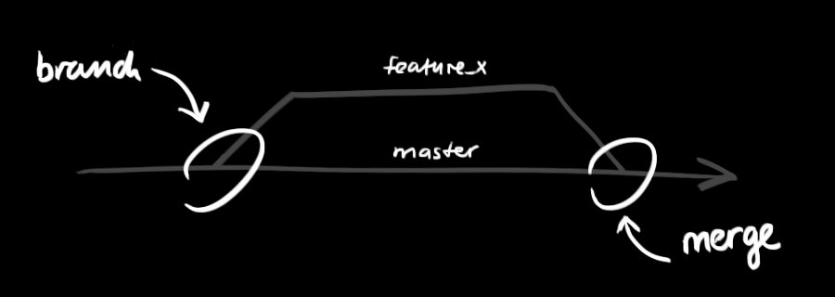
Creating branches
git branch feature_x
git checkout feature_x
Branching is the way to work on different versions of a repository at one time.
By default your repository has one branch named master which is considered to be the definitive branch.

Slide 10
Start local version
$ git add
  git -A can also be used
  git *.c can be used to add all .c files
This adds all your current files to the repository.
Type in $ git commit –m "Message".

Slide 11
Cloning a Repository from elsewhere
$ git clone URL
$ git clone URL mypath
  These make an exact copy of the repository at the given URL.
$ git clone git://github.com/rest_of_path/file.git
  GitHub is the most popular (free) public repository.
Typically, each team member works in his/her own repository, and “merges” with other repositories as appropriate.

Slide 12
Push pull fetch and merge
Push To remote
$ git push origin branch_name
Fetch & Merge
$ git pull
Fork
$ git fork URL
Merge
$ git merge origin master

Slide 13
Checking the status
$ git status
If you run this command directly after a clone, you should see something like this:
$ git status
On branch master
Your branch is up-to-date with 'origin/master'.
nothing to commit, working directory clean

Slide 14
Removing files
To remove a file from Git, remove it from your tracked files (more accurately, remove it from your staging area) and then commit.
The git rm command does that, and also removes the file from your working directory so you don’t see it as an untracked file the next time around.
$git rm calcu.sh

Slide 15
Differentiate and show commits
git diff commit_id1 commit_id2
It would represent the change happen between these two commit history.
git show
It shows the commit.

Slide 16
Some useful commands
To look back at the changes
$ git log
reflog
$ git reflog
Blame
$ git blame
A useful tool
$ gitk

Slide 17
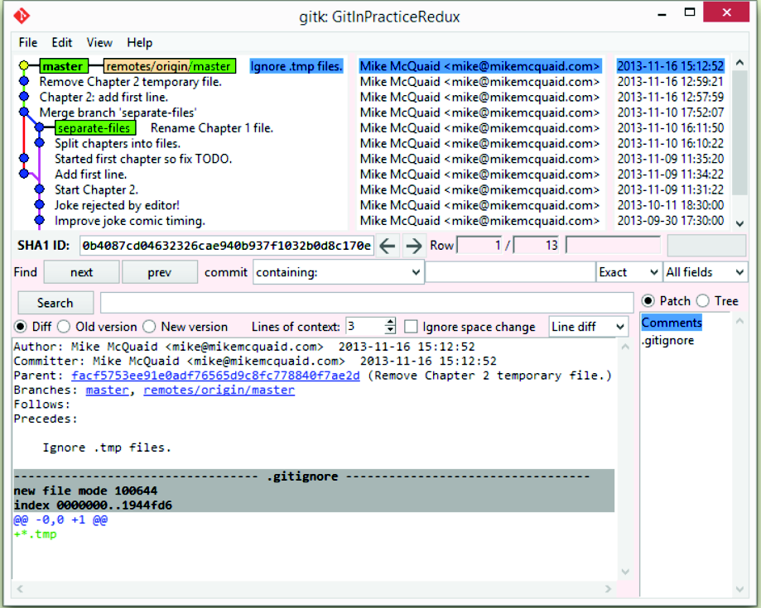

Slide 18
Thank You

