Slide 1
Particle Swarm Optimization
Greg Morneault

Slide 2
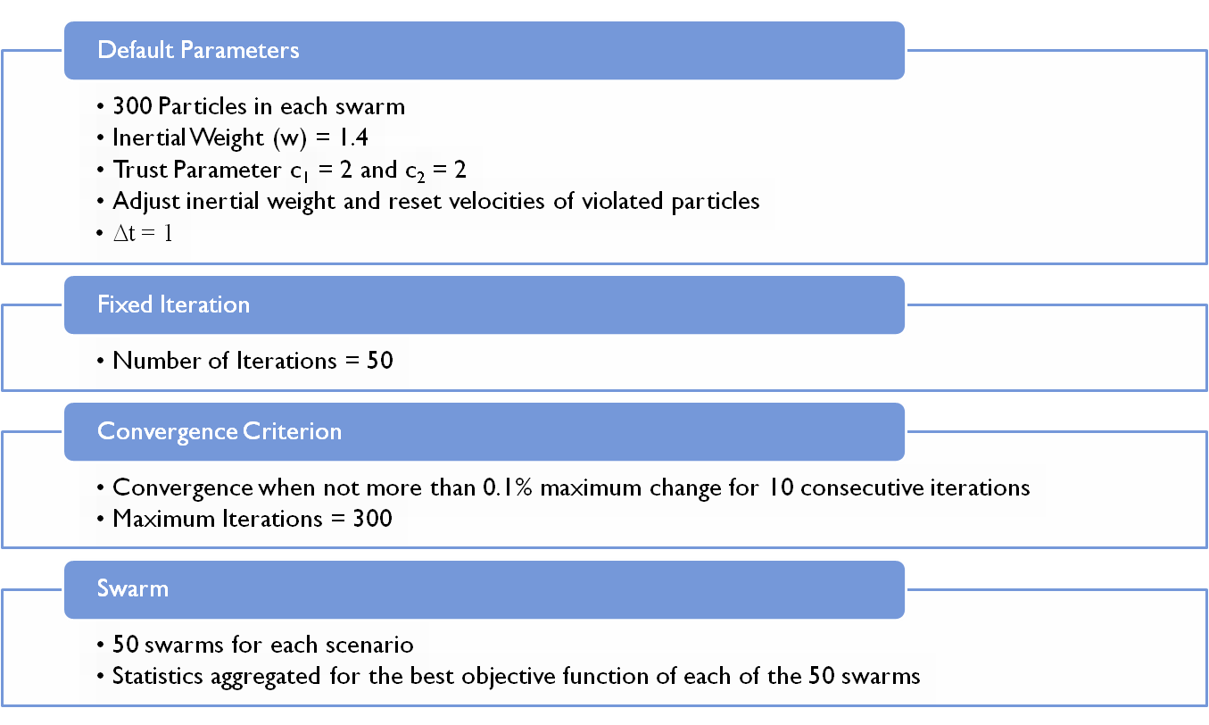
Default Parameters and Setup

Slide 3
Adjusting Inertial Weight and Resetting Velocities of Violated Particles
Dynamically adjusting the inertial weight as well as resetting velocities of violated particles has a significant and positive influence
Dynamically adjusting the inertial weight is more effective than resetting velocities of violated particles
Fixed Iteration
Option | Mean | StdDev | Best | Worst
------ | 1.3882E-03 | 3.5032E-03 | 2.2965E-06 | 2.1048E-02
W | 1.6934E-06 | 4.8004E-06 | 1.4674E-09 | 2.5777E-05
R | 2.9825E-05 | 4.8251E-05 | 1.8323E-07 | 2.2374E-04
RW | 5.5728E-08 | 2.1467E-07 | 1.3704E-10 | 1.2998E-06
Convergence Criterion
Option | Mean | StdDev | Best | Worst | Iterations
------ | 2.1242E-03 | 3.3100E-03 | 2.5171E-07 | 1.8225E-02 | 300.0
W | 0.0000E+00 | 0.0000E+00 | 0.0000E+00 | 0.0000E+00 | 138.1
R | 2.5853E-05 | 6.4070E-05 | 2.4726E-08 | 4.1057E-04 | 300.0
RW | 0.0000E+00 | 0.0000E+00 | 0.0000E+00 | 0.0000E+00 | 123.7

Slide 4
Changing the Trust Parameters c₁ and c₂
Best combination is when c₁ = c₂ = 1. Algorithm is most effective when each particle exhibits less trust in itself and the swarm as a whole.
More sensitive to changes in c₂ versus c₁.
Fixed Iteration
C₁ | C₂ | Mean | StdDev | Best | Worst
1 | 1 | 2.0283E-09 | 4.9220E-09 | 3.9993E-11 | 3.0070E-08
1 | 2 | 1.6564E-08 | 3.9896E-08 | 2.8026E-11 | 2.5661E-07
1 | 3 | 4.1989E-07 | 1.8229E-06 | 1.0847E-09 | 1.2931E-05
2 | 1 | 3.4167E-09 | 1.0334E-08 | 7.9129E-12 | 5.8606E-08
2 | 2 | 1.0538E-08 | 3.2662E-08 | 1.5193E-11 | 2.1716E-07
2 | 3 | 2.8177E-07 | 7.1732E-07 | 3.2111E-10 | 4.3455E-06
3 | 1 | 3.8771E-09 | 2.3989E-08 | 2.7071E-12 | 1.6996E-07
3 | 2 | 2.0670E-08 | 6.1897E-08 | 1.5423E-10 | 4.0808E-07
3 | 3 | 6.6621E-07 | 1.4140E-06 | 3.8669E-10 | 6.0785E-06

Slide 5
Changing the Trust Parameters c₁ and c₂
Best combination is still c₁ = c₂ = 1 based on number of iterations required for convergence.
Still more sensitive to changes in c₂ versus c₁ based on number of iterations required for convergence.
Convergence Criterion
C₁ | C₂ | Mean | StdDev | Best | Worst | Iterations
1 | 1 | 0.0000E+00 | 0.0000E+00 | 0.0000E+00 | 0.0000E+00 | 105.0
1 | 2 | 0.0000E+00 | 0.0000E+00 | 0.0000E+00 | 0.0000E+00 | 120.8
1 | 3 | 0.0000E+00 | 0.0000E+00 | 0.0000E+00 | 0.0000E+00 | 184.5
2 | 1 | 0.0000E+00 | 0.0000E+00 | 0.0000E+00 | 0.0000E+00 | 105.0
2 | 2 | 0.0000E+00 | 0.0000E+00 | 0.0000E+00 | 0.0000E+00 | 123.4
2 | 3 | 0.0000E+00 | 0.0000E+00 | 0.0000E+00 | 0.0000E+00 | 300.0
3 | 1 | 0.0000E+00 | 0.0000E+00 | 0.0000E+00 | 0.0000E+00 | 109.7
3 | 2 | 0.0000E+00 | 0.0000E+00 | 0.0000E+00 | 0.0000E+00 | 300.0
3 | 3 | 0.0000E+00 | 0.0000E+00 | 0.0000E+00 | 0.0000E+00 | 300.0

Slide 6
Increasing Number of Dimensions
The algorithm becomes less effective when increasing the number of dimensions
However, when increasing the number of dimensions the mean objective function changes by less than an order of magnitude
Standard deviation and best and worst values also change only slightly
Fixed Iteration
Dimension | Mean | StdDev | Best | Worst
3 | 3.3840E-02 | 7.3245E-02 | 2.8242E-09 | 1.9544E-01
4 | 1.5034E-01 | 1.3446E-01 | 1.8554E-08 | 5.3648E-01
5 | 2.3097E-01 | 1.4881E-01 | 1.0387E-07 | 5.2712E-01
6 | 3.0230E-01 | 1.8681E-01 | 6.9340E-07 | 8.0983E-01
Convergence Criterion
Dimension | Mean | StdDev | Best | Worst | Iterations
3 | 1.8414E-02 | 5.0742E-02 | 0.0000E+00 | 1.9259E-01 | 116.6
4 | 1.4902E-01 | 1.4079E-01 | 0.0000E+00 | 5.8344E-01 | 95.1
5 | 2.6266E-01 | 1.7389E-01 | 0.0000E+00 | 8.5850E-01 | 77.4
6 | 3.3974E-01 | 1.8990E-01 | 0.0000E+00 | 7.6556E-01 | 68.8

Slide 7
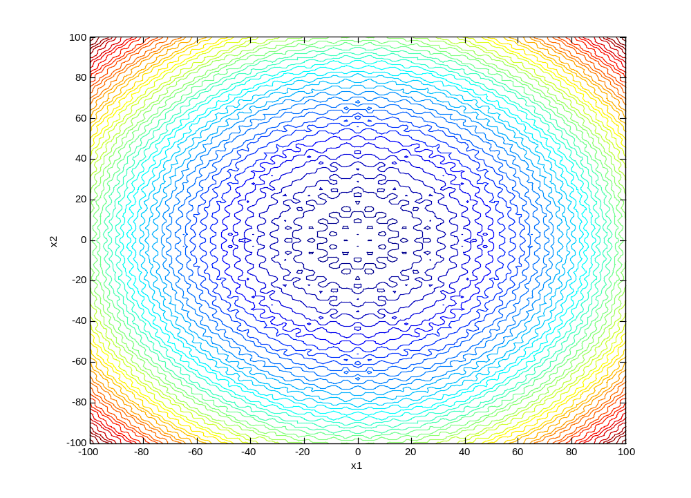
Changing Boundary Condition

Slide 8
Changing Boundary Condition
Fixed maximum so relative position of global minimum moves further away from center of design space
Progressively lowering the minimum boundary value results in less accurate calculations of the mean objective function
Total number of iterations required is slightly smaller for larger design space
Fixed Iteration
Minimum | Mean | StdDev | Best | Worst
-50 | 3.3840E-02 | 7.3245E-02 | 2.8242E-09 | 1.9544E-01
-100 | 1.5034E-01 | 1.3446E-01 | 1.8554E-08 | 5.3648E-01
-150 | 2.3097E-01 | 1.4881E-01 | 1.0387E-07 | 5.2712E-01
-200 | 3.0230E-01 | 1.8681E-01 | 6.9340E-07 | 8.0983E-01
Convergence Criterion
Minimum | Mean | StdDev | Best | Worst | Iterations
-50 | 2.9124E-03 | 2.0594E-02 | 0.0000E+00 | 1.4562E-01 | 123.0
-100 | 5.8247E-03 | 2.8825E-02 | 0.0000E+00 | 1.4562E-01 | 121.3
-150 | 1.4562E-02 | 4.4129E-02 | 0.0000E+00 | 1.4562E-01 | 117.5
-200 | 1.4562E-02 | 4.4129E-02 | 0.0000E+00 | 1.4562E-01 | 117.2

