Slide 1
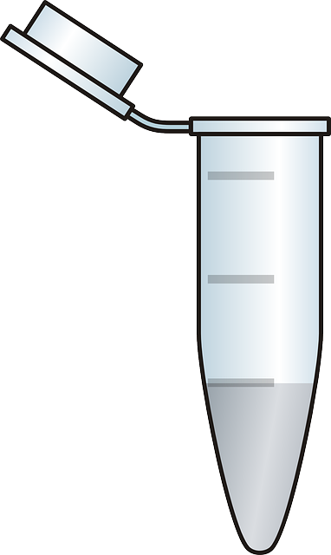

Check biological constraints
Fountain
code
Droplet
Convert to
hexadecimal
08df35...
AACGGTC…
DNA
synthesis
DNA pool
Map hex to DNA nts
Mapping scheme
0 → AAC, GAC, 1→ AAG, GAG…..
Fountain
code
Accept/reject
Check error
08df35...
AACGGTC…
DNA
sequencing
Error Introduced
Sequencing

