Slide 1
Micropython
Sensemakers Amsterdam
November 2019

Slide 2
History
Python
Interpreted procedural and object-oriented language.
Guido van Rossum (Sara, CWI, US)
First release 1991. Last released version 3.8, October 2019.
In 2019 #3 most popular language, below Java and C but above C++.
Micropython
Python 3.5-ish, re-implemented in C for microcontrollers.
Damien George (Cambridge)
First release May 2014. Last release 1.11, May 2919
Kickstarter campaign introducing the PyBoard.

Slide 3
Micropython.org
Kickstarter campaign introducing the Pyboard line (STM32)
Micropython open sourced on Github:
micropython/micropython
micropython/micropython-lib
Ported to:
STM32, CC3200, ESP8266, ESP32, Teensy, nRF, PIC-16, PowerPC, ARM, SAMD
Zephyr
Javascript, Linux, Windows

Slide 4
CircuitPython
Clone of Micropython, maintained by Adafruit
Supports only SAMD21, SAMD51 and nRF52840 (Adafruit stuff)
Tracks Micropython releases
Changes to Micropython:
User Interface
Boot order/behavior
Hardware IO API model
https://github.com/adafruit/circuitpython/blob/master/README.rst

Slide 5
Code – bare Micropython
Interpreter
pyc-compiler
bin – load module
File System
RAM
Flash

Slide 6
Code – add a built-in library
Interpreter
neopixel.pyc
neopixel_write
pyc compiler
pyc-cross compiler
c-compiler
PC: neopixel.pc
PC: neopixel_write.c
bin – load module
File System
RAM
Flash

Slide 7
Code – flash to module
Interpreter
neopixel.pyc
neopixel_write
pyc-compiler
bin – load module
File System
RAM
Flash

Slide 8
Code - Code – add your application
Interpreter
neopixel.pyc
neopixel_write
pyc-compiler
boot.py
main.py
bin – load module
RAM
Flash
File System

Slide 9
Code –start
Interpreter
boot.pyc
main.pyc
neopixel.pyc
neopixel_write
py-compiler
boot.py
main.py
not_used.py
bin – load module
RAM
Flash
File System

Slide 10
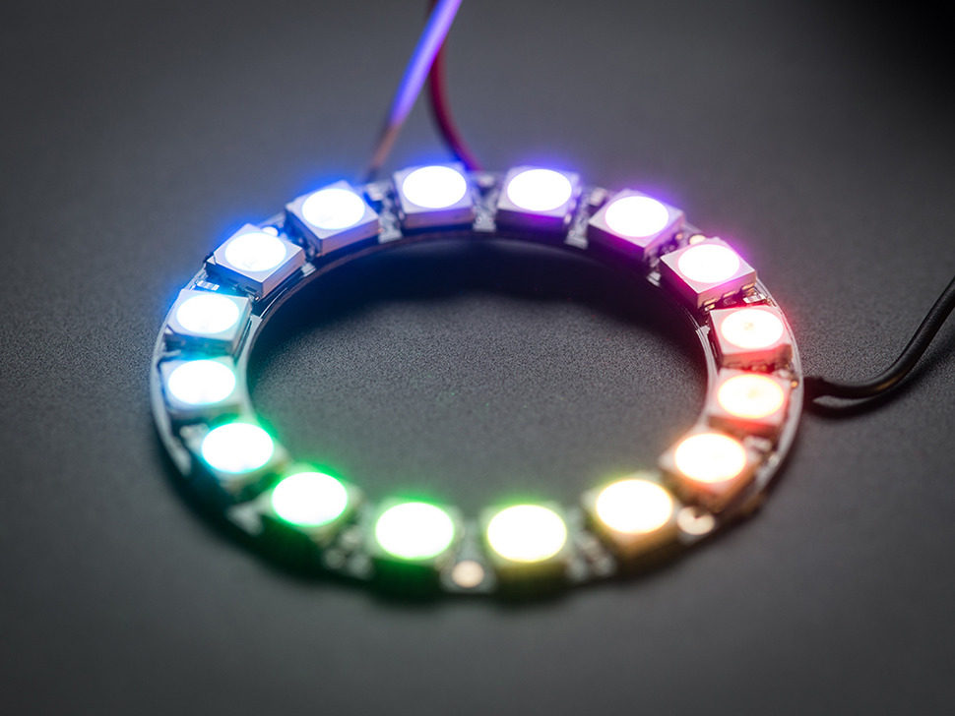
Code – add your code and start
Interpreter
1- boot.pyc
2- main.pyc
3- neopixel.pyc
4- neopixel_write
py-compiler
boot.py
main.py
not_used.py
bin – load module
RAM
Flash
File System

Slide 11
Out of the box for ESP
ESP deep sleep
ESP WiFi and sockets
Pins (digital and analog), PWM, pulse
1-wire, ds18x20
Neopixel, APA102
DHTxx
I2C, SPI
RTC, Timers, Delay
Touch (ESP32)

Slide 12
Python or C?
C-code is linked into interpreter -> full build / flash required -> slow workflow
Py code is in the file system -> compiled on the fly -> fast workflow
Hence, only use C if required for timing and Python for all else.
Run Python code from file system. Optionally add to pre-compiled module if stable, general purpose.
In 8 months use no C-code required (one change in the pipe)
Tons of library code implemented in Python (I2C based mostly)

Slide 13

ESP architecture
RTOS + Espressif OS
WiFi
UART
USB-Chip
PC

Slide 14
ESP architecture – SMA Demo board
RTOS + Espressif OS
WiFi
UART
I2C
USB-Chip
Display
PC
DHT11

Slide 15
SMA Demo board + Arduino
Display Library
DHT11 Library
…..
Your sketch:
setup()
loop()
IDE compiles, links, uploads this on every cycle.
Arduino Abstraction Layer ESP8266
pin() , delay(), …, esp_stuff()
RTOS + Espressif OS
WiFi
UART
I2C
USB-Chip
Display
PC
DHT11

Slide 16
SMA Demo board + Micropython
Flash file system with more Python library modules and Python application code in main.py
File manager updates changed files only.
Micropython, DHT11 module, pin(), …
(web - REPL direct access)
Occasional toolchain compile, link, upload at version upgrade, bug fix, …
RTOS + Espressif OS
WiFi
UART
I2C
USB-Chip
PC
rshell - file manager and terminal
Display
DHT11

Slide 17
Start-up sequence
Hard boot:
ESP RTOS boots and inits
IO ports in default state
possibly connecting to WiFi
ESP RTOS starts MicroPython task
Soft boot:
MicroPython initializes
MicroPython runs boot.py
MicroPython runs main.py (which may never exit)
MicroPython idles waiting for (web)repl connection

Slide 18
Terminal
MicroPython
Reserves UART-0 (or soft UART on USB, not for ESP) for console on 115200 bps
Built in Python REPL (Read Evaluate Print Loop)
Also a WebREPL on a websocket (optional, but enabled in Sensemakers set-up)
Connect via rshell, putty, uPyCraft, …
If MP is not idle (main.pu running), abort with ^c
rshell and uPyCraft are MP-aware and will abort for you

Slide 19
Rshell
pip(3) install rshell
Find out port/dev for your MP serial connection
rshell –p <whatever>
Aborts running program
Syncs MP clock time on your board
Get a directory listing for the files on your board
Goes into command mode

Slide 20
Rshell 2
Commands: ls, cp, rsync, cat, edit, repl, …
Default is current directory.
Files on your board are in /pyboard
File to board: cp whatever.py /pyboard
File from board: cp /pyboard/credentials.py mylocaldir/credentials.py
Changed files from local dir to board: rsync mylocaldir /pyboard
Enter repl: repl
Exit: exit or ^d

Slide 21
In repl
TAB auto completion
^x exit the repl (remember! Only alternative is a hard-reset)
^c abort running statement
^e enter paste mode
^d leave paste mode or start soft-boot
Up/Down access command history
^r execute command

Slide 22
In repl
If a command produces a result in repl, the result will be printed automatically.
Try:
dir()
uos.listdir('')
In a program you would need to use:
print(uos.listdir(''))

Slide 23
Connecting to the world
http://docs.micropython.org/en/latest/
http://docs.micropython.org/en/latest/esp8266/quickref.html
Pins
I2C
DHT
Neopixel
…

Slide 24
Pin
from machine import Pin
pin_obj = Pin( <nr> [,<direction>], [,<mode] )
Examples:
p2 = Pin(2, Pin.IN, Pin.PULL_UP) # create input pin on GPIO2 with pull_up
print(p2.value()) # get value, 0 or 1
p5 = Pin(5, Pin.OUT, value=1) # set pin high on creation
P5.value(0) # and then set it low

Slide 25
I2C
from machine import Pin, I2C
i2c = I2C(scl=Pin(<sclpin>), sda=Pin(<sdapin>) [, freq=<freq>])
Examples:
i2c = I2C( scl=Pin(5), sda=Pin(4), freq=100000 )
i2c.writeto(0x3a, '12’) # write '12' to slave device with address 0x3a
buf = i2c.readfrom(0x3a, 4) # and then read 4 bytes response

Slide 26
Neopixel
import neopixel as np
x = np.NeoPixel(Pin(5), 30)
x[0] = (10,0,0)
x.write()

Slide 27
DHT
Out of time. See during the course

