Slide 1

Exploring Access to Healthcare in the U.S. on an interactive dashboard.
Ghita Moummi
DATA606_Capstone
FALL2020

Slide 2

Agenda
Why is this important?
Similar Project
How is this project different?
Planning and implementing the project
The dataset
Next steps

Slide 3

Why is this important?
There is a large inequity in health care distribution across the US. These iniquities result in an inequity in illness distribution (Meyer et. Al., 2013)
Visualizing access to healthcare and distribution of disease in the U.S. can help policy makers know where we should invest more money and on which conditions.
Notes:
Using preventive health services can substantially reduce morbidity and mortality in the U.S.. Therefore, continuous monitoring of preventive services use and chronic diseases is essential to the development of health promotion strategies, intervention programs, and health policies at the state, city, and county level (Chowdhury et. Al., 2012).

Slide 4
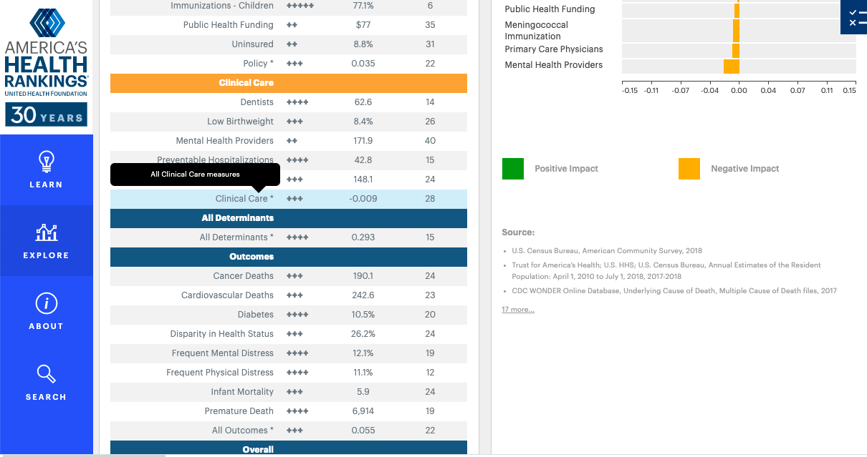
Similar Projects
America’s health rankings dashboard:
shows how the United States is doing as a whole in different aspects (behavior, healthcare access, outcomes, chronic diseases, education…etc.)
shows how each state is doing for the same aspects and its ranking compared to the other states.
The table screenshot on the right shows an example for Virginia.
Source: https://www.americashealthrankings.org/explore/annual/measure/PCP/state/ALL

Slide 5
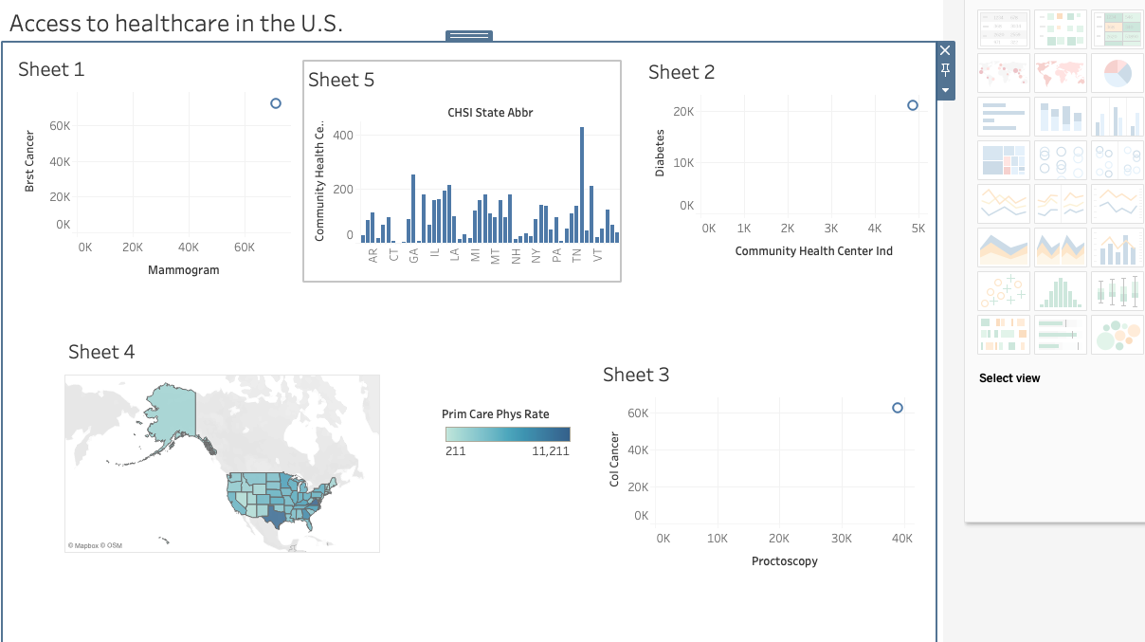
How is this project different?
The distribution of healthcare and disease across all counties of each state
Focus on healthcare &disease distribution
The distribution of healthcare and disease across all states
Rank of diseases in each state and county (most urgent to least urgent)

Slide 6
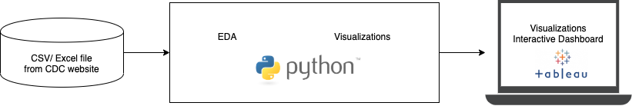
Planning and implementing the project (Data Flow& Architecture Diagram)

Slide 7

The dataset
CHSI dataset source:
https://ftp.cdc.gov/pub/Health_Statistics/NCHS/Datasets/CHDI/chsi_dataset.zip
It is a zip file containing many datasets. Datasets used:
Demographics: 44 columns; 3141 rows
Risk factors and access to healthcare: 31 columns; 3141 rows
Preventive service use: 43 columns; 3141 rows
Measures of birth and death: 141 columns; 3141 rows
After merging the datasets, and selecting the needed columns, we have: 34 columns, and 3141 rows

Slide 8

Next steps.. Exploratory Data Analysis(EDA)
The EDA will explore the following:
The correlation between preventive health services and disease
The correlation between number of primary care practioners (PCPs) and chronic/other diseases
The correlation between chronic diseases and number of deaths /life expectancy
Other…

Slide 9
References
Chowdhury, P. P., Mawokomatanda, T., Fang Xu, Gamble, S., Flegel, D., Pierannunzi, C., Garvin, W., & Town, M. (2016). Surveillance for Certain Health Behaviors, Chronic Diseases, and Conditions, Access to Health Care, and Use of Preventive Health Services Among States and Selected Local Areas -- Behavioral Risk Factor Surveillance System, United States, 2012. MMWR Surveillance Summaries, 65(4), 1–139. https://doi-org.proxy-bc.researchport.umd.edu/10.15585/mmwr.ss6504a1
Gamble, S., Mawokomatanda, T., Fang Xu, Chowdhury, P. P., Pierannunzi, C., Flegel, D., Garvin, W., & Town, M. (2017). Surveillance for Certain Health Behaviors and Conditions Among States and Selected Local Areas -- Behavioral Risk Factor Surveillance System, United States, 2013 and 2014. MMWR Surveillance Summaries, 66(16), 1–139. https://doi-org.proxy-bc.researchport.umd.edu/10.15585/mmwr.ss6616a1
Meyer, S. B., Luong, T. C., Mamerow, L., & Ward, P. R. (2013). Inequities in access to healthcare: analysis of national survey data across six Asia-Pacific countries. BMC Health Services Research, 13(1), 238–250. https://doi-org.proxy-bc.researchport.umd.edu/10.1186/1472-6963-13-238
https://skagitcounty.blog/tag/inequity/
https://telelanguage.com/language-access-healthcare-open-enrollment-infographic/
https://unsplash.com/s/photos/

Slide 10
Thank you!
Questions?
gmoummi1@umbc.edu
https://github.com/gmoummi/Capstone_Project/tree/master

