Slide 1

Exploring Access to Healthcare in the U.S. on an interactive dashboard.
Ghita Moummi
DATA606_Capstone
FALL2020

Slide 2

Agenda
Brief topic & dataset overview
Exploratory Data Analysis – Cleaning & Transformations
Exploratory Data Analysis- Visualization
Machine Learning Model Used
Initial results interpretation
Next steps

Slide 3
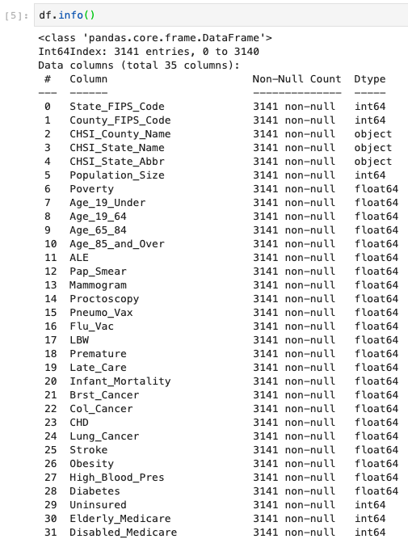
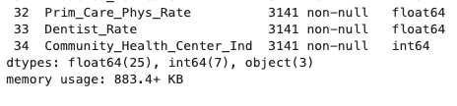
Topic & Dataset Overview
Visualize access to healthcare and distribution of disease in the U.S. to determine which states and which counties need the most intervention, and on what illnesses.
Notes:
This project aims to do descriptive analysis. We are answering the question: “What happened in the healthcare field?” so we can know where and how we should intervene in US states and counties.

Slide 4
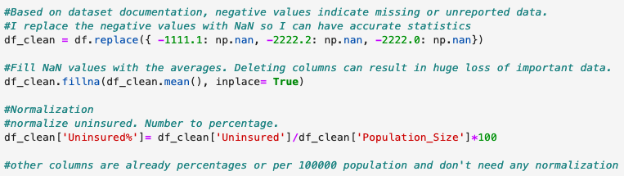
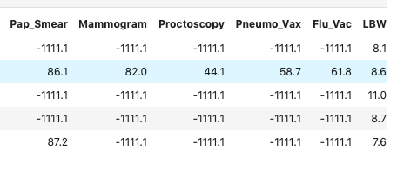
Exploratory Data Analysis- Cleaning & Transformations
Replace Negative values (-1111.1, -2222.2 )with NaN
Filling NaN with the mean (Deleting rows can result in huge loss of important data).
Normalize the data.

Slide 5
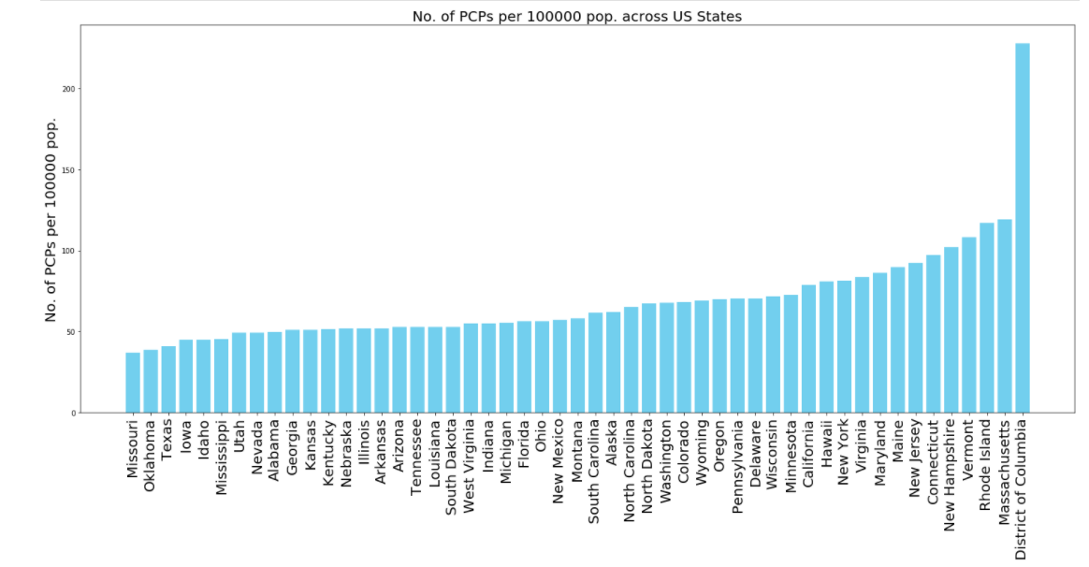
Exploratory Data Analysis- Visualization
States with lowest Number of PCPs per 100000 pop:
Missouri
Oklahoma
Texas
Iowa
Idaho
States with the highest Number of PCPs per 100000 pop:
District of Colombia
Massachusetts
Vermont
New Hampshire
Connecticut

Slide 6
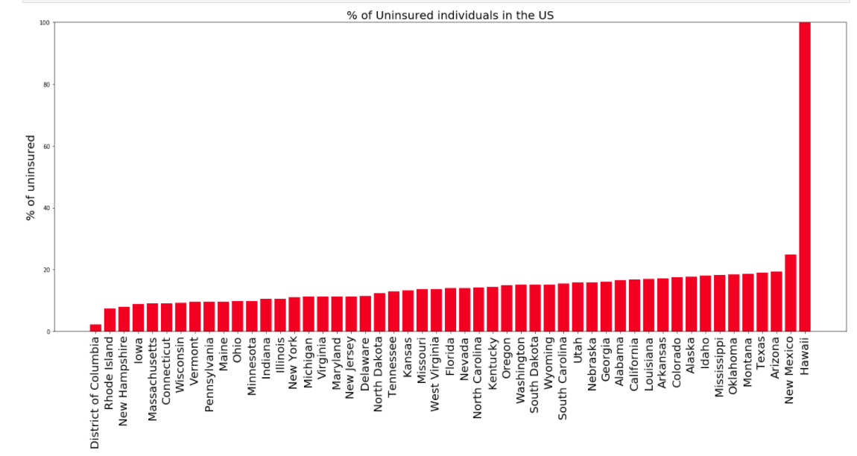
Exploratory Data Analysis- Visualization (cont.)
States with lowest % of of uninsured:
District of Colombia
Rhode Island
New Hampshire
Iowa
Massachusetts
States with the highest % of uninsured:
Hawaii
New Mexico
Arizona
Texas
Montana

Slide 7
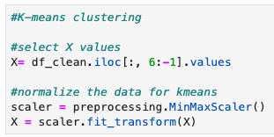
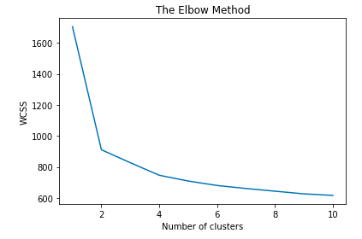
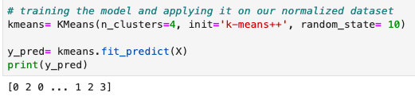
ML Model used: K-means Clustering
Why did we use it? Unsupervised ML (no labels provided)
How do we choose the correct number of clusters? The elbow method

Slide 8
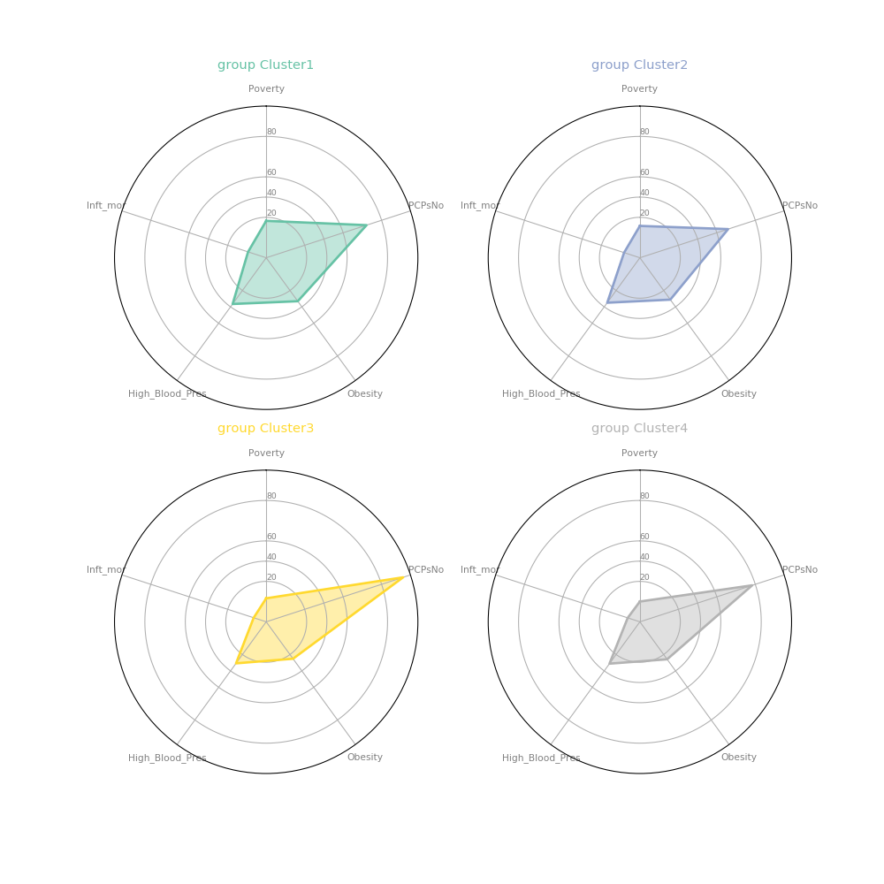
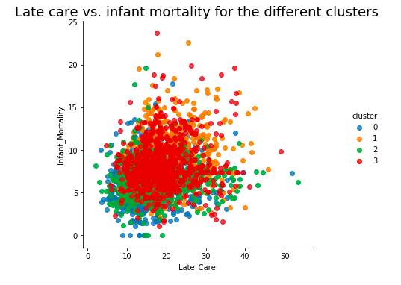
Initial Results Interpretation
Radar chart that shows the difference in features among the clusters
Notes:
Main source for building the radar chart: https://python-graph-gallery.com/392-use-faceting-for-radar-chart/

Slide 9
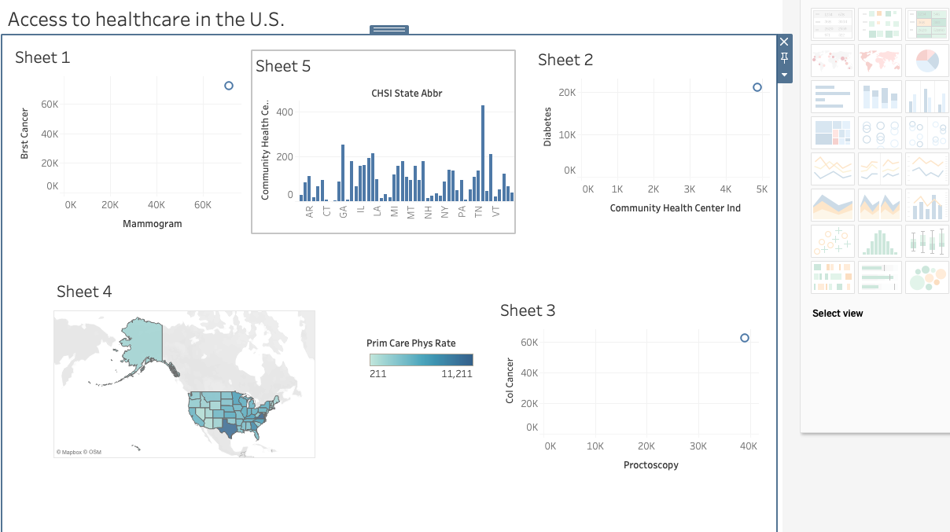
Next step.. Building the Dashboard

Slide 10
References
Chowdhury, P. P., Mawokomatanda, T., Fang Xu, Gamble, S., Flegel, D., Pierannunzi, C., Garvin, W., & Town, M. (2016). Surveillance for Certain Health Behaviors, Chronic Diseases, and Conditions, Access to Health Care, and Use of Preventive Health Services Among States and Selected Local Areas -- Behavioral Risk Factor Surveillance System, United States, 2012. MMWR Surveillance Summaries, 65(4), 1–139. https://doi-org.proxy-bc.researchport.umd.edu/10.15585/mmwr.ss6504a1
Gamble, S., Mawokomatanda, T., Fang Xu, Chowdhury, P. P., Pierannunzi, C., Flegel, D., Garvin, W., & Town, M. (2017). Surveillance for Certain Health Behaviors and Conditions Among States and Selected Local Areas -- Behavioral Risk Factor Surveillance System, United States, 2013 and 2014. MMWR Surveillance Summaries, 66(16), 1–139. https://doi-org.proxy-bc.researchport.umd.edu/10.15585/mmwr.ss6616a1
Meyer, S. B., Luong, T. C., Mamerow, L., & Ward, P. R. (2013). Inequities in access to healthcare: analysis of national survey data across six Asia-Pacific countries. BMC Health Services Research, 13(1), 238–250. https://doi-org.proxy-bc.researchport.umd.edu/10.1186/1472-6963-13-238
https://python-graph-gallery.com/392-use-faceting-for-radar-chart/
https://skagitcounty.blog/tag/inequity/
https://telelanguage.com/language-access-healthcare-open-enrollment-infographic/
https://unsplash.com/s/photos/
https://www.yumpu.com/en/document/read/36342808/data-sources-definitions-and-notes-centers-for-disease-control-

Slide 11
Thank you!
Questions?
gmoummi1@umbc.edu
https://github.com/gmoummi/Capstone_Project/tree/master

