Slide 1

G2M insight for Cab Investment firm
Company: XYZ
Date: 9 August 2021

Slide 2
Contents
Problem description
The Data
Exploratory Data Analysis
Hypothesis Testing
Model Design
Conclusions

Slide 3
Problem Description
XYZ is a private equity firm in US. Due to remarkable growth in the Cab Industry in the last few years and multiple key players in the market, it’s planning to invest in the Cab Industry
We are going to provide actionable insight to help XYZ firm in identifying the right company for investing
Cab Companies
Yellow Cab
Pink Cab
Includes:
Data visualization
Multiple hypothesis tests

Slide 4
The Data
We have 4 datasets
Cab_data.csv – this file contains details of transactions for the 2 companies
Customer_id.csv – this file contains a unique identification number that is linked with the customer’s information
Transaction_id.csv – this is a table that maps each transaction with the customer’s information and payment mode
City.csv – this file contains the list of US cities, their population and the number of cab users

Slide 5
EXPLORATORY DATA ANALYSIS

Slide 6
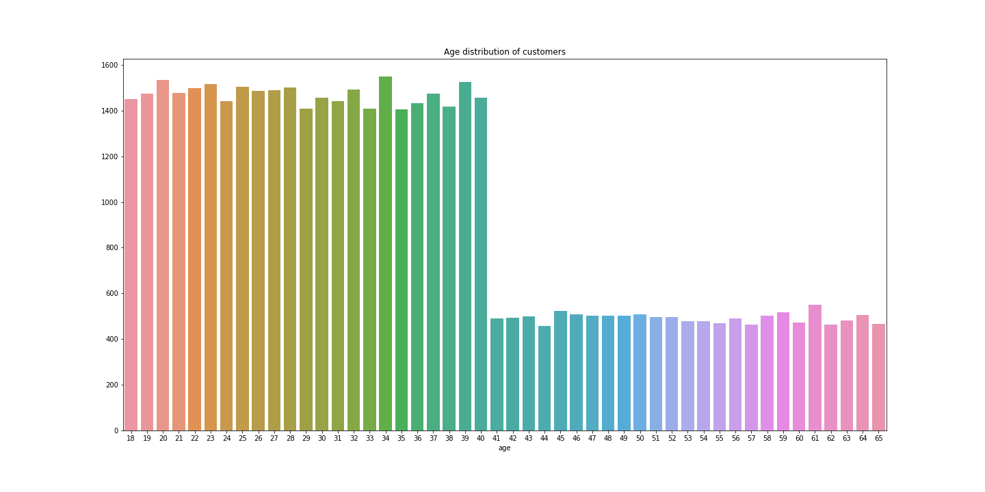
Age Distribution
73% of users are ≤ 40 years old

Slide 7
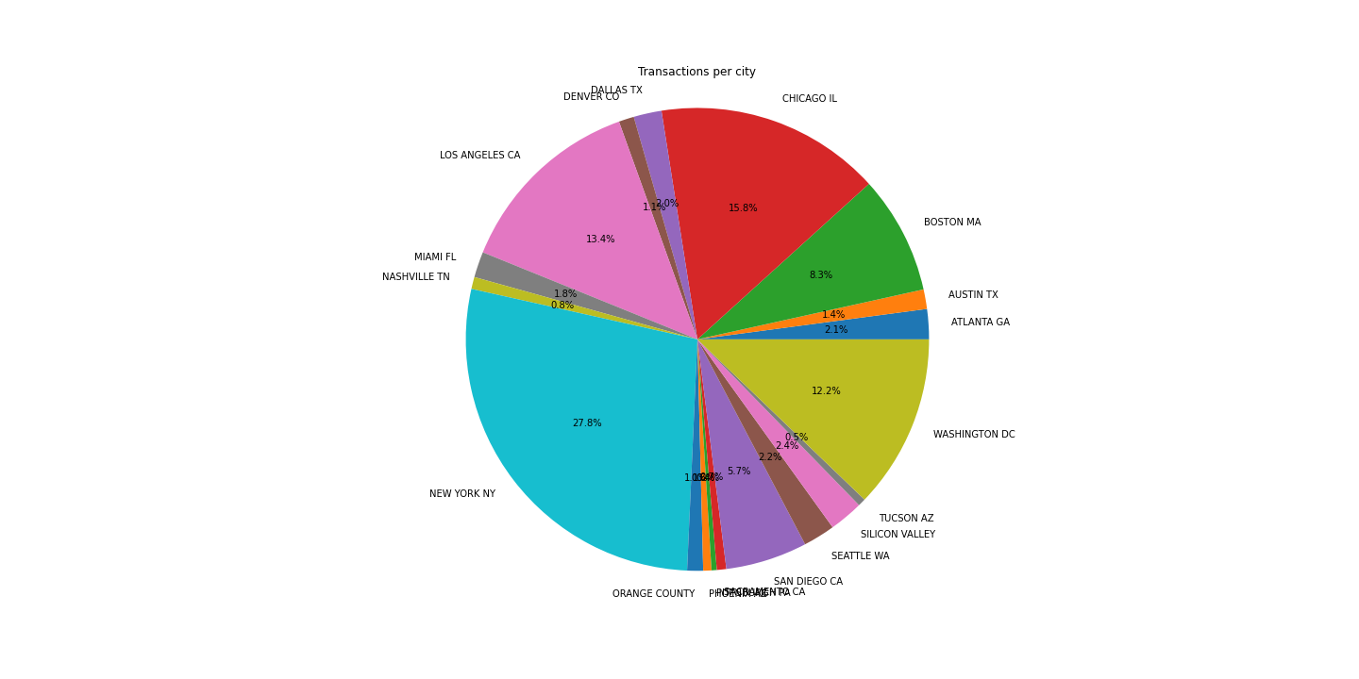
Cab users per City
New York City, Chicago and Los Angles have the highest number of cab users

Slide 8
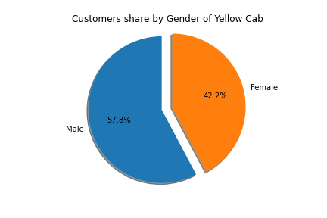
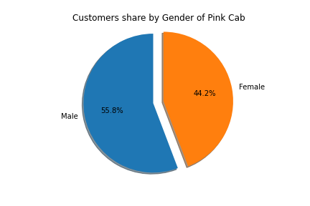
Gender share
Pink cab has a higher number of female customers

Slide 9
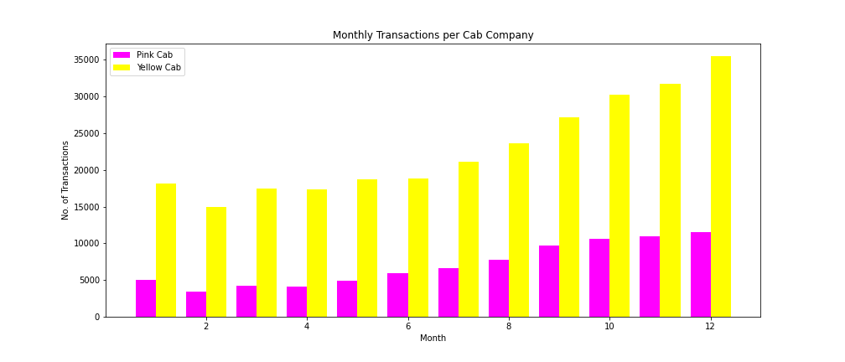
Monthly Transactions for both Cabs
From the graph we can see that Yellow Cab has a higher number of transactions monthly

Slide 10
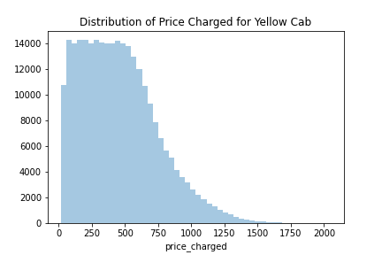
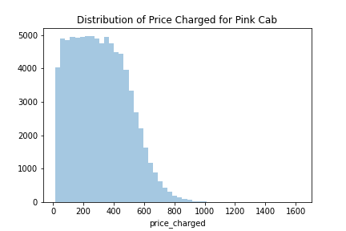
Distribution of Prices Charged
On average Yellow Cab has higher prices due to some outliers
Yellow Cab has more than 15 thousand transactions charged more than 1000 USD

Slide 11
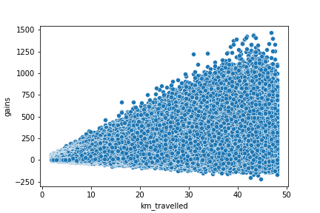
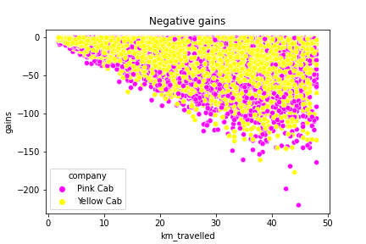
Gains for the drivers based on KMs
Gains rise proportionally based on the distance travelled
Though around 11% of some cab rides their drivers don’t necessarily gain profit from them

Slide 12
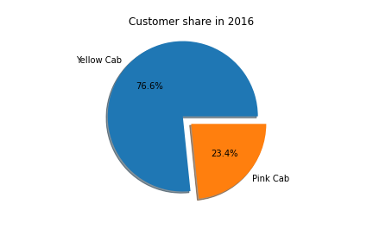


Customer share
Pink cab very slowly gains more customers through the years

Slide 13
Hypothesis Testing

Slide 14
What is hypothesis testing?
Hypothesis testing is used to assess the plausibility of a hypothesis by using sample data.
We use a random population sample to test two different hypotheses: the null hypothesis and the alternative hypothesis.
Null hypothesis: rejects our initial hypothesis that there is a relation between the data and causes altercations
Alternative hypothesis: accepts our initial hypothesis regarding the relationship that we are trying to find in the data

Slide 15
T-Test
A t-test is a type of hypothesis test used to determine if there is a significant difference between the means of two groups.
Determine if the mean values came from the same population.

Slide 16
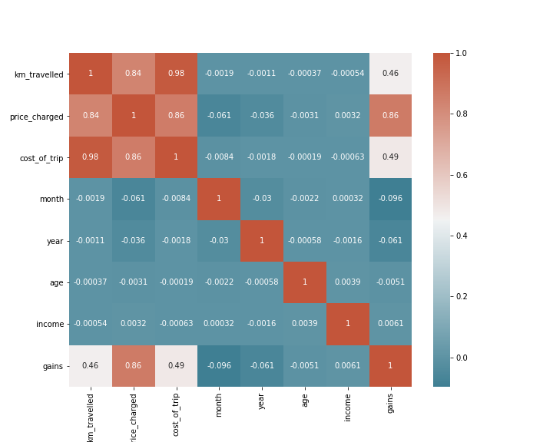
Correlation
Statistically km_travelled is directly related with price_charged, cost_of_trip and gains
The rest of the attributes do not contribute at all

Slide 17
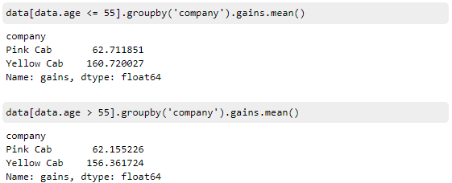

Gains based on age groups
A quick glance suggests that there is a difference for Yellow Cab
And our hypothesis tests proves us that there is
We could assume that Yellow Cab offers discounts to the elderly
Pink cab
Yellow cab

Slide 18
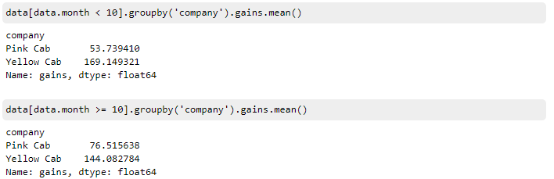
Gains based on Holiday period
The graph shows a large number of transactions during the holiday season (after the month of October)
A quick glance suggests that there is a difference for both Cab companies in their earnings

Slide 19
Gains based on Holiday period
And our hypothesis tests proves us that there is a difference for both companies
Pink cab
We could assume that:
Yellow Cab offers discounts during the holiday season
Pink Cab drivers slightly raise their prices for profit
Yellow cab

Slide 20
Gains based on age groups
A quick glance suggests that there is a difference for Yellow Cab
And our hypothesis tests proves us that there is
We could assume that Yellow Cab offers discounts to the elderly
Pink cab
Yellow cab

Slide 21
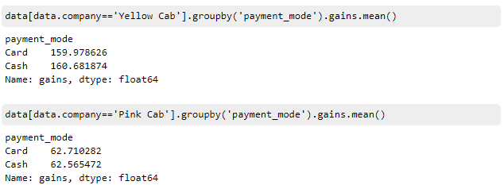

Gains based on Payment methods
A quick glance shows no major difference
And our hypothesis tests proves us that we are correct
Pink cab
Yellow cab

Slide 22
Model Design

Slide 23
Linear Regression
With Linear Regression we test 2 things
To see how closely related are two or more variables
If we know how closely related are these variables we can make predictions
In our dataset we have all those variables that relate to Price Charged and define its final value

Slide 24
Linear Support Vector Regression
What’s the main difference between SVR and a simple regression model?
In simple regression we try to minimize the error rate. While in SVR we try to fit the error within a certain threshold.
SVR gives us the flexibility to define how much error is acceptable in our model and will find an appropriate line (or hyperplane in higher dimensions) to fit the data.

Slide 25
Decision Tree & Random Forest
Decision Tree is one of the most commonly used, practical approaches for supervised learning.
It can be used to solve both Regression and Classification.
The Root Node is the initial node that represents a sample
Random Forest is a construction of multiple Decision Trees
The final predictor is the average of all the Decision Trees

Slide 26
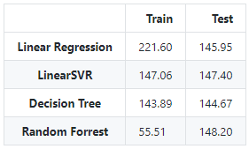
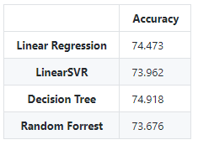
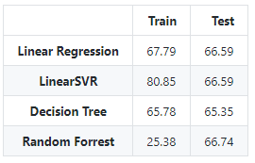
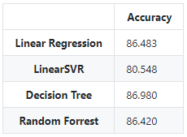
Tests and Scores
We used Root Mean Square Error which is calculated after the difference of Predicted value – Actual value
The lower the error the better the model performs
RSME & Accuracy for Yellow
RSME & Accuracy for Pink
From the results we could assume that using a simple Linear Regression model would fit our job perfectly
For even better results one can try to take the best attributes of each model and create a final ensemble model

Slide 27
Conclusions
Monthly transactions are for Yellow Cab are almost triple than those of Pink Cab
Holiday season attracts a lot of users and Yellow Cab rewards them with discounts
Elderly people are rewarded with discounts for using Yellow Cab
Yellow Cab has the highest presence with cab users in New York with 28%
Based on the above Yellow Cab is a suitable choice for investment.

Slide 28
Thank You
For your attendance

