Slide 1
The Gallery Problem
camera
How many cameras are needed to watch a gallery and
where should they be placed?
Notes:
You have won even more money and investing in art in a big way. How do you protect it as cheaply as possible?

Slide 2
Simple Polygonal Galleries
Regions with holes are not allowed and no self intersections
convex polygon
one camera is enough
an arbitrary n-gon (n corners)
? cameras might be needed

Slide 3
A Polygonal Gallery
.
n= 19 vertices

Slide 4
Triangulation
To make things easier, we decompose a polygon into pieces that only
need one guard
Guard the gallery
by placing a camera in
every triangle
Join pairs of corners by non-intersecting
lines that lie inside the polygon with 19 sides

Slide 5
3-Colouring the Gallery
Assign each corner a colour:
pink, green, or yellow.
Any two corners connected by
an edge or a diagonal must have
different colours.
Thus the vertices of every triangle
will be in three different colors.
A 3-colouring is always possible. Put cameras at corners of same colour
Pick the smallest of the coloured corner groupings to locate the cameras.
You will need at most [n/3] = [19/3] = [6.33] = 6 cameras (yellow or pink).

Slide 6
The Chvátal Theorem
For a simple polygonal Gallery with n corners,
[n/3] cameras are sufficient and sometimes necessary
for every interior point to be seen by at least
one camera.
For n = 100, n/3 = 33.33 and [n/3] = 33
[x] is the integer part of x
Note that [n/3] cameras may not always be necessary
Notes:
First proof of Theorem published in 1975 by Vasek Chvatal. (pronounced ‘xvaːtal]) He is at Concordia Univ Montreal Computer Sci Dept. Fled Czech in 1968 3 days after soviet invasion

Slide 7
The Worst Case Scenario
[n/3] V-shaped rooms
A camera can never be positioned
so as to watch over two Vs
The maximum of [n/3] cameras are required

Slide 8
Simple Concepts Introduced
A number of simple concepts are appearing:
straight lines for lines of sight, 360 degree look around
Polygons
Convexity
Triangulation (and later quadralaterisation)
3 colouring
Idea of functions like [..]
Necessary and sufficient conditions
Exploring what the bad cases look like
Visualisation
generalising

Slide 9
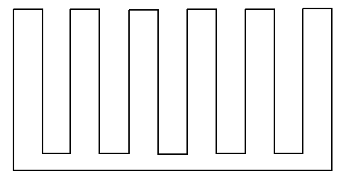
Orthogonal Galleries
All corners are right angles
Only [n/4] cameras are needed, and are always sufficient
n = 100 needs only 25 guards now

Slide 10
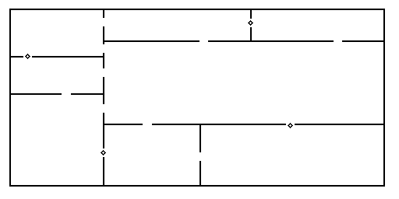
Rectangular Rooms
All adjacent rooms have connecting archways
8 rooms
and 4 cameras
in the arches
Rectangular Gallery with r rooms,
⎡r/2⎤ cameras are needed to watch the Gallery
Next integer bigger than r/2

Slide 11
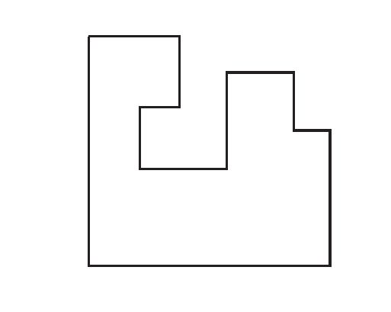
Orthogonal Galleries

Slide 12
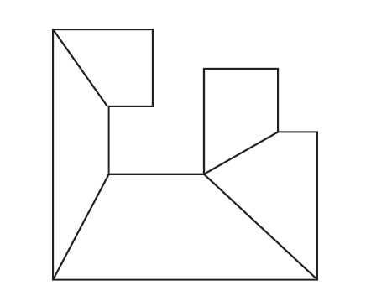
Convex Quadrilateralisation

Slide 13
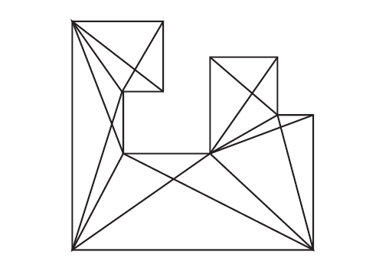
2. Add diagonals

Slide 14
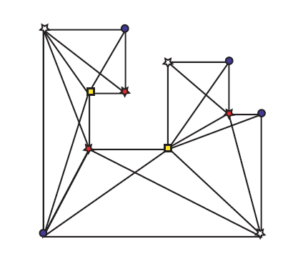
3. Colour with 4 colours:
no adjacent points of same colour

Slide 15
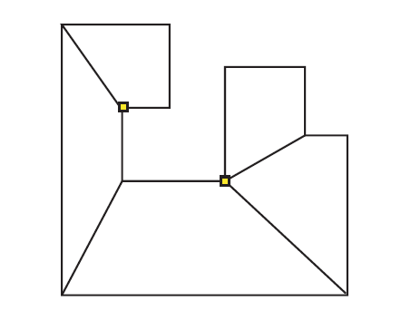
4. Choose smallest colour set
n = 12 so [n/4] = 3 > 2

Slide 16
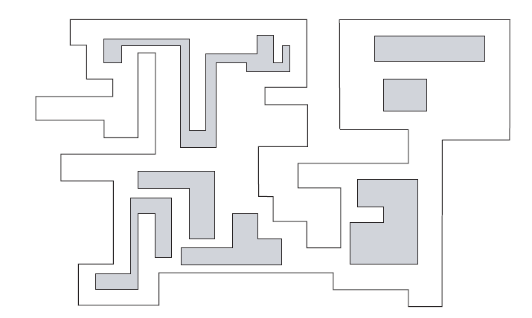
Galleries with opaque holes
n vertices and h holes

Slide 17
An awkward case
[(3n+4+4h)/16]
mobile guards
required
n = 20 h = 4 needs
80/16 = 5 guards

Slide 18
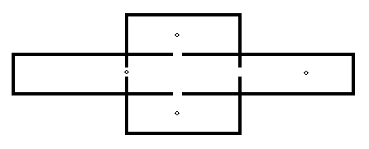
An orthogonal gallery divided into rectangular rooms
More than [n/2] guards may be needed. Take a central rectangular room with a
similar room on each side. One guard can watch the central room and one other.
But no two side rooms share a common wall so each need an extra guard.
So, five rooms require four guards.
For a gallery with c corners and h holes that is divided into r rectangular
rooms, we may need
[(2r +c - 2h - 4) / 4] guards
Here: c = 20, h = 4, r = 5 so [18/4] = [9/2] = 4

Slide 19
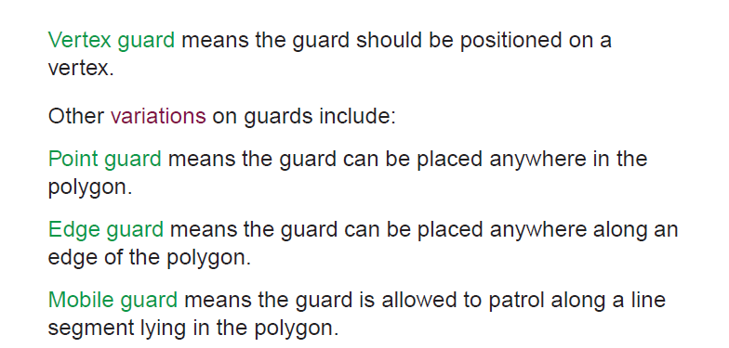
Different types of guard

Slide 20
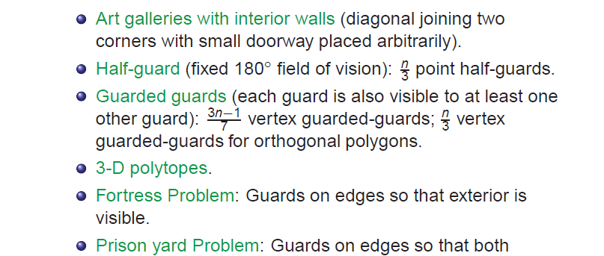
Some more variations

Slide 21
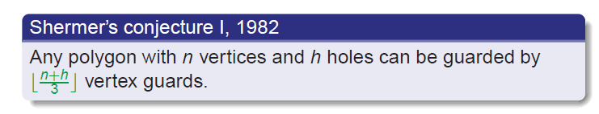
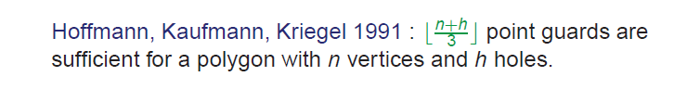
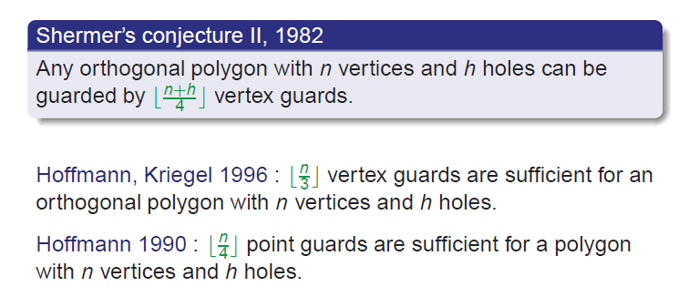
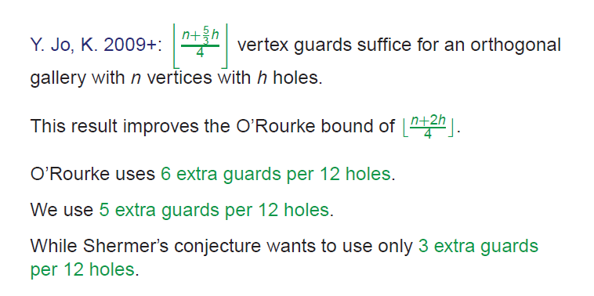

Slide 22
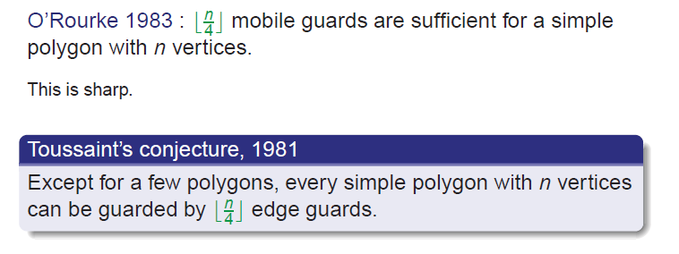
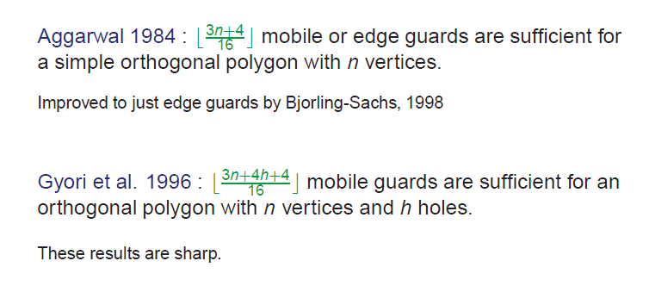
Edge and Mobile Guards

Slide 23
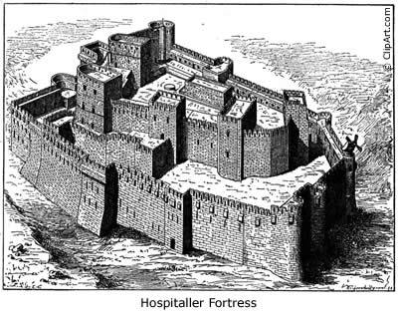
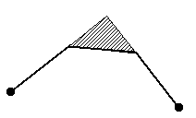
The Fortress Problem
⎡n/2⎤ corner guards are always necessary and sufficient to guard the exterior of a polygonal fortress with n walls
n = 4 example
⎡4/2⎤ = 2
⎡x⎤ is smallest integer ≥ x
So ⎡π⎤ = 4 and ⎡2⎤ = 2

Slide 24
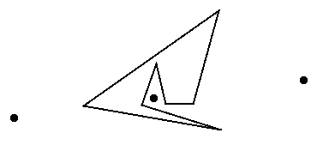
n/2 ⎤ corner guards or ⎡n/3⎤ point guards (ie located anywhere) are
always sufficient and sometimes necessary to guard the polygonal
exterior of a fortress with n corners
n = 7 needs ⎡ 7/3 ⎤ = 3 point guards
and 4 corner guards

Slide 25
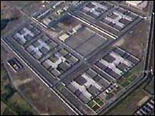
Prisoner Cell H Block Problem
4
1
For orthogonal fortresses with n
Corners: 1 + ⎡n/4⎤ corner guards are
necessary and sufficient
2
3
12-sided H block will need 1 + 3 = 4
Notes:
The Maze (Long Kesh) closed 2000 dismantled from 2006 onwards

Slide 26
Other possibilites
Reflecting walls (mirrors)
Curved walls
How many walls are being doubly (or triply watched)?
Spotlight coverage of a stage from above
Using the several possible 3 colourings to have
guards watching guards or doubling the security

Slide 27
Refs
A useful and easy to follow review article (2004) is
‘Art Gallery and Illumination Problems’
Jorge Urrutia
Online at
> > http://www.matem.unam.mx/urrutia/ArtBook.html/Completo.pdf
A more recent one (2007) is the ppt lecture by H Kaul at
www.math.iit.edu/~kaul/talks/LongArtGalleryTalk.pdf‎

