Slide 1
Trimming Short Sequencing Reads
Eddy Yeh
Schnable Laboratory
30 April 2014

Slide 2
Short Reads Trimming
Short reads trimming was implemented to facilitate the removal of low quality nucleotides produced by pyrosequencing technologies
Removing low quality reads can produce better alignment results
The script “trim_fastq.pl” allows:
Reading any FASTQ variant file (fastq-sanger, fastq-solexa, and fastq-illumina) and automatically converts the quality values adjusted accordingly
Writing trimmed reads in any FASTQ variant or standard FASTA/QUAL file formats
Enables/Disables trimming of low quality bases at the ends (phase 1) and/or at the middle of the reads (phase 2) respectively
Multi-threading support coming soon (next version)
The trimming of the reads is performed in 2 phases (see next slide)

Slide 3
Short Reads Trimming – Phase #1
(1) Trim low quality nucleotides from the beginning and end of the sequence read if they are below the “end quality” (-eq) threshold (default: 15) – Default was increased to Q20 (≤1% error rate) in 2014
Red Bars: Low quality nucleotides to be removed by trimming phase 1
Gray Bars: Nucleotides that remain after phase 1
Scan from right to left to determine the first nucleotide
whose quality value is above
threshold
(default: 15)
Scan from left to right to determine the first nucleotide
whose quality value is above
threshold
(default: 15)
Remaining 61 Nucleotides in the middle will be scanned
during the second phase of trimming
9 low quality
nucleotides
(Remove)
6 low quality
nucleotides
(Remove)

Slide 4
Short Reads Trimming – Phase #2
(2) Slide across the read with windows (default: 10 bp) to determine the first window with average quality below “internal quality” threshold (default: 15). Trim the sequence starting from the window and beyond.
Red Bars: Low quality nucleotides to be removed by trimming phase 1
Blue Bars: Low quality nucleotides to be removed by trimming phase 2
Gray Bars: Nucleotides that remain after trimming
Windows with average
quality >= threshold
Window with average
quality < theshhold. Remove from here and beyond
Post-Trim Sequence
After Phase 1 and 2

Slide 5
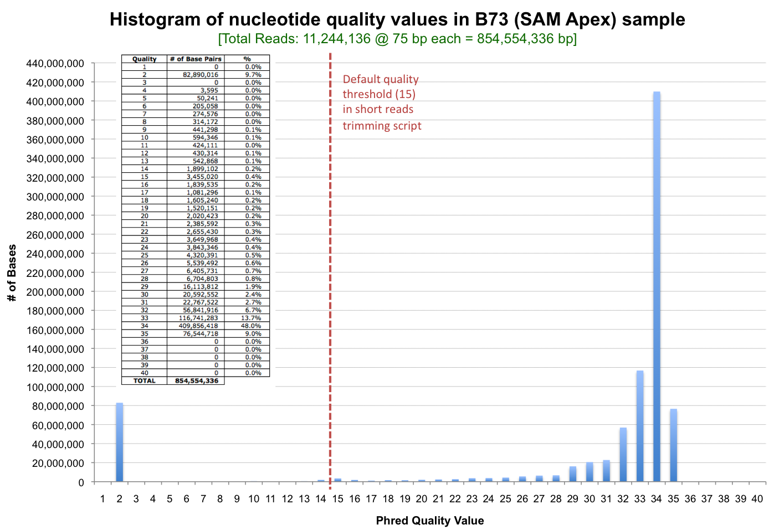
Default Quality Threshold = 15?
Trimming script has a default minimum PHRED quality threshold (Q) of 15. The formula to compute quality and probability of error is:
Q = -10 x log(prb_error) OR prb_error = 10^{(Q/-10)}
Phred Quality (Q) | Probability of Error (prb_error)
40 | 0.0001
35 | 0.0003
30 | 0.0010
25 | 0.0032
20 | 0.0100
15 | 0.0316
10 | 0.1000
5 | 0.3162
Q = 15 infers that ~97% of the nucleotides are correct/accurate

