Slide 1
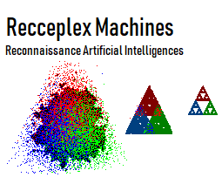
Intelligent Cities
To Combat Urban Insurgencies
Dr. George Ray
Director Research and Development
Blue Glacier Management Group
November 17, 2018

Slide 2

Framework Principles General Sir Frank Kitson, GBE, KCB, MC & Bar, DL Successful Counter-Insurgency Commander
Dense Urban Warfare
In mountainous or forested areas, insurgents can build up an armed force to combat civil society
In urban areas, propaganda, sabotage, and low level violence are the better strategy
Cities are suitable sources of sufficient numbers of people who can be manipulated into riots or marches
With the added benefit that the media are quickly on scene to report it
Often insurgents do violent acts that seem pointless but such acts are typically useful to coerce or persuade local populations
Government credibility is undermined if insurgent violence is left unchecked
[1] Kitson, F. (1960). Gangs and Counter-gangs, Barrie and Rockliff
[2] Kitson, F. (1977). Bunch of Five, Faber and Faber
[3] Kitson, F. (1987). Warfare As A Whole. Faber & Faber

Slide 3
Framework Principles (con’t)
Insurgency
Insurgency is largely a battle for men's minds
Civil society must have a mechanism to disseminate information and influence
A government information service is only effective at the start of an insurgency
Once an insurgency has operational momentum, a mass of lower-level information is a necessity
Intelligence must be decentralized to an extent such that local commanders can organize their operations effectively
The major difficulty is the speed that is required to do this once an insurgency catches civil society unawares.
Regarding intel security, once in the fight security risks must be taken to ensure effective local operations
The public cannot defend itself against organized insurgent violence, as the heaps of bodies in Kenya, Malaya and Cyprus attest
Insurgents are better at violence than civil citizenry
[1] Kitson, F. (1960). Gangs and Counter-gangs, Barrie and Rockliff
[2] Kitson, F. (1977). Bunch of Five, Faber and Faber
[3] Kitson, F. (1987). Warfare As A Whole. Faber & Faber

Slide 4
Framework Principles (con’t)
Counter-Insurgency
Governments typically believe that they can fight an insurgency without the use of violence.
The fact that an insurgency has reached the point of using riots or other forms of violence means that violence must be used to counter it
There is a temptation to delay the use of force against violent bad actors because of the danger of driving uncommitted into the insurgent camp
Counter-insurgency should not be considered an operational matter but a major function of civil society. It needs good coordinating machinery (can Solomine help?)
Everything done by the government and its civil agents must be legal, otherwise you play into the insurgents propaganda
Making radical changes to the legal system to fight the insurgency cannot be done unless a decentralized information service exists that influences all major support groups
[1] Kitson, F. (1960). Gangs and Counter-gangs, Barrie and Rockliff
[2] Kitson, F. (1977). Bunch of Five, Faber and Faber
[3] Kitson, F. (1987). Warfare As A Whole. Faber & Faber

Slide 5
Framework Principles (con’t)
Paramount Principles
The use of technology is critical for the efficient ordering of civil forces
Auxiliary local forces should be integrated into counter-insurgency operations
Local Government
Police
Emergency Responders
Civil Authorities
Local Security Organizations
Liaison positions are flexible mechanisms to encourage informal relationships. They are used where work is complex, horizontally specialized and highly interdependent
In contrast, an integrating manager is a liaison position with formal authority to act on behalf of the central unit
[1] Kitson, F. (1960). Gangs and Counter-gangs, Barrie and Rockliff
[2] Kitson, F. (1977). Bunch of Five, Faber and Faber
[3] Kitson, F. (1987). Warfare As A Whole. Faber & Faber

Slide 6
Framework Principles (con’t)
Special Operations do not win wars, they must be integrated with conventional force operations[2]
One of the major shortcomings of Future War thinking is that militaries study only what is comfortable for them and that which makes them satisfied with themselves [1]
Raiding is not a strategy, it is not a substitute for joint force conventional operations; such raids often embolden the enemy (consider Somalia); special forces must join with combined arms teams [1]
Reliance on proxies to do our fighting on the land and only fight in the air is a fallacy [1]
[1] McMaster, HR ((2003-2015) Thinking and War Scholarship, War on Terrorism, Future War and Technology, US Govt/DoD. pp105 to 107, pp 16 to 17
[2] Kitson, F. (1977). Bunch of Five, Faber and Faber

Slide 7
Framework Principles (con’t)
Technology and firepower is not a strategy, i.e. efficient targeting is not a sufficient strategy to overcome an adversary without combined arms forces that can compel an outcome [1]
Uncertainty is friction on the battlefield
Technology is effective at identifying the enemy and ensuring all friendly forces have a common understanding of the operation and this reduces some uncertainty
Technology may be effective at identifying enemy positions but this does not end uncertainty because the tenor of your enemy is still unknown.
First shock may steel their resolve to fight until victory or it may shatter them.
We can’t assume it will shatter them, there is still uncertainty
[1] McMaster, HR ((2003-2015) Thinking and War Scholarship, War on Terrorism, Future War and Technology, US Govt/DoD. pp105 to 107, 14 to 15

Slide 8
Framework Principles (con’t)
The Air Force and Navy advocate certainty through technology, shock and awe in future war. [1]
The Marine Corps rejects these prevailing assumptions about future war[1]
It is a combined arms force that operates on land, sea, air; it knows land warfare
It does not redefine war in frameworks of reduced risk
It defines war as a violent struggle between hostile, irreconcilable wills and is characterized by chaos, friction and uncertainty.
We need to unleash the power of combined arms across the Army[1]
We have overwhelming power in our Infantry, Armor and Cavalry working together
American Military Power is joint power: land, air, sea, space and cyber [1]
[1] McMaster, HR ((2003-2015) Thinking and War Scholarship, War on Terrorism, Future War and Technology, US Govt/DoD. pp105 to 107, 23 to 25, pp 140 to 142

Slide 9
Intelligent Cities
It is mission critical that a unified representation of all intelligence, from internal and external sources, is organized on a stable and scalable structure that can be dynamically enhanced
Applying the principles and rules of Linked Open Data to provide an unified representation for using this massive data resource, will enable
Local commanders as well as staff analysts to investigate, process and apply the information
Use machine learning to augment the discovery of new patterns, anomalies, and relationships relevant to downstream objectives
November 17, 2018

Slide 10
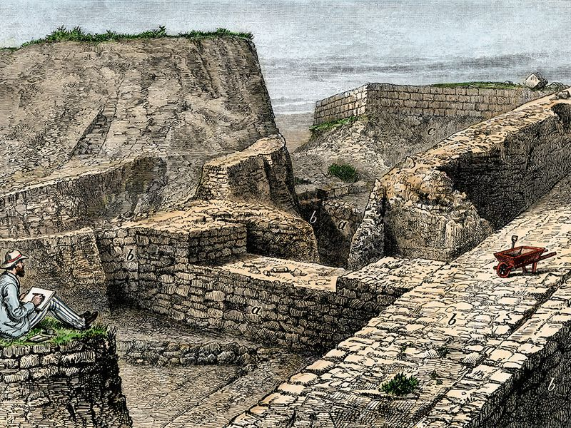
SOLOMINE
Sense Making tool for open source intelligence: social media, survey, geospatial, general Web, semantic Web, dark Web
November 17, 2018

Slide 11
Background
Solomine is a software tool to data mine, analyze and prepare tactical predictions for operators for planning their action
Textual Analytics, Sentiment Analytics, Geospatial Analytics, Risk Terrain Mapping, Probability Grid Method
Areas of operation have geographic, psychographic and demographic attributes
Descriptive and predictive analytics can compare incidents with coincident real-world characteristics
The multiple dimensions of these characteristics mean that multiple models can be derived
Strategies can be tailored to a specific context
November 17, 2018

Slide 12
Dark Web
Local Command
Social Media
Actionable intelligence
Situational Awareness Enactment
Tactical Situational Awareness
IP addr, sentiment, lexical analysis, summarization, n-gram
Local data, operational status
Mapping Enactment
User ID, demographics, location, sentiment analysis, influence, lexical analysis
Sense Making
Staff Analyst
Solomine
Attributed significance: operational and meme, Sentiment analysis, lexical analysis, auto-summarizations, n-grams
Topologies of potential surprise: cause maps, differentiating scenery , concept exploration
Sense Making Enactment
General Web Data
Social Media Data
Dark Web Data
Commercial Sites Data
Query Results Sets
General Web
Sentiment analysis, lexical analysis, summarizations, n-grams
Targeted insurgents thru overt/covert means,
Crime, disorder, insurgent hotspot data,
Linked series of incidents, crimes,
Potential preventative measures
Local Data
MongoDB
External Intel Sources
November 17, 2018

Slide 13
Open Source Intelligence Batch Environment
Data Sources
Data Acquisition
Data Storage
Case Mgmt
Case Manager
Integration
Hadoop Cluster
Data Access
Documents, emails
Hortonwork Data Platform
Machine Learning, Data Analytics and Visualization
Predictive Analytics
Geolocation based
Sentiment
Demographic
Psychographic
Risk Terrain Map
Prob Grid Analysis
Heat Maps
Influencers
Bad Actors
Zonal Statistics,
Terrain analysis
hexGridHeatMap
Buffering and buffer analysis
Proximity analysis
Points of interest
General Web
Flume
PIG
Mahout
Social Media
Chukwa
Zeppelin
Impala
External Intel Sources
SQOOP
SQL Server PolyBase
Oracle ODI
Drill
DBMS and EDW
Hadoop
Put
HIVE
SQL Server EDW
November 17, 2018
Oracle EDW

Slide 14
Solomine Real-time AIEnvironment
Data Sources
Data Storage
Solomine
MongoDB
Machine Learning
Analysis and Visualization
Case Mgmt
Documents, emails
AI-> Classifications, Metrics
Local data, training datasets
Predictive Analytics
Geolocation based
Sentiment
Demographic
Psychographic
Risk Terrain Map
Prob Grid Analysis
Heat Maps
Influencers
Bad Actors
Zonal Statistics,
Terrain analysis
hexGridHeatMap
Buffering and buffer analysis
Proximity analysis
Points of interest
General Web
GPU Cluster for State-of-the-Art Algorithms
MongoDB Hadoop Connector
Models
Social Media
CPU for Classical Algorithms
External Intel Sources
Hadoop Cluster
DBMS and EDW
November 17, 2018

Slide 15
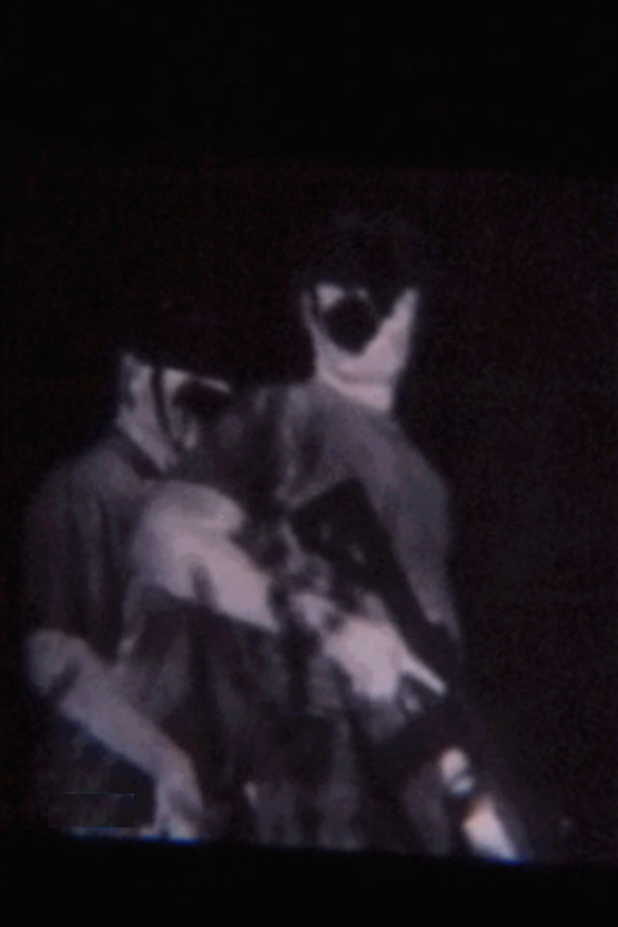
TIRYNS
Tactically Integrated Robotically Enhanced Network / Secure
November 17, 2018

Slide 16
Background
TIRYNS is a tactical application of the NeuroMachina sensory detection and processing systems for robotic devices – devices under the control of artificial intelligences
A comprehensive system to create a clear analysis of information for military and security personnel
Equipment that supports military, law enforcement and security operators while performing their duties
No more blind spots
No more ambush assaults
A sensory detection and processing framework
November 17, 2018

Slide 17
NeuroMachina
Classic and state-of-the-art machine learning algorithms in robotic systems
For tactical force multiplication
For data mining open source intelligence
Solomine
Sense making of the environment with a toolset to develop, integrate, and maintain thorough, accurate, and current information about people, groups, concepts, product and systems that feeds into other systems
TIRYNS
Situational Awareness through sensory detection and processing systems for robotic devices – devices under the control of artificial intelligences
November 17, 2018

Slide 18
TIRYNS
Sensory Network
Portable WIFI
Sensor Protocol
Encryption
Recharging
GNU Radio
P25 Integration
JTRS Integration
Packet Sniffing net vulnerabilities
Sensory Nodes
Audio Nodes
Visual Nodes
NBC Nodes
GPS
Range Finder
Metrologic Nodes
Anemometer
Barometer
Temp/Humidity
November 17, 2018

Slide 19
Drill Down to One Function: Object Detection
TIRYNS
Sensory Nodes
Visual Nodes
Node Config
Node Function
Object Detection
Offline
Train HAAR & HOG RGB
Train HAAR & HOG IR
Train HAAR & HOG Thermal
IR/RGB/Thermal fusion
Onliine
Socket to Nvidia GPU cluster
Train CNN Torso
Train CNN Pedestrian
Train CNN Head
Train IR/RGB/Thermal
November 17, 2018

Slide 20
TIRYNS Portable Sensory Environment
CSI
Wifi
Portable Wifi
Image classification
Geospatial analytics
Encryption
Equipment
Cameras
Microphone
Motion Detect
Anemometer
Range Finder
Temp/Humid
Altimeter
Heater/Fan
PYTHON
Rpi.GPIO
PyUSB
Picamera
Opencv
GDAL/OGR
SKLearn
Dlib
Sockets
GPIO
Analysis
Motion detected
Number of Tangos
Direction of march
Interdiction path
Line of sight analysis
Sensory enhanced video
Distance to target
Wind speeds
Elevation
Temp/humid
Cover or concealed positions
USB
DEM
Geospatial Database
November 17, 2018
Recceplex Machines

Slide 21
Communications Environment
Mobile Wifi (802.11)
P25 radios (Homeland Security Agencies, Police, Foreign Military)
GNU Radio
PRC 152
Software Option
PYTHON
MIMO
USRP
DoD Tactical Networks
JTRS/SCA compliant Future Communications Networks
November 17, 2018
Recceplex Machines

Slide 22
GPU Cluster Environment
WIFI
Mobile Wifi
AWS
PYTHON
Sockets
Send Image
Recv Class
PYTHON
Sockets
CNN Match CUDA
nVidia
GPU Cluster
PYTHON
Sockets
CNN Train
CUDA
nVidia
GPU Cluster
November 17, 2018
Recceplex Machines

