Slide 1
Situational awareness for smart cities Sensor systems and open source data
Presentation to MITRE on 6/14/2019
McLean Campus
Dr. George Ray

Slide 2
Agenda
Smart Cities
Machine Learning
ML for Object Recognition and Substance Detection
Computer Vision
Fusion of Sources
Sensor Integration
ML for Decision Support Systems
Mining Public Data
Classification Predictive Models
Predicting Trends and
Connecting
Infrastructure
Communications
Funding Strategy
Datasets
Help other agenciies – FBI NIBBRS

Slide 3
Smart Cities Background
Requirements for smart cities and dense urban warfare shape the direction of our development
We use an open source approach too the extent possible as evidence of following standard practice
Smart cities are connected cities and use technology to connect components across the city
Open data is the key to a smart city.
Data from all segments is analyzed, and patterns are derived from the collected data.
[1] Maddox, T. (2016). Smart cites: 6 essential technologies. Innovation.

Slide 4
Smart Cities Background
McKinsey Projects the smart city industry to be a $400 billion market by 2020, with 600 cities worldwide.
Data collection and analysis is a key component of a smart city in order to provide predictive analytics.
City of Barcelona at the cutting edge of using digital devices and the Internet of Things to improve municipal operations
Smart city as a platform
Goal: create an open-source sensor network, standards based, connected to a computing platform managed by the city
[1] Maddox, T. (2016). Smart cites: 6 essential technologies. Innovation - TechRepublic.
[2] Loffreda, D. (2019) Tomorrow's cities: evolving from "smart" to Adaptive. Cienna

Slide 5
Smart Cities Background
Three essential functions are required for a Smart City
Connecting with a programmable Infrastructure
Sensing using analytics and artificial intelligence
Acting through software control and automation
Smart cities will rely on smart image and vision sensor technology to collect and interpret visual data
[1] Maddox, T. (2016). Smart cites: 6 essential technologies. Innovation - TechRepublic.
[2] Loffreda, D. (2019) Tomorrow's cities: evolving from "smart" to Adaptive. Cienna
[3] Ligozat, T. (2017) Smart City. Connected City. Teledyne. APAC Innovation Summit 2017

Slide 6
Smart Cities Key Technologies
Smart grids are a critical component of a smart city
Smart transportation: multi-modal transportation, smart traffic lights, smart parking
Smart data: to be useful the massive amounts of data must be analyzed quickly
Smart infrastructure: enables pro-active maintenance and effective planning for future demand
Data mobility: unconstrained as it moves between systems, respects intellectual property, security and privacy
IoT devices: sensors and actuators in our cities are here to stay
[1] Maddox, T. (2016). Smart cites: 6 essential technologies. Innovation.

Slide 7
Smart Cities Machine Learning
Two important theme for Smart Cities
Use of sensors and effective analysis of sensor data
Data collection and analysis is a key component of a smart city in order to provide predictive analytics
Machine Learning is used for both classification from sensor data and predictive analytics of social data
[1] Maddox, T. (2016). Smart cites: 6 essential technologies. Innovation.

Slide 8
Smart Cities Machine Learning
It’s mission critical for a unified representation of all data from sensor and social sources
We apply the principles and rules of Linked Open Data
Machine learning is the use of mathematical algorithms to analyze data
Machine Learning models can be categorized as relationship or classification models

Slide 9
Smart Cities Network Protocol
Intelligent network must monitor, select, explore, and model large amounts of data
Sensors data and social mining data cannot be standalone
Sensor Command, Control and Coordination
Assess situation
4 Factor analysis: What resources to increase, decrease, add or delete
For example, if detect motion with no object recognition
[1] Finley, S (2017). Artificial Intelligence and Machine Learning. Relativistic Books.
[2] Sousa, K. & E. oz (2015). Management Information Systems. Cengage.

Slide 10
Smart City sensor system
Tactically Integrated Robotically Enhanced Network / Secure Tiryns
June 14, 2019

Slide 11
Background
TIRYNS is a sensory detection and processing system - devices under the control of mathematical reasoning
A comprehensive system to create a clear analysis of information for Smart City Management
Equipment that supports traffic planners, law enforcement and maintenance operators while performing their duties
No more blind spots
No more ambush assaults
A sensory detection and processing framework
June 14, 2019

Slide 12
NeuroMachina
Classic and state-of-the-art machine learning algorithms in robotic systems
For tactical force multiplication
For data mining open source intelligence
Smart City Dash
Sense making of the environment with a toolset to develop, integrate, and maintain thorough, accurate, and current information about people, groups, concepts, product and systems that feeds into other systems
TIRYNS
Situational Awareness through sensory detection and processing systems for robotic devices – devices under the control of artificial intelligences
June 14, 2019

Slide 13
TIRYNS
Sensory Network
Portable WIFI
Sensor Protocol
Encryption
Recharging
GNU Radio
P25 Integration
JTRS Integration
Packet Sniffing net vulnerabilities
Sensory Nodes
Audio Nodes
Visual Nodes
NBC Nodes
GPS
Range Finder
Metrologic Nodes
Anemometer
Barometer
Temp/Humidity
June 14, 2019

Slide 14
Drill Down to One Function: Object Detection
TIRYNS
Sensory Nodes
Visual Nodes
Object Detection
Offline
Train HAAR & HOG RGB
Train HAAR & HOG IR
Train HAAR & HOG Thermal
IR/RGB/Thermal fusion
Onliine
Socket to Nvidia GPU cluster
Train CNN Torso
Train CNN Pedestrian
Train CNN Head
Train IR/RGB/Thermal
Node Config
Node Function
June 14, 2019

Slide 15
TIRYNS Portable Sensory Environment
CSI
Wifi
Portable Wifi
Image classification
Geospatial analytics
Encryption
Equipment
Cameras
Microphone
Motion Detect
Anemometer
Range Finder
Temp/Humid
Altimeter
Heater/Fan
PYTHON
Rpi.GPIO
PyUSB
Picamera
Opencv
GDAL/OGR
SKLearn
Dlib
Sockets
GPIO
Analysis
Motion detected
Number of Tangos
Direction of march
Interdiction path
Line of sight analysis
Sensory enhanced video
Distance to target
Wind speeds
Elevation
Temp/humid
Cover or concealed positions
USB
DEM
Geospatial Database
June 14, 2019

Slide 16
Communications Environment
Mobile Wifi (802.11)
P25 radios (Homeland Security Agencies, Police, Foreign Military)
GNU Radio
PRC 152
Software Option
PYTHON
MIMO
USRP
DoD Tactical Networks
JTRS/SCA compliant Future Communications Networks
June 14, 2019

Slide 17

GPU Cluster Environment
WIFI
Mobile Wifi
AWS
PYTHON
Sockets
Send Image
Recv Class
PYTHON
Sockets
CNN Match CUDA
nVidia
GPU Cluster
PYTHON
Sockets
CNN Train
CUDA
nVidia
GPU Cluster
June 14, 2019

Slide 18
DEmo
Network cameras
Force multiplication
Situational awareness
-
Motion activated RGB
IR
Thermal
WIFI
Bluetooth

Slide 19
Sensor Components: Commercial Products
As noted above, Smart Cities need to deploy technologies that enhance perception and awareness.
Commercial-off-the-shelf sensing solutions can be integrated into a Smart City infrastructure.
Advantage in using commercial products is reduced development work in casing, programming, and systems integration
[1] Maddox, T. (2016). Smart cites: 6 essential technologies. Innovation - TechRepublic.
[2] Loffreda, D. (2019) Tomorrow's cities: evolving from "smart" to Adaptive. Cienna
[3] Ligozat, T. (2017) Smart City. Connected City. Teledyne. APAC Innovation Summit 2017
[4] FLIR(2019). FLIR Atlas. Retreived from https://www.flir.com/support/products/flir-atlas-sdk-for-.net#Overview
June 14, 2019

Slide 20
FLIR Detection
FLIR has been providing such solutions to the government for the past 50 years, including the US Government
We can programmatically access and control such devices with FLIR software libraries and drivers
We are extending FLIR capabilities with machine learning and streaming of their equipment signal over secure networks
June 14, 2019
[1] FLIR (2019). Threat Detection. https://www.flir.com/threat-detection/

Slide 21
DEmo
C3 Thermal
Discuss extension to FLIR detection

Slide 22
Custom Developed Sensor Systems
Smart connected devices are an integral aspect of Smart Cities
While many of the unique applications are currently uncertain many are being developed and applied
IoT smart connected devices are critical components
What is needed is a modular, extensible approach to developing new devices and incorporating them into Smart Cities
The FLIR equipment is one approach
Another is to work directly with low level sensors
June 14, 2019
[1] Maxim Iintegrated (2019) Datasheet.

Slide 23
I2C Bus for Sensors
The advantage of working directly with low level sensors
Flexibility in device feature set – not preconfigured by a manufacturer
Flexibility in form factor (e.g. daisy chain 10 sensors 100m from microprocessor)
I²C (Inter-Integrated Circuit) is serial computer bus invented in 1982 by Philips Semiconductor (now NXP Semiconductors)
It is widely used for attaching lower-speed peripheral ICs to microcontrollers in short-distance, intra-board communication
Many sensors use the I2C bus and drivers for these sensors can be written starting from a standard template for easy maintenance
We will demonstrate the Panasonic AMG8833 sensor as an example
June 14, 2019
[1] Miller, D. (2019) AMG8833 8x8 Thermal Camera Sensor. Adafruit Learning.
[2] Wikipedia. I2C. Wikipedia.org

Slide 24
AMG88xx Sensor
GPIO
I2C bus
Sensor
I2C class
AMG88xx
Driver
Application
Program
CPU
RAM
[1] Miller, D. (2019) AMG8833 8x8 Thermal Camera Sensor. Adafruit Learning.
[2] Wikipedia. I2C. Wikipedia.org
June 14, 2019

Slide 25
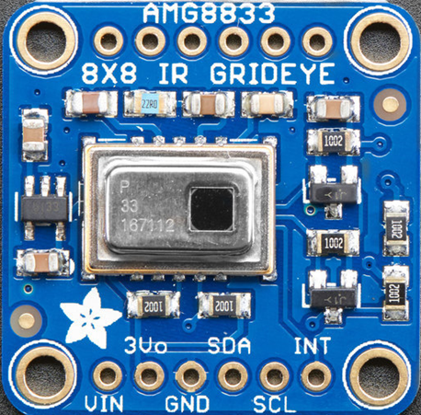
AMG8833 Sensor
[1] Byron, J. & S. Hymel (2018) I2C Tutorial.
[2] Miller, D. (2019) AMG8833 8x8 Thermal Camera Sensor. Adafruit Learning.
[3] Wikipedia. I2C. Wikipedia.org
June 14, 2019

Slide 26
DEmo
Panasonic AMG 8833 Chip
Discuss Extension to other chips

Slide 27
Sensor Fusion
Fusion is the merger of different sensor modalities resulting in an integrated system
One approach is fused sensor where single or multiple sensors are used to collect different sensor information, such as an rgb image and a thermal image.
A fused algorithm is used to create a single identification decision based on the results of those matrices.
Fusion Categories
Feature extraction level
Matching score level
Decision level
[1] Newman, R. (2010). Security and Access Control Using Biometric Technologies, 1st Edition. Cengage.
June 14, 2019

Slide 28
Sensor Fusion
We are investigating how to leverage multiple sensors to improve recognition, improving the precision of classification and identification
With fusion there is a potential to improve classification performance.
If we have three models, each one if 33% reliable all is not necessarily lost.
At the extreme, if their errors are disjoint so they are not shared by the other models we get a 100% reliable system w/ voting.
[1] Newman, R. (2010). Security and Access Control Using Biometric Technologies, 1st Edition. Cengage.
June 14, 2019

Slide 29
Sensor Fusion
The reliability goes down corresponding to the extent of overlap in incorrect answers.
The necessary diversity for separate models to work better together is that the models lack coincident failure.
The advantage of diversity is lost as the extent of common failure goes up.
[1] Newman, R. (2010). Security and Access Control Using Biometric Technologies, 1st Edition. Cengage.
June 14, 2019

Slide 30
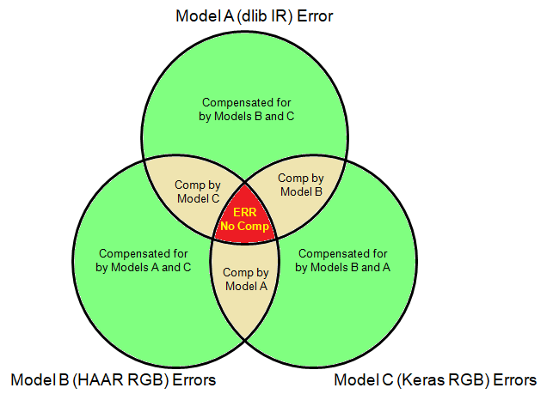
Sensor Fusion
Here is a diagram of the effect, with overlapping errors. The area in red will still be an error - it is the overlap of the three models, i.e. where they share the same error.
[1] Patridge, D. (2013). Artificial Intelligence and Software Engineering: Understanding the Promise of the Future 1st Edition,. Routledge
June 14, 2019

Slide 31
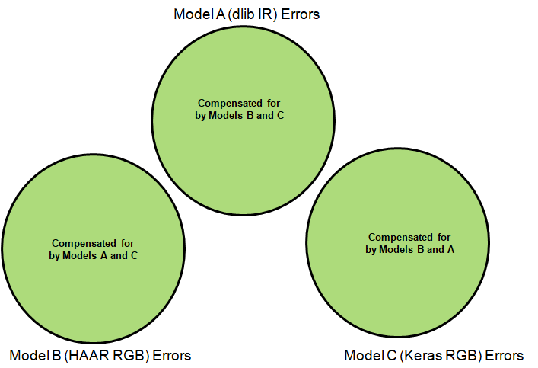
Sensor Fusion
Here is an extreme example with disjoint error, so a majority voting scheme will yield the correct answer 100% of the time.
[1] Patridge, D. (2013). Artificial Intelligence and Software Engineering: Understanding the Promise of the Future 1st Edition,. Routledge
June 14, 2019

Slide 32
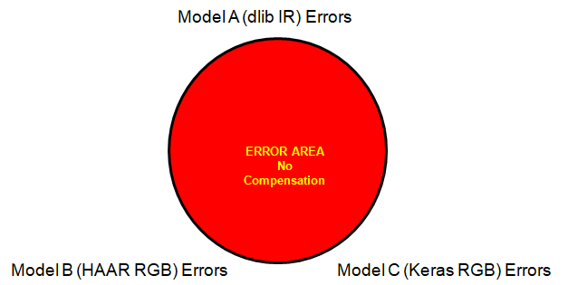
Sensor Fusion
Here is the other extreme of completely coincident error. In this example the 67% error rate still holds (33% precision above).
[1] Patridge, D. (2013). Artificial Intelligence and Software Engineering: Understanding the Promise of the Future 1st Edition,. Routledge
June 14, 2019

Slide 33
Other Research to Improve Results
Test different types of cameras
Vary the following attributes:
Lighting: frontal lighting, side lighting, back lighting, frontal hard (single source - usually with shadows) and frontal soft (multiple light sources to reduce or eliminate shadowing)
Angles: high angle, eye level, low angle, oblique (30, 45, 60 and 90 degrees)
Distance: long shot (full shot so pedestrian model), medium shot (torso), closeup (face, profile)
Using decision models of pedestrian, torso, front face, profile.
June 14, 2019

Slide 34
Privacy Concerns
Privacy Definition
Right of individuals or groups to protect themselves and personal information from unauthorized access
Categories of privacy:
Financial
Informational
Internet
Medical
Workplace
[1] Security and Access Control Using Biometric Technologies, 1st Edition, Robert Newman, ISBN-13: 978-1-4354-4105-7
[2] Principles of Information Security, 6th Edition, by Whitman and Mattord. Stamford, CT. Cengage Learning; March 13, 2017. ISBN-13: 978-1337102063

Slide 35
Privacy Concerns
Concerns
Potential for misuse
When do risks outweigh benefits
Information aggregation
What statutes govern privacy
Surveillance
Voluntary or involuntary capture.
Databases
Linking
Tracking
Necessary protections
[1] Security and Access Control Using Biometric Technologies, 1st Edition, Robert Newman, ISBN-13: 978-1-4354-4105-7
[2] Principles of Information Security, 6th Edition, by Whitman and Mattord. Stamford, CT. Cengage Learning; March 13, 2017. ISBN-13: 978-1337102063

Slide 36
Privacy Concerns
Federal Law
The Federal Privacy Act of 1974
The Electronic Communications Privacy Act of 1986
Computer Fraud and Abuse Act of 1986 (CFA Act)
National Information Infrastructure Protection Act of 1996
USA PATRIOT Act of 2001
USA PATRIOT Improvement and Reauthorization Act(2006)
The PATRIOT Sunset Extension Act of 2011
[1] Security and Access Control Using Biometric Technologies, 1st Edition, Robert Newman, ISBN-13: 978-1-4354-4105-7
[2] Principles of Information Security, 6th Edition, by Whitman and Mattord. Stamford, CT. Cengage Learning; March 13, 2017. ISBN-13: 978-1337102063

Slide 37
Smart city dashboard
Sense Making tool for open source intelligence: social media, survey, geospatial, general Web, semantic Web, dark Web
June 14, 2019

Slide 38
Background
Smart City Dash is a software tool to data mine, analyze and prepare tactical predictions for operators for planning their action
Textual Analytics, Sentiment Analytics, Geospatial Analytics, Risk Terrain Mapping, Probability Grid Method
Areas of operation have geographic, psychographic and demographic attributes
Descriptive and predictive analytics can compare incidents with coincident real-world characteristics
The multiple dimensions of these characteristics mean that multiple models can be derived
Strategies can be tailored to a specific context
June 14, 2019

Slide 39
Dark Web
Local Mgmt
Social Media
Actionable intelligence
Situational Awareness Enactment
Tactical Situational Awareness
IP addr, sentiment, lexical analysis, summarization, n-gram
Local data, operational status
Mapping Enactment
User ID, demographics, location, sentiment analysis, influence, lexical analysis
Sense Making
Staff Analyst
Smart City Dash
Attributed significance: operational and meme, Sentiment analysis, lexical analysis, autosummarization, n-grams
Sense Making Enactment
Topologies of potential surprise: cause maps, differentiating scenery , concept exploration
General Web Data
Social Media Data
Dark Web Data
Commercial Sites Data
Query Results Sets
General Web
Sentiment analysis, lexical analysis, summarizations, n-grams
Targeted insurgents thru overt/covert means, Crime, disorder, insurgent hotspot data, Linked series of incidents, crimes, Potential preventative measures
Local Data
MongoDB
External Intel Sources
June 14, 2019

Slide 40
Open Source Intelligence Batch Environment
Data Sources
Data Acquisition
Data Storage
Case Mgmt
Case Manager
Integration
Hadoop Cluster
Data Access
Documents, emails
Hortonwork Data Platform
Machine Learning, Data Analytics and Visualization
Predictive Analytics
Geolocation based
Sentiment
Demographic
Psychographic
Risk Terrain Map
Prob Grid Analysis
Heat Maps
Influencers
Bad Actors
Zonal Statistics,
Terrain analysis
hexGridHeatMap
Buffering and buffer analysis
Proximity analysis
Points of interest
General Web
Flume
PIG
Mahout
Social Media
Chukwa
Zeppelin
Impala
External Intel Sources
SQOOP
SQL Server PolyBase
Oracle ODI
Drill
DBMS and EDW
Hadoop
Put
HIVE
SQL Server EDW
June 14, 2019
Oracle EDW

Slide 41
Real-time Environment
Data Sources
Data Storage
Smart City Dash
MongoDB
Machine Learning
Analysis and Visualization
Case Mgmt
Documents, emails
AI-> Classifications, Metrics
Local data, training datasets
Predictive Analytics
Geolocation based
Sentiment
Demographic
Psychographic
Risk Terrain Map
Prob Grid Analysis
Heat Maps
Influencers
Bad Actors
Zonal Statistics,
Terrain analysis
hexGridHeatMap
Buffering and buffer analysis
Proximity analysis
Points of interest
General Web
GPU Cluster for State-of-the-Art Algorithms
MongoDB Hadoop Connector
Models
Social Media
CPU for Classical Algorithms
External Intel Sources
Hadoop Cluster
DBMS and EDW
June 14, 2019

Slide 42
DEmo
Mine Twitter

Slide 43
DEmo
Mine Google

Slide 44
DEmo
Mine Baltimore NIBRS Data

Slide 45
Optional DEmo
Mine QnA Forum and create expert system ML model

Slide 46
Optional DEmo
Speed read documents

Slide 47
Funding Strategy
Partnership with Baltimore for NSF and DoT grant money
Smart Cities
Dense Urban Warfare
Needs integration with Smart Cities
DoD studies
Example grants
June 14, 2019

Slide 48
Strategy
Example NSF funding that involves or involved Smart Cities
Smart and Connected Communities ( 19-564 ) currently open
Cyber-Physical Systems ( 19-553 ) currently open
US Ignite: ( 16-553 )
US-EU Internet Core & Edge Technologies ( 18-535 )
NSF/VMware Partnership on Edge Computing Data Infrastructure ( 18-540 )
Platforms for Advanced Wireless Research (PAWR): Establishing the PAWR Project Office (PPO) ( 16-585 )
NSF/Intel Partnership on Information-Centric Networking in Wireless Edge Networks ( 16-586 )
June 14, 2019

Slide 49
Funding Strategy
Working with a city like Baltimore will help satisfy the "big ideas" that guide NSF funding
1. Future of Work at the Human-Technology Frontier
2. Growing Convergence Research
3. Harnessing the Data Revolution
4. Mid-scale Research Infrastructure
5. NSF 2026
June 14, 2019

Slide 50
Datasets
Social Data
Baltimore City Data
FBI NIBRS
Object Recognition
https://www.cs.toronto.edu/~kriz/cifar.html
http://www-old.emt.tugraz.at/~pinz/data/GRAZ_01/
http://homepages.inf.ed.ac.uk/rbf/CVonline/Imagedbase.htm
https://storage.googleapis.com/openimages/web/index.html
http://chenlab.ece.cornell.edu/people/Andy/ImagesOfGroups.html
http://scikit-learn.org/stable/modules/generated/sklearn.datasets.fetch_lfw_people.html
http://www.image-net.org/
June 14, 2019

