Slide 1
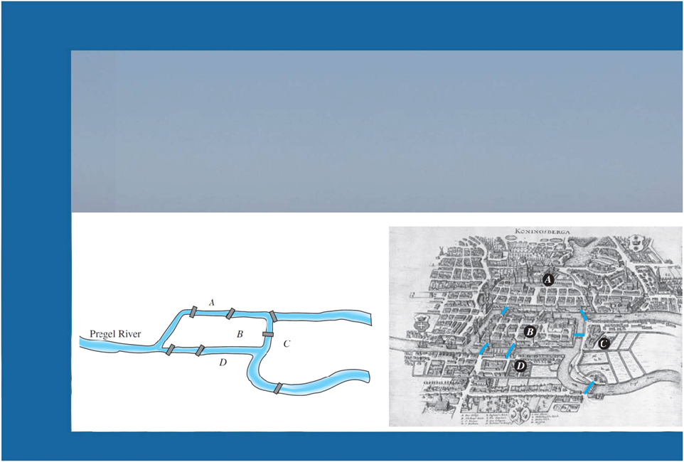
Solomine Data Flow Diagrams

Slide 2
Introduction to Solomine
Solomine is a tool and a methodology to elicit meaningful strategic information from the firehose of data available on the social Web.
Organizations can use Solomine to enhance their research and situational awareness, using social media analysis to assist strategic planning.
It uses application programming interfaces available on the Web to search, filter, and retrieve both:
The content of people’s public interaction on the web
Demographic and pyschographic data of those individuals
It uses data mining techniques for classification, regression, clustering, deviation detection, association analysis, and evaluation of patterns mined from Web social data
Notes:
Social media mining is a methodology to elicit meaningful strategic information from the firehose of data available on the social Web. People today are actively expressing themselves through the social media channels, and organizations are using social media to enhance their research, situational awareness, and integrated marketing communications. Social media provides organizations with empirical data to guide strategic planning.
In this course, students will learn to use application programming interfaces available on the Web: how to create authentication tokens, search, filter, and retrieve both the content of people’s public interaction in a social media channel as well as the demographic and pyschographic data of those individuals. The students will further learn data mining techniques for classification, regression, clustering, deviation detection, association analysis, and evaluation of patterns mined from social data and apply them in individual and group projects.

Slide 3
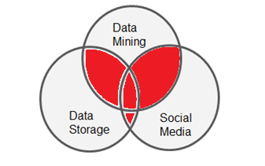
Solomine Purpose and goals
Solomine is about social media mining
Connect to the popular social web sites, as well as the general Web
Customize the access, extraction, analysis and display of insights from those sites
Turn a business, political or economic problem into a data problem
Search data produced by people for people to identify patterns that will improve situational awareness

Slide 4
Design Choices
Solomine uses Python:
Version 2 is the original and almost all of the python ecosystem is compatible with version 2
Social media based on JSON that are easily handled by Python
Intuitive language for retrieving, parsing complex structures
Supports Map/Reduce
Open Source
Vast array of open source packages to simplify work

Slide 5
Design Choices
Solomine has three layers:
Data model: data access and mining logic
View: presentation of data
Router: receives events, calls data model routines, and returns a view to the user
The data flow diagrams are grouped into these three categories
There are there three main sections in the remainder of this document: Model, Router, and View

Slide 6
Model Data Flow Diagrams
gmrSocial Class subsystem of Model

Slide 7
Solomine components
This application is grouped into three categories of functionality:
Model: data access (including to social media) and mining logic functionality;
Router: receives events, executes functionality that is in the Model, and returns a view to the user
View: presentation of data and available commands
The router and view groups are implemented through a Web application framework
A Web server contains the navigation functionality and coordinates the requests from the view with the functions in the model
A Web client implements the view user interface
URL mapping over HTTP is the link between view events and router routines
The model is implemented as a Python package with 2 classes:
gmrSocial
gmrTextAnalytics

Slide 8
gmrSocial class
The gmrSocial class has access routines for Twitter, Facebook, Google assets, and the general Web
It has methods to perform
Search queries,
Get trends,
Retrieve and organize text from tweets, posts, comments, and screen scraping
Determine sentiment and influence as well as lexical diversity
Starts background threads for long running queries, e.g. Twitter Stream queries, and load up mongodb so users do not wait needlessly
Calls on gmrTextAnalytics for further analysis

Slide 9
gmrSocial class
It also has helper methods to remove unicode,
The constructor is called with the query parameters the users entered in the particular view html page
It likewise hosts a set of variables used by the other methods in the class and also the controller to retrieve values to display
The major methods are:
getTrends
getTwitter
getStream
getFace
getGoogle
gmrScreenScrape

Slide 10
gmrNLP.gmrSocial.getTrends
Solomine
Topic List
getTrends
Topic List
WOEID
WOEID
Twitter

Slide 11
getTrends
The trends method gets trending topics in Twitter.
It uses the trends.place method in the Twitter API
This method takes the Yahoo Where On Earth ID (WOEID)

Slide 12
gmrNLP.gmrSocial.getTwitter
twitStat
Solomine
Tweet Mined Results
Tweet Mined Results
twitFreq
twitTFIDF
Topic, (maxID,other,term)
getTwitter
Topic, (etc)
Tweet List
Tweet List
Twitter

Slide 13
getTwitter
This collects the full set of data on each tweet
It performs mining functions on data at tweet['status']['text'] level
It also uses the tweet[‘metadata’] field maxID to give users an option for next 25
It connects to Twitter using Oauth 2.0
The main body of this method is a for loop that iterates over the set of 25 tweets
Calls twitFreq, twitTFIDF and twitStat
Sets class attributes with tweet text, user data, and mined data

Slide 14
gmrNLP.gmrSocial.twitFreq
getTwitter
twitFreq
Tweets
memory
Freq_out
memory

Slide 15
twitFreq
This method calculates the freq distribtuion on the words in the twitter data.
It uses the class attribute tweets that is set by the calling routine.
It sets a class attribute - freqOut

Slide 16
gmrNLP.gmrSocial.twitStat
getTwitter
twitStat
Tweets
memory
Tweets_Other
memory

Slide 17
twitStat
This method performs statistical calculations on the twitter data from the search;
One tweet at a time is sent here
This data is for secondary results screens in the View html

Slide 18
gmrNLP.gmrSocial.twitTFIDF
getTwitter
twitTFIDF
Tweets
memory
TFIDF_Score
memory

Slide 19
twitTFIDF
This method takes derived lists from a parsing of the tweet result set as input.
It also uses a class attribute - tweets - that is set by the calling routine.
It creates sentences and calculates TFIDF
It then sets a class attribute – tfidf_score - that is used by the model and router functions

Slide 20
gmrNLP.gmrSocial.getStream
Solomine
Message on DB storage
Topic
getTwitter
Mongodb
Topic
Tweet List
Twitter

Slide 21
getStream
This gets current real time tweets so there will be a delay as it collects them
Uses open source package Twython instead of the package Twitter.
Writes to MongoDB

Slide 22
gmrNLP.gmrSocial.getFace
countLikes
Solomine
page analytics
page analytics
processFB
page
getFace
Page posts, cmnts
page
Page posts, cmnts
Facebook

Slide 23
getFace
This facebook method is in social class; these is also one in the router: Solomine
This one uses the hourly social graph access token
An application 60 day token specific to an app is used in the router
This class is initialized with the ID of the public Facebook page that is being accessed
It accesses Facebook using Oauth 2.0
The main body of this function is a for loop that iterates through the set of posts on the target page
This method needs to be enhanced to give option to get the next 25 posts
Magic cookie alert - 25 hard coded

Slide 24
gmrNLP.gmrSocial.processFB
count_likes
getFace
ID, fb_conn
like count
processFB
a post
FB results
Posts
Likes
Comments
Sentiment
User demog url

Slide 25
processFB
This method is sent one post at a time
It culls out the post text, comments and their text
Calculates sentiment, loops thru the posts from the FB search
Facebook now needs special routine to count likes, the one here I called count_likes

Slide 26
gmrNLP.gmrSocial.getScreenScape
gmrTextAnalytics
Summary
Solomine
Page Analytics
Page Analytics
Bigrams
Freq/POS
Web URL
getScreenScrape
Web URL
Navigable Tag Tree
Page HTML
Web

Slide 27
gmrScreenScrape
Screen scraping accesses the page that is the input to the process
It then gets the html and uses BeautifulSoup to create a navigable search tree.
Given the wide variance in html formats across the Web
This method looks for text in all the usual places and presents it all
Longer term we may want an algorithm to intelligently select what texty fields to use
It also calls methods in the gmrTextAnalytics class; those routines will be described in that section of this document

Slide 28
Model Data Flow Diagrams
gmrTextAnalytics Class subsystem of Model

Slide 29
gmrTextAnalytics
The gmrTextAnalytics class has document analysis routines for:
Preparing a summary
Doing frequency analysis
Lexical analysis,
N-Grams and other textualal analytics
The constructor takes a text document as input
There are a variety of class attributes for storing results that can be accessed throughout the application

Slide 30
gmrNLP.gmrTextAnalytics.do_prelim
Summary
Solomine
Document Analytics
Document Analytics
Bigrams
Freq/POS
Text Document
Do_
Prelim
Text Document

Slide 31
Do_prelim
gmrTextAnalytics has three worker methods:
FreqDist
Bigrams
getSummary
These methods can be called individually
In addition, there is a consolidator method, do_prelim can be called and in turn executes all three

Slide 32
gmrNLP.gmrTextAnalytics.Do_Text
gmrTextAnalytics
Summary
Solomine
Document Analytics
Document Analytics
Bigrams
Freq/POS
Text Document
Do_
Text
Text Document

Slide 33
Router Data Flow Diagrams

Slide 34
Solomine.Trends
View. Home
@xqt
gmrNLP. getTrends
/Trends
trends url
topic list
topic list
View. Trends

Slide 35
Solomine.aTrends
View. Trends
topic
gmrNLP. getTwitter
/aTrends
topic
tweet: mined results
tweet: mined results
View. Twitter

Slide 36
Solomine.Twitter
View. Home
topic
gmrNLP. getTwitter
/Twitter
topic
tweet: mined results
tweet: mined results
View. Twitter

Slide 37
Solomine.Next
View. Twitter
topic, maxID
gmrNLP. getTwitter
/tNext
topic, maxID
tweet: mined results
tweet: mined results
View. Twitter

Slide 38
Solomine.Other
View. Twitter
topic, /other
gmrNLP. getTwitter
/aOther
topic, /other
tweet: mined results
tweet: mined results
View. Twitter

Slide 39
Solomine.gmr
View. Home
topic
gmrNLP. getStream
/gmr
topic
/twythread
topic
DB msg
DB msg
View. Twython

Slide 40
Solomine.face
View. Home
/face
topic
Facebook
topic
page list
page list
View. Faces

Slide 41
Solomine.aFace
View. Faces
page
gmrNLP. getFace
/aFace
page
list of (
Posts
Likes
Comments
Sentiment
User demog
urls
)
DB msg
View. aFace_result

Slide 42
Solomine.post/aScrape
View. Home
post. /aScrape
topic
Yahoo Search
topic
url list
url list
View. aScrape

Slide 43
Solomine.route/aScrape
View. aScrape
url
gmrNLP. gmrScreenScrape
route /aScrape
url
page analytics
page analytics
View. aScrape_result

Slide 44
Solomine.route/Basic
View. Home
textFile
gmrTextAnalytics. do_text
/Basic
file
summary, n-grams, frequent term
pdf
textFile
Sum, n-g freq trm
PDF to Text
docx
textFile
View. Basic_result
Docx to Text

Slide 45
View Data Flow Diagrams

Slide 46
Home/Basic
Information Ops
summary, n-grams, frequent term
Home. Basic
file

Slide 47
Home/Trends
Information Ops
Topic list
Home. Trends
@xqt

Slide 48
Home/aTrends
Information Ops
1. topic list
Home. aTrends
2. topic
3. Tweet mined results

Slide 49
Home/Twitter
Tactical Forces
or
Information Ops
tweet:
mined results
Home. Twitter
topic

Slide 50
Home/tNext
Information Ops
1. Tweet mined results
Home. Twitter
2. topic, maxID
3. Next tweet mined results

Slide 51
Home/Other
Information Ops
1. Tweet mined results
Home. Twitter
2. topic, /other
3. Other tweet mined results

Slide 52
Home/gmr (Stream)
Information Ops
DB msg
Home. gmr
topic

Slide 53
Home/aScape
Tactical Forces
or
Information Ops
URL List
Home. aScrape
topic
Tactical Forces
or
Information Ops
page analytics
aScrape_ results
A URL

Slide 54
Home/face
Tactical Forces
or
Information Ops
page List
Home. face
topic
Tactical Forces
or
Information Ops
page analytics
aFace_ results
A page

Slide 55
gmrNLP.gmrSocial.getTrends
FB results
Likes
Comments
Sentiment
User demog url
WOEID
Solomine
FB Posts
memory
Twitter
getTrends
WOEID
Tweets
memory
Topics
memory
Topic
memory

