Slide 1
Design Innovation
and virtual teams

Slide 2
global virtual teams and innovation
Innovation is critical in the modern global economy
Technology enhanced productivity and the industrialization of emerging countries has created a world-wide supply that exceeds demand
To survive, innovation is essential and it must leverage distributed knowledge
Findings from current research are that global virtual teams are more creative and produce more innovative solutions than collocated teams
Innovation follows certain patterns
Barnett proposes that innovation is the basis for cultural advance, and defined comprehensive theory
[1] Barnett, H. (1953). Innovation: The Basis of Cultural Change. New York, NY: McGraw-Hill.
[2] Plump, C. & D. Ketchen (2013). Navigating the Possible Legal Pitfalls of Virtual Teams. Journal of Organization Design JOD, 2(3), 51-55
[3] Kim, W. & R. Mauborgne (2009, September). How strategy shapes structure. Harvard Business Review
[4] Cochrum, K.. (2013). Close: Leading Well Across Distance and Cultures. Amazon: On-Demand Publishing LLC.
P188, 204
[5] Porter, M. (1998). Competitive Advantage. Free Press
[6] Porter, M. (1998). Competitive strategy. Techniques for analyzing industries and competitors. New York, NY: The Free Press

Slide 3
global virtual teams and innovation
Schumpeter proposes that innovation is the basis for economic development
Economic
Economic Growth →
Development
Factors of Production
Output
[1] Schumpter, J. (1911). The Theory of Economic Development (R. Opie Trans., 1934). New Brunswick, NJ: Transaction Publishers. (Republished in 1983).

Slide 4
Art VS repeatable process

Slide 5
innovation today
Kim and Mauborgne as well as Hargadon argue that innovation is essential for survival in today’s competitive world
Kim and Mauborgne apply Barnett’s Assimilation approach to innovation for differentiating products
Hargadon applies it to making processes more effective
In addition to the Assimilation innovation used by current authors, Barnett defined two others: dissimilation and allegorical parallel that have not been explored in the research literature but explain high tech innovation
[1] Hargadon, A. (2003). How Breakthroughs Happen. Boston, MA: Harvard Business School Press.
[2] Kim, W. & R. Mauborgne (2009, September). How strategy shapes structure. Harvard Business Review

Slide 6
Recombination as Innovation
Schumpeter views innovation as new combinations implemented by entrepreneurs
Assimilation is the basis of Kim and Mauborgne’s Blue Ocean Strategy
Boundary spanning to find interesting features to enhance current product
Virtual teams inherently span boundaries
Kim and Mauborgne produce new combinations in a four action process
Add, remove
Increase or decrease features that results in new combination
This four action analysis is a familiar process in design.
[1] Freeman, P. & A. Newell (1971) A model for functional reasoning in design. International Joint Conference on Artificial Intelligence Proceedings (1971), 621-640.
[2] Kim, W. & R. Mauborgne (2009, September). How strategy shapes structure. Harvard Business Review

Slide 7
Recombination as Innovation
Reasoning in design evaluates an object’s feature set to determine
What new features should be added,
What features should be deleted,
What features should be increased or decreased
In addition, the reasoning in design model extends the four action process to include how an object interacts with other objects as possible redesign considerations
[1] Freeman, P. & A. Newell (1971) A model for functional reasoning in design. International Joint Conference on Artificial Intelligence Proceedings (1971), 621-640.

Slide 8
Take 5

Slide 9
Barnett’s recombination

Slide 10
Assimilation recombination
Wallace gives a classic example of Assimilation that involved work in submarine design to improve underwater efficiency.
First, it was observed that submarines and fish both operate underwater so they are related at a fundamental level.
Some observations were that submarines with a ship shape move slowly underwater, while fish with a shark shape swim fast.
The designer then combined observations about submarines and fish into a new idea by substituting.
The new idea: Submarines with a shark shape should move fast underwater.
[1] Wallace, A. (1963). Culture and Personality. New York, NY: Random House.

Slide 11
Recombination formal definitions
Assimilation
Two objects that are similar and have a performance trait that is related to one or more of their attributes
The attribute(s) and relationships in the two concepts recombine to create a new object with an innovative combination of features
Shark Shape
Ship Shape
Shark Shape
Fast
Slow
Potentially Fast
Shark
Sub
Sub

Slide 12
Recombination formal definitions
Assimilation
A synthesis of elements from two or more objects
The more dissimilar the correlate objects, the more unique the new innovation will appear
Object 1
Object 2
New Object
Y
A
Y
R2
R1
R2
X
B
B
Current innovation literature does not go beyond Barnett’s Assimilation method

Slide 13
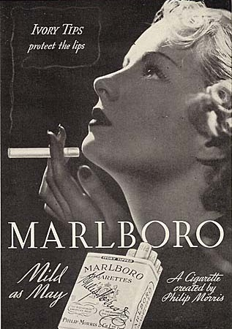
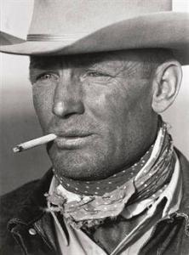
Historical example of Assimilation
Product recombination as a Assimilation
1950s cancer studies caused a desire in men to smoke filters
They could not: filter cigarettes were considered effeminate
Masculine-Filtered combination would be rich new market
Filtered
Unfiltered
Filtered
Protection
Masculine
Masculine
Women cig.
Men cig.
Men cig.
Radical change in product image
Marlboro makes the new market of filters-for-men
Original filter meaning : protection
Marlboro product recombination : macho

Slide 14


Results of Marlboro Assimilation
Marlboro’s new concept was organized and implemented into a marketing campaign that was introduced in November of 1954.
Sales of Marlboro went from 18 million cigarettes in 1954 to over 5 billion in 1955
Sales increased 3,241% in that single year. Marlboro became one of the great money making machines of the 20th century.
A radical change in the product concept created a new market
and long-lasting market leadership.
Notice also the change of other
attributes
[1] Barnett, H. (1953). Innovation: The Basis of Cultural Change. New York, NY: McGraw-Hill.
[2] Gershman, M. (1990). Getting It Right. Reading, MA: Addison-Wesley.

Slide 15
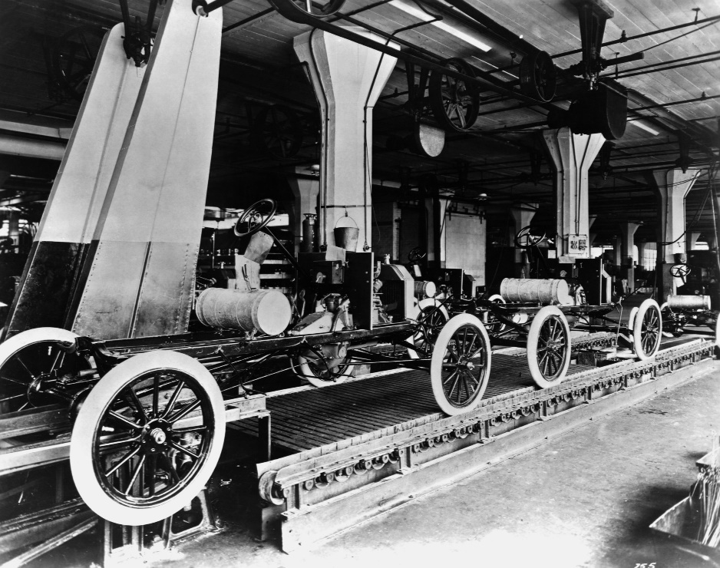
Automobile Assembly line
Auto
Packing
Auto
Slow
Hi-cost
Fast
Lo-cost
Fast
Lo-Cost
Craftsman
Stations
Assembly
line
Assembly
line
The recombination of meat packing and custom automobile manufacturing
[1] Hargadon, A. (2003). How Breakthroughs Happen. Boston, MA: Harvard Business School Press.

Slide 16
Recombination formal definitions
Dissimilation
Elimination of redundant functionality
If A,B,C… perform the same function, a service can be provided, eliminating need for all the separate components: potentially better efficiency
Useful for explaining innovations in information technology industry

Slide 17
Dissimilation historical example
From On-premise above
To Cloud Technology on the right

Slide 18
Recombination Methods
Parallels or Analogies
Specific type of Assimilation
The projection of only the relationship from one pair of correlates to another
Y
B
B
R2
R1
R2
X
A
A
Design Patterns in software industry are an example

Slide 19
Parallel historical example
Brand recombination as a parallel
In early 1980s Harley Davidson on verge of 3rd bankruptcy
Poor results when marketing as a hobby: little traction with target market
Harley could not compete as transportation so competed as transformation
The happy hobby image of the old Harley was contrary to the need of the target professional but the rebel did have appeal
Motorcycle gangs
Professionals
Professionals
Hobby
Rebel
Rebel
Camaraderie
Camaraderie
Harley
Motorcycles
Harley
[1] Bowman, C. & R. Schoenberg (2008). From Customer Understanding to Strategy Innovation: Practical Tools to Establish Competitive Positioning. In Galavan, R., J. Murray, & C. Markides (Eds). Strategy, Innovation, and Change (38-57). Norfolk: Oxford University Press.
[2] Bignell, J. (2002). Media Semiotics. Manchester, England: Manchester University Press.
[3] Pascale, R. & E. Christiansen (1983a). Honda (A). Boston, MA: Harvard Business School Publishing, case 9-384-049. (Revised October 26, 1989).
[4] Zaltman, G. & L. Zaltman (2008). Marketing Metaphoria. Boston, MA: Harvard Business School Press.

Slide 20
Parallel historical results
Haley presented an effective image
Harley’s attempts to stay alive in the motorcycle market as a hobby were disappointing because it lacked appeal to the lucrative target market
Professionals felt repressed in their work life and social life
Professionals were not buying hardware, or even a lifestyle. They were buying redemption from their entrapment in dead world.
A Harley-Davidson motorcycle was the transformation bridge for a Rebel joining a tribe.
Sales increased 30% compounded since ‘86
[1] Peak, M. (1993). Harley-Davidson: Going whole hog to provide stakeholder satisfaction. Management Review 82(6), 53-56. Retrieved from EBSCOHOST.
[2] Zaltman, G. & L. Zaltman (2008). Marketing Metaphoria. Boston, MA: Harvard Business School Press.

Slide 21
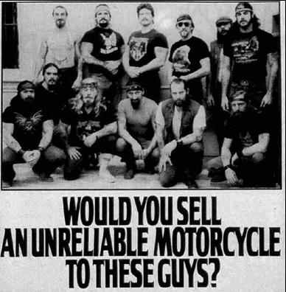
Professional as Warrior
[1] Peak, M. (1993). Harley-Davidson: Going whole hog to provide stakeholder satisfaction. Management Review 82(6), 53-56. Retrieved from EBSCOHOST.
[2] Zaltman, G. & L. Zaltman (2008). Marketing Metaphoria. Boston, MA: Harvard Business School Press.

Slide 22
Actions by GVT
In Comprehensive innovation process

Slide 23
Product or system Recombination Process
The process works on inputs to create an output
Recombination as Assimilation, dissimilation or parallel
Inputs are old product, related concepts that have target performance
Old product
Combiner
Assimilation Technique
OR
Discriminatory Dissimilation Technique
OR
Parallel Technique
New Product
Correlate
Attributes

Slide 24
Product Recombination Process
Harley Example
Combiner
Harley as hobby
Harley as camaraderie
Motorcycle gangs with camaraderie

Slide 25
Searching for Combination Ideas
Need search strategies to find interesting new concepts to recombine with current product or process
Effective strategies for finding new concepts reduce search costs
Information Search
Ogden/Crovitz Relational Algorithm
Davis Reversal of Relational Assumptions
Boundary Spanning
Preemptive Claims
Old product
Correlate Attributes

Slide 26
Ogden/Crovitz Relational Algorithm
Crovitz views innovation as a recombination
A combination is a relationship between two objects
Ogden/Crovitz Relational Algorithm uses 42 relational words, shown below, to search for new concepts to consider
For example, consider Harley
Using the from relational word leads to question: Where did Harley come from – motorcycle gangs not hobbyists.
What is the salient aspect of motorcycle gangs: rebels with camaraderie
Is the target against this aspect or for it?
[1] Crovitz, H. (1970). Galton’s Walk. Methods for the Analysis of Thinking, Intelligence, and Creativity. New York, NY: Harper & Row, Publishers.
[2] Ogden, C. (1934). The System of Basic English. New York, NY: Harcourt Brace
.

Slide 27
Reversal of Assumptions
From organizing theory, Davis identifies 12 relationship assumptions that are listed below.
To search for interesting ideas, examine the reverse of an assumption
Function | If an entity is assumed to be ineffective at some activity, look for possibility that it is instead functional.
Generalization | If the assumption is that the relationship applies generally, look for the possibility that it is instead a specific relationship. The converse is also guidance.
Organization | If the assumption is that the relationship is unstructured, look for the possibility that it is actually structured. Again, the converse is also guidance.
Causation | If the assumption is that one entity in the relation causes the other, look for the possibility that there is no causation.
Opposition | If the assumption is that entities are similar, look for the possibility they are opposites. Vice Versa.
Co-variance | If the assumption is an inverse relationship in two entities, look for possibility they have a direct relationship.
Curvilinear | This is also known as the fallacy of linear expectations - that events will go on as they always have. Instead look for threshold or tipping point possibilities.
Co-existence | If the relationship between entities is assumed to be incompatible, look for possibility that they are compatible. Vice Versa.
Co-relation | If the assumption is that entities are interrelated, look for possibility that they are independent.
Composition | If an entity is assumed to be one absolute unity, look for possibility that it is composed of interacting components.
Evaluation | If the relationship is assumed to unjust or otherwise detrimental, look for possibility that it is just.
Stabilization | If the relationship between entities is assumed to be stable, look for possibility that it can break apart.
[1] Davis, M. (1971). That's Interesting! Towards a Phenomenology of Sociology and a Sociology of Phenomenology. Philosophy of Social Science, 1(1971), 309-344.

Slide 28
Reversal of Assumptions
As an example, consider the functional assumption
If the assumption is that the relationship is dysfunctional then examine the possibility that it is functional instead
Automobiles were considered dysfunctional at safety in the 1960s and 1970s
Volvo challenged this assumption and built a design concept around a safe automobile
Volvo created the new market of safe automobiles

Slide 29
Boundary Spanning
A third search strategy is boundary spanning
Recommended by Barnett, Kim & Mauborgne, Gratton
Crossing various boundaries in the search for related concepts, correlates, to a product ‘s or process’s performance
Study alternative products or services
Study complementary products
Study value chain
Study trends and history related to product and industry
[1] Barnett, H. (1953). Innovation: The Basis of Cultural Change. New York, NY: McGraw-Hill.
[2] Gratton, L. (2008). Nurturing innovation hot spots. In Galavan, R., J. Murray, & C. Markides (Eds). Strategy, Innovation, and Change (254-269). Norfolk: Oxford University Press
[3] Kim, W. & R. Mauborgne (2005). Blue Ocean Strategy: How to Create Uncontested Market Space and Make Competition Irrelevant. Boston, MA: Harvard Business Review Press

Slide 30
Product Recombination Process Adding Search
Information Search
Crovitz Relational Algorithm
Davis Reversal of Relational Assumptions
Boundary Spanning
Preemptive Claims
Old product
Correlate attributes
Search strategies look for an inventory of candidate attributes and potential performance relationships
Combiner uses them to create a new product design
Combiner
Old product
Assimilation Technique
OR
Discriminatory Dissimilation Technique
OR
Parallel Technique
New Product
Correlate
attributes

Slide 31
Evaluating a Candidate
The Product Recombination Process creates potential new concepts that must be evaluated for viability
The following are essential criteria for a successful change
Is it a new product or process environment?
Is there a desire/need for change by current customer/stakeholder, a dissatisfaction or concern to be reduced?
Is there an advantage to the change?
Is there infrastructure that supports the opportunity?
Will the market/environment support the price/cost?
Does the opportunity have adequate quality?
Does market/environment have adequate size to generate expected results?

Slide 32
Evaluation Example
Heinz extended its vinegar product line and added a cleaning product
This was a crowded and hotly contested environment, NOT a new one
There was NO general dissatisfaction with cleaning products
There was infrastructure to support the opportunity
The price and quality was comparable to other cleaning products
There was an advantage in using natural ingredients
The potential market appeared small
Market niche did not grow, product withdrawn
[1] Chapman, M. (2006). In Search of Stupidity. Berkeley, CA: Apress.

Slide 33
Product Recombination Process
Information Search
Crovitz Relational Algorithm
Davis Reversal of Relational Assumptions
Boundary Spanning
Preemptive Claims
Old product
Correlate Attributes
Combiner
Old product
Assimilation Technique
OR
Discriminatory Dissimilation Technique
OR
Parallel Technique
Candidate New Product
Correlate
Attributes
Candidate New Product
Viability Test
New Product

Slide 34
Selecting team
For innovation

Slide 35
Adding variety through Virtual teams
An important governing principle for selecting team members is the Law of Requisite Variety.
This law states that the variety of knowledge in an organization must be at least as great as the environmental variety that it is attempting to influence. Ashby gives an example in photography:
A photographer has 5 subjects each at a different distance from the camera.
The photographer’s camera must have 5 distinct setting to capture all subjects with uniform density and clarity
If the camera has fewer than 5 settings it lacks requisite variety and will not register with sufficient detail to depict all scenes with accuracy
Choose the team so it has knowledge from the variety of necessary domains to analyze its current situation and accomplish its assigned mission
[1] Ashby, R. (1956). An Introduction to Cybernetics. New York, NY: John Wiley.
[2] Weick, K. (1979). The Social Psychology of Organizing. New York, NY: McGraw-Hill.

Slide 36
Innovation and collaborative technology
For requisite variety, knowledge access and utilization are both relevant.
Distributed knowledge must be identified, retrieved and exploited in order to ignite creative forces in the team and direct them to accomplish the mission
Information and collaboration technology affect these identification, retrieval and exploitation of knowledge
An organization will not realize its innovation potential without effective collaboration technology to support virtual team interaction
[1] Gressgård, L. (2011). Virtual team collaboration and innovation in organizations. Team Performance Management. Mar2011, Vol. 17 Issue 1, p102-119. 18p.
[2] Gratton, L. (2008). Nurturing innovation hot spots. In Galavan, R., J. Murray, & C. Markides (Eds). Strategy, Innovation, and Change (254-269). Norfolk: Oxford University Press

Slide 37
Innovation and virtual workspaces

Slide 38
Internal coworking Hubs in organizations
The “heart of an organization’s ability to innovate” is greater collaboration, which is supported with intuitive rather than sophisticated collaboration tools
A new organization design is rapidly sweeping the work world: virtual coworking hubs that support this greater collaboration and resulting innovation
They are an application of Urban Hubs
[1] Johns, T. & L. Gratton (2013). The Third Wave of Virtual Work. Harvard Business Review Reprint R1301D
[2] Microsoft (1994). Solutions Development Discipline. Redmond: Microsoft.

Slide 39
Urban Hubs
Urban hubs are community based, collaborative workspaces that workers use, because of their convenience, in lieu of commuting to work
Urban hubs are frequented by talented and creative people who often work as external consultants to organizations
Some examples are Citizen Space in San Francisco, San Jose and Las Vegas; Somerset House in London; the Hub in Amsterdam
[1] Johns, T. & L. Gratton (2013). The Third Wave of Virtual Work. Harvard Business Review Reprint R1301D

Slide 40
Internal coworking Hubs in organizations
The concept of open space and a casual design for a workspace is being applied by corporations as well, replacing the cubicle farms of today
These spaces reflect a sharp contrast between the old and new work models
The new model is founded on the virtual collaborative work rules we have previously discussed
Such virtual hubs must have the right culture, the right talent and apply the right virtual leadership principles
In leading organizations, adaptable community workspaces are replacing offices and cubicle farms
[1] Johns, T. & L. Gratton (2013). The Third Wave of Virtual Work. Harvard Business Review Reprint R1301D

Slide 41
Internal coworking Hubs in organizations
These coworking hubs are the culmination of change started with Hayek’s observation that relevant problem related knowledge is distributed
Organizations recognized the need for improved information sharing and collaboration to tap into and leverage that distributed knowledge
All to support the driving need to leverage all relevant knowledge so to innovate

