Slide 1
ENMG 661: Overview of the course
Introduction to global virtual teams
Review of the technology used in course

Slide 2
World going virtual
New expectations
Skills and information are available on demand
World more tightly knit
Technology enhanced productivity and the industrialization of emerging countries has created a world-wide supply that exceeds demand
To survive, innovation is essential and it must leverage distributed knowledge
The greatest obstacle to becoming truly effective in this world is lack of leaders prepared to thrive in the new virtual paradigm
Competitors and military adversaries employ virtual technologies
Presence of purely local teams is disappearing
Worldwide mobile workforce now tops 1 billion
[1] Kim, W. & R. Mauborgne (2009, September). How strategy shapes structure. Harvard Business Review
[2] Cochrum, K.. (2013). Close: Leading Well Across Distance and Cultures. Amazon: On-Demand Publishing LLC.
P188, 204

Slide 3
World going virtual
Old Rules
Work is a location
Work is 9-5
Staff need controller
Relations must be face-to-face
New Rules
Work is accomplishing tasks
Work is from time assigned to time done
Staff are responsible agents – if you need to control your staff, you hired the wrong staff
Relations can be with almost anyone at anytime
Work is becoming more people centric and less place centric
[1] Kuhnert, K. & P. Lewis (1987). Transactional and transformational leadership: A constructive/developmental analysis. Academy of Management Review, 12(4), 648-657
[2] Tichy, N. (1997). The leadership engine. New York, NY: Harper Business
[3] Levine, Locke, Searls & Weinberger (2001). The Cluetrain Manifesto: The End of Business as Usual. Basic Books.
[4] Cochrum, K.. (2013). Close: Leading Well Across Distance and Cultures. Amazon: On-Demand Publishing LLC.
P215-224. 233
[5] Beyerlein, M., J. Nemiro & S. Beyerlein (2008). A Framework for Working Across Boundaries. In Nemiro, J., M. Beyerlein, L. Bradley, S. Beyerlein (Eds). The Handbook of High-Performance Virtual Teams (31-57). San Francisco: Jossey-Bass.

Slide 4
This course
Examines Global and Virtual Teams from a variety of perspectives
Distributed knowledge
Leadership Theory
Integrated Communications Management
Technology
Culture
Legal
Information sharing and collaboration toolsets
Problem Solving
The result will be clear guidelines on how to organize and operate these teams

Slide 5
Course overview
The first half of the class is the theory for leading global virtual teams
By class session 7, we will have completed the theory portion of the course and will take the theory exam
Likewise, postings and responses will be completed
The second half of the course is practical matters for leading global virtual teams.
Group projects and term papers will be completed during the second half
In Lecture 2, we examine why virtual teams are formed: because people in different locations have knowledge we need.
The recognition about the decentralized nature of knowledge is changing the old authoritative management hierarchies.
Networks of teams are being introduced to understand and adapt to new environments.

Slide 6
Course overview
In Lecture 3, we apply leadership theories to global virtual teams
The global virtual team is an emerging form of organization that needs different management than the rigid hierarchical form
Different theories of leadership are introduced and examined for fitness in leading global virtual teams
In Lecture 4, communication principles tailored for virtual teams are presented
Communications is the force that restores the cohesion, coordination and control that is undermined by distance, time and cultural difference
Principles for effective communications are surveyed
How to prepare a communication plan is presented

Slide 7
Course overview
In Lecture 5, we study the impact of culture on global virtual teams
Advances in communication have made globalization a reality but also created the need to deal with different cultures
The Hofstede and Hall models are widely used for understanding different cultures and their effect on business
In Lecture 6, we review the role of technology in virtual teams and principles for effectively employing it
Determining technology needs; appropriately matching technology to task
Global technology considerations

Slide 8
Course overview
In Lecture 7, technical tools will be reviewed
Examine the attributes of good collaboration tools
Web conferencing tools
Forums, wikis and blog tools
In Lecture 8, we continue discussing technical tools
Collaborative platforms
Integrated collaboration environments
In Lecture 9, we investigate team building
The five critical functions in building a successful team
Purpose of team charter
Coaching
Barriers to building a global virtual team and how they can be mitigated

Slide 9
Course overview
In Lecture 10, legal issues will be discussed
Global teams are more vulnerable to certain legal issues
Discuss records management
Discuss discrimination, wages and hours, disability accommodation, intellectual property and contracting
In Lecture 11, we investigate innovation theory
Recombination as innovation
Idea generation and search strategies
In Lecture 12, we investigate problem solving
The problem solving process
Techniques for hard problems: Analogy, Sagacity, Stepwise refinement, Heuristics, Induction, Mastery over pedantry, Think”ing”, Mutating metaphors

Slide 10
Course Overview: What is a virtual Team
Group versus Team
A team is a group of individuals who have committed to accomplishing the goals of the group
Team building is a critical process: it transforms a group of individuals into a cohesive team
The manager accomplishes team building: encouraging group members to embrace the project goals, and builds trust and cohesiveness
Trust is key element
Built on genuine concern
Leader is advocate for team members
Leader understands what is occurring in the team’s world
[1] Cochrum, K.. (2013). Close: Leading Well Across Distance and Cultures. Amazon: On-Demand Publishing LLC, p 528.
[2] Pocket Mentor (2010). Leading Virtual Teams. Boston: Harvard Business Press
[3] Allen, J. (2009). Building a group into a team. Internet Journal of Healthcare Administration, 6(1), 3.

Slide 11
Course Overview: What is a virtual Team
A virtual team is not co-located but instead linked through a variety of communication methods
In the past, through letters, orders, or messengers as exemplified by the military or religious orders
Today, through email, telephone, teleconferencing, video conferencing or Web conferencing and digital workspaces such as team Web sites.
Virtual Team membership
Company employees in different locations, potentially globally located
External stakeholders in different locations, potentially globally located
[1] Cochrum, K.. (2013). Close: Leading Well Across Distance and Cultures. Amazon: On-Demand Publishing LLC, p 392.
[2] Pocket Mentor (2010). Leading Virtual Teams. Boston: Harvard Business Press
[3] Allen, J. (2009). Building a group into a team. Internet Journal of Healthcare Administration, 6(1), 3.

Slide 12
Course Overview: What is a virtual Team
Core management doctrines that govern the leadership of a virtual team are those of a co-located team
Clarity of goals
Enlist the right resources and skills
Motivate commitment to team goals
Foster collaboration and information sharing
Space and time differences make it more challenging to apply these doctrines and organize a group of individuals into a team
Modern technology is offered as a mitigation to the difficulties presented by space and time
In using modern technology, virtual teams also encounter technical challenges
[1] Cochrum, K.. (2013). Close: Leading Well Across Distance and Cultures. Amazon: On-Demand Publishing LLC.
[2] Pocket Mentor (2010). Leading Virtual Teams. Boston: Harvard Business Press

Slide 13
Course overview: A Case history
2000 years ago, the Apostle Paul developed a virtual organization across the Mediterranean that eventually went world-wide
Paul’s methods
Started with face-to-face meeting
Rapidly appointed local leaders, liaisons, in each location to minimize cultural friction
Kept repeating the vision to the team, the distributed churches
Worked by proxy – sending agents to the teams
Worked through letters to communicate
[1] Cochrum, K.. (2013). Close: Leading Well Across Distance and Cultures. Amazon: On-Demand Publishing LLC, p 392, 402, 409

Slide 14
Course overview: A Case history
Paul’s methods con’t
Promoted shared leadership
Mutual respect fostered with local churches
Aggressively trusted others with the mission
Gave power away
Technology of the day was pen and paper
In the course we will review modern success stories that use modern technology but use the same leadership principles
Global instrumentation companies
US Army
Surgical teams
Academic conferences
[1] Cochrum, K.. (2013). Close: Leading Well Across Distance and Cultures. Amazon: On-Demand Publishing LLC, p 449

Slide 15
Course overview: virtual Leadership functions
Cast the vision
Set direction
Inspire, motivate
Align work to mission
Communicate, coach
Delegate
[1] Andersson, D. (2005). The Spatial Nature Of Entrepreneurship. The Quarterly Journal of Austrian Economics, 8(2), 21–34
[2] Cochrum, K.. (2013). Close: Leading Well Across Distance and Cultures. Amazon: On-Demand Publishing LLC.
[3] Pocket Mentor (2010). Leading Virtual Teams. Boston: Harvard Business Press

Slide 16
Course Overview: Why have a virtual Team
Leverage distributed knowledge
Virtual teams can integrate extremely diverse set of skills and knowledge
In a global organization, it is critical to incorporate local knowledge from each area of operation
Law of Requisite Variety
Cultural diversity
Team can work 24 hours per day
[1] Galavan, G., Murray, J. and Markides, C. (2008). Strategy, Innovation and Change. Oxford University Press.
[2] Nugent, J. (2010). Plan To Win: Analytical And Operational Tools - Gaining Competitive Advantage. SMC University.
[3] Cochrum, K.. (2013). Close: Leading Well Across Distance and Cultures. Amazon: On-Demand Publishing LLC.
[4] Pocket Mentor (2010). Leading Virtual Teams. Boston: Harvard Business Press
[5] Ashby, W. (1956). Introduction to Cybernetics. John Wiley
[6] Finkelstein, Clive (2006). Enterprise Architecture for Integration. Artech House
[7] Sotirovski, Drasko (May/June 2001). “Heuristics for Iterative Software Development”, Raytheon. Retrieved from http://www.computer.org/portal/web/csdl/doi/10.1109/52.922728

Slide 17
Lectures
Synthesize key points from readings on PowerPoint presentation deck
Additional information from readings is discussed as we progress through lecture and is associated with key point slides but not on them
Lectures will be recorded with Blackboard and Youtube links sent to the entire class as soon as the process is complete
Some limits on what can be done online with Blackboard depend on the capacity of the client machines
We will target functionality that works on smartphone and tablet

Slide 18
Grading
Discussion postings 25%
Theory exam 25%
Term paper 25%
Group project 25%

Slide 19
Theory Exam
Will be given during the 7th class period.
The questions will be presented to you in an e-mail and you will have 24 hours to complete the exam.

Slide 20
Group Project
Four groups with four /five members
Groups should collaborate virtually
Deliverables are:
Team Charter
Team Directory
Team Rules of Behavior
Staffing plan
Collaborative Technology Plan
Communications Plan
The required elements for each deliverable are in the project assignment which is on Blackboard now

Slide 21
Term Paper
You will be writing a formal critique of an academic journal article
Guidelines for writing a journal critique are found on the Blackboard site
These guidelines must be followed in your paper
Additionally, APA citing guidelines must be followed and can be found on the Blackboard site

Slide 22
Our tools in this course

Slide 23
Technology we will use
Blackboard: discussion boards, document repository, recording function
Youtube
Email
Zoom

Slide 24
Things to know
EBSCO
JSTOR
APA
RT.umbc.edu

Slide 25
blackboard

Slide 26
Blackboard Tools
BlackBoard is an eLearning tool used by the University of Maryland
We will take advantage of its collaboration features to manage the class and simultaneously gains hands-on experience with virtual team tools
With these collaboration tools you will participate in weekly discussions, and present group projects.

Slide 27
Discussion Board

Slide 28
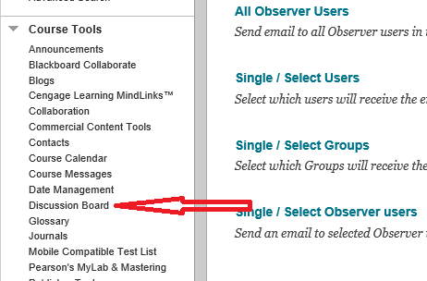
Discussion Board
As with Collaborate, Discussion Board is accessed in the Course Tools Section
Click the Discussion Board link on the Blackboard left-side menu

Slide 29
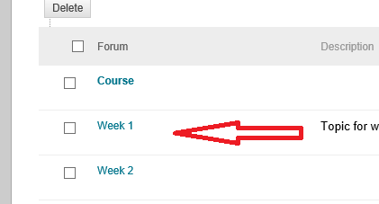
Discussion Board
A list of forums in the ENMG 661 Discussion Board will be displayed.
Click on a forum to select it, for example the Week 1 forum

Slide 30
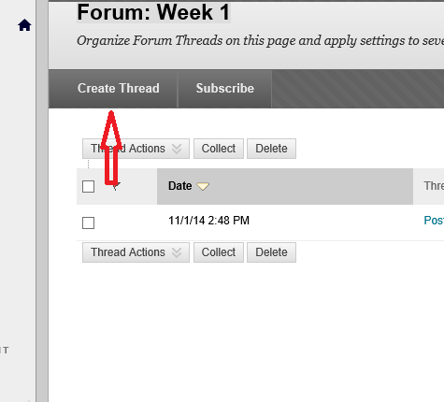
Discussion Board
You will see the posts of other students listed as threads
To create your post, click the Create Thread button

Slide 31
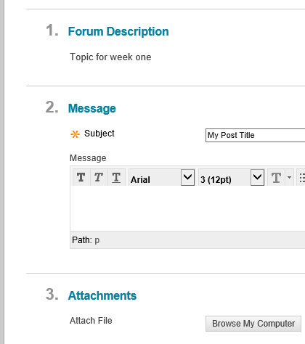
Discussion Board
Enter the title of your post
Type in the body of your post
Click the browse my computer if you want to add attachments
When finished, click the submit button

Slide 32
Demo
Blackboard:
Posting and responding on discussions

Slide 33
Using Online Libraries

Slide 34
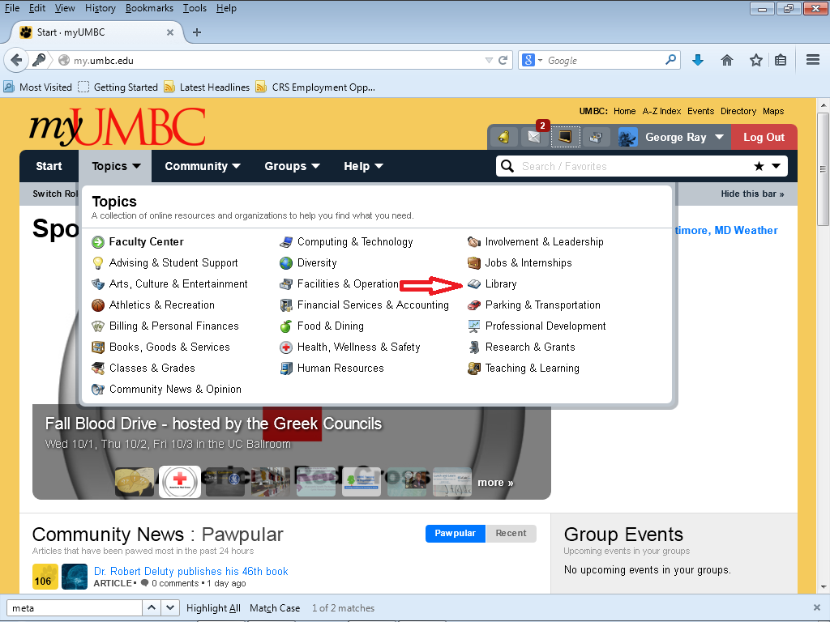
On-line Libraries
Another resource available for you from the myUMBC portal is on-line libraries
To access them, click on Library

Slide 35
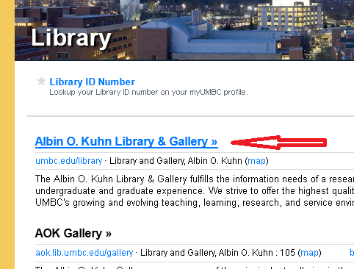
On-line Libraries
At the Library Site, click on the Albin O. Kuhn Library Link

Slide 36
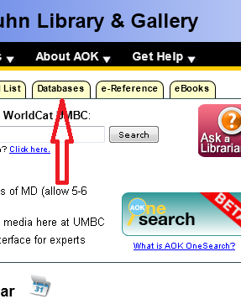
On-line Libraries
Click on the Databases tab to select the database to use

Slide 37
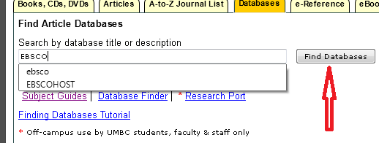
On-line Libraries
Type in the online library
We will use EBSCO and JSTOR
Then click find databases

Slide 38
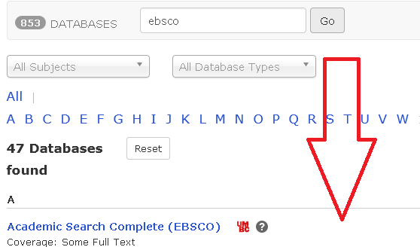
On-line Libraries
For the given library, you then be asked to select the databases you would like to access
JSTOR has only one choice
EBSCO has multiple
Business Source Premier is a good starting point for EBSCO
You can choose other databases once you begin searching for article

Slide 39
Demo
Using libraries

Slide 40
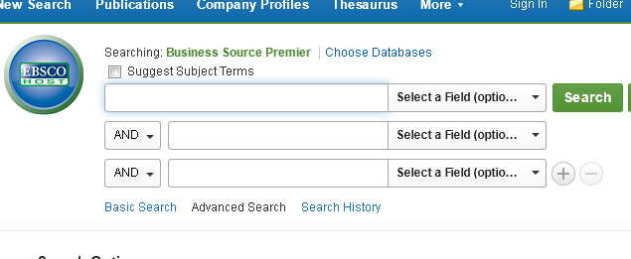
On-line Libraries
Both EBSCO and JSTOR have standard search interfaces and should be intuitively obvious to you

