Slide 1
Technology tools
Virtual Management: bridge to 21st Century Organization

Slide 2
Topics
Exam Review
Group Project and Myers:Briggs Personality Inventory
Group Exercise
Lecture 8
Categories of collaboration tool
Case Study CISSE International Conference
Text Analytics

Slide 3
Exam review

Slide 4
Personality AND global virtual teams
Specific to individual
Personality
Specific to group
Culture
Universal to all
Human Nature
[1] Carmel, E. & P. Tjia (2005). Offshoring information technology. Cambridge, United Kingdom: Cambridge University Press

Slide 5
Personality AND global virtual teams
Personality is how an individual usually approaches or responds to similar situations
For example, two people may have a need for reducing stress but approach it very differently
One may seek out solitude and relax by quietly reading a book
Another may relax by partying with friends and meeting new acquaintances
To accomplish the same goal, two different personality types behave very differently
[1] Hawkins, D., D. Mothersbaugh & R. Best (2007). Consumer behavior. McGraw-Hill/Irwin.
[2] Wallace, A. (1963). Culture and Personality. New York, NY: Random House.
[3] Boeree, G. (2009). Trait Theories of Personality. Retrieved from http://webspace.ship.edu/cgboer/genpsytraits.html

Slide 6
Personality AND global virtual teams
Just as with leadership, there are different categories of personality theory
One of the leading categories is trait theories, which includes one of the most popular personality inventories today: Myers-Briggs
Trait theories assert that people have inborn temperaments that lead to their actions
Trait theories assume that these central tendencies are inborn or formed early in life and they are fairly fixed throughout our lives
[1] Hawkins, D., D. Mothersbaugh & R. Best (2007). Consumer behavior. McGraw-Hill/Irwin.
[2] Wallace, A. (1963). Culture and Personality. New York, NY: Random House.
[3] Boeree, G. (2009). Trait Theories of Personality. Retrieved from http://webspace.ship.edu/cgboer/genpsytraits.html

Slide 7
Personality AND global virtual teams
Multitrait theories look at several traits and see them in opposition
Myers-Briggs has four such opposition pairings of traits.
Introversion-Extroversion
Sensing-Intuiting
Thinking-Feeling
Judging-Perceiving
[1] Hawkins, D., D. Mothersbaugh & R. Best (2007). Consumer behavior. McGraw-Hill/Irwin.
[2] Wallace, A. (1963). Culture and Personality. New York, NY: Random House.
[3] Boeree, G. (2009). Trait Theories of Personality. Retrieved from http://webspace.ship.edu/cgboer/genpsytraits.html

Slide 8
Personality AND global virtual teams
There are many variations of Myers-Briggs and it is a favorite with corporate trainers
These are usually 3 day courses that explore all of the ramifications
Here is a link to a simplified Myers-Briggs personality inventory:
http://www.humanmetrics.com/cgi-win/JTypes1.htm
[1] Hawkins, D., D. Mothersbaugh & R. Best (2007). Consumer behavior. McGraw-Hill/Irwin.
[2] Wallace, A. (1963). Culture and Personality. New York, NY: Random House.
[3] Boeree, G. (2009). Trait Theories of Personality. Retrieved from http://webspace.ship.edu/cgboer/genpsytraits.html

Slide 9
Personality AND global virtual teams
After completion of the inventory you get a four letter indicator of your type:
I for introvert or E for extravert,
S for sensing or N for intuiting,
T for thinking or F for feeling,
J for judging or P for perceiving.
[1] Hawkins, D., D. Mothersbaugh & R. Best (2007). Consumer behavior. McGraw-Hill/Irwin.
[2] Wallace, A. (1963). Culture and Personality. New York, NY: Random House.
[3] Boeree, G. (2009). Trait Theories of Personality. Retrieved from http://webspace.ship.edu/cgboer/genpsytraits.html

Slide 10
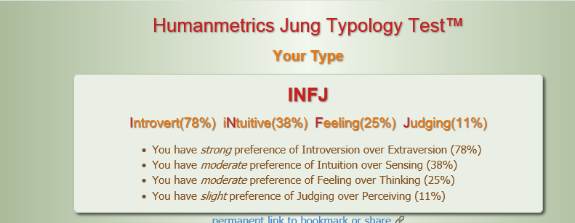
Personality AND global virtual teams
Here is my type index
None of the types is right or wrong – its just the way you are.

Slide 11
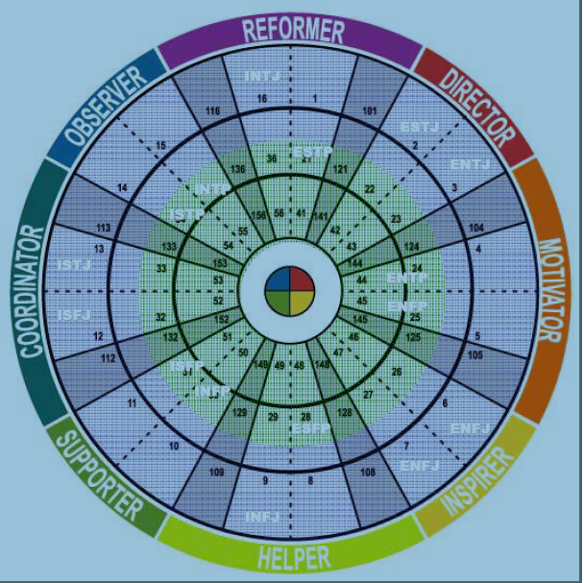
[1] Insights.com (2014). Comparison of Insights Discovery System to Myers-Briggs Type Indicator. Retrieved from http://www.inside-inspiration.com.au/factsheets/insights-discovery-and-mbti-comparison.pdf

Slide 12
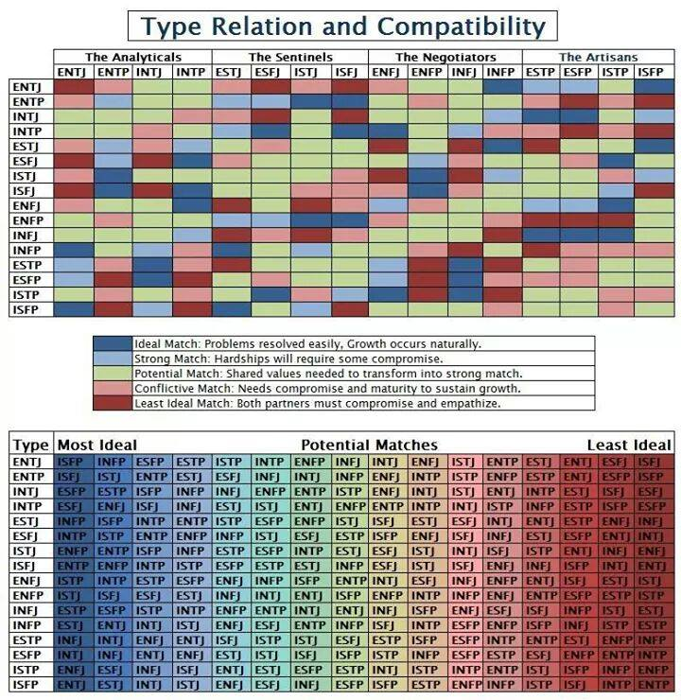
[1] Personality Cafe (2014). MBTI Type Compatibility Chart similar to Socionics Intertype Relations. Retrieved from http://personalitycafe.com/socionics-forum/338458-mbti-type-compatibility-chart-similar-socionics-intertype-relations.html.

Slide 13
Personality AND global virtual teams
Blue
Weaknesses
1. Get bogged down in details
2. Rigid on methods
3. Sensitive to criticism
4. Tends to be pessimistic
Needs others to provide
1. Rapid decision making
2. Optimism
Green
Weaknesses
1. Resist change
2. Misses deadlines
3. Procrastinates
4. Indecisive
Needs others to help
1. Introduce new challenges
2. Solving complex problems
3. Provide initiative
[1] Blue Harvest (2005). The Four Color Personality Test, What color are you? Retrieved from http://forum.blueharvest.net/index.php?showtopic=5883 .

Slide 14
Personality AND global virtual teams
Red
Weaknesses
1. Insensitive
2. Impatient, overlook risks
3. Inflexible and demanding
4. Resents restrictions
Needs others to provide
1. Attention to task
2. Risk awareness
3. Consider facts and details
Yellow
Weaknesses
1. Not completing commitments
2. Overestimating abilities
3. Acting impetuously
4. Jumping to conclusions
Needs others to provide
1. Complete all details
2. Focus on work
3. Rational approach
[1] Blue Harvest (2005). The Four Color Personality Test, What color are you? Retrieved from http://forum.blueharvest.net/index.php?showtopic=5883 .

Slide 15
Project Groups

Slide 16
Group exercise

Slide 17
Text Analytics

Slide 18
Qualitative Analysis
Non-numeric means of acquiring an in-depth understanding of an activity, event or topic
Methods historically rely on in-depth exploration by small groups of people to guide and support the construction of ideas, hypothesis or review. There are several types of qualitative analysis. Two approaches are case and emergent studies
A case study is research into an issue and a case or cases are selected to illustrate the issue. Case studies have a theoretical point of view and the cases in review are explained by that theory or potentially refute the theory.
An emergent study, in contrast, does not have a pre-existing theoretical framework. Instead, a pattern is expected to emerge from the analysis of the cases
In case studies, codes for categorizing the text can be derived from existing theory. Not so for emergent where codes must emerge from the research
[1] Merriam, S. (2002). Qualitative Research in Practice: Examples for Discussion and Analysis. San Francisco, CA: Jossey-Bass
[2] Drolet, J. & C. Tonay (2010, June 3). Are Analytic Tools Adequate for Qualitative Analysis? iModerate Research Technologies.
[3] Crowstona, K., et al (2010, May 30). Using natural language processing technology for qualitative data analysis. Syracuse University

Slide 19
Qualitative research management
Qualitative analysis labels, stores and retrieves data according to coded categories.
Categorical aggregation is used to classify cases into a taxonomy based on codes that are assigned during the analysis.
One goal of classifying is to identify similarities and differences between the cases.
To accomplish this, the researcher analyzes each case individually for themes.
Next, analysis is done to identify common themes across collection.
Patterns are recognized: relationships that are a correspondence between categories.
[1] Merriam, S. (2002). Qualitative Research in Practice: Examples for Discussion and Analysis. San Francisco, CA: Jossey-Bass
[2] Drolet, J. & C. Tonay (2010, June 3). Are Analytic Tools Adequate for Qualitative Analysis? iModerate Research Technologies.
[3] Crowstona, K., et al (2010, May 30). Using natural language processing technology for qualitative data analysis. Syracuse University

Slide 20
Qualitative research management
Data interpretation is pulling apart data and putting it back together again, in more meaningful ways.
Goal is to generate naturalistic generalizations that apply to other populations.
Interpreting findings to add value to the issue or concern that motivated the study.
Six Stages to qualitative analysis
Organizing: Create and organize files for data
Memoing: Read through the text, make margin notes, form initial codes
Describing: Describe the case and its context
Classifying: Use categorical aggregation to establish themes or patterns
Interpreting: Explain a case with naturalistic abstraction
Representing: Present an in-depth picture of the cases using narrative, tables and figures.
[1] Creswell, J. (2012). Qualitative Inquiry & Research Design: Choosing Among Five Approaches Third Edition. Thousand Oaks, CA: Sage Publications

Slide 21
Text Analytics
Text analytics is the application of natural language processing to document and directory collections
The intent is to turn raw text into data for analysis
A wide variety of techniques from artificial intelligence and machine learning are applied in Text Analytics to the various stages of qualitative analysis
TextOre is a text analytics tools that works with SharePoint for knowledge discovery work

Slide 22
Demo
Qualitative Analysis
(Summary, bigram analysis, simple grammars)

Slide 23
Collaboration tools

Slide 24
Attributes of good collaboration tools
Simplicity: For the administrator/host, it should be easy to install and manage, especially in setting up meetings. For participants, it should be intuitive and easily usable. Simplicity keeps the tool from distracting from the collaboration.
Standardization: For inter-organization and inter-department compatibility, collaboration tools should be based on industry standards.
Reliability: Technical glitches in an otherwise simple to use tool, distracts people from collaboration and focuses their attention on the glitch.
Security: Security is essential when working on vital tasks for the organization to preclude the disclosure of strategic direction or the theft of intellectual property.
[1] Baasch, W (2002). Group Collaboration in Organizations: Architectures, Methodologies, and Tools. Monterey, CA: Naval Postgraduate School.

Slide 25
Attributes of good collaboration tools
Interoperability: You will be using a variety of tools so it is beneficial if they can exchange data .
Configurability: Different workgroups will have different needs, so the tool must be easily adjustable to increase, decrease, add or remove certain functionality
Web-based: The world connects through the Internet, so a Web based tool lets a team leverage that connection
[1] Baasch, W (2002). Group Collaboration in Organizations: Architectures, Methodologies, and Tools. Monterey, CA: Naval Postgraduate School.

Slide 26
Case study: CISSE Conference
Computer, Information, and SystemsSciences, and Engineering

Slide 27
Computer, Information, and Systems Sciences, and Engineering (CISSE)
Scientific conferences have advanced science over the centuries through knowledge sharing and the exchange of ideas that otherwise were local
Today these events are comprised mainly by American and Western European researchers
This has been the result of the following factors:
Travel and hoteling costs
Time out of office
Visa’s
Schools in the developing world are reluctant to pay for attending these events or to allow time off of work duties
[1] Sobh, T. & S. Patel (2008). On-line Virtual Real-Time E-Collaboration:An Innovative Case Study on Research Teleconferencing Management. International Journal of Online Engineering 4(4), 57-59.

Slide 28
Computer, Information, and Systems Sciences, and Engineering (CISSE)
The CISSE International E-Conference was the first major scientific conference to host its proceedings online
CISSE used advanced virtual collaboration tools to provide equal access to present across the globe regardless of economic situation
The virtual nature of this E-Conference enabled academics and professionals from the developing world to present their advances in the art
The use of virtual collaboration technology virtually eliminated the previously inhibiting factors to developing world participation
[1] Sobh, T. & S. Patel (2008). On-line Virtual Real-Time E-Collaboration:An Innovative Case Study on Research Teleconferencing Management. International Journal of Online Engineering 4(4), 57-59.

Slide 29
Computer, Information, and Systems Sciences, and Engineering (CISSE)
To make their contributions, conference presenters and attendees needed just a modern PC with mic and speakers, and a Web connection
CISSE provided the virtual conferencing toolset so there was no cost for procuring the collaboration tools either
The CISSE virtual toolset had excellent audio capability even over low bandwidth connections that developing world presenters might encounter
[1] Sobh, T. & S. Patel (2008). On-line Virtual Real-Time E-Collaboration:An Innovative Case Study on Research Teleconferencing Management. International Journal of Online Engineering 4(4), 57-59.

Slide 30
Computer, Information, and Systems Sciences, and Engineering (CISSE)
The virtual CISSE E-Conference offered several advantages in addition to avoiding the cost and wasted time associated with international travel
A primary advantage was there was no longer a seat limitation to attending a particular presentation. Through virtual connections, an unlimited number of participants could attend a major presentation
In addition, attendees or presenters participate from the comfort of their home or regular office
With chat, attendees can ask questions throughout the presentation without interrupting, unlike face-to-face conferences
[1] Sobh, T. & S. Patel (2008). On-line Virtual Real-Time E-Collaboration:An Innovative Case Study on Research Teleconferencing Management. International Journal of Online Engineering 4(4), 57-59.

Slide 31
Computer, Information, and Systems Sciences, and Engineering (CISSE)
In addition to the conference itself being virtualized, paper submissions are handled with an automated workflow engine that is accessed from the CISSE Web site
Papers are subject to a rigorous peer review that can be programmed into the workflow tool
Papers are assigned to reviewers with expertise in the domain topics of the paper
Papers and PowerPoint presentations are made available to the participants weeks in advance as shared electronic documents rather than a bulky book delivered at the start of the conference
[1] Sobh, T. & S. Patel (2008). On-line Virtual Real-Time E-Collaboration:An Innovative Case Study on Research Teleconferencing Management. International Journal of Online Engineering 4(4), 57-59.

Slide 32
Computer, Information, and Systems Sciences, and Engineering (CISSE)
Using the CISSE virtual collaboration software, all presentations are recorded
Registrants receive a dvd after the E-conference ends with all of the presentations, papers and PowerPoints
Moreover, they receive a hardcopy book of the conference
[1] Sobh, T. & S. Patel (2008). On-line Virtual Real-Time E-Collaboration:An Innovative Case Study on Research Teleconferencing Management. International Journal of Online Engineering 4(4), 57-59.

Slide 33
Computer, Information, and Systems Sciences, and Engineering (CISSE)
The CISSE virtual collaboration system encompasses the entire conference event
This includes the initial submissions for proposed papers and presentations, the actual conference itself and post event processing
The ground breaking results are a superior conference with greater ability to attend desired lectures, ease of attendance and more options for publication
Furthermore, it has removed barriers to attendance for scientists and professionals in the developing world
[1] Sobh, T. & S. Patel (2008). On-line Virtual Real-Time E-Collaboration:An Innovative Case Study on Research Teleconferencing Management. International Journal of Online Engineering 4(4), 57-59.

