Slide 1
Designing a Device for Monitoring Ankle Mechanics in Pickleball and Beyond
Julia Durling, Win Golembewski, Aditi Kulkarni, Griffin St. Pierre, Reid Vacharakupt
Advisor: Professor Songbai Ji
Notes:
Winthrop Golembewski

Slide 2

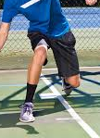
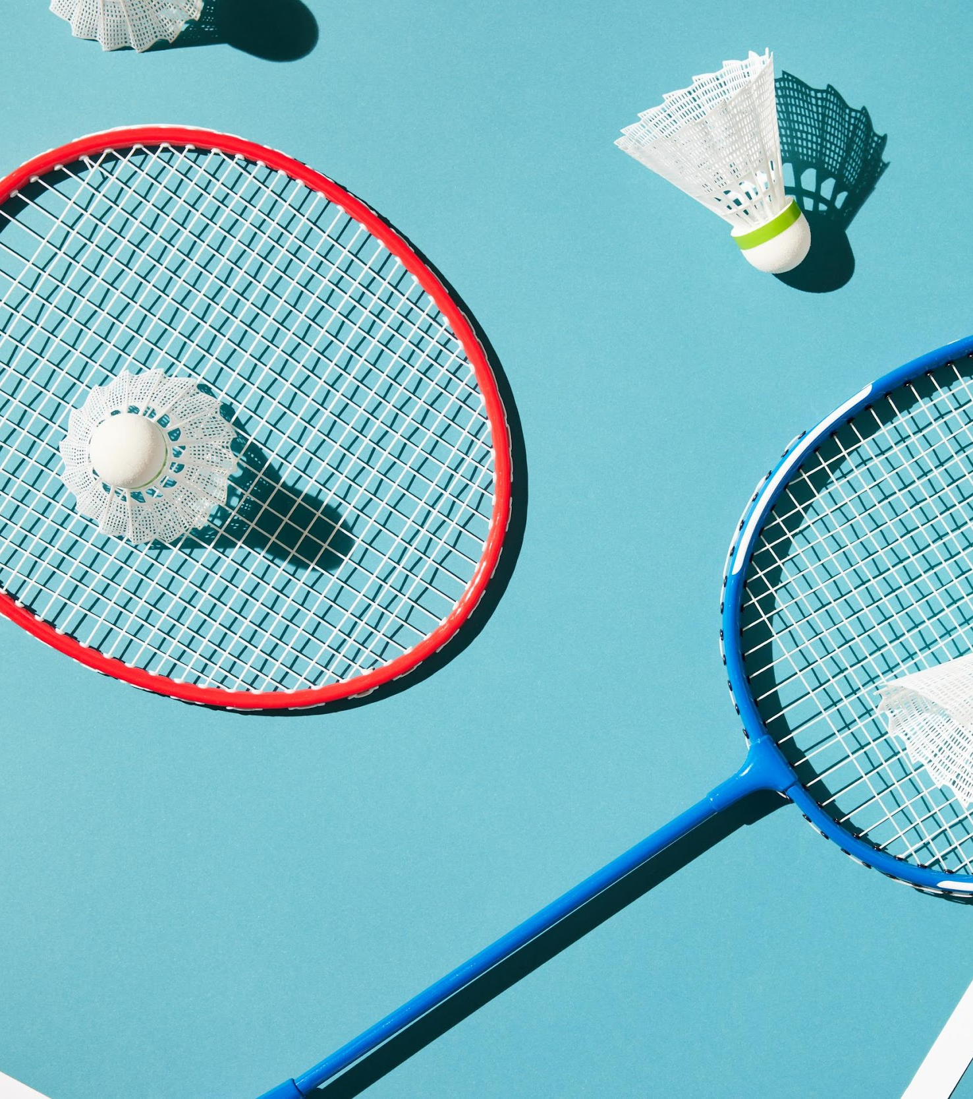
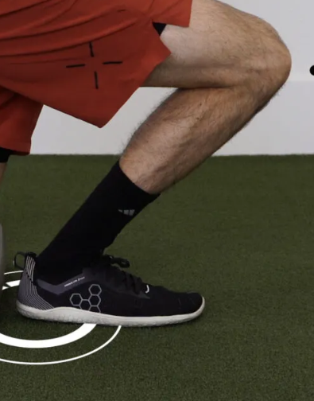

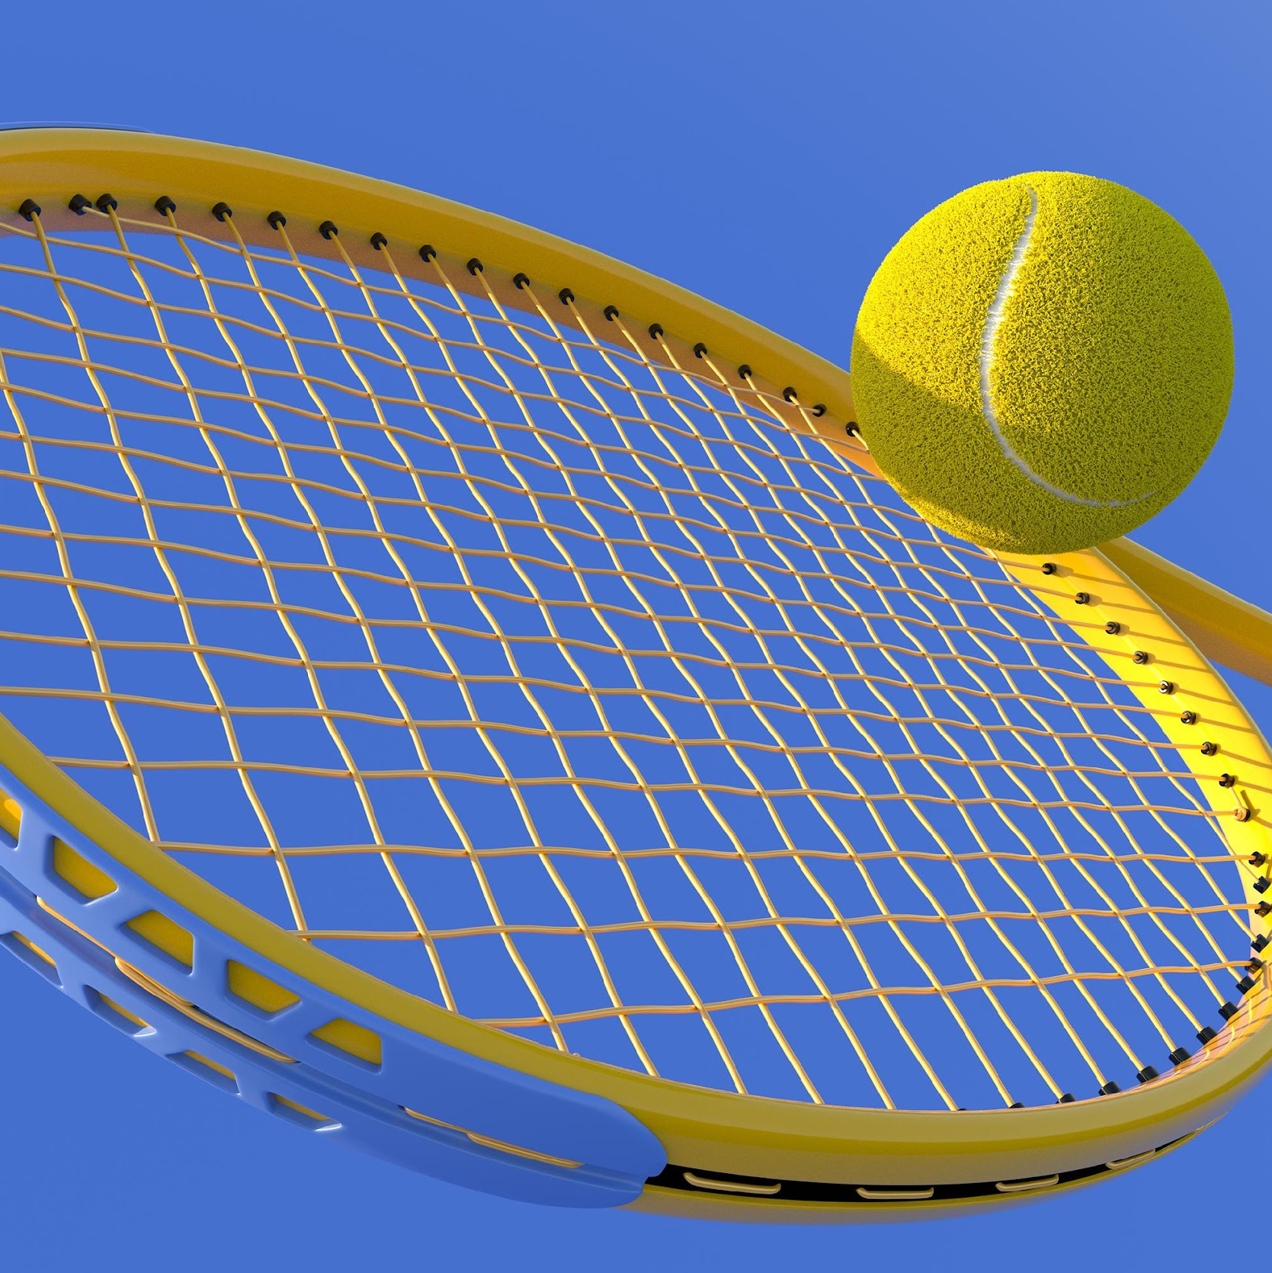
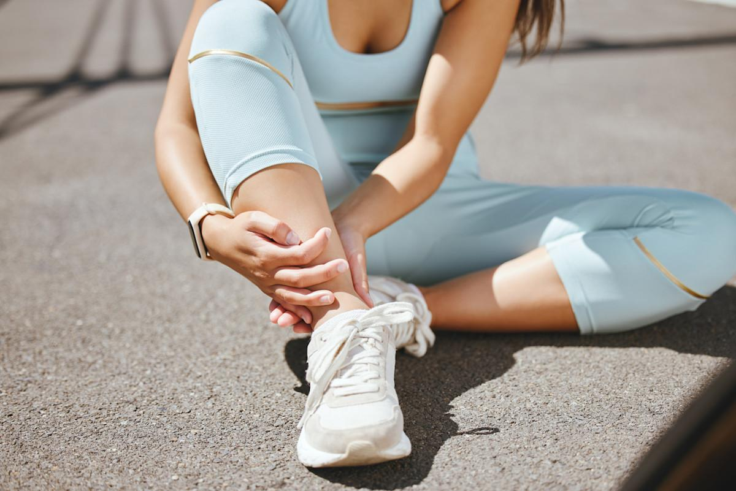
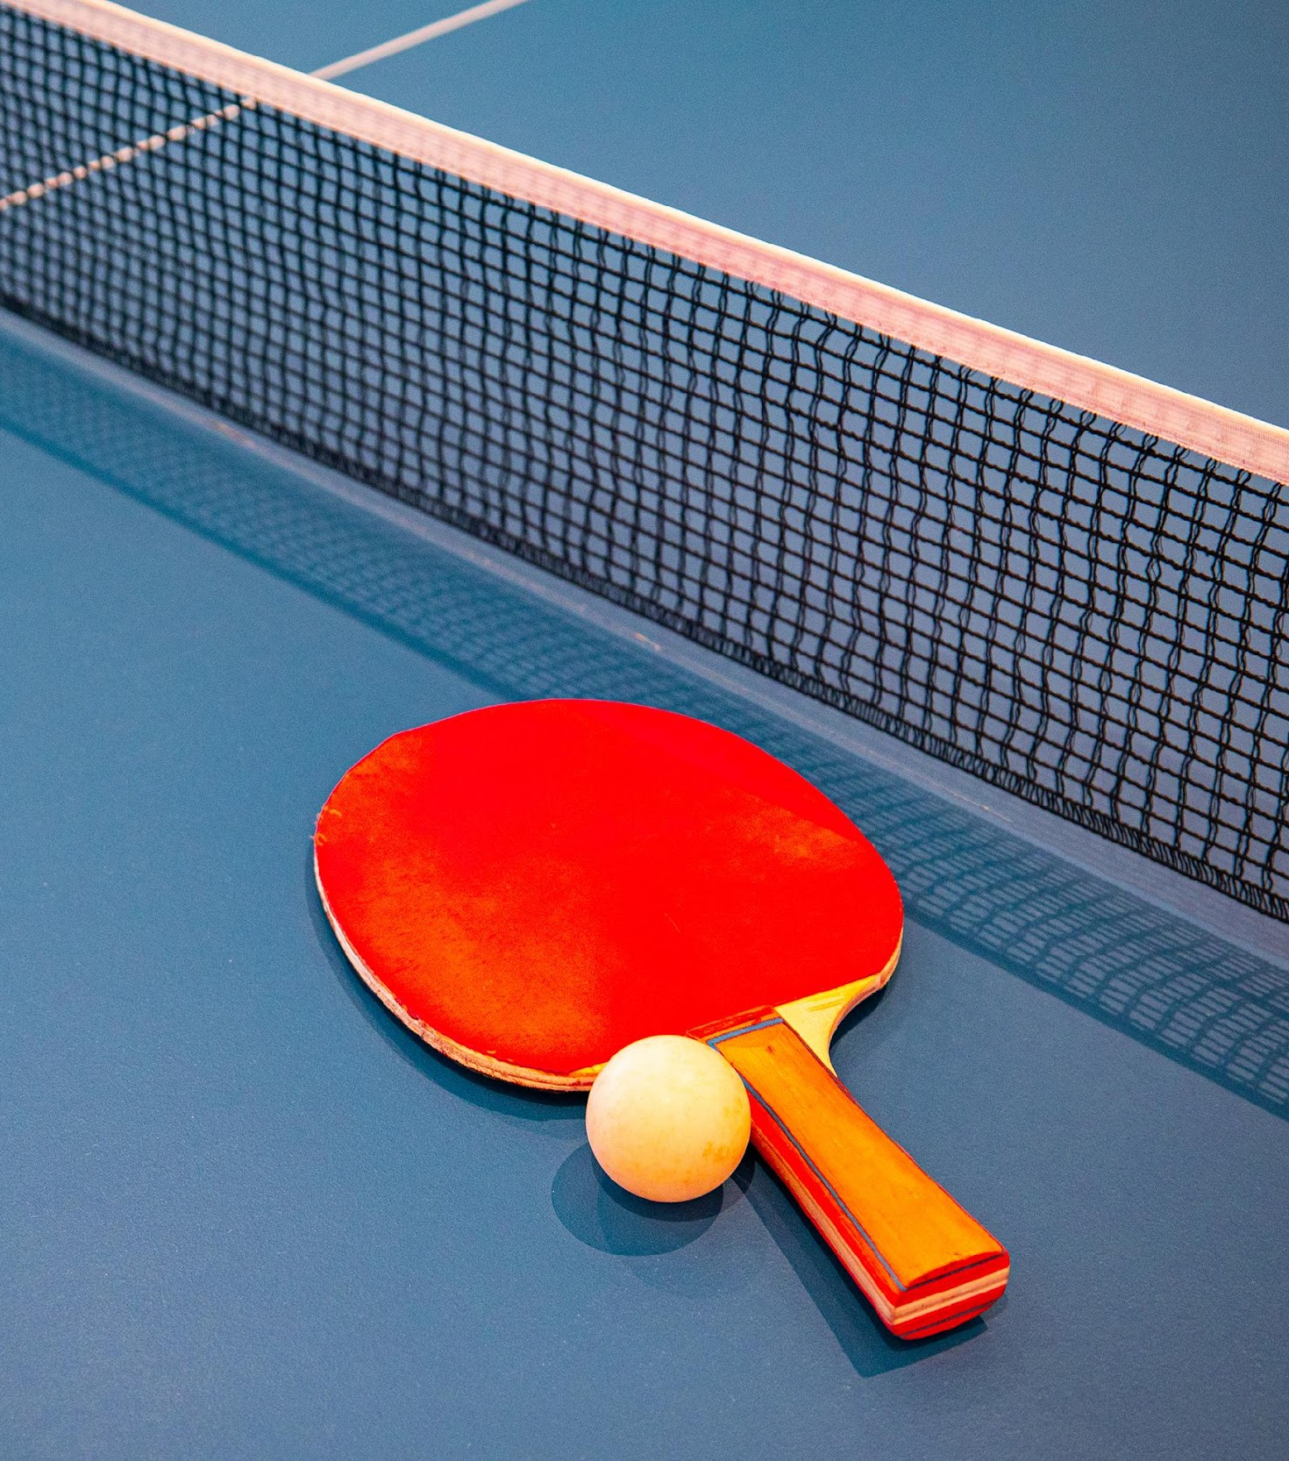

Pickleball - Introduction
Ankle Loaded Dorsiflexion
765%
Ahn et al. 2025; Casper et al., 2023; Cerezuela, J.-L., Firouzbakht et al, 2025; Lirola, M.-J., & Cangas, A. J., 2023; Denning et al., 2022; Lauxtermann, L., & Stubbs, B., 2025; Ryan et al. 2019; UBS 2023; Zaifman et al. 2025
Notes:
Lower extremity injuries:
Lunging and backpedaling can lead to ankle injuries
Unstable ankles can lead to falls which can lead to head injuries or upper extremity injuries
765% increase in hand, wrist, and finger injuries over the last decade, with over half of these cases occurring from fractures due to falling
Ankle dorsiflexion can determine if someone’s ankle is unstable
No lower extremity injury source which is why there needs to be a device to record kinematic data

Slide 3
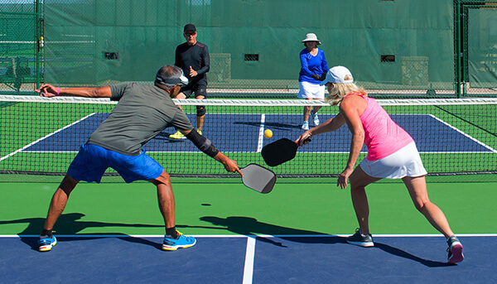
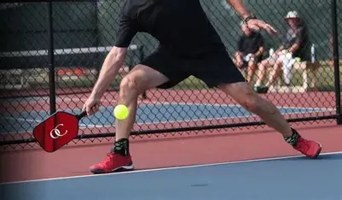
Client Statement
Design a non-invasive wearable device that provides useful kinematic data for pickleball players to help with injury prevention

Slide 4
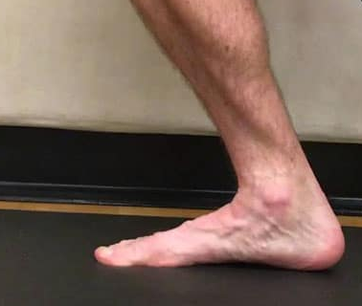
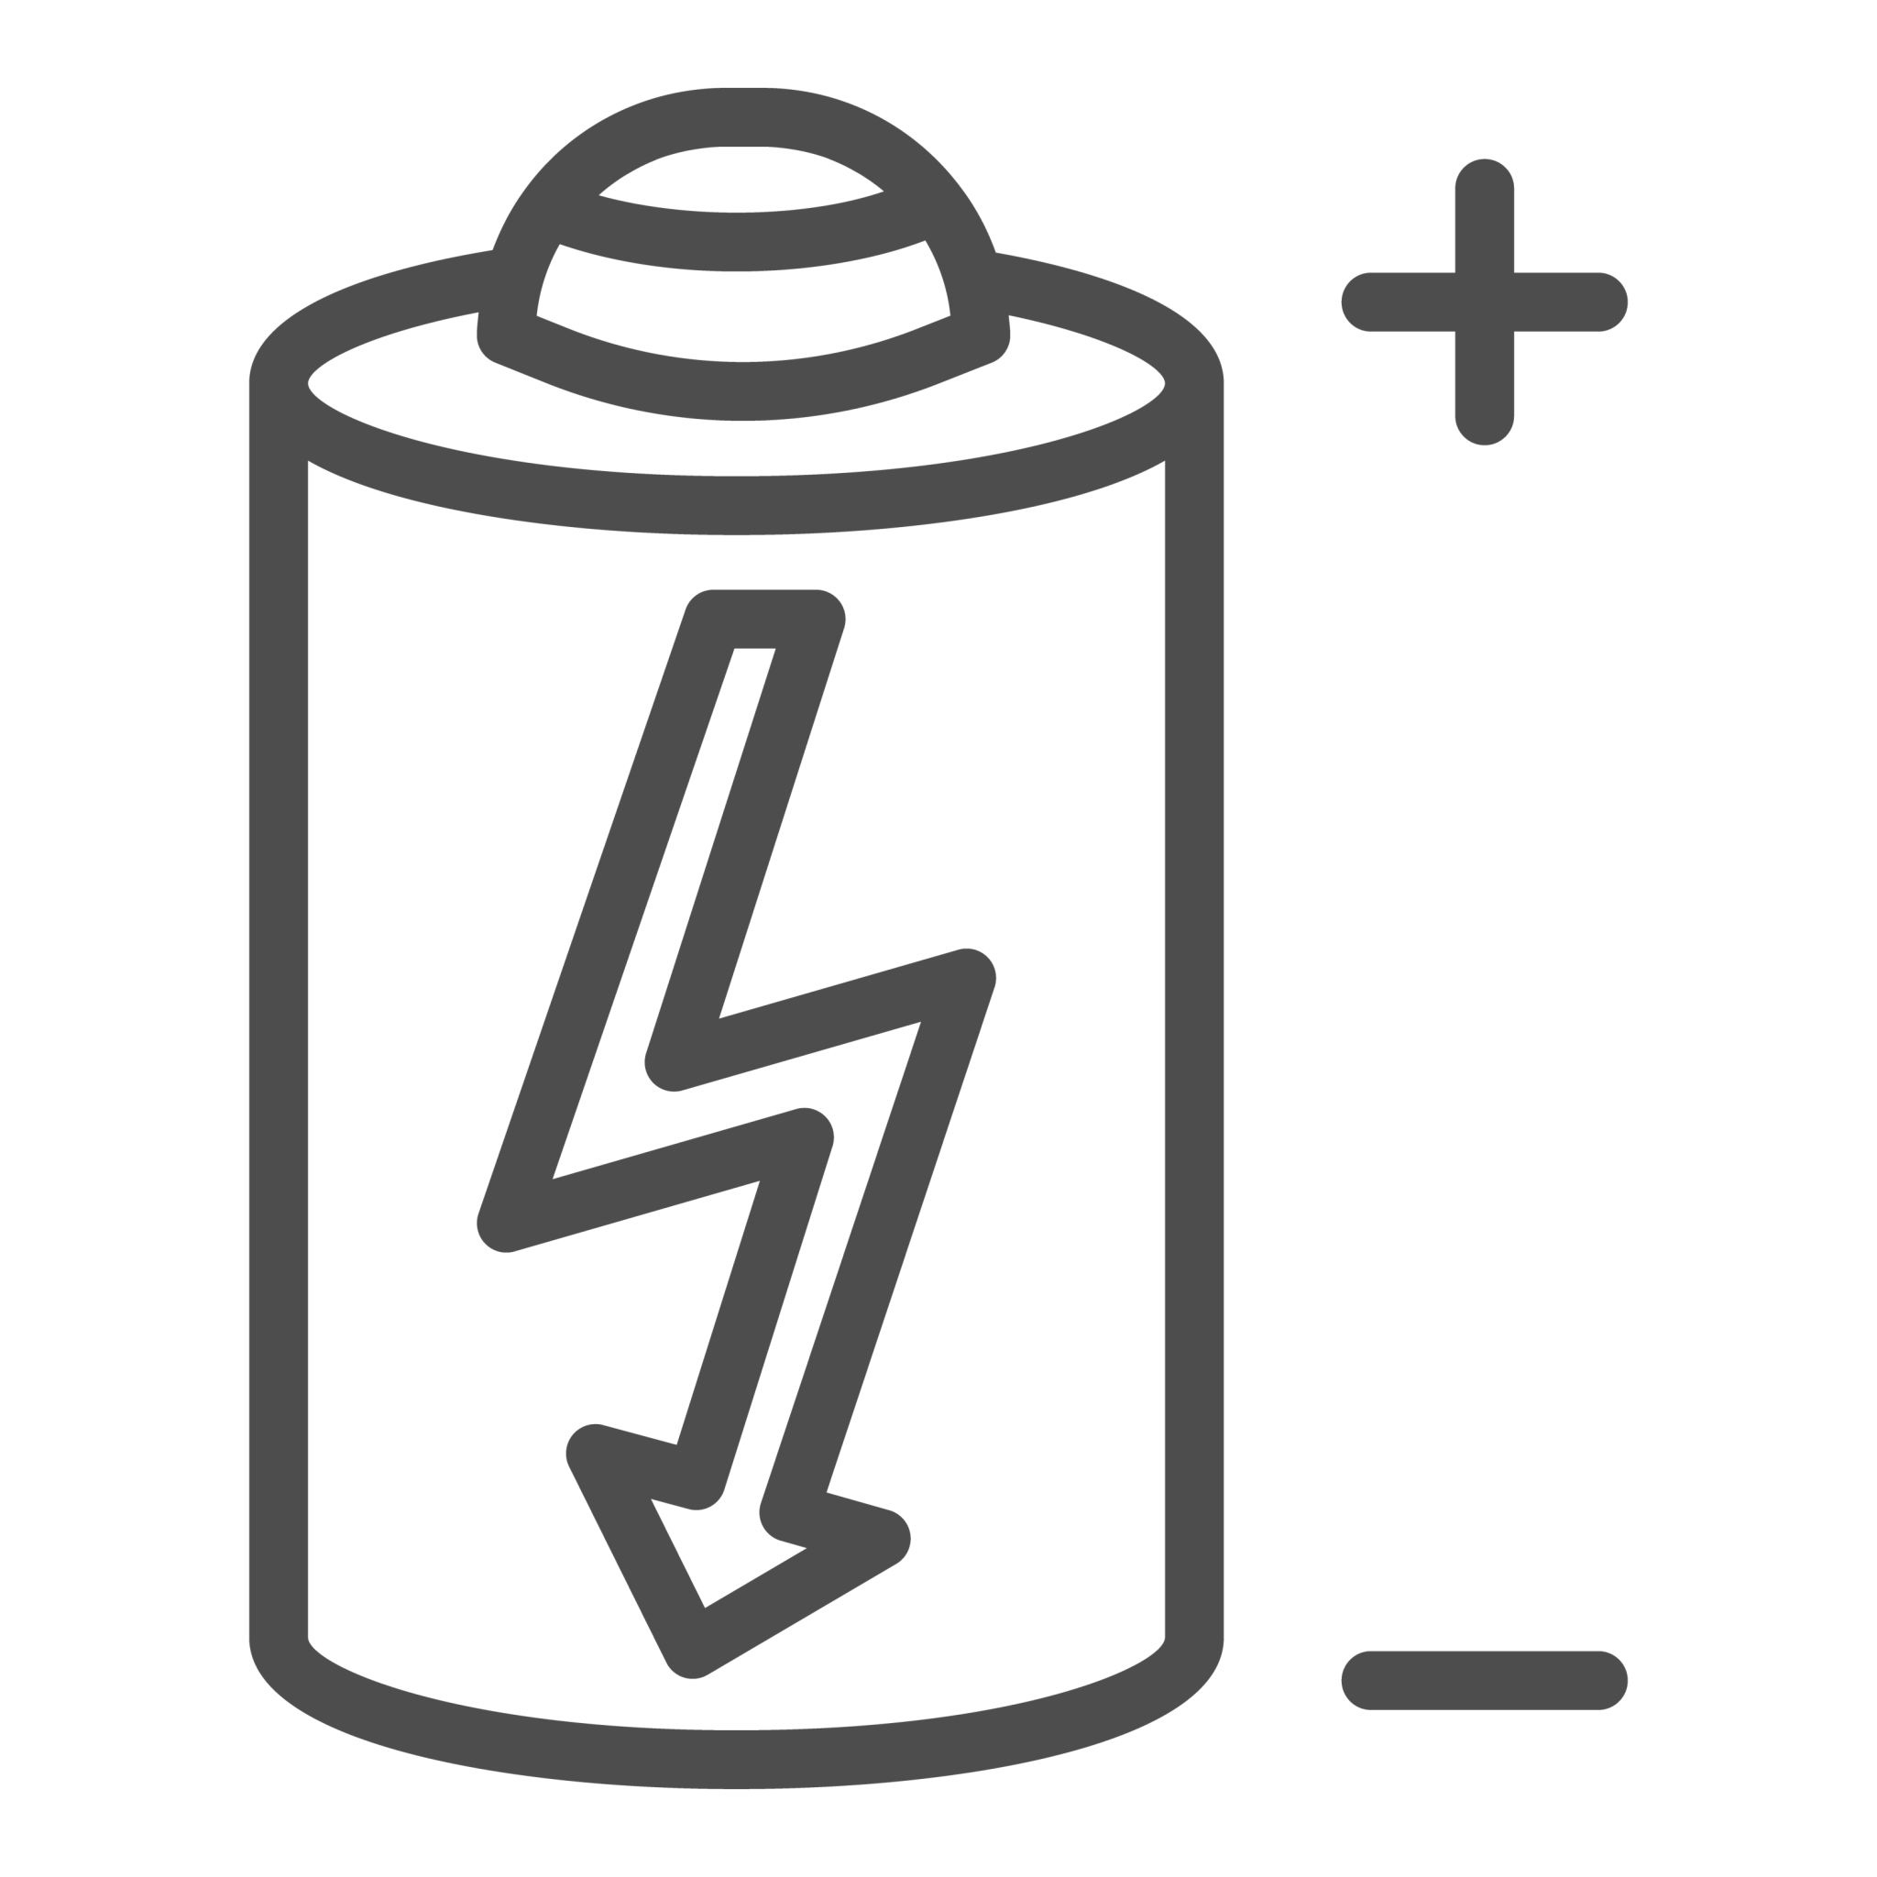
Design Requirements
Required
Preferred
Future Additions
Measure tibia over ankle flexion
Durable
Comfortable
Lightweight “multi-pod” setup
Breathable skin contact straps
On device buffer/reconnect
Minimal latency
Long lasting battery
BLE streaming to phone/tablet

Slide 5
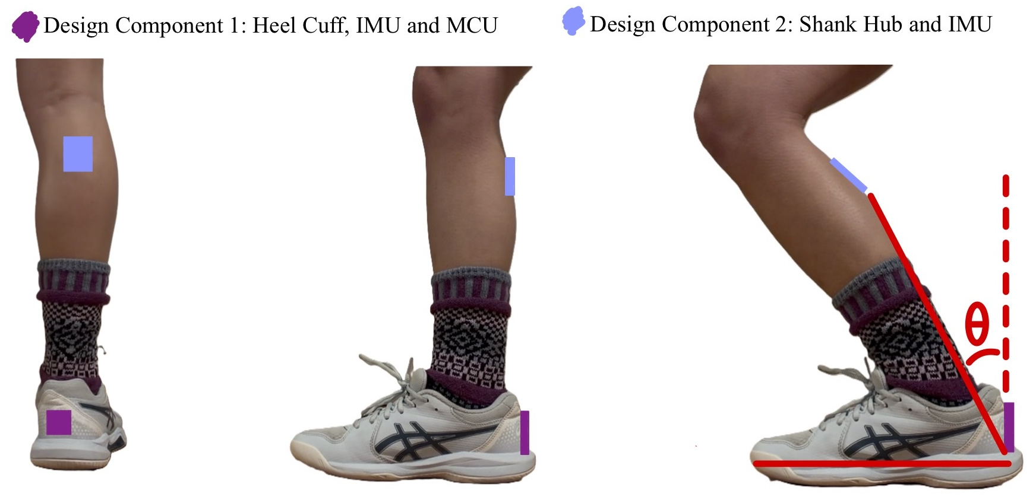
Potential 2 - IMU System Setup
Back View
Side View
Side View - Angle Change
Notes:
Initially we had thought to use two IMUS, one at the heel and one at the shank, and use their change in angles would calculate loaded ankle dorsiflexion

Slide 6
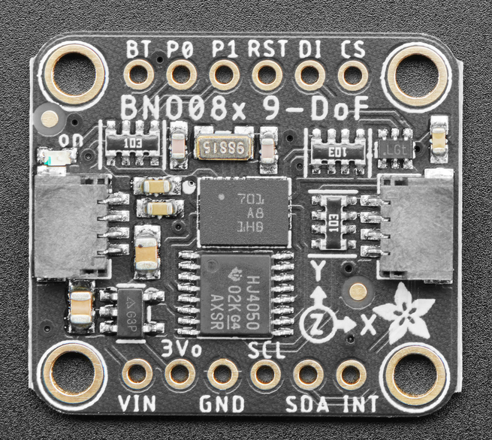
Sensor Progression
Initial Design
Switch to Feather Sense
Final Configuration
Chosen MCU: HUZZAH ESP32 Feather for strong multisensor support
IMUs: Two BNO085 units for absolute orientation needed for ankle biomechanics
Failure:
Could not detect IMUs on I²C despite correct wiring
Research showed BNO08x is unstable on ESP32 I²C
Feather Sense: Fully compatible with BNO08x family
Became the new microcontroller platform
Failure:
IMU address issues
Address solutions didn’t work with BNO085
Final Configuration
One IMU setup using the external BNO085 selected to prioritize system reliability and repeatable data collection within hardware constraints
Notes:
Emphasize more on how and why we switched from 2 → 1 IMU

Slide 7
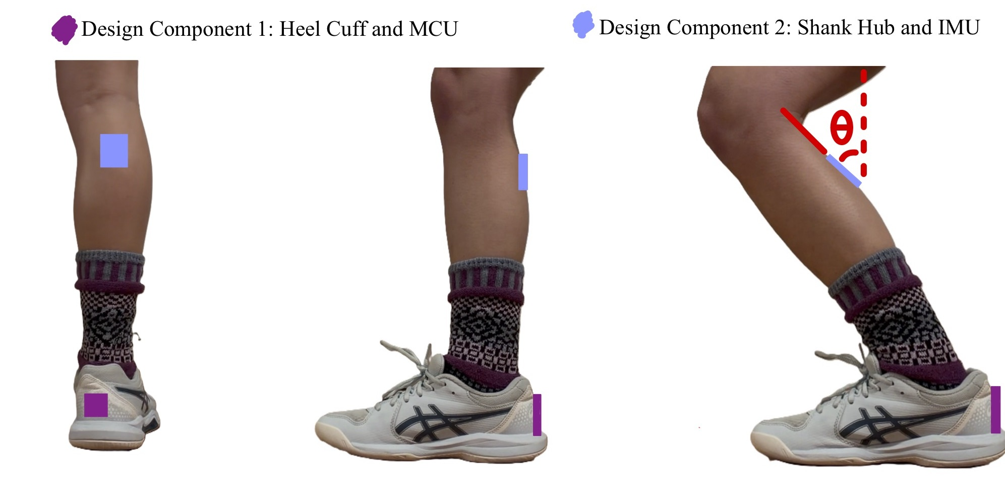
Final System Setup
Back View
Side View
Side View - Angle Change
Notes:
Simplified setup, one IMU setup on the shank, and MCU on the heel, and the IMU takes the measurement

Slide 8
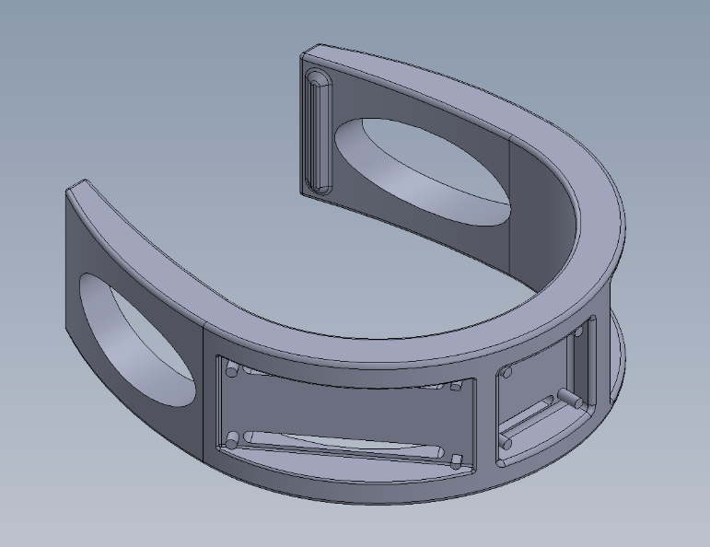
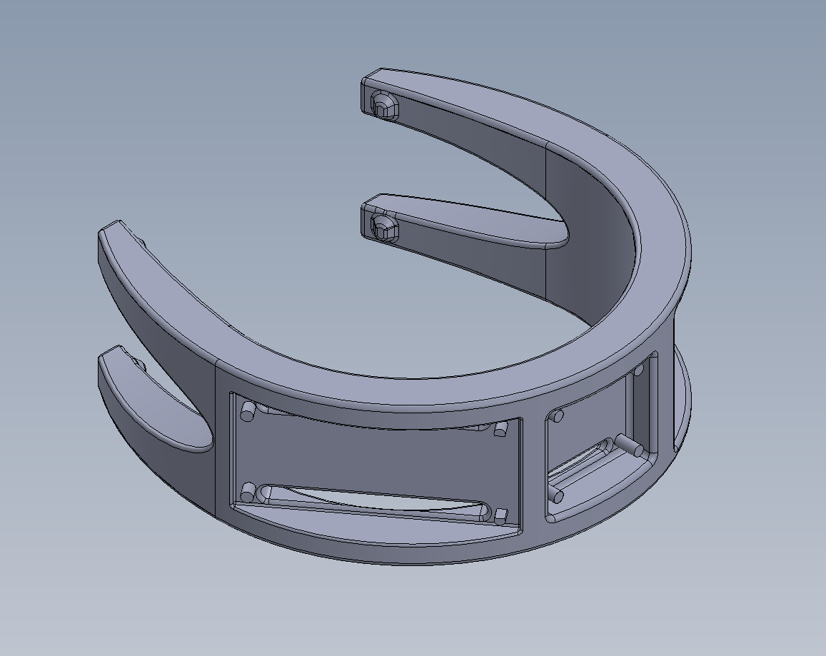
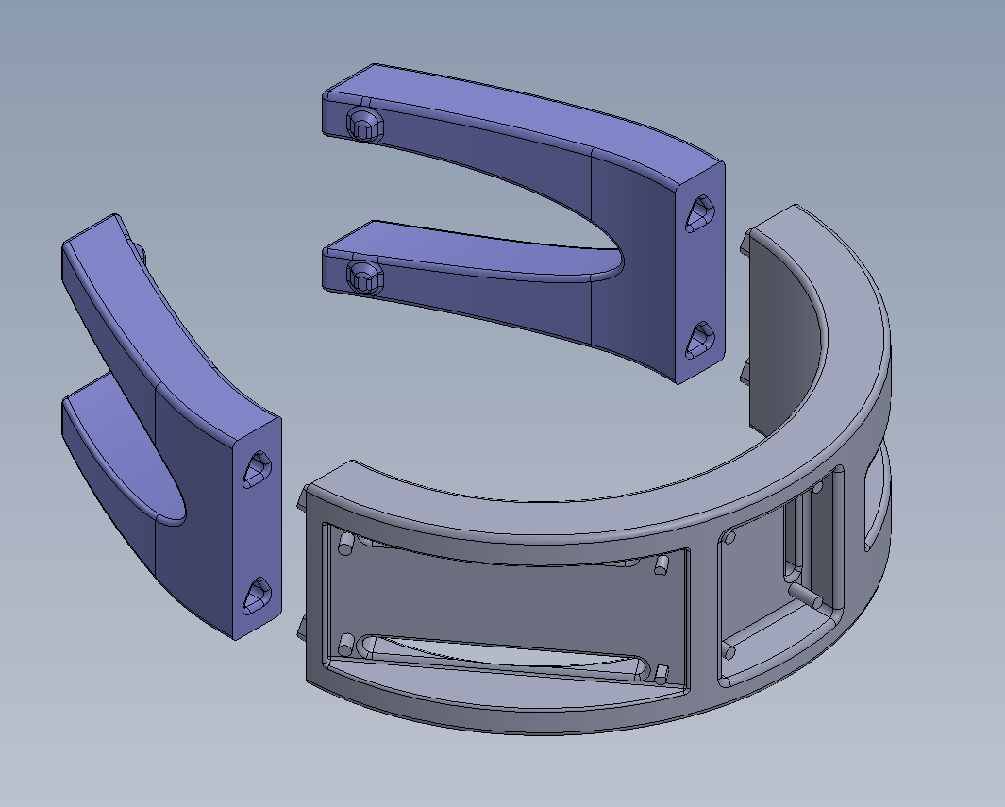
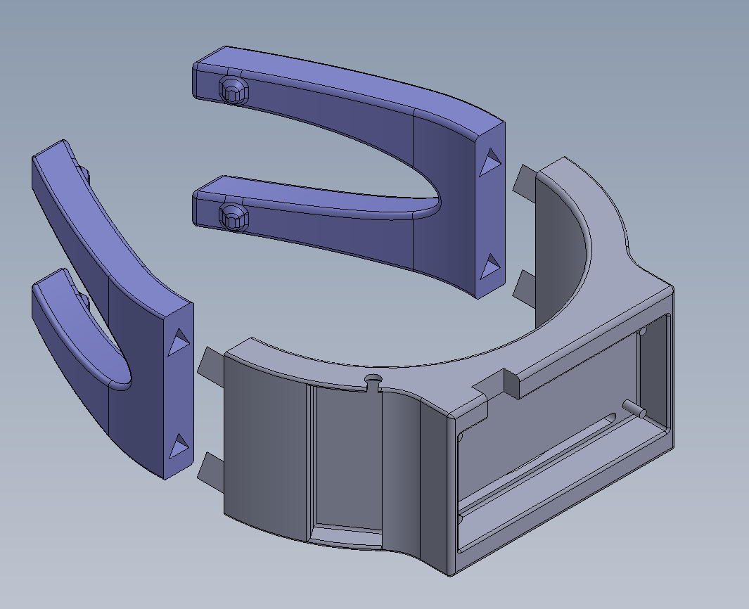
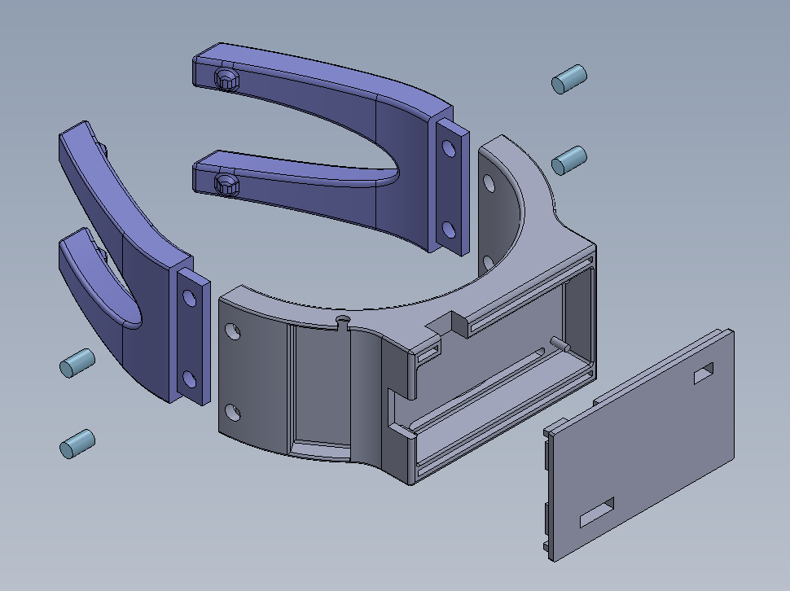
Design Iterations:
Heel Cuff
V1.0
V1.1
V1.2
V1.3
V1.4
Prototype
Flexible Fit
Dual Material
Improved Fit
Secure Connection

Slide 9
Design Iterations:
Heel Cuff
V1.0
V1.1
V1.2
V1.3
V1.4
Prototype
Flexible Fit
Dual Material
Improved Fit
Secure Connection

Slide 10
Design Iterations - Heel Cuff
V1.0 - Prototype
Core Structure: U-shape wraps heel effectively
Electronics Storage: Built-in slots for computer chips & battery
Fit: Design too large → cuffs sits loose and low
Flexibility: Material too stiff → limits movement
PLA

Slide 11
Design Iterations - Heel Cuff
V1.2 - Dual Material
TPU
Two-Part Design: Pin-connectors separate arms from base
Mixed Materials: Flexible arms + rigid base for electronics
Flex & Comfort: Forked elastic arms fit & mold to the foot
Gap Issue: Small gap forms at connection when arms flex
PLA
Notes:
Add circles to highlight problematic areas

Slide 12
Design Iterations - Heel Cuff
V1.4 - Secure Connection
Easier Assembly: Slot & rivet system simplifies connections
Gap Fix: Interface stays flush when arms flex
Compact Design: Smaller battery & repositioned ESP32 → thinner, lighter design
Easy Access: Ports simplify wiring & sensor testing, cover addition
PLA
TPU

Slide 13
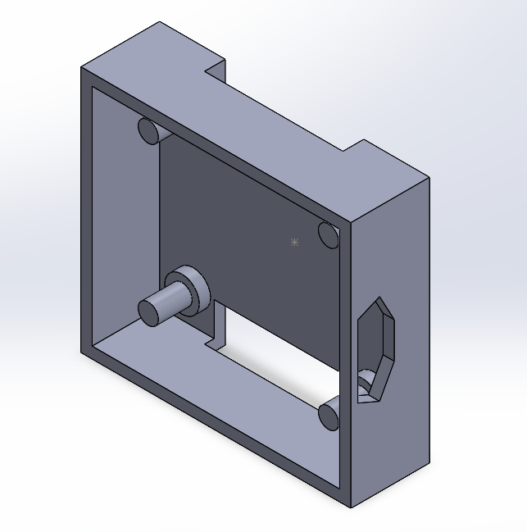
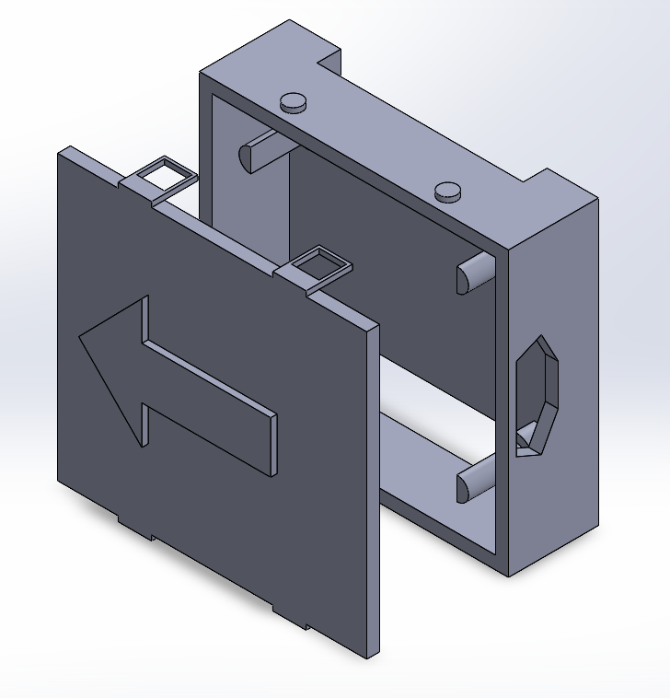
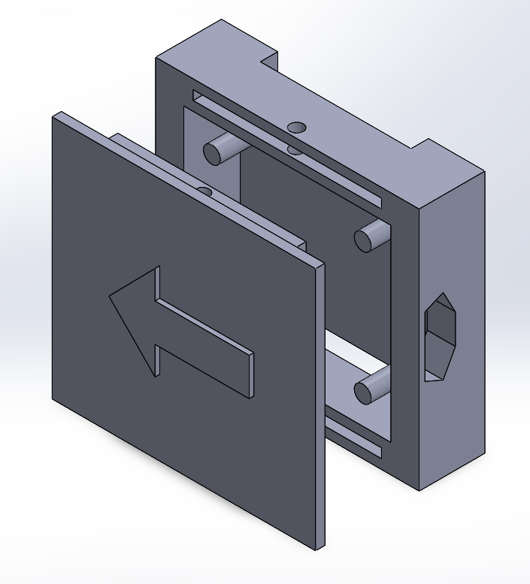
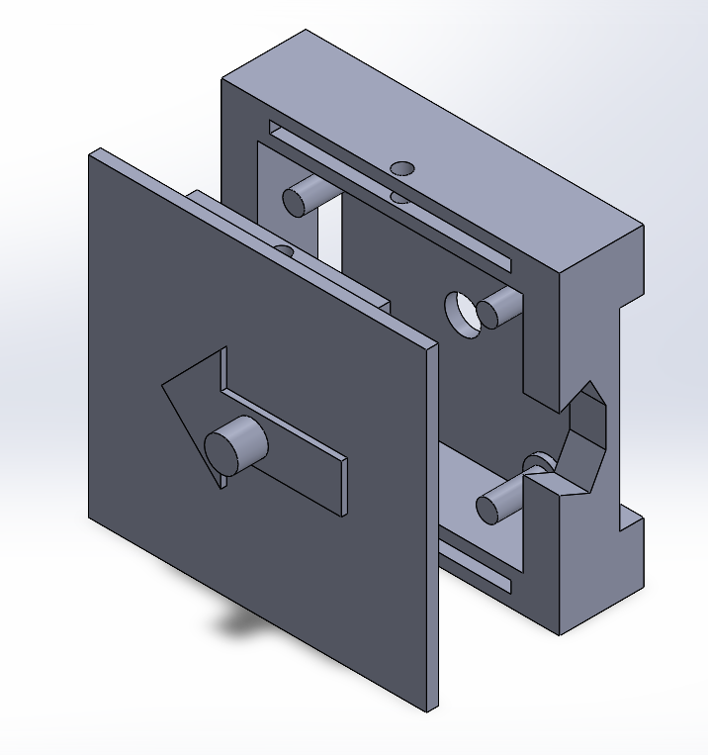
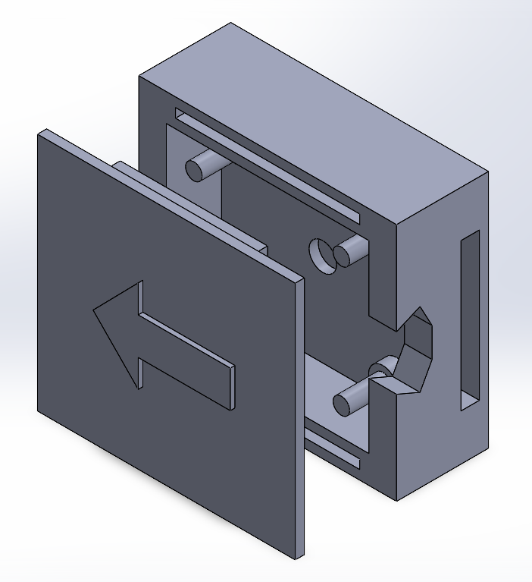
Design Iterations:
Shank Hub
V1.0
V2.0
V2.1
V2.2
V2.3
Prototype
Redesigned Lid
Through Pin
Orientation & QOL Improvements
Structural Stability

Slide 14
Design Iterations:
Shank Hub
V1.0
V2.0
V2.1
V2.2
V2.3
Prototype
Redesigned Lid
Through Pin
Orientation & QOL Improvements
Structural Stability

Slide 15

Design Iterations - Shank Hub
V1.0 - Prototype
4-Pin Housing Structure: Fixes IMU in place with minimal movement
Velcro adhesion: Additional cutouts under IMU for attachment to shank
Cable Connection: Slotted opening for computer access
Issues with use: IMU prone to falling out of holding when flipped
Cable Connection
4-Pin Housing

Slide 16
Design Iterations - Shank Hub
V2.1 - Through Pin
Through Pin Design
Lid Design: Through hole lid setup generated to enclose IMU
Extension of Velcro: Velcro strap dimensions expanded for ease
Lid adhesion: Lid divots did not fit within bounds
Peg system interference: 4 pegs had impaired stability due to cut through
IMU Removal: IMU difficult to extract from holding for maintenance
Notes:
Arrow explanation / purpose

Slide 17
Design Iterations - Shank Hub
V2.3 - Structural Stability
Velcro Relocation
Cover adhesion: Removed through hole, resized extrusions
Velcro relocation: Extended base to remove strap and peg interference
Removal: IMU removal aid added for quality of life
Cable cutout: Expanded cutout for cable for more freedom of movement
IMU Removal
Notes:
Highlight changes made and express purpose

Slide 18
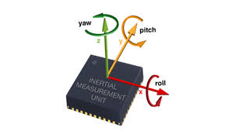
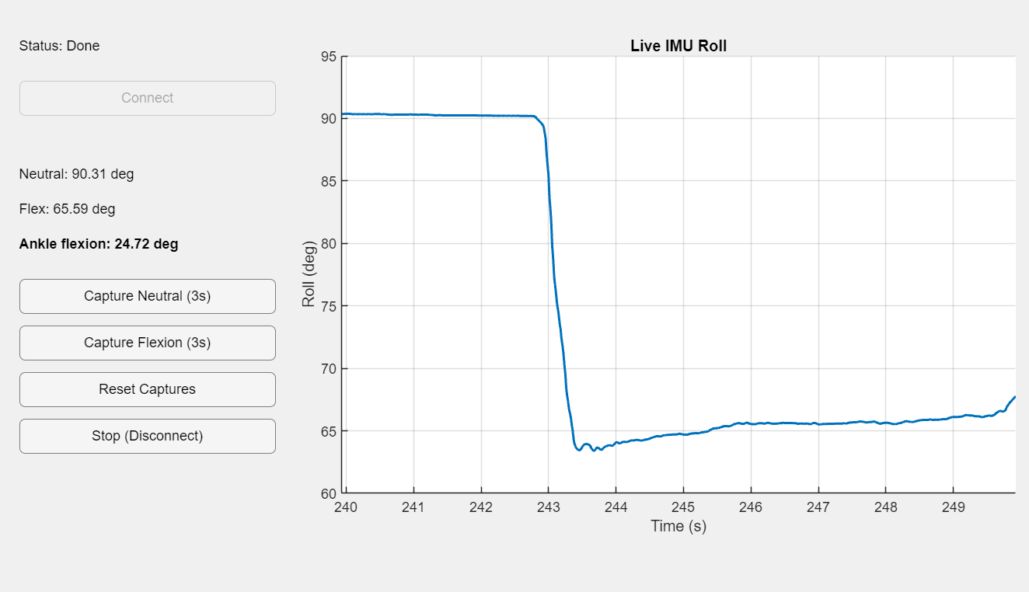
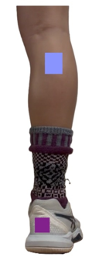
Data Acquisition
System Setup:
Shin IMU: External BNO085 (drift-free 9-DOF fusion)
Orientation Data Collection:
The shin IMU outputs time-stamped yaw, pitch, and roll orientation data for analysis
IMU
Measurement Protocol:
MATLAB receives time-stamped roll orientation data, records a neutral baseline, captures peak ankle flexion, and computes ankle flexion angle from relative orientation changes
MCU
Notes:
add image of the Matlab interface

Slide 19
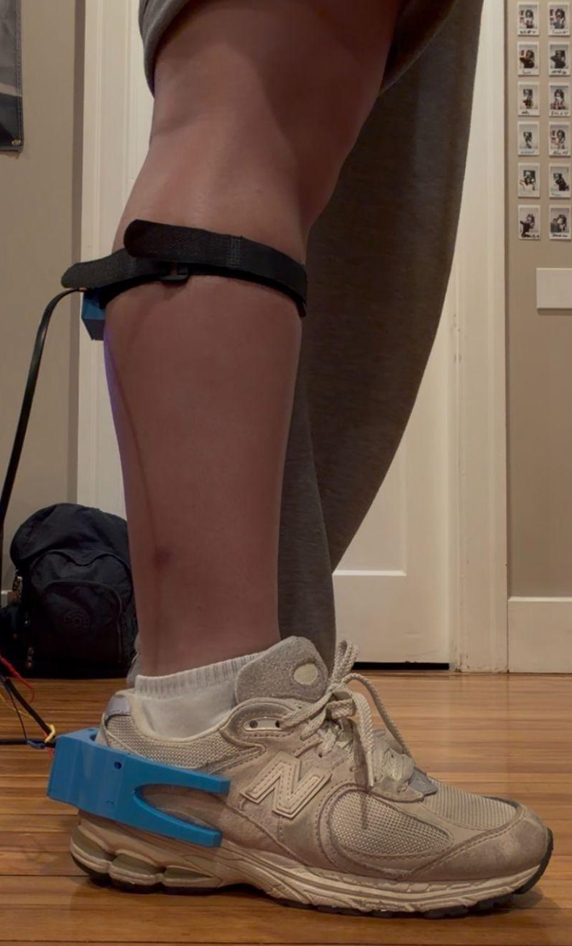
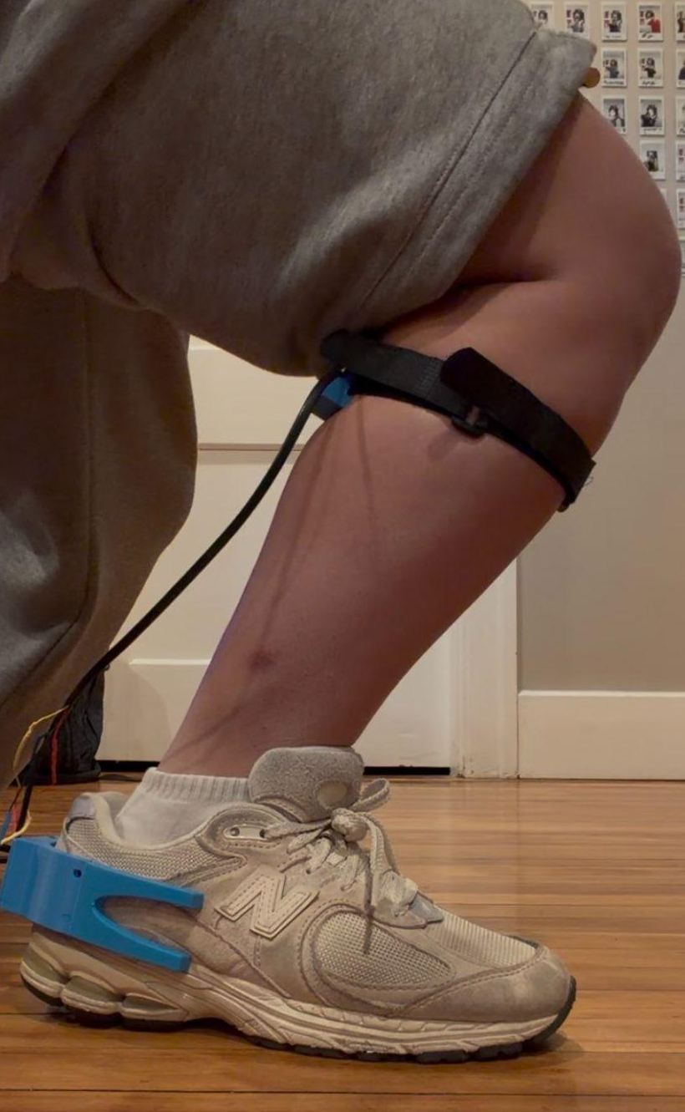
Test Methods
n=15 Each ➢ College Men ➢ College Women ➢ Men 55+ ➢ Women 55+
Heel cuff and shank hub are placed on the participant
Static standing angle is captured
Participant leans forward over foot as far as far as possible without heel lifting up
Repeat five times
Repeat process with other foot
★IRB Approved

Slide 20
Data Analysis
Output from device
Range of Motion of left and right ankles
Ankle loaded dorsiflexion was calculated using the roll output from the BNO085 IMU positioned on the shank
Hypotheses
Difference in ROM between left and right ankles
Difference in ROM between sample groups
Analysis
Repeatability analysis
Measurement repeatability was evaluated using the standard deviation (SD) of the five trials collected for each ankle
Limb symmetry analysis
Limb symmetry was assessed by comparing the mean ROM values between the right and left ankles of each participant

Slide 21
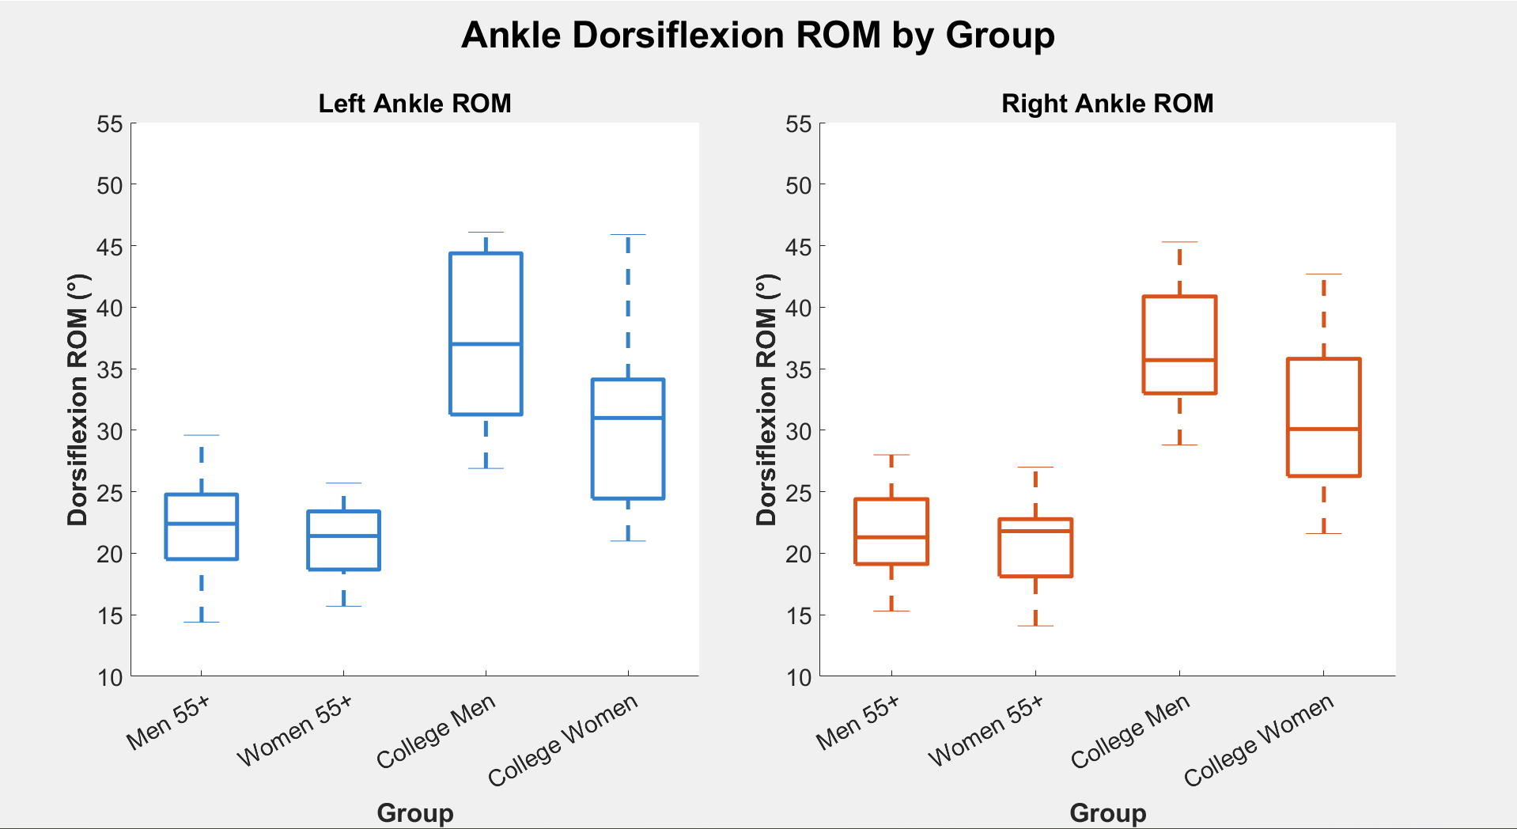
Results - Ankle Dorsiflexion ROM
Boxplot of ankle dorsiflexion averages per each foot in each individual sample group

Slide 22
Discussion and Results
Hypothesis 1: Limb Symmetry
Null: ROM between left & right ankles is not statistically significant
All groups: p > 0.00833 (no significance)
No significant side-to-side differences
Conclusion: Fail to reject the Null as the ROM between limbs is not statistically significant
Hypothesis 2: Differences in Dorsiflexion ROM
Null: ROM between any of the four populations is not statistically significant
Statistical Significance: p < 0.00833 for each pairing of groups other than Men 55+ and Women 55+
Conclusion: Reject the Null as statistical differences between groups is found
Notes:
difference between college aged men and college aged women appear to go away with age, mention this

Slide 23
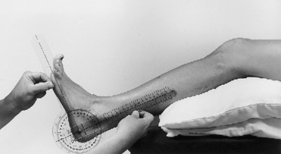
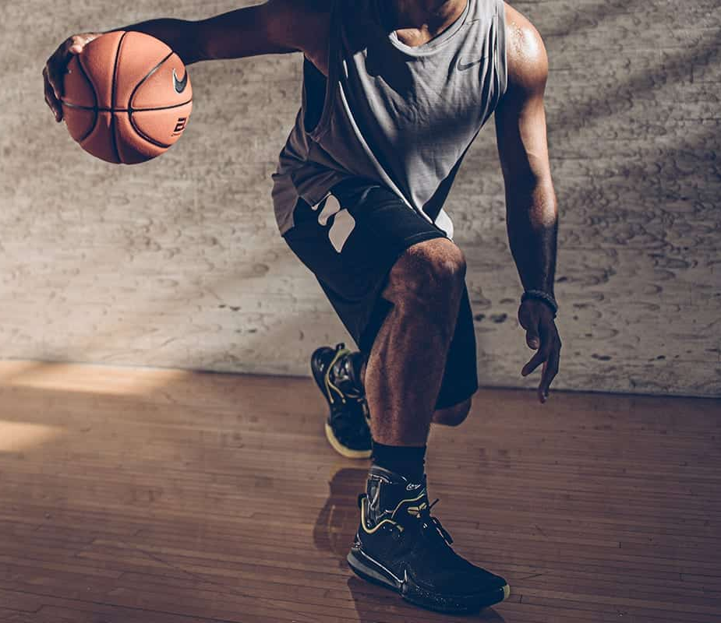
Conclusions
Reflections
Met all design requirements set
Environmental and Sustainability Impacts
The main materials are TPU and PLA
This device is reusable and durable
Economic Impacts
Total cost of the device is around $100
Regulations
Follows standard ISO and FDA regulations for medical devices
Societal and Global Impacts
Physical therapists can use this setup to replace goniometers
Can be applied to other sports
Notes:
Add that the design meets the initial criteria
Go back to design requirements
Can use device statically but not on the court
Add bullet point to say that it can be applied to other sports

Slide 24
Special thanks to our testing participants and Professor Ji!
Any questions?
Notes:
Thank advisor, subjects

