Slide 1
Employee Management System
Presented by: Muhammad Shahzad

Slide 2
Functions
The Program has following functions with File Handling.
Insert
Search by ID
Edit
Delete
Display
Salary Slip
Search by Department
Exit (Simply exits the program)

Slide 3
UML Diagram, EMS
+ ---------------------- +
| employee |
+ ---------------------- +
- head: node*
+ ---------------------- +
+ employee()
+ introduction()
+ login()
+ control_panel()
+ insert()
+ search_id()
+ Edit()
+ del()
+ display()
+ salary_slip()
+ search_dept()
+ ---------------------- +
+ ---------------------- +
| node |
+ ---------------------- +
- employee_id: string
- name: string
- post: string
- department: string
- salary: float
- next_add: node*
+ ---------------------- +

Slide 4
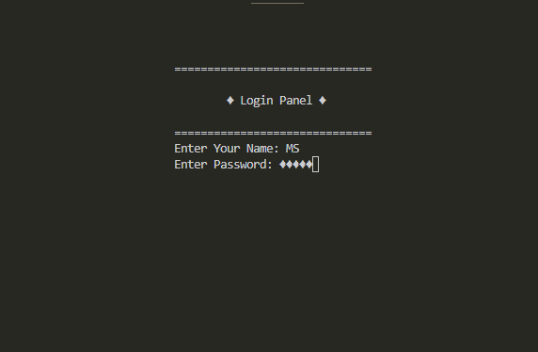
Login Panel
In this function the user will enter the username and password to login the system. If any of them or both are wrong, the system will generate a relatable message.

Slide 5
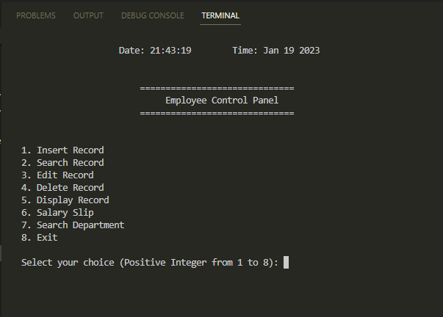
Employee Control Panel
After successful login the user will enter in this function and can interact with the system in a proper way.

Slide 6
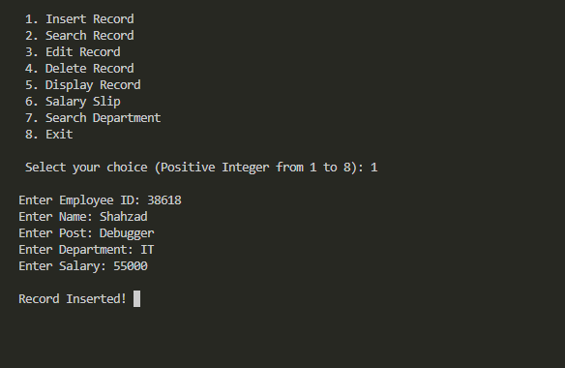
Insert Function
In this function, the user can Insert a new Record of an Employee. When insertion is done, a message “Record Inserted” will be generated on screen. After insertion, the user will go back to the main menu.

Slide 7
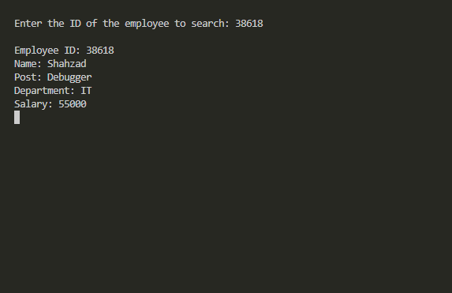
Employee search by ID
In this function, the user can search and display a specific Employee Record by entering his exact ID. If the given ID is wrong or not saved, the system will generate a message on screen “Record not found!”, and then the user will go back to the main menu.

Slide 8
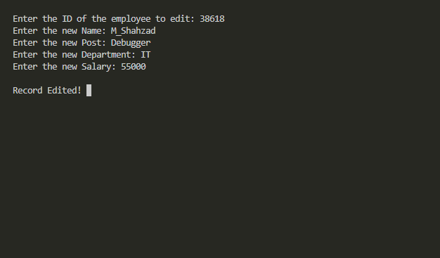
Edit Function
In this function, the user will first search a specific Employee by entering his exact ID then can Edit his Record, and then will go back to the main menu. If the given ID is wrong or not saved, the system will generate a message on screen “Record not found!”.

Slide 9
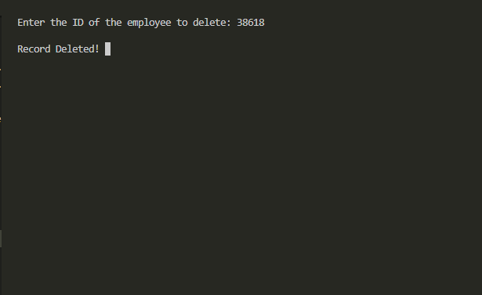
Delete Function
In this function, the user will first search a specific Employee by entering his exact ID then can Delete his Record, and then will go back to the main menu. If the given ID is wrong or not saved, the system will generate a message on screen “Record not found!”.

Slide 10
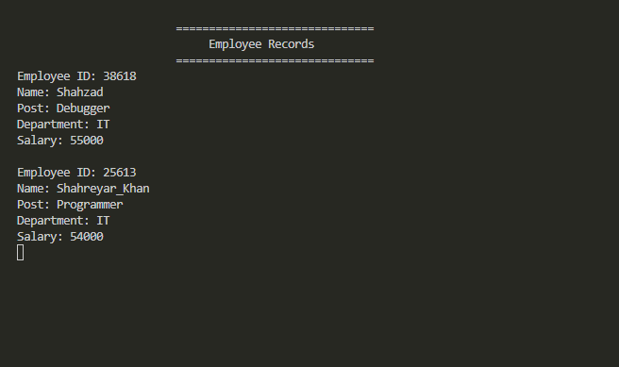
Display Function
In this function, the user can see all saved Records at once, and then will go back to the main menu. If there is no Records saved in, it will show empty screen, and then the user will go back to the main menu.

Slide 11
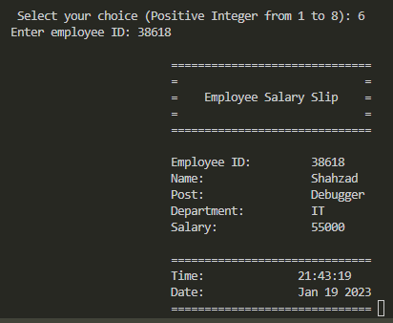
Salary Slip
In this function, the user can generate the Salary Slip of a specific Employee by entering his exact ID, and then will go back to the main menu. If the given ID is wrong or not saved, the system will generate a message on screen that “Employee not found!”.

Slide 12
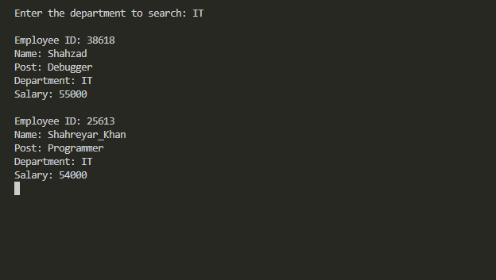
Employee search by Dept.
In this function, the user can display the Record of all or a single Employee by entering the exact Dept. Name related to the Employees. If the given Dept. Name is wrong or not saved, the system will generate a relatable message on screen, and then the user will go back to the main menu.

