Slide 1
Manipulating MySQL
Databases with PHP
PHP Programming with MySQL

Slide 2
Objectives
In this lesson, you will:
Connect to MySQL from PHP
Work with MySQL databases using PHP
Create, modify, and delete MySQL tables with PHP
Use PHP to manipulate MySQL records
Use PHP to retrieve database records

Slide 3
Connecting to MySQL with PHP
PHP has the ability to access and manipulate any database that is ODBC compliant
PHP includes functionality that allows you to work directly with different types of databases, without going through ODBC

Slide 4
Determining which MySQL Package to Use
The mysqli (MySQL Improved) package became available with PHP 5 and is designed to work with MySQL version 4.1.3 and later
Earlier versions must use the mysql package
The mysqli package is the object-oriented equivalent of the mysql package but can also be used procedurally
Mysqli package has improved speed, security and compatibility with libraries.

Slide 5
Opening and Closing a MySQL Connection
Open a connection to a MySQL database server with the mysqli_connect() function
The mysqli_connect() function returns a positive integer if it connects to the database successfully or FALSE if it does not
Assign the return value from the mysqli_connect() function to a variable that you can use to access the database in your script

Slide 6
Opening and Closing a MySQL Connection (continued)
The syntax for the mysqli_connect()
function is:
$connection = mysqli_connect("host" [, "user", "password"[,”database”]]);
The host argument specifies the host name
where your MySQL database server is installed
The user and password arguments specify a MySQL account name and password
You can optionally select the database when connecting.

Slide 7
Opening and Closing a MySQL Connection (continued)
The database connection is assigned to the $DBConnect variable
$DBConnect = mysqli_connect("localhost", "billyeakus ", "hotdog");
Close a database connection using the mysql_close() function
mysqli_close($DBConnect);

Slide 8
Opening and Closing a MySQL Connection (continued)
mysqli_get_client_info() Returns the MySQL client library version
mysqli_get_client_stats() Returns statistics about client per-process
mysqli_get_client_version() Returns the MySQL client library version as an integer
mysqli_get_connection_stats() Returns statistics about the client connection
mysqli_get_host_info() Returns the MySQL server hostname and the
connection type
mysqli_get_proto_info() Returns the MySQL protocol version
mysqli_get_server_info() Returns the MySQL server version
mysqli_get_server_version() Returns the MySQL server version as an integer

Slide 9
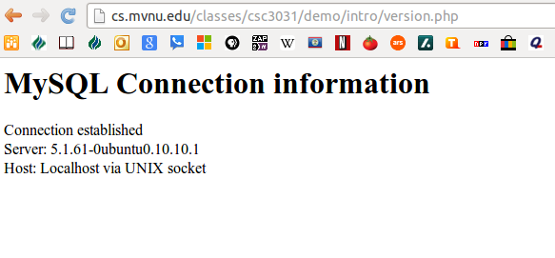
Opening and Closing a MySQL Connection (continued)
version.php in a Web browser

Slide 10
Reporting MySQL Errors
Reasons for not connecting to a database server include:
  The database server is not running
  Insufficient privileges to access the data source
  Invalid username and/or password

Slide 11
Reporting MySQL Errors (continued)
The mysqli_errno() function returns the error code from the last attempted MySQL function call or 0 if no error occurred
The mysqli_error() — Returns the text of the error message from previous MySQL operation
The mysqli_errno() and mysqli_error() functions return the results of the previous mysqli*() function

Slide 12
Selecting a Database
The syntax for the mysqli_select_db() function is:
  mysqli_select_db(connection, database);
The function returns a value of TRUE if it successfully selects a database or FALSE if it
does not
For security purposes, you may choose to use an include file to connect to the MySQL server and select a database

Slide 13
Sample Code
good
$link = mysqli_connect("cs.mvnu.edu",
“demo", “demo");
mysqli_select_db($link, "nonexistentdb",
echo mysql_errno($link) . ": " .
mysql_error($link). "<br>";
mysqli_select_db( $link, “demo");
mysqli_query($link, "SELECT * FROM nonexistenttable");
echo mysqli_errno($link) . ": " .
mysqli_error($link) . "<br>";
bad
good
bad

Slide 14
Sample Code
$host='localhost';
$userName = 'demo';
$password = 'demo';
$database ='demo';
$link = mysqli_connect ($host, $userName, $password) ;
if (!$link) {
die('Could not connect: ' . mysqli_error($link));
}
echo 'Connected successfully';
mysqli_close($link);

Slide 15
Sample Code
<?php
$link = mysqli_connect('localhost', 'mysql_user', 'mysql_password');
if (!$link) {
die('Not connected : ' . mysqli_error($link));
}
// make foo the current db
$db_selected = mysqli_select_db($link,'foo');
if (!$db_selected) {
die ('Can\'t use foo : ' . mysqli_error($link));
}
?>

Slide 16
Suppressing Errors with the Error Control Operator
By default, functions in the mysql package display errors and warnings as they occur
Use the error control operator (@) to suppress error messages
The error control operator can be prepended to any expression although it is commonly used with expressions

Slide 17
Executing SQL Statements
Use the mysqli_query() function to send SQL statements to MySQL
The syntax for the mysqli_query() function is:
mysqli_query(connection, query);
The mysqli_query() function returns one of three values:
  For SQL statements that do not return results (CREATE DATABASE and CREATE TABLE statements) it returns a value of TRUE if the statement executes successfully

Slide 18
Executing SQL Statements (continued)
  For SQL statements that return results (SELECT and SHOW statements) the mysqli_query() function returns a result pointer that represents the query results
    A result pointer is a special type of variable that refers to the currently selected row in a resultset
  The mysqli_query() function returns a value of FALSE for any SQL statements that fail, regardless of whether they return results

Slide 19
Sample Code
<?php
// This could be supplied by a user, for example
$firstname = 'fred';
$lastname = 'fox';
//never trust user data
$firstname= mysql_real_escape_string($firstname);
$lastname= mysql_real_escape_string($lastname);
// Formulate Query
// For more examples, see mysql_real_escape_string()
$query = "SELECT firstname, lastname, address, age FROM friends WHERE firstname=‘$firstname ‘ AND lastname= ‘$lastname’”;
// Perform Query
$result = mysql_query($query);
// Check result
// This shows the actual query sent to MySQL, and the error. Useful for debugging.
if (!$result) {
$message = 'Invalid query: ' . mysql_error() . "<br>";
$message .= 'Whole query: ' . $query;
die($message);
}
// Use result
// Attempting to print $result won't allow access to information in the resource
// One of the mysql result functions must be used
// See also mysql_fetch_array(), mysql_fetch_row(), etc.
while ($row = mysql_fetch_assoc($result)) {
echo $row['firstname'];
echo $row['lastname'];
echo $row['address'];
echo $row['age'];
}
// Free the resources associated with the result set
// This is done automatically at the end of the script
mysql_free_result($result);
?>

Slide 20
Adding, Deleting, and Updating Records
To add records to a table, use the INSERT and VALUES keywords with the mysqli_query() function
To add multiple records to a database, use the LOAD DATA statement with the name of the local text file containing the records you want to add
To update records in a table, use the UPDATE statement

Slide 21
Adding, Deleting, and Updating Records
<?php
$con = mysqli_connect("localhost","demo","demo");
if (!$con)
{
die('Could not connect: ' . mysqli_error($con));
}
mysqli_select_db($con, "demo");
mysqli_query($con, "INSERT INTO friends (FirstName, LastName, Age) VALUES ('Les\
ter', 'Longbottom', '35')");
mysqli_query($con,"INSERT INTO friends (FirstName, LastName, Age) VALUES ('Carl\
y', 'Sampson', '33')");
mysqli_close($con);
?>

Slide 22
Adding, Deleting, and Updating Records (continued)
The UPDATE keyword specifies the name of the table to update
The SET keyword specifies the value to assign to the fields in the records that match the condition in the WHERE clause
To delete records in a table, use the DELETE statement with the mysqli_query() function
Omit the WHERE clause to delete all records in a table

Slide 23
Adding, Deleting, and Updating Records
From W3c
?php
$con = mysqli_connect("localhost","demo","demo");
if (!$con)
{
die('Could not connect: ' . mysqli_error($con));
}
mysqli_select_db($con,"demo");
mysqli_query($con,"UPDATE friends SET Age = '61'
WHERE FirstName = 'Bill' AND LastName = 'Yeakus'");
mysqli_close($con);
?>

Slide 24
Retrieving Records into an
Indexed Array
The mysql_fetch_row() function returns the fields in the current row of a resultset into an indexed array and moves the result pointer to the next row
echo "<table border=1>";
echo "<tr><th>First</th><th>Last</th>
<th>Address</th><th>age</th></tr>";
$Row = mysqli_fetch_row($result);
do {
echo "<tr><td>{$Row[0]}</td>";
echo "<td>{$Row[1]}</td>";
echo "<td>{$Row[2]}</td>";
echo "<td>{$Row[3]}</td></tr>";
$Row = mysqli_fetch_row($result);
} while ($Row);
echo "</table>";
mysqli_close($con);
?>

Slide 25
Sample Code
<?php
$con = mysqli_connect("localhost","demo","demo","demo");
if (!$con)
{
die('Could not connect: ' . mysqli_error($con));
}
$q = "SELECT * FROM friends";
$result = mysqli_query($con,$q);
echo "<table border=1>";
echo "<tr><th>First</th><th>Last</th>
<th>Address</th><th>age</th></tr>";
while ($Row=mysqli_fetch_assoc($result)) {
echo "<tr><td>{$Row['firstname']}</td>";
echo "<td>{$Row['lastname']}</td>";
echo "<td>{$Row['address']}</td>";
echo "<td>{$Row['age']}</td></tr>";
}
echo "</table>";
mysqli_close($con);
?>

Slide 26
Using the mysqli_affected_rows() Function
With queries that return results (SELECT queries), use the mysqli_num_rows() function to find the number of records returned from the query
With queries that modify tables but do not return results (INSERT, UPDATE, and DELETE queries), use the mysqli_affected_rows() function to determine the number of affected rows

Slide 27
Using the mysql_affected_rows() Function (continued)
$QueryResult = mysqli_query($con,"UPDATE friends SET Age = '67'
WHERE FirstName = 'Bill' AND LastName = 'Yeakus'");
if ($QueryResult === FALSE)
echo "<p>Unable to execute the query.</p>"
. "<p>Error code " . mysqli_errno($con)
. ": " . mysqli_error($con) . "</p>";
else
echo "<p>Successfully updated "
. mysqli_affected_rows($con) . " record(s).</p>";
mysql_close($con);
?>

Slide 28
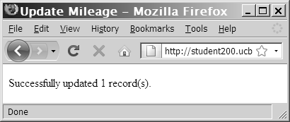
Using the mysql_affected_rows() Function (continued)
Output of mysql_affected_rows() function
for an UPDATE query

Slide 29
Using the mysql_info() Function
For queries that add or update records, or alter
a table’s structure, use the mysqli_info() function to return information about the query
The mysqli_info() function returns the number of operations for various types of actions, depending on the type of query
The mysqli_info() function returns information about the last query that was executed on the database connection

Slide 30
Using the mysqli_info() Function (continued)
The mysqli_info() function returns information about queries that match one of the following formats:
  INSERT INTO...SELECT...
  INSERT INTO...VALUES (...),(...),(...)
  LOAD DATA INFILE ...
  ALTER TABLE ...
  UPDATE
For any queries that do not match one of these formats, the mysql_info() function returns an empty string

Slide 31
Using the mysql_info() Function (continued)
$SQLstring = "INSERT INTO company_cars " .
" (license, model_year, make, model, mileage) " .
" VALUES " .
" ('CPQ-894', 2011, 'Honda', 'Insight', 49.2), " .
" ('CPQ-895', 2011, 'Honda', 'Insight', 17.9), " .
" ('CPQ-896', 2011, 'Honda', 'Insight', 22.6)";
$QueryResult = @mysqli_query($DBConnect,$SQLstring);
if ($QueryResult === FALSE)
echo "<p>Unable to execute the query.</p>"
. "<p>Error code " . mysql_errno($DBConnect)
. ": " . mysqli_error($DBConnect) . "</p>";
else {
echo "<p>Successfully added the record.</p>";
echo "<p>" . mysqli_info($DBConnect) . "</p>";
}

Slide 32
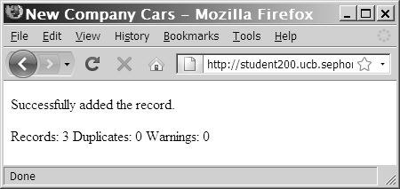
Using the mysql_info() Function (continued)
Output of mysqli_info() function for an
INSERT query that adds multiple records

Slide 33
Using the mysqli_info() Function (continued)
The mysqli_info() function also returns information for LOAD DATA queries
  $SQLstring = "LOAD DATA INFILE 'company_cars.txt'
  INTO TABLE company_cars;";
  $QueryResult = @mysqli_query($SQLstring, $DBConnect);
  if ($QueryResult === FALSE)
  echo "<p>Unable to execute the query.</p>"
  . "<p>Error code " . mysqli_errno($DBConnect)
  . ": " . mysqli_error($DBConnect) . "</p>";
  else {
  echo "<p>Successfully added the record.</p>";
  echo "<p>" . mysqli_info($DBConnect) . "</p>";
  }

Slide 34
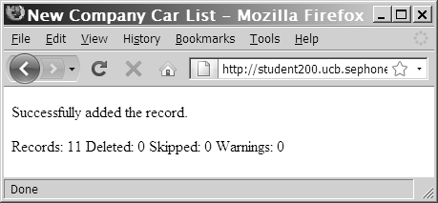
Using the mysql_info() Function (continued)
Output of mysqli_info() function for a
LOAD DATA query

Slide 35
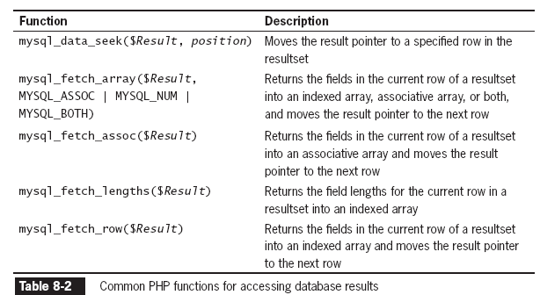
Working with Query Results

Slide 36
Retrieving Records into an Indexed Array
The mysqli_fetch_row() function returns the fields in the current row of a result set into an indexed array and moves the result pointer to the next row

Slide 37
Retrieving Records into an Indexed Array
$q = "SELECT * FROM friends";
$result = mysqli_query($con,$q);
echo "<table border=1>";
echo "<tr><th>First</th><th>Last</th>
<th>Address</th><th>age</th></tr>";
$Row = mysqli_fetch_row($result);
do {
echo "<tr><td>{$Row[0]}</td>";
echo "<td>{$Row[1]}</td>";
echo "<td>{$Row[2]}</td>";
echo "<td>{$Row[3]}</td></tr>";
$Row = mysql_fetch_row($result);
} while ($Row);
echo "</table>";
mysqli_close($con);

Slide 38
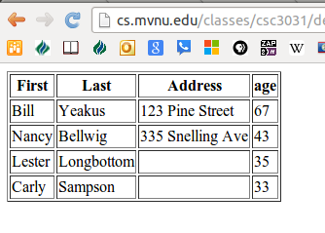
Retrieving Records into an Indexed Array

Slide 39
Retrieving Records into an Associative Array
The mysqli_fetch_assoc() function returns the fields in the current row of a resultset into an associative array and moves the result pointer to the next row
The difference between mysqli_fetch_assoc() and mysqli_fetch_row() is that instead of returning the fields into an indexed array, the mysqli_fetch_assoc() function returns the fields into an associate array and uses each field name as the array key

Slide 40
Closing Query Results
When you are finished working with query results retrieved with the mysqli_query() function, use the mysqli_free_result() function to close the resultset
To close the resultset, pass to the mysqli_free_result() function the
variable containing the result pointer from the mysqli_query() function

Slide 41
Accessing Query Result Information
The mysqli_num_rows() function returns the number of rows in a query result
The mysqli_num_fields() function returns the number of fields in a query result
Both functions accept a database connection variable as an argument

Slide 42
Accessing Query Result Information (continued)
$SQLstring = "SELECT * FROM company_cars";
$QueryResult = @mysqli_query($DBConnect$, SQLstring);
if ($QueryResult === FALSE)
echo "<p>Unable to execute the query.</p>"
. "<p>Error code " . mysqli_errno($DBConnect)
. ": " . mysqli_error($DBConnect) . "</p>";
else
echo "<p>Successfully executed the query.</p>";
$NumRows = mysqli_num_rows($QueryResult);
$NumFields = mysqli_num_fields($QueryResult);
if ($NumRows != 0 && $NumFields != 0)
echo "<p>Your query returned " .
mysqli_num_rows($QueryResult) . " rows and "
. mysqli_num_fields($QueryResult) . " fields.</p>";
else
echo "<p>Your query returned no results.</p>";
mysqli_close($DBConnect);

Slide 43
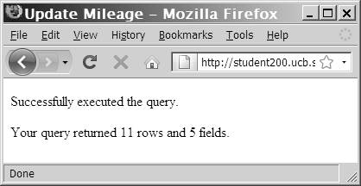
Accessing Query Result Information (continued)
Output of the number of rows and fields
returned from a query

Slide 44
Summary
The mysqli_connect() function opens a connection to a MySQL database server
The mysqli_close() function closes a database connection
The mysqli_errno() function returns the error code from the last attempted MySQL function call or zero if no error occurred

Slide 45
Summary (continued)
The mysqli_error() function returns the error message from the last attempted MySQL function call or an empty string if no error occurred
The error control operator (@) suppresses error messages
You use the mysqli_create_db() function to create a new database
The mysqli_select_db() function selects a database

Slide 46
Summary (continued)
You use the mysqli_drop_db() function to delete a database
The mysqli_query() function sends SQL statements to MySQL
A result pointer is a special type of variable that refers to the currently selected row in a resultset
You use the CREATE TABLE statement with the mysqli_query() function to create a table

Slide 47
Summary (continued)
The PRIMARY KEY clause indicates a field or fields that will be used as a referential index for the table
The AUTO_INCREMENT clause creates a field that is automatically updated with the next sequential value for that column
The NOT NULL clause creates a field that must contain data
You use the DROP TABLE statement with the mysqli_query() function to delete a table

Slide 48
Summary (continued)
You use the LOAD DATA statement and the mysqli_query() function with a local text file to add multiple records to a database – MAY NOT WORK ON PARADOX
You use the UPDATE statement with the mysqli_query() function to update records in a table
You use the DELETE statement with the mysqli_query() function to delete records from a table

Slide 49
Summary (continued)
The mysqli_info() function returns the number of operations for various types of actions, depending on the type of query.
The mysqli_fetch_row() function returns the fields in the current row of a resultset into an indexed array and moves the result pointer to the next row.

Slide 50
Summary (continued)
The mysqli_fetch_assoc() function returns the fields in the current row of a resultset into an associative array and moves the result pointer to the next row
The mysqli_free_result() function closes a resultset

Slide 51
Summary (continued)
The mysqli_num_rows() function returns the number of rows in a query result, and the mysqli_num_fields() function returns the number of fields in a query result
With queries that return results, such as SELECT queries, you can use the mysqli_num_rows() function to find the number of records returned from the query

Slide 52
Creating and Deleting Tables
Use the CREATE TABLE statement with the mysqli_query() function to create a new table
Use the mysqli_select_db() function before executing the CREATE TABLE statement to verify that you are in the right database

Slide 53
Creating and Deleting Tables (continued)

Slide 54
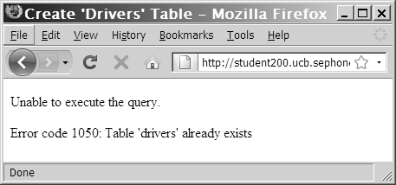
Creating and Deleting Tables (continued)
Error code and message that displays when you attempt to create a table that already exists

Slide 55
Creating and Deleting Tables (continued)
Use the SHOW TABLES LIKE command to prevent code from trying to create a table that already exists.
If the table does not exist, the mysqli_num_rows()function will return a value of 0 rows
$TableName = "subscribers";
$SQLstring = "SHOW TABLES LIKE '$TableName'";
$QueryResult = @mysqli_query($DBConnect, $SQLstring);

Slide 56
Creating and Deleting Tables (continued)
To identify a field as a primary key in MySQL, include the PRIMARY KEY keywords when you define a field with the CREATE TABLE statement
The AUTO_INCREMENT keyword is often used with a primary key to generate a unique ID for each new row in a table
The NOT NULL keywords are often used with primary keys to require that a field include a value

Slide 57
Creating and Deleting Tables (continued)
To delete a table, use the DROP TABLE statement with the mysqli_query() function

Slide 58
Creating a Database
Use the mysqli_create_db() function to create a new database
The basic syntax for the mysqli_create_db() is:
$result = mysqli_create_db(connection, "dbname" );
The mysqli_create_db() returns a Boolean TRUE if successful or FALSE if there was an error
In most cases we will use mysql monitor, PhpMyAdmin or Workbench to create databases.

Slide 59
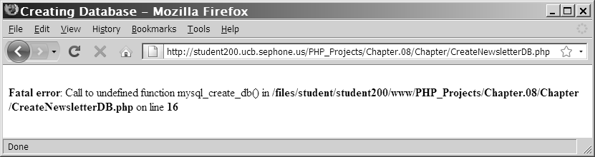
Creating a Database (continued)
Error message when the mysqli_create_db() function is unavailable because of insufficient privileges

Slide 60
Deleting a Database
To delete a database, use the mysqli_drop_db() function.
The format for the mysql_drop_db() function is:
$Result = mysqli_drop_db($connection, "dbname");
The function returns a value of TRUE if it successfully drops a database or FALSE if it
does not

