Slide 1
03 | Expressions & Filters
Stacey Mulcahy | Technical Evangelist
Christopher Harrison | Content Developer

Slide 2
Expressions & Filters
What are Expressions?
What can you do with Expressions?
Using Expressions
What are Filters?
Using Filters
Creating a Custom Filter

Slide 3
03 | What is an Expression?
Stacey Mulcahy | Technical Evangelist
Christopher Harrison | Content Developer

Slide 4
What is an Expression
JavaScript code snippets placed in bindings {{Hello World}}
Evaluated against a scope object
Forgiving, don’t throw an error
Can use filters with expressions to format data
Expressions do not have access to window, document or location
https://docs.angularjs.org/guide/expression

Slide 5
Basic Expression

Slide 6
03 | What can you do in an Expression?
Stacey Mulcahy | Technical Evangelist
Christopher Harrison | Content Developer

Slide 7
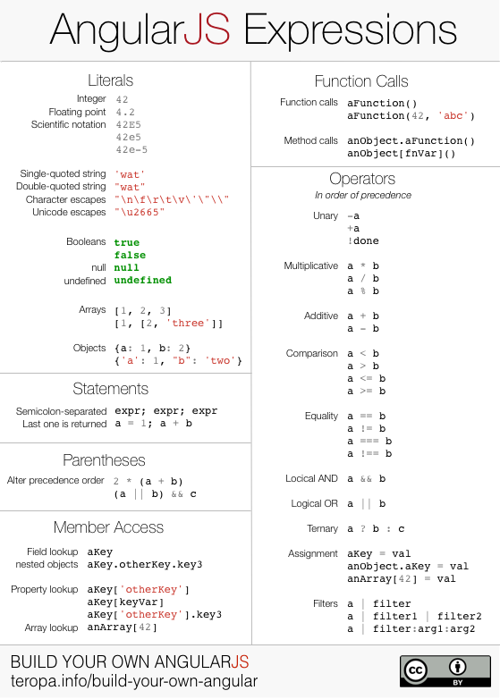
What can you do with Expressions?
http://teropa.info/images/angular_expressions_cheatsheet.png

Slide 8
03 | Using Expressions
Stacey Mulcahy | Technical Evangelist
Christopher Harrison | Content Developer

Slide 9
Using Expressions

Slide 10
Calling a method from an Expression

Slide 11
Expressions : One time binding
Notes:
https://docs.angularjs.org/guide/expression – one time binding is good when you know that its stable and don’ wana trigger watch all over. If it will not change once its set, one time binding is the way to go.

Slide 12
03 | What are Filters?
Stacey Mulcahy | Technical Evangelist
Christopher Harrison | Content Developer

Slide 13
What are Filters?
Formats the value of an expression
Filters can be applied in the view {{employees.array | filter:‘s'}}
Filters applied in the view can be costly as they are re-evaluated
Filters can be used elsewhere: controllers, services etc

Slide 14
03 | Using Filters
Stacey Mulcahy | Technical Evangelist
Christopher Harrison | Content Developer

Slide 15
Built in Filters
orderBy
limitTo
lowercase & uppercase
filter
currency
number
date
Notes:
orderBy to sort an array of items
limitTo – limit to a number
Lowercase/uppsercase – applies
Filter – allows for search
http://www.programming-free.com/2013/10/exploring-angularjs-built-in-filters.html

Slide 16
Using Filters

Slide 17
03 | Creating a Custom Filter
Stacey Mulcahy | Technical Evangelist
Christopher Harrison | Content Developer

Slide 18
Creating a Custom Filter
Register a new filter factory function
Return a filter function that takes the input value as the first argument
Filter function should be stateless (typically )

Slide 19
Creating a Custom Filter

