Slide 1


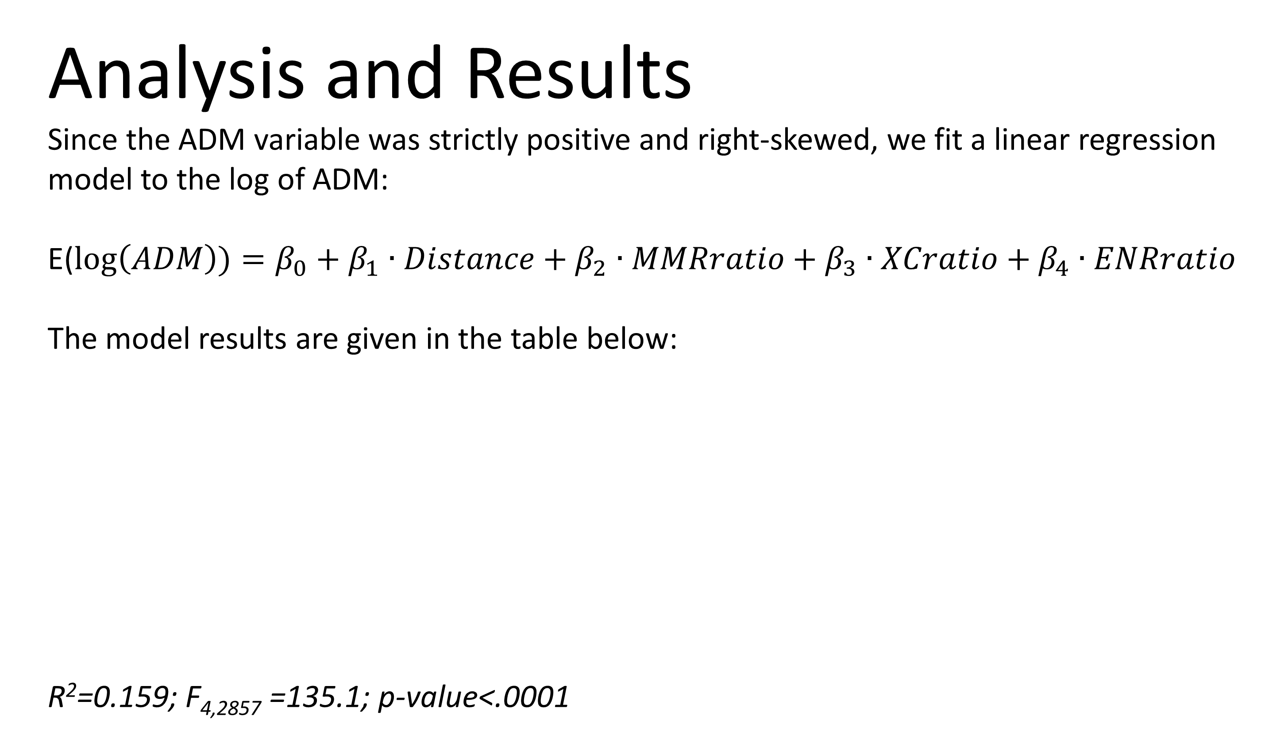
Analysis of Open Enrollment Factors in Minnesota Public Schools Joanna Sink and Solvei Stenslie Concordia College, Moorhead, Minnesota Advisor: Dr. John Reber, Department of Mathematics
Introduction
Open enrollment (the ability for K-12 students to choose which public school they attend regardless of where they live) has been a Minnesota policy since 1990¹. Because the state of Minnesota provides funding to public school districts based on the total number of students enrolled, open enrollment creates market competition between schools². Consequently, the factors that draw students out of their district are of interest to schools.
Previous studies have found that within the constraints of distance, high academic achievement is the largest factor driving open enrollment flows. Also, a greater number of students transferred into schools with higher socio-economic status, higher per-pupil spending, and more extracurricular activities. Wealthy students were more likely to take advantage of open enrollment options. High-achieving districts lost more students than low-achieving districts, but they lost their students to even higher-achieving districts³. Our study aims to analyze the relationship between enrollment and these factors while also examining the impact of district enrollment size.
Discussion
The model is fit on a natural log scale. To interpret the parameters, we therefore need to exponentiate them. This process converts the additive model to a multiplicative one; hence, the exponentiated parameters can be interpreted as the expected percentage change in ADM for every one-unit increase in the variable.
Distance: exp(-0.044) = 0.957. This means that every additional mile between school districts reduces the expected ADM by about 4.3% (p-value <.0001).
MMRratio: exp(0.030) = 1.030. Every one-unit increase in the MMRratio between districts increases the expected ADM by about 3% (p-value = 0.0120).
XCratio: exp(0.079) = 1.082. Every one-unit increase in the XCratio between districts increases the expected ADM by about 8.2% (p-value = 0.0987).
ENRratio: exp(0.047) = 1.048. Every one-unit increase in the enrollment ratio between districts increases the expected ADM (toward the school district with lower enrollment) by about 4.8% (p-value <.0001).
Based on these results, distance, academics, and total district enrollment seem to be important factors in influencing open enrollment flow. Extracurricular activities were not as significant, although this variable may have been confounded with total enrollment.
Data
The state of Minnesota provides data on student movement by district (measured in Average Daily Membership (ADM)) for the 2009-2010 and 2010-2011 school years^{4,5}. To these data we added the following variables:
Distance between districts (taken from Minnesota Geographic Information Systems data⁶). For each district we calculated a district “centroid:” the average location of all schools in the district, weighted by school enrollment. These centroids and enrollment flows between districts are displayed in Figure 1.
The ratio of multiple measurement rating (MMR) scores (enrolled district to home district) for the 2011-2012 school year⁷ (MMRratio). MMR provides us with a proxy variable for academic performance, and the ratio between districts allows us to compare districts academically.
The ratio of the number of extracurricular activities (enrolled district to home district) offered by secondary schools within districts⁸ (XCratio). For districts with multiple secondary schools, the number of extracurricular activities was averaged across schools.
The ratio of total enrollments (home district to enrolled district) between districts (ENRratio).
Figure 1: Minnesota school district centroids and student enrollment flows between districts.
Analysis and Results
Since the ADM variable was strictly positive and right-skewed, we fit a linear regression model to the log of ADM:
E($\log\left(ADM\right))=β_{0}+β_{1}∙Distance+β_{2}∙MMRratio+β_{3}∙XCratio+β_{4}∙ENRratio$
The model results are given in the table below:
R²=0.159; F_{4,2857} =135.1; p-value<.0001
References
State of Minnesota, Office of the Revisor of Statutes. (2013). 2013 minnesota statutes: Enrollment options program (124D.03). Retrieved from website: https://www.revisor.mn.gov/statutes/?id=124d.03
Lavery, L., & Carlson, D. (2014). Dynamic participation in interdistrict open enrollment. Educational Policy, doi: 10.1177/0895904813518103
Carlson, D., Lavery, L., & Witte, J. (2011). The determinants of interdistrict open enrollment flows: Evidence from two states. Educational Evaluation and Policy Analysis, 33(1), 76-94. Retrieved from http://www.jstor.org/stable/41238539
Minnesota Department of Education, Student Movement by District 2009-10 School Year. (2010). [Data set]. Retrieved from www.house.leg.state.mn.us.
Minnesota Department of Education, Student Movement by District 2010-11 School Year. (2011). [Data set]. Retrieved from www.house.leg.state.mn.us.
Minnesota Geospatial Information Office, MnGeo’s Clearinghouse Data Catalog, School district and attendance boundaries, 2013-14 [Data set] Retrieved from http://www.mngeo.state.mn.us/chouse/metalong.html#admin
Minnesota Department of Education, Data Reports and Analytics [Data sets]. Retrieved from http://w20.education.state.mn.us/MDEAnalytics/Data.jsp
Minnesota State High School League [Data set]. Retrieved from http://www.mshsl.org/mshsl/index.asp
Variable | Parameter | SE | t | p-value
Intercept | 3.477 | 0.064 | 54.02 | <.0001
Distance | -0.044 | 0.002 | -22.43 | <.0001
MMRratio | 0.030 | 0.012 | 2.51 | 0.0120
XCratio | 0.079 | 0.048 | 1.65 | 0.0987
ENRratio | 0.047 | 0.005 | 8.93 | <.0001

