Slide 1
InfoBeermatics
Ali Abdelmalek, Emmanuel Olawuyi, Graham Murphy, Shakeel Huda

Slide 2
Original Plan
ABV vs Rating (grouped by country)
Beer Type vs Rating (grouped by country)
Brewery country of origin vs Rating
Emmanuel

Slide 3
Original Data Sources
OpenBrewery DB - Brewery Information
Ratebeer.com - ABV and Rating
Issue: Could not obtain Ratebeer.com API Key
Emmanuel

Slide 4
Research Questions
What is the is the distribution of breweries in the United States?
How do brewery ratings compare vary by state? Which State on average has the best breweries?
Does the average temperature of the brewery location have any effect on it’s rating?
Emmanuel

Slide 5
Updated Plan
Heat Map of Brewery Density
Brewery Rating by State
Brewery Rating by Brewery Type
Brewery Types by State
Scatter Plot of Max City Temperature vs. Brewery Rating
Scatter Plot of Average State Temperature vs. Brewery Rating
Emmanuel

Slide 6
Updated Data Sources
OpenBrewery DB - Brewery Information
Google Places - Brewery Ratings
Open Weather - Max Temperature for current day
Current Results.com - Historical temperature for State
Emmanuel

Slide 7
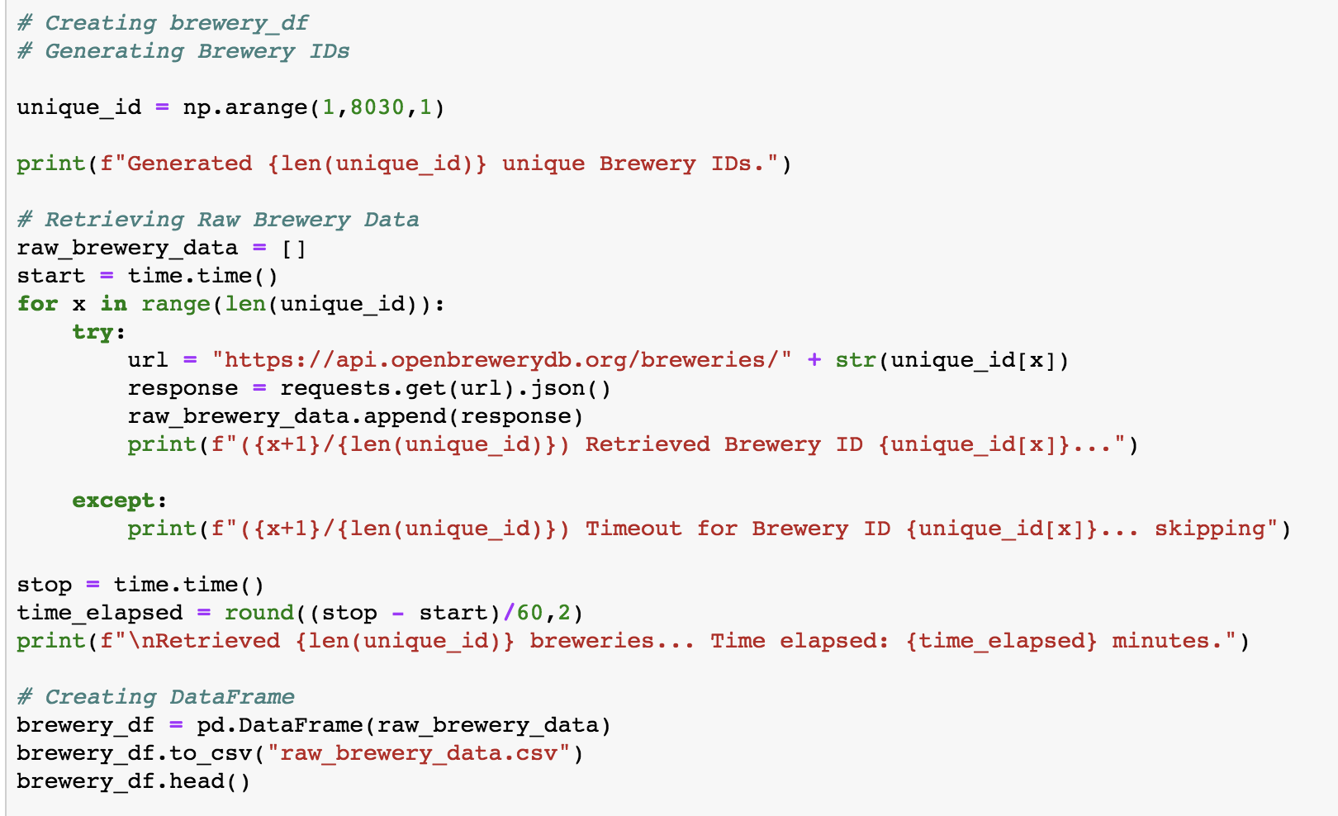
Data Exploration
Shakeel
Notes:
We began our data exploration by pulling our data sets from three of the APIs we just mentioned. Our goal was to pull everything into a dataframe and then merge everything together. First, we began with generating our Brewery data. There were a little over 8000 breweries from the ObenBrewery DB API so we generated a list of unique ids to search through the API. Using a for loop, we pulled each brewery record from the API and placed it into a list. Next, we generated our brewery data frame and saved this into a csv file.

Slide 8
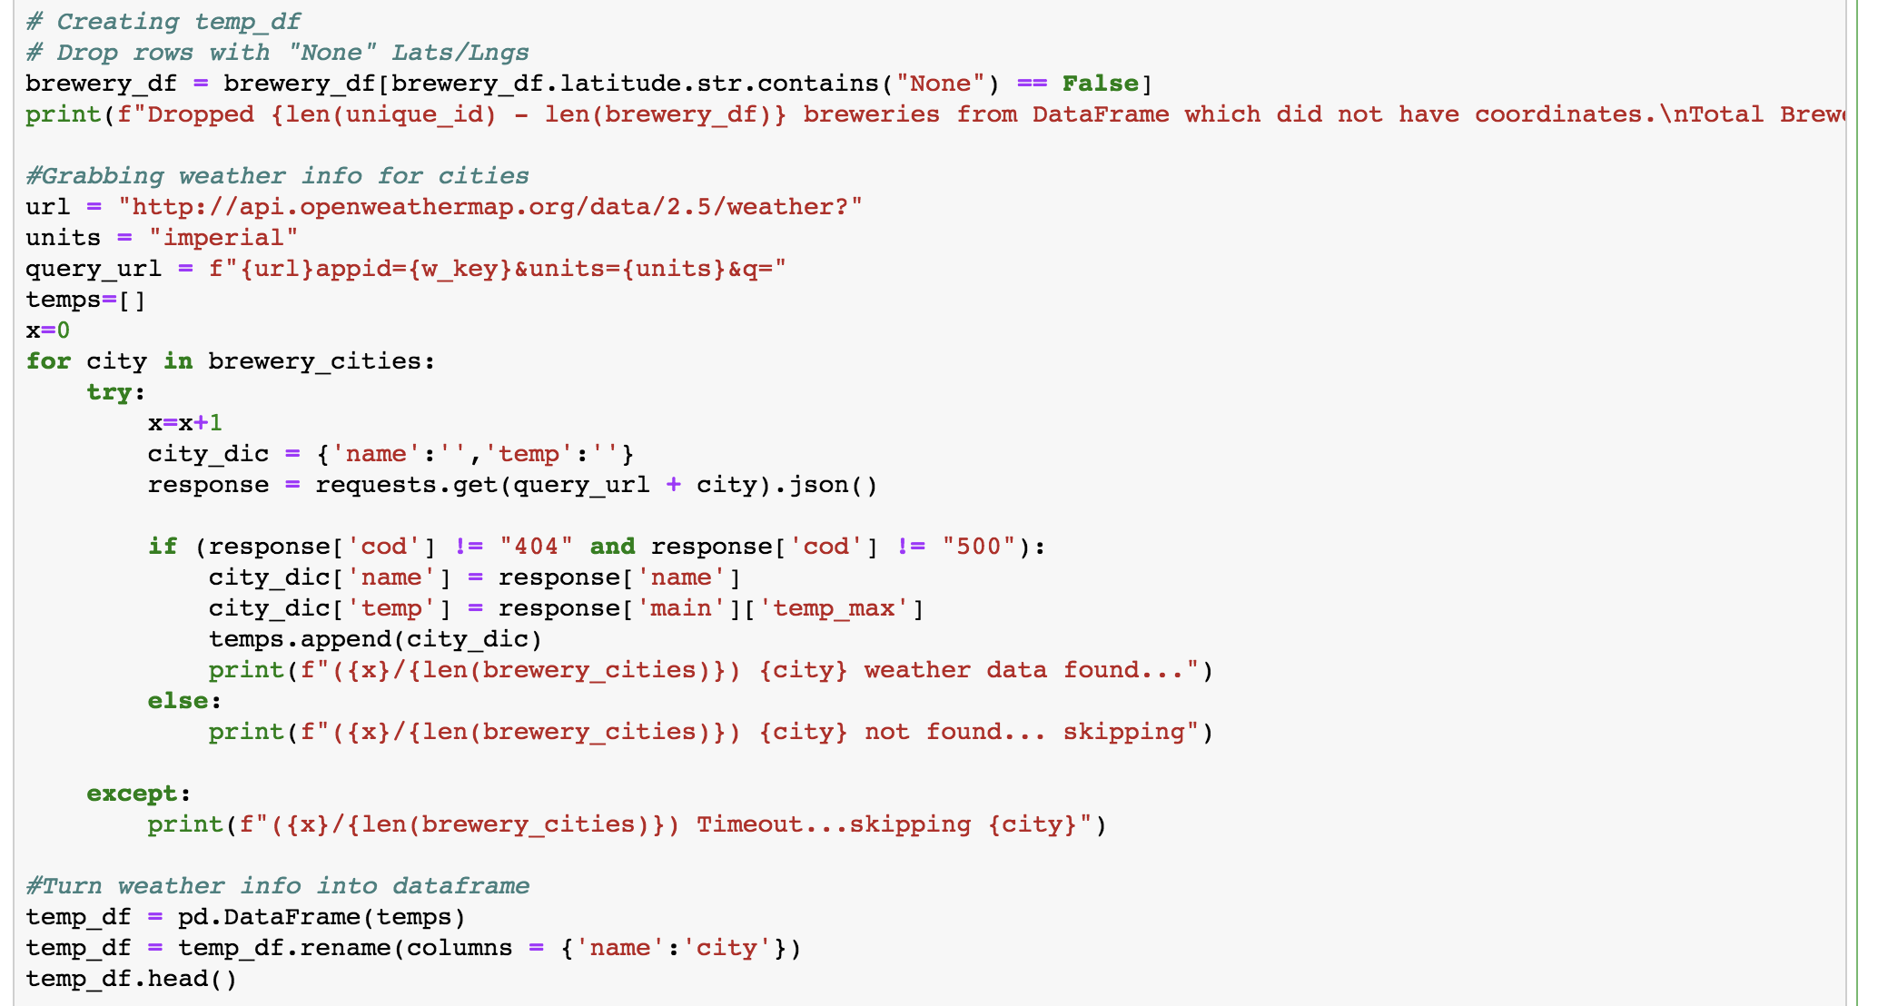
Data Exploration
Shakeel
Notes:
Our next step was to create our dataframe of temperatures at the cities the breweries were located at. Due to some constraints with the API and other limitations, we pulled the max temperature of the city at the current moment we were running the code. One thing I liked to point out is that we ran into some errors where OpenWeather did not have the city in its API. To bypass this, we used a conditional to create the list of temperatures. After generating this list, we converted it into a dataframe.

Slide 9
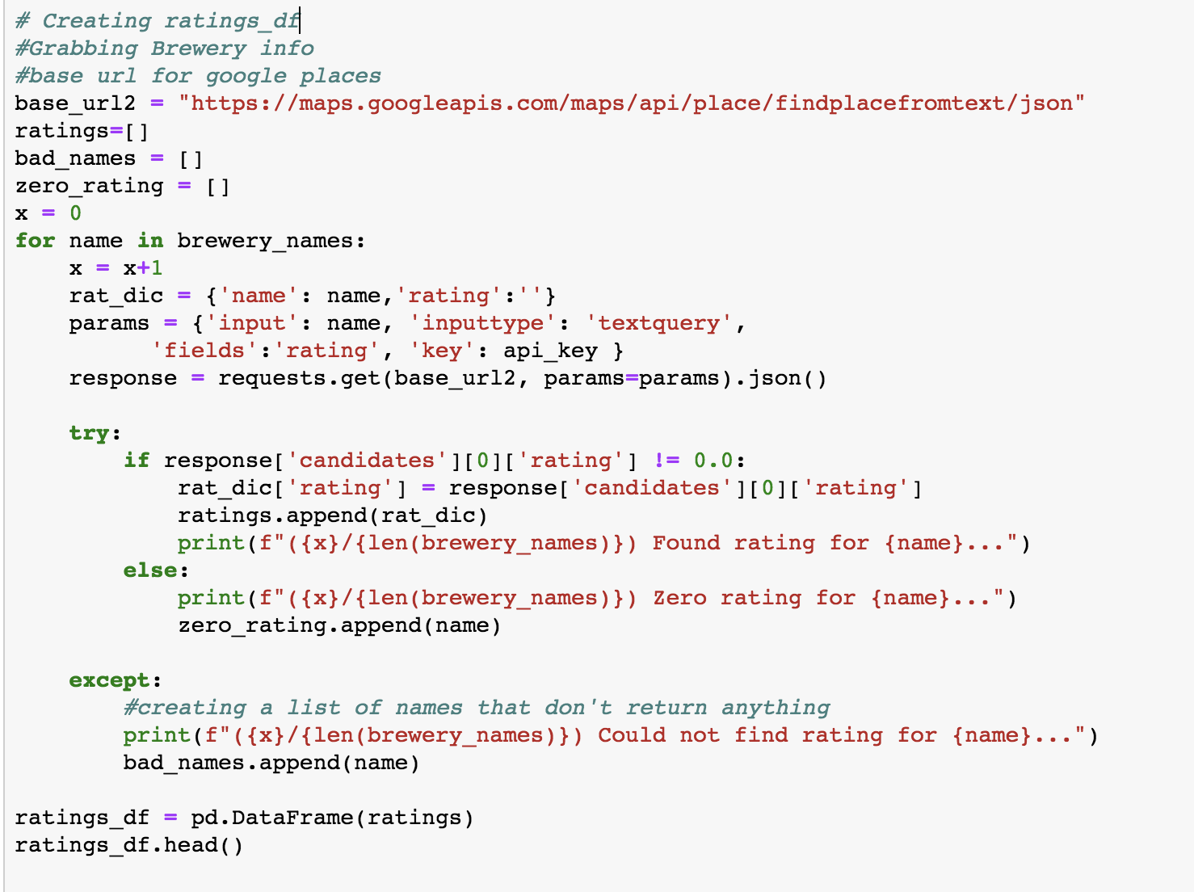
Data Exploration
Shakeel
Notes:
Our final dataframe consisted of the brewery ratings from the Google places API. Similar to the previous two steps, we used a for loop to pull each record into a list. We used a conditional to avoid retrieving breweries with a 0 rating. In addition, we had to drop breweries we could not find with a rating from the google places api.

Slide 10
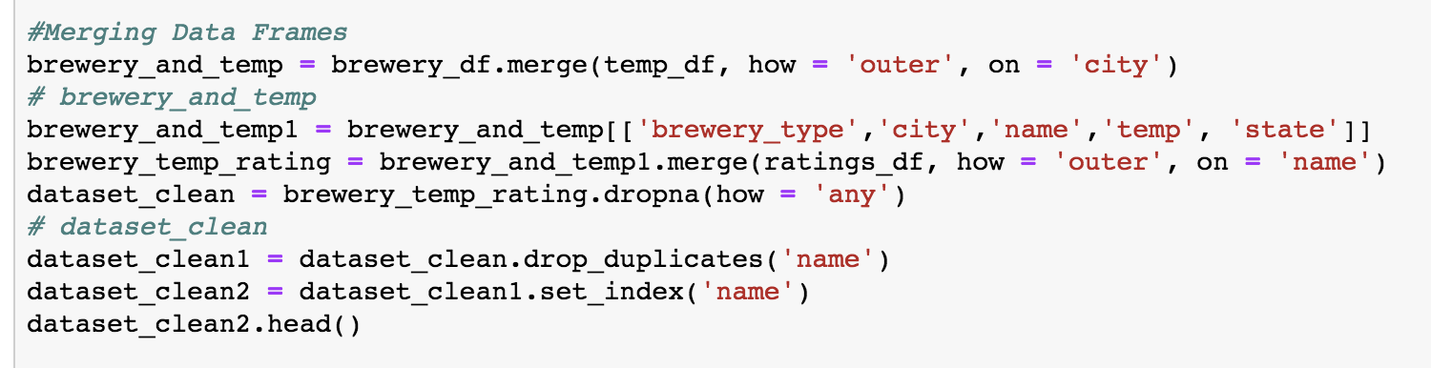
Data Cleanup
Shakeel
Notes:
Our data cleanup consisted of 2 merges. We merged the brewery dataframe with the temperature dataframe on the city field. Next, we merged that table with the ratings dataframe. We cleaned up our dataframe a bit with columns we needed. We dropped duplicates and set the index to the brewery’s name. This was the final dataframe we needed to become our data analysis.

Slide 11
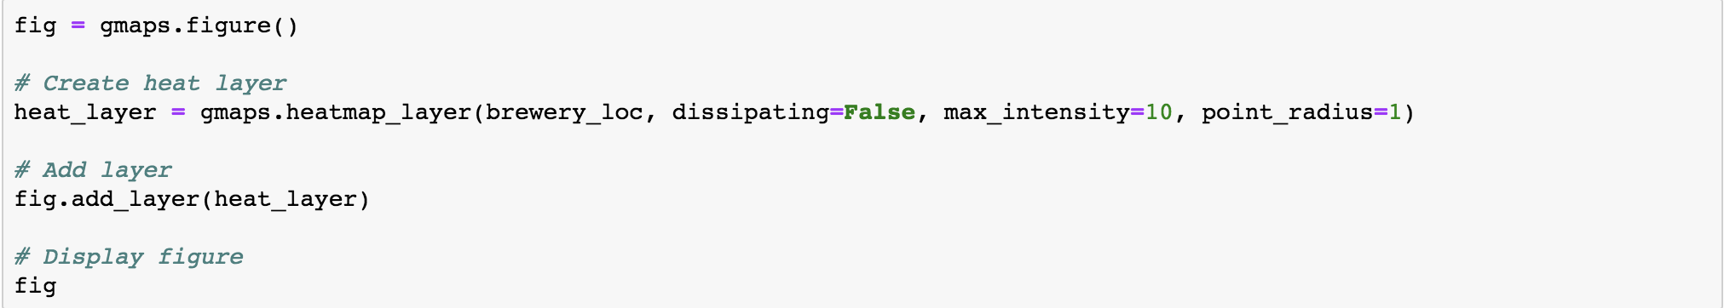
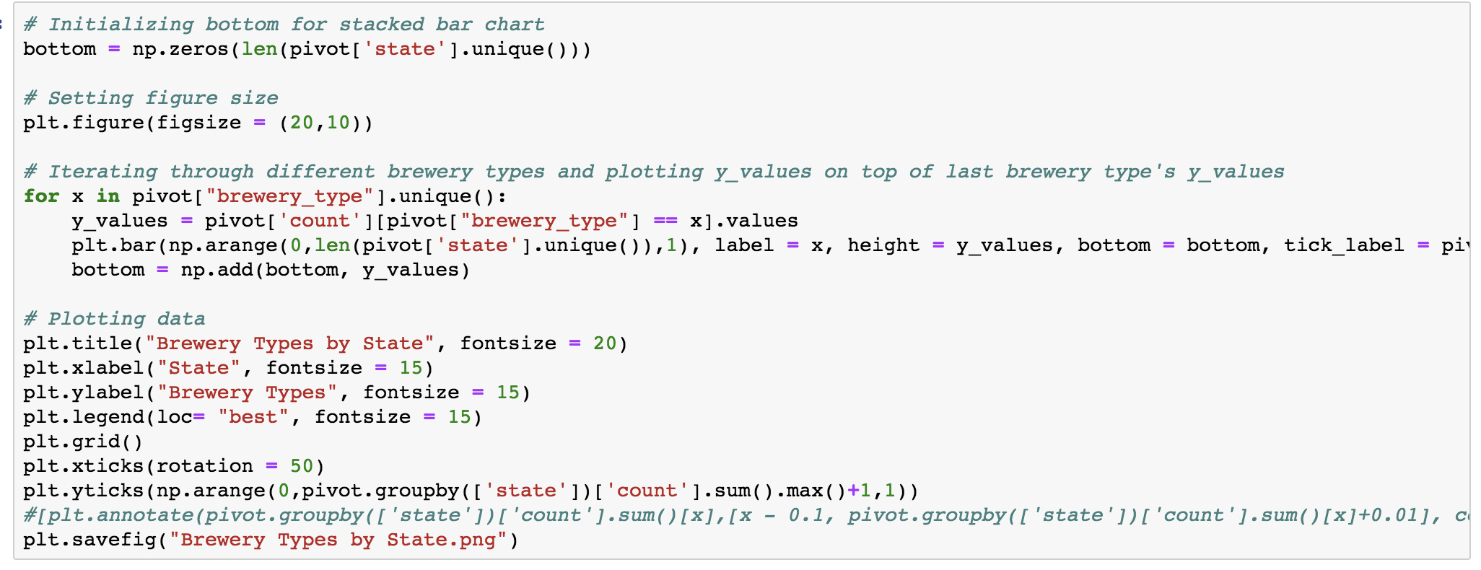
Analysis Process
Shakeel
Notes:
Here are a few snippets of code. The first shows our process to generate our heat map. The second shows our process to generate our stacked bar chart. Now, we’ll cover our data visualizations.

Slide 12
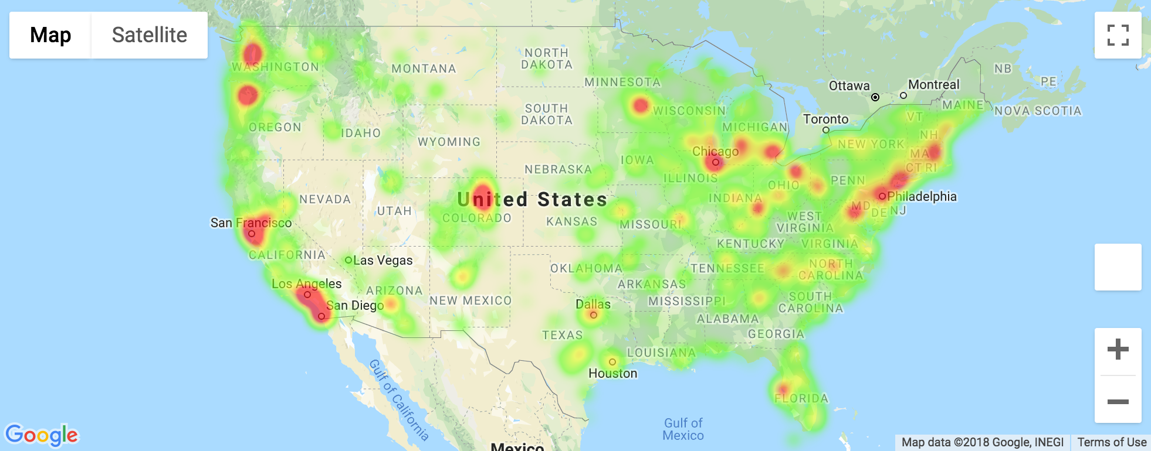
Heat Map of Brewery Density - US Mainland
Shakeel
Notes:
Here is our heat map. It’s very interesting, as you can see major metro areas with a higher density. Some of the obvious areas are Denver, Seattle, Portland, and most of the cities in California. You can see the density of breweries in the northeast as well.

Slide 13
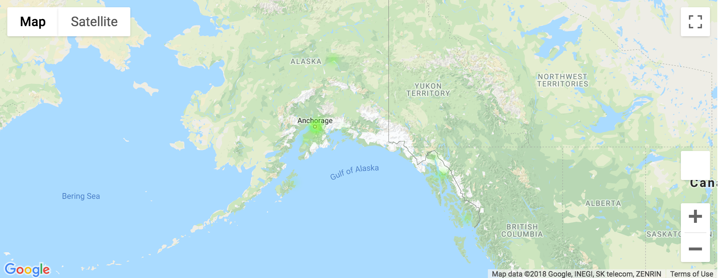
Heat Map of Brewery Density - US Alaska
Shakeel
Notes:
We have a heat map of Alaska as well.

Slide 14
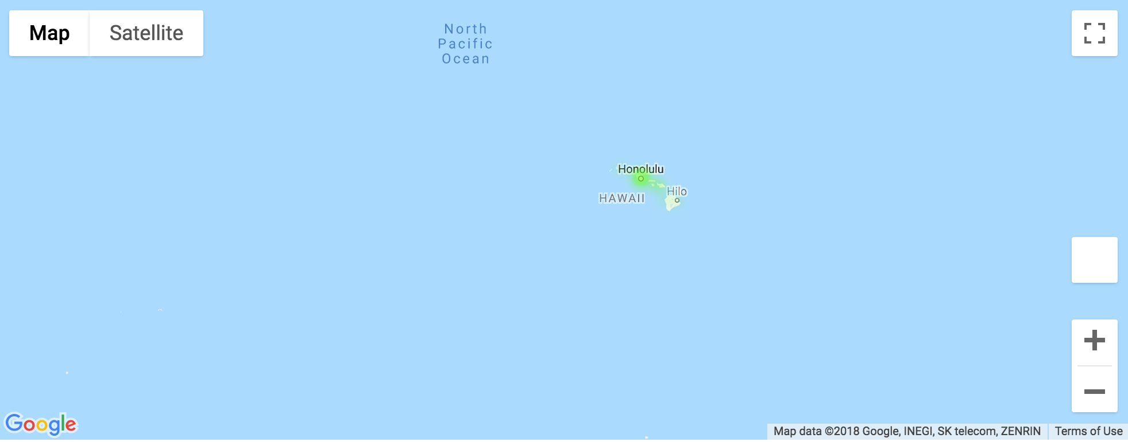
Heat Map of Brewery Density - US Hawaii
Shakeel
Notes:
And here is Hawaii. I’d like to pass it over now to Ali, who will cover more of our data visualizations.

Slide 15
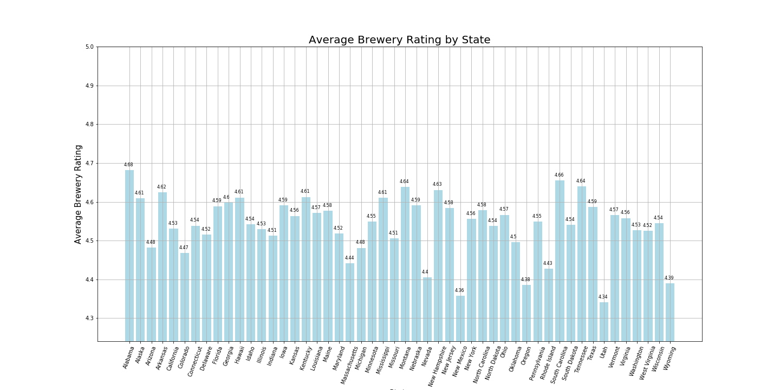
Brewery Rating by State
Ali

Slide 16
Top 5 States with Best Breweries
State | Rating
Alabama | 4.68
South Carolina | 4.66
Tennessee | 4.64
Montana | 4.64
New Hampshire | 4.63
Ali

Slide 17
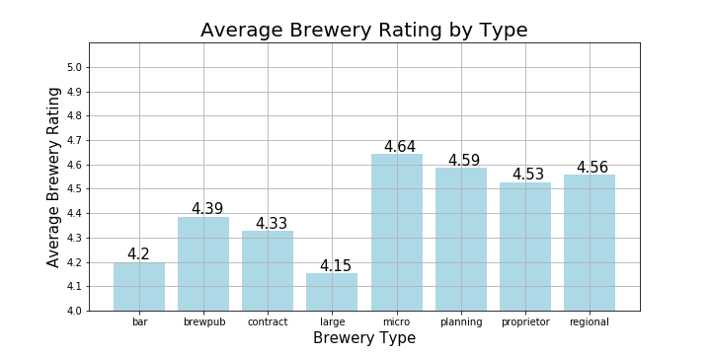
Brewery Rating by Brewery Type
Ali

Slide 18
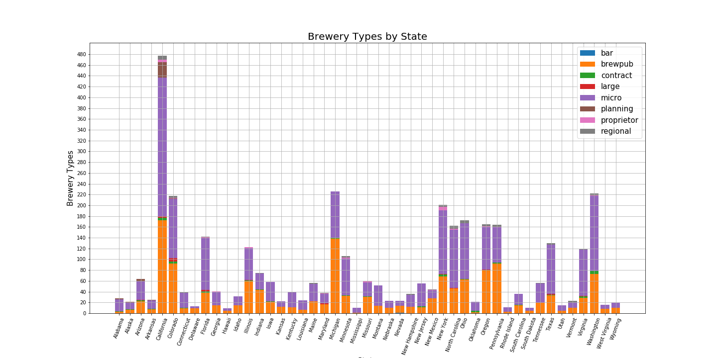
Count of Brewery Types by States
Ali

Slide 19
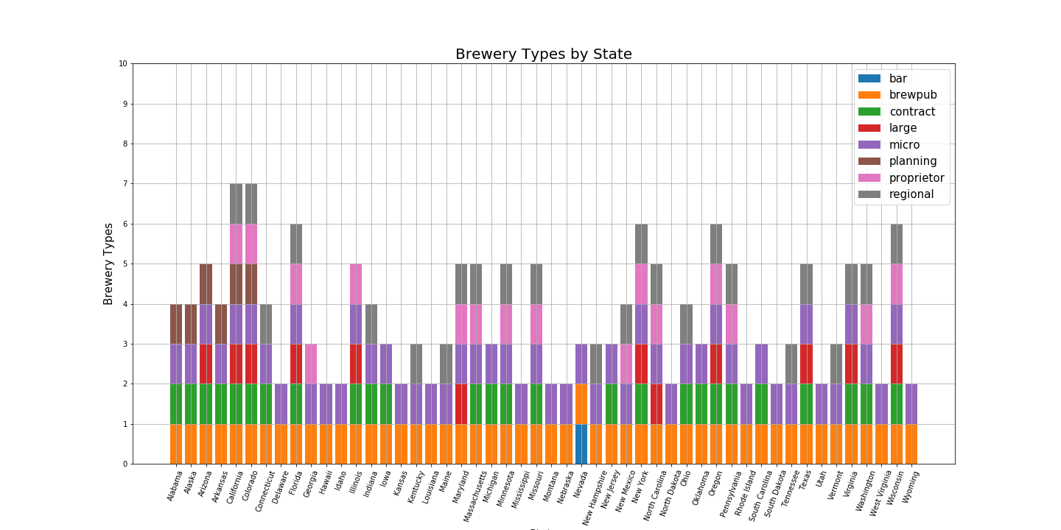
Variation of Brewery Types by States
Ali

Slide 20
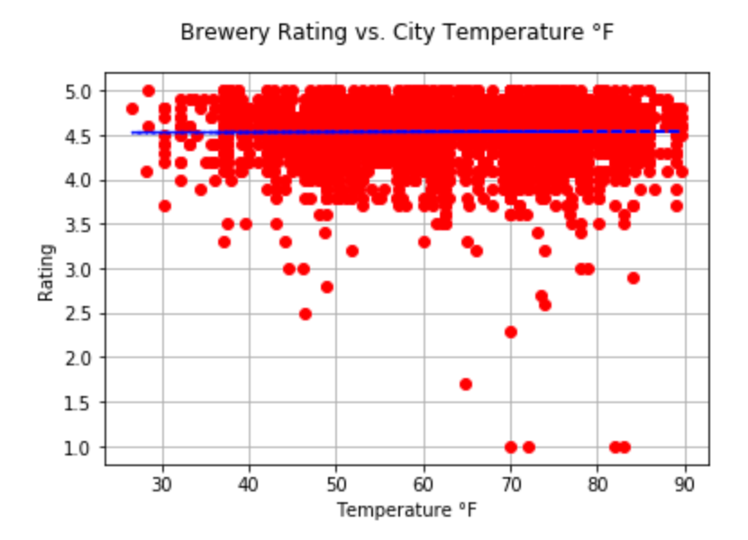
City Max Temperature vs. Brewery Rating
The slope of the line of best fit is 0.0024274899245278676 The correlation coefficient is 0.06103732548884982

Slide 21
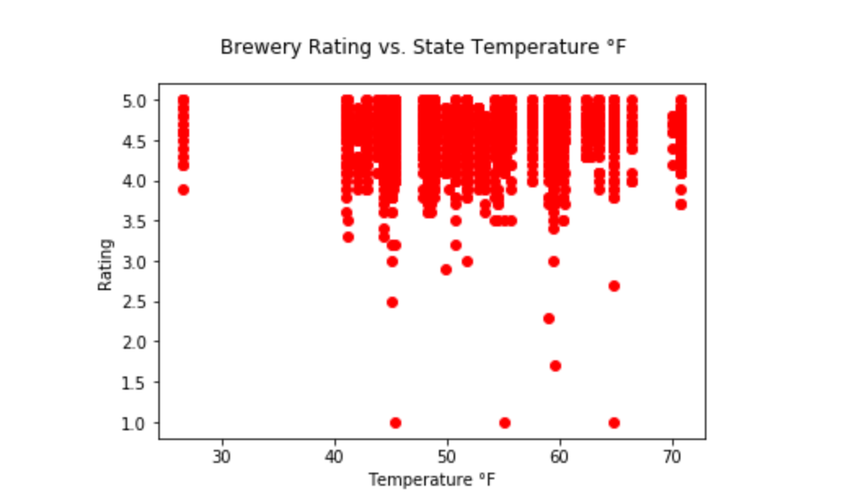
Average State Temperature vs. Brewery Rating
graham

Slide 22
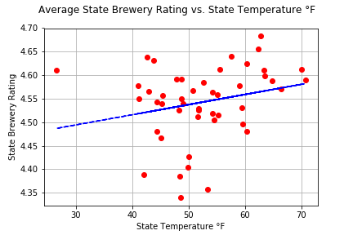
Average State Temperature vs. Average State Brewery Rating
The slope of the line of best fit is 0.00215352975151537 The correlation coefficient is 0.24035168467639476
graham

Slide 23
Conclusion
Our results:
Most breweries are concentrated around major US cities with large population, which was expected.
The brewery type with the highest count per state is a “micro brewery” followed by brew pubs.
The state with the highest rated breweries is Alabama.
From the correlation coefficients found, there appears to be little to know relationship between brewery rating and location temperature.
graham

Slide 24
Lessons Learned
Bias in brewery data
Open Brewery DB API is not a random data source for brewery data.
Slide 12 shows most breweries have a rating >4.5
A better source could be the Google Places API to find random breweries in United States
API abuse
OpenWeather API Key was blocked due to excessive frequency (>862 calls/min)
Limited resources and time
With more time, we may have been able to get an API key for RateBeer.com
WIth more resources, we may have secured an API key for historical weather data on OpenWeather
graham

