Slide 1
SYNBA: A CONTEXTUALIZED SYNONYM-BASED ADVERSARIAL ATTACK FOR TEXT CLASSIFICATION​
Alma Mater Studiorum – University of Bologna
Department of Computer Science and Engineering
Master’s Degree in Artificial Intelligence
Master Thesis in Natural Language Processing
Supervisor: Prof. Paolo Torroni
Co-supervisors: Dr. Federico Ruggeri
Co-supervisors: Dr. Giulia De Poli
Candidate: Giuseppe Murro
Academic Year 2021-2022 - Third session

Slide 2

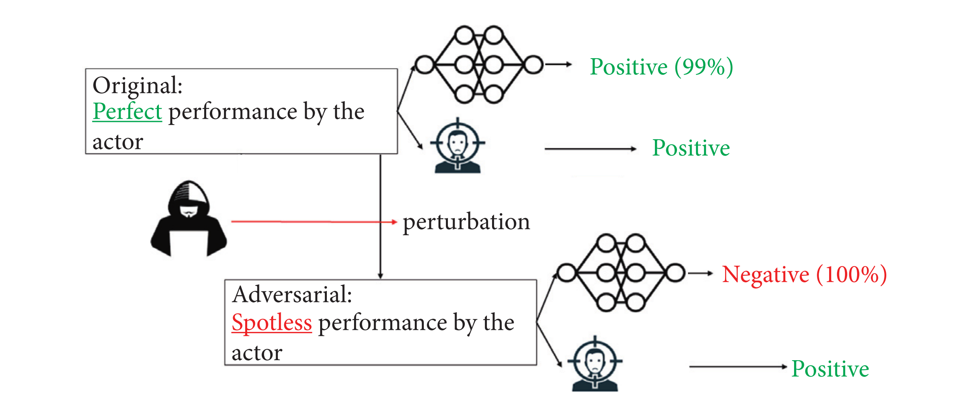
Introduction
Adversarial Machine Learning
Paradigm shift: from CV to NLP
Intersection of Machine Learning and Cybersecurity
Aims to trick ML models by providing deceptive input
Two kinds of Artificial Intelligence Attacks
Data poisoning
Evasion or Adversarial Attack
Adversarial examples originated in the Computer Vision community
It is hard to guarantee that the quality of the generated textual adversarial examples is high
The robustness of ML models can be improved by including high-quality adversarial examples in the training set
Successful textual adversarial example
It is a carefully designed instance with small perturbations that cause a machine learning model to make a false prediction, while theinstance is still correctly classified by a human observer
Giuseppe Murro
Alma Mater Studiorum – University of Bologna
2

Slide 3
Adversarial attacks on Text Classification
Attacks from literature
They can be classified according to the semantic granularity of the perturbation
Researchers proposed special attacks in the text domain to maintain semantic consistency and syntactic correctness
In practice, they frequently violate linguistic constraints
GRANULARITY
ATTACK METHODS
ADVERSARIAL EXAMPLES GENERATED
CHARACTER-LEVEL
DeepWordBug
Introduce typos for some words
Original (POS): This film has a special place in my heart
Perturbed (NEG): This film has a special p1ace in my herat
WORD-LEVEL
TextFooler
Find synonyms exploting cosine similarity between word embeddings
Original (POS): generates an enormous feeling of empathy for its characters
Perturbed (NEG): leeds an enormous foreboding of empathy for its fonts
BERT-Attack (BAE)
Use BERT as MLM for word replacement
Original (NEG): bears is even worse than i imagined a movie ever could be.
Perturbed (POS): bears is even greater than i imagined a movie ever could be.
SENTENCE-LEVEL
SCPNs
Use an encoder-decoder model to produce a paraphrase of the original sentence
Original (NEG): I’d have to say the director is the big problem here
Perturbed (POS): By the way, you know, the director is the big problem
Giuseppe Murro
Alma Mater Studiorum – University of Bologna
3

Slide 4

Proposed solution
SynBA
TextFooler and BERT-Attack suffer respectively from a lack of context and semantic similarity
We tried to combine their strengths in a new recipe called SynBA (Synonym-Based adversarial Attack)
Transformation
For each selected word, replacement candidates are obtained from a weighted function
The rank of candidates for word replacement is computed by summing up three normalized scores
The weights were defined after a hyperparameter tuning phase
SynBA-Score = λ₁* MLM-Score + λ₂* Thesaurus-Score + λ₃* WordEmb-Score
The confidence of candidates obtained by MLM (BERT) in a descending order
The cosine similarity is computed between the reference words and the top closest embeddings
WordNet is used to retrieve synonyms and antonyms of the original word
Giuseppe Murro
Alma Mater Studiorum – University of Bologna
4

Slide 5
Proposed solution
Constraints
Constraints are used to avoid the generation of adversarial examples that are too different from the original input text
Part-of-speech - constraints perturbations to only swap words with the same part of speech
Max modification rate - limits the number of words that can be perturbed in the input text to a maximum of 20% of total words
Word embedding distance - throws away perturbations by words with a cosine similarity lower than 0.6
Semantic Textual Similarity - checks whether the similarity between the original and the perturbed text is higher than a threshold t = 0.7 using a Sentence-BERT pre-trained model
Giuseppe Murro
Alma Mater Studiorum – University of Bologna
5

Slide 6


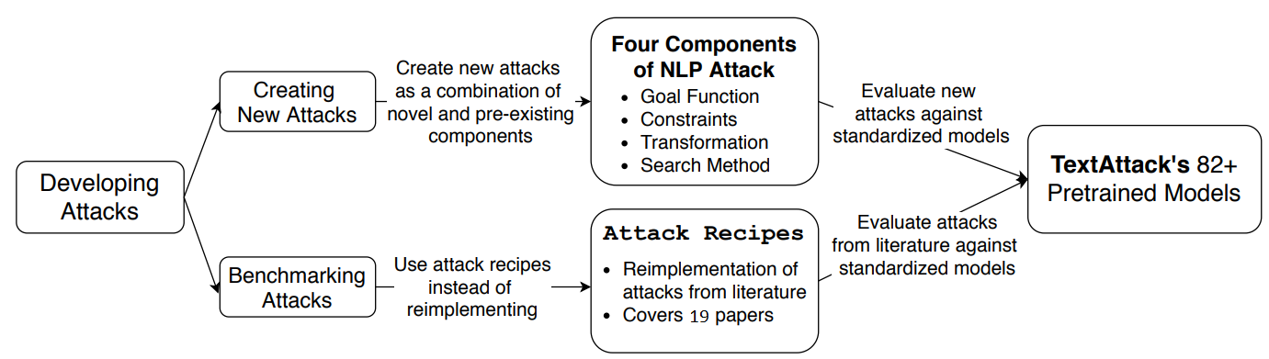
Empirical evaluation
TextAttack
Python framework that provides implementations for 19 adversarial attacks methods from the literature
Directly integrated with HuggingFace’s transformers
Components
goal function, determines whether the attack is successful in terms of the model outputs
constraints, determine if a perturbation is valid
transformation, given an input, generates a set of potential perturbations
search method, selects promising perturbations from a set of transformations
Giuseppe Murro
Alma Mater Studiorum – University of Bologna
6

Slide 7
Experimental results
Datasets
Target models
Sampled 1000 examples from two movie review datasets
IMDB – avg. 229 words (± 162) per example
Rotten Tomatoes – avg. 19 words (±9) per example
BERT-base uncased model fine-tuned according to the dataset used as input
Quality assessment on IMDB
Quality assessment on Rotten Tomatoes
Metric
TextFooler
BERT-Attack
SynBA
Metric
TextFooler
BERT-Attack
SynBA
Attack success rate (↑)
98.39
65.24
92.7
Attack success rate (↑)
89.44
61.92
68.56
Original/perturbed perplexity (↓)
41.48/
63.0
41.78/
48.4
41.5/
50.74
Original/perturbed perplexity (↓)
72.58/
154.52
76.96/
99.91
72.05/
112.08
Sentence-BERT
similarity (↑)
0.928
0.964
0.944
Sentence-BERT
similarity (↑)
0.805
0.776
0.901
Contradiction rate (↓)
0.053
0.164
0.049
Contradiction rate (↓)
0.196
0.536
0.123
Giuseppe Murro
Alma Mater Studiorum – University of Bologna
7

Slide 8
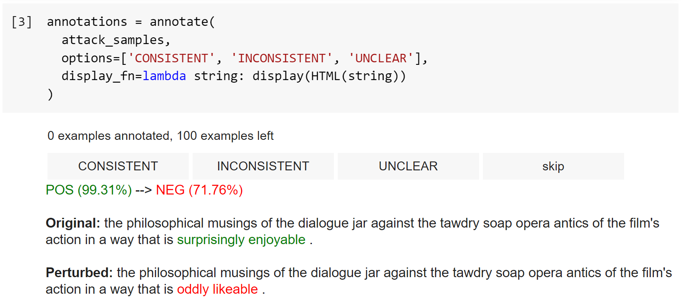
Human evaluation
Human prediction consistency assessment
Three human annotators were asked to evaluate 100 successful adversarial examples for each attack method
The task is to decide if the perturbed sample is consistent with the original one
Annotation interface
Survey results
Giuseppe Murro
Alma Mater Studiorum – University of Bologna
8

Slide 9
Some adversarial examples
Method
Label
Adversary
Original
TextFooler
BERT-Attack
SynBA
POS (99.95%)
NEG (97.79%)
FAILED
NEG (99.88%)
peppered with witty dialogue and inventive moments.
riddled with witty dialogue and inventive min.
charming with easy ways and dry wit.
riddled with witty dialogue and inventive moments.
Original
TextFooler
BERT-Attack
SynBA
POS (99.95%)
NEG (95.55%)
NEG (98.28%)
NEG (92.26%)
the most ingenious film comedy since being john malkovich.
the most malignant film comedy since being john malkovich.
the most difficult film comedy since being john malkovich.
the most artful film comedy since being john malkovich.
Original
TextFooler
BERT-Attack
SynBA
NEG (99.94%)
POS (99.88%)
POS (98.36%)
FAILED
an unsophisticated sci-fi drama that takes itself all too seriously.
an impressionable sci-fi drama that takes itself all too attentively.
an awesome sci-fi drama that takes itself all too soon.
an unsophisticated sci-fi tragedy that took itself all too heavily.
Giuseppe Murro
Alma Mater Studiorum – University of Bologna
9

Slide 10
Conclusions
Limitations
Future developments
If the MLM-Score is much higher than the others in the final SynBA score, the best candidate is likely to be an antonym or inconsistent with the original counterpart
Assessment performed only on movie reviews datasets
Contradiction rate metric seems to be promising in the context of sentiment analysis, but it could be less informative for other tasks
Extend SynBA to other tasks like machine translation, question answering, and text summarization
Add a new constraint which penalizes the use of words that lead to a contradiction
Exploit enhanced language models to generate more semantically related perturbations
Giuseppe Murro
Alma Mater Studiorum – University of Bologna
10

Slide 11
Thank you
all for your attention!
Giuseppe Murro
Alma Mater Studiorum – University of Bologna
11

