Slide 1
Performance Tools and Metrics

Slide 2
Metrics of Interest
Workload Metrics
Cluster Resource Metrics
Throughput
Queries per Second
Calculations per Second
Ingest rows per Second
Response Time
Query SQL
Histogram of results
Ingest
Raw resources
CPU, Disk, Memory, Network
Normalize resource usage in terms of Workload throughput
CPU% per Query
Disk% per Query
….
Increase Workload and measure impact
CPU% per Queries per Second
...

Slide 3
Memsql-top
Notes:
This takes all activity from the cluster
It calculates resource usage by pulling from mv_activities with a delta tunable
Describe each column – sorting stuff
Dive into Management Views – be able to explain all columns
Difference between mv_activities_extended and mv_activities, network send + receive, disk, read and write

Slide 4
What is memsql-top?
Top-like interface that accompanies management views
Queries MV tables for near real-time view of cluster activity that updates automatically
Included with memsql-ops
On master aggregator simply type:
$ memsql-ops memsql-top

Slide 5
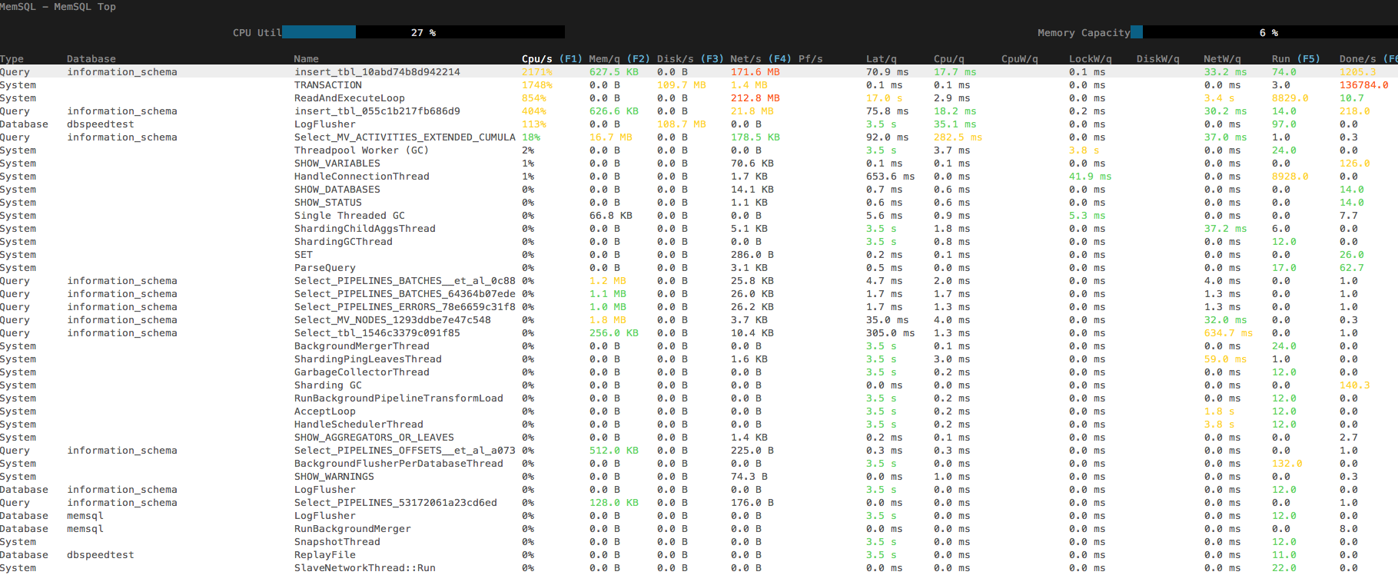
MemSQL Top
Notes:
Describe all columns
Mention sorting
Drill into queries
Powerful = Management views
Calculates recent resource use by computing the change in mv_activities_extended_cumulative over an interval of time

Slide 6
DBBENCH
Simulating Workloads

Slide 7
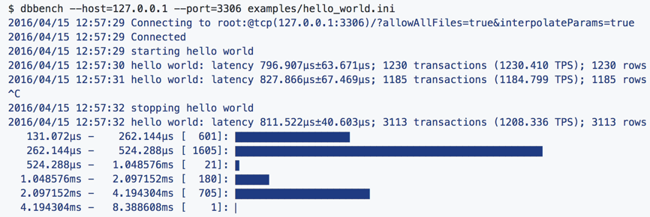
What is dbbench?
Fast, lightweight database workload driver, not a data generator
Executes a workload as a flexible configuration file defines
Notes:
dbbench
dbbench is a fast, lightweight database workload generator that executes a workload defined a flexible configuration file. Using this dbbench, simple 'jobs' can be defined to describe a workload run against a server. Each job represents a single query; by composing multiple jobs together, an arbitrary workload can be described. The jobs are executed against the server and timed to produce aggregated benchmarking information that is emitted periodically and when the test completes. Exact job run data can also be logged for additional offline analysis.
Note that since dbbench is a workload driver, it does not randomly generate queries, tables, data, etc. Any random data generation or setup can be easily done with SQL queries.

Slide 8
Dbbench jobs
'jobs’ describe a workload run against a cluster
Each job represents a single query
Composing multiple jobs together, an arbitrary workload can be described.
Jobs are executed against the server
Timed to produce aggregated benchmarking information
Emitted periodically and when the test completes.
Exact job run data can also be logged for additional offline analysis

Slide 9
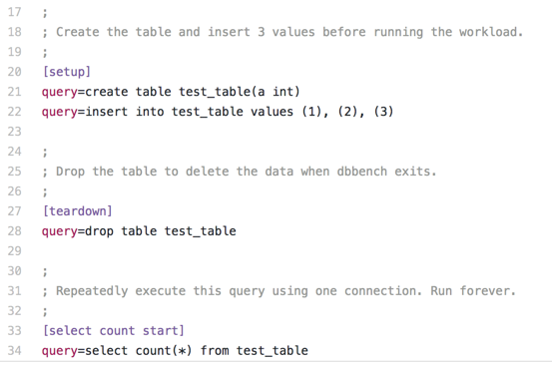
Configuration file (.ini)
Describes workload
Each [name] is job
Reserved names
setup
teardown
Global
Defaut
Job runs repeatedly in a single connection
Notes:
dbbench is a tool for running a database workload against a database. The workload is described in a simple configuration file. Each section of the configuration file defines a job and how it is executed.
This configuration describes a workload where a single connection repeatedly executes the query select "hello world" forever. dbbench will run this workload until the user interrupts the process (usually with Ctrl-C):

Slide 10



Job attributes
concurrency
rate
batch-size
Define simultaneous instances
Define frequency of start of instances
query takes 100 seconds to complete but is started every 10 seconds
workload will need to use at least 10 connections.
# of instances will be launched in the batch
runs 10 simultaneous queries every second
Notes:
Add a concurrency parameter to the job, which defines the number of simultaneous connections that will used by the job. There will be at most this many simultaneous instances of the job active at any given time. For example, the job in this workload will run the same query repeatedly in 10 simultaneous connections.
Add a rate parameter to the job, which defines how frequently a batch of job instances will be started. dbbenchwill use as many connections as are necessary to sustain starting this many job instances per second. For example, the job in this workload will run the given query once every 10 seconds.
Note that since the query takes 100 seconds to complete but is started every 10 seconds, this workload will need to use at least 10 connections.

Slide 11
Download dbbench
https://github.com/memsql/dbbench
Download to Master Aggregator
Install dependencies
git
golang
Set go environmental variables

Slide 12
Follow Tutorial
Write a workload that loads data into a table in the setup section.
Write a workload that does 1000 load data queries a minute that all start executing in the first second of the minute.
Write a workload that does a load data of a different file every second.
Write a query-log that run 4 concurrent sleep(1) queries. When you are done, check the example dbbench config file and query log file.

Slide 13
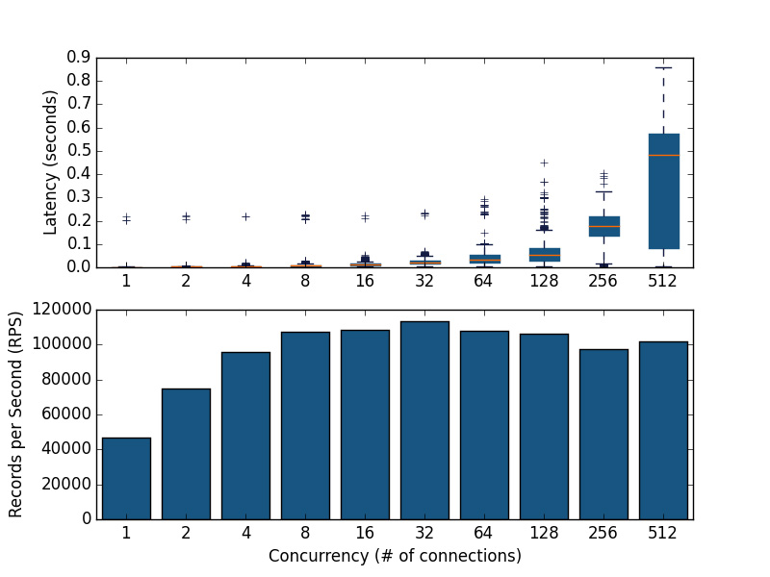
Python scripts for improving dbbench workflows
https://github.com/memsql/dbbench-tools
Easily describe and efficiently run a workload
How many concurrent inserts a small MemSQL cluster can support?
dbbench-scalar shows 100,000 inserts per second in batches of 128
Notes:
dbbench-scaler is one of several tools provided by the dbbench-tools package to help answer this question. dbbench-scaler runs a dbbench-defined workload at different levels of concurrency to find the limits of the database installation.
In this example, not only did dbbench-scaler answer the question “will MemSQL handle the scale of many users”, it also found the ideal number of users for this application.
I ran dbbench-scaler with this configuration to determine that this small test cluster could sustain 100,000 inserts per second in batches of 128, as depicted in the top half of the chart below. In the bottom half of the chart, we see that using more connections allows us to insert more records per second (RPS) until we reach 32 connections, after which there is no benefit to using more connections and we see a hugely adverse effect on query latency:

Slide 14
Management Views and memsql-top
Polling the real-time

Slide 15
What are Management Views?
Set of tables in information_schema database
Show resource usage of recent activities across all nodes in MemSQL cluster
Activities are categorized into Query, Database, System
Query: Application or Person querying MemSQL
Database: Replication Activity, Log Flusher
System: Garbage Collector, Read and Execute Loops
Available in Versions 5.8 and greater - must set a global variable
read_advanced_counters = ‘ON’
memsql-ops memsql-update-config --set-global --key read_advanced_counters --value ‘ON’ --all
Notes:
All Nodes on the cluster, not individual nodes
It’s updated near-real time
Can do many cuts with the data, other tables in info_schema with node/partition information that can be joined on. (memory per partition)

Slide 16
Management Views Tables
SHOW tables in information_schema like "MV_%";
mv_activities | Profile of all activities that recently ran on the cluster and the activity resource usage over a time interval
mv_activities_extended | Profile of all activities that recently ran on the cluster and activity resource usage (plus extended statistic)
mv_nodes | All nodes in the cluster
mv_queries | All recent query activities and the associated query text
mv_activities_cumulative | Profile of any completed or currently running tasks on the cluster and the total resource usage of the activity
For more information, see: Management View Reference
Notes:
Mv- Activities – all tasks at a high level from any node in the cluster (All Nodes)
Mv_actiities extended
Mv_activities get’s updated from cumulative - the delta of resource usage over configurable time period is taken from cumulative
Queries mv_activities and

Slide 17
Notable Management View Metrics
CPU Time
CPU Wait Time
Memory Bytes
Disk Bytes (Read/Write)
Network Bytes (Send/Receive)
Lock Wait Time
Disk Wait Time
Network Wait Time
Failure Time
For more information, see: Management View Reference
Notes:
Activity can be
query: someone executing or ops executing
System – garbage collection when you run delete
Database – Replication
--Highlight different activities and provide examples

Slide 18
Questions management views can help us answer
What queries are using the most CPU time?
Which partitions are using the most memory?
Which leaves are using the most network bandwidth? Memory?
What activities are using the most disk?
How many queries have recently failed?
What databases are using the most CPU?
What’s the most frequent activity type on each node?
Notes:
You can review scenario: https://docs.memsql.com/v5.8/docs/workload-profiling-scenarios

Slide 19
What query activities are using the most CPU time?
Without query text:
select activity_name, cpu_time_ms
from mv_activities where
activity_type = 'Query'
order by cpu_time_ms limit 5;
With query text:
select activities.cpu_time_ms, activities.activity_name,
LEFT(query.query_text,20)
from mv_activities activities
inner join mv_queries query on query.activity_name= activities.activity_name where activity_type = 'Query'
order by cpu_time_ms limit 5;

Slide 20
Which partitions are using the most memory?
select partition_id, sum(memory_bs)
from mv_activities_extended
where partition_id != "NULL"
group by 1 order by 2 limit 5;

Slide 21
What’s average network bandwidth used on each leaf? Average Memory?
Network(Send + Receive)
select nodes.id, nodes.ip_addr, nodes.port, avg(network_logical_recv_b+network_logical_send_b)
from mv_activities_extended activities
inner join mv_nodes nodes on
nodes.id =activities.node_id
group by 1;
Memory
select nodes.id, nodes.ip_addr, nodes.port, avg(memory_bs) from mv_activities_extended activities
inner join mv_nodes nodes on nodes.id = activities.node_id
group by 1;

Slide 22
What activities are using the most disk?
select activity_type, sum(disk_b)
from mv_activities
group by 1 order by 2 DESC limit 5;
With more granular disk information:
Select activity_type, sum(disk_logical_write_b)
from mv_activities_extended
group by 1 order by 2 DESC limit 5;

Slide 23
Have any queries recently failed?
select activity_name, failure_count
from mv_activities_extended
where activity_type ='Query' and failure_count >0;
With Count:
select count(*)
from mv_activities_extended
where failure_count > 0 and activity_type = 'Query’;

Slide 24
What databases are using CPU?
select sum(cpu_time_ms),
database_name
from mv_activities_extended
group by database_name;

Slide 25
What is the most frequent activity type on each node?
select node_id, activity_type, count(*)
from mv_activities_extended activities
inner join mv_nodes nodes on nodes.id = activities.node_id
group by 1, 2
order by 2 DESC;

Slide 26
Top ten Queries… ordered by various metrics
SELECT
substr(replace(replace(query_text,'\n',''), ' ',' '),1,250) as query_text,
database_name,
last_finished_timestamp AS last_run,
(cpu_time_ms/(run_count+success_count+failure_count)) as avg_cpu_time_ms,
(cpu_wait_time_ms/(run_count+success_count+failure_count)) AS avg_cpu_wait_time_ms,
(elapsed_time_ms/(run_count+success_count+failure_count)) AS avg_elapsed_time_ms,
(lock_time_ms/(run_count+success_count+failure_count)) AS avg_lock_time_ms,
(network_time_ms/(run_count+success_count+failure_count)) AS avg_network_time_ms,
(disk_time_ms/(run_count+success_count+failure_count)) AS avg_disk_time_ms,
(round((disk_b/1024/1024),2)/(run_count+success_count+failure_count)) AS avg_disk_mb,
(round((network_b/1024/1024),2)/(run_count+success_count+failure_count)) AS avg_network_mb,
round((1000*(memory_bs/1024/1024)/(elapsed_time_ms)),2) AS avg_memory_mb,
(memory_major_faults/(run_count+success_count+failure_count)) AS avg_major_faults,
(run_count+success_count+failure_count) AS total_executions
FROM information_schema.mv_activities_cumulative JOIN information_schema.mv_queries
ON mv_queries.activity_name = mv_activities_cumulative.activity_name
WHERE activity_type = 'Query'
-- and database_name = 'ie_dba'
and last_finished_timestamp <= now() and last_finished_timestamp >= (now() - interval 20 minute)
order by
avg_elapsed_time_ms desc
-- avg_cpu_time_ms desc
-- avg_network_time_ms desc
-- avg_memory_mb desc
-- avg_major_faults desc
-- avg_disk_time_ms desc
-- avg_disk_mb desc
limit 10\G

Slide 27
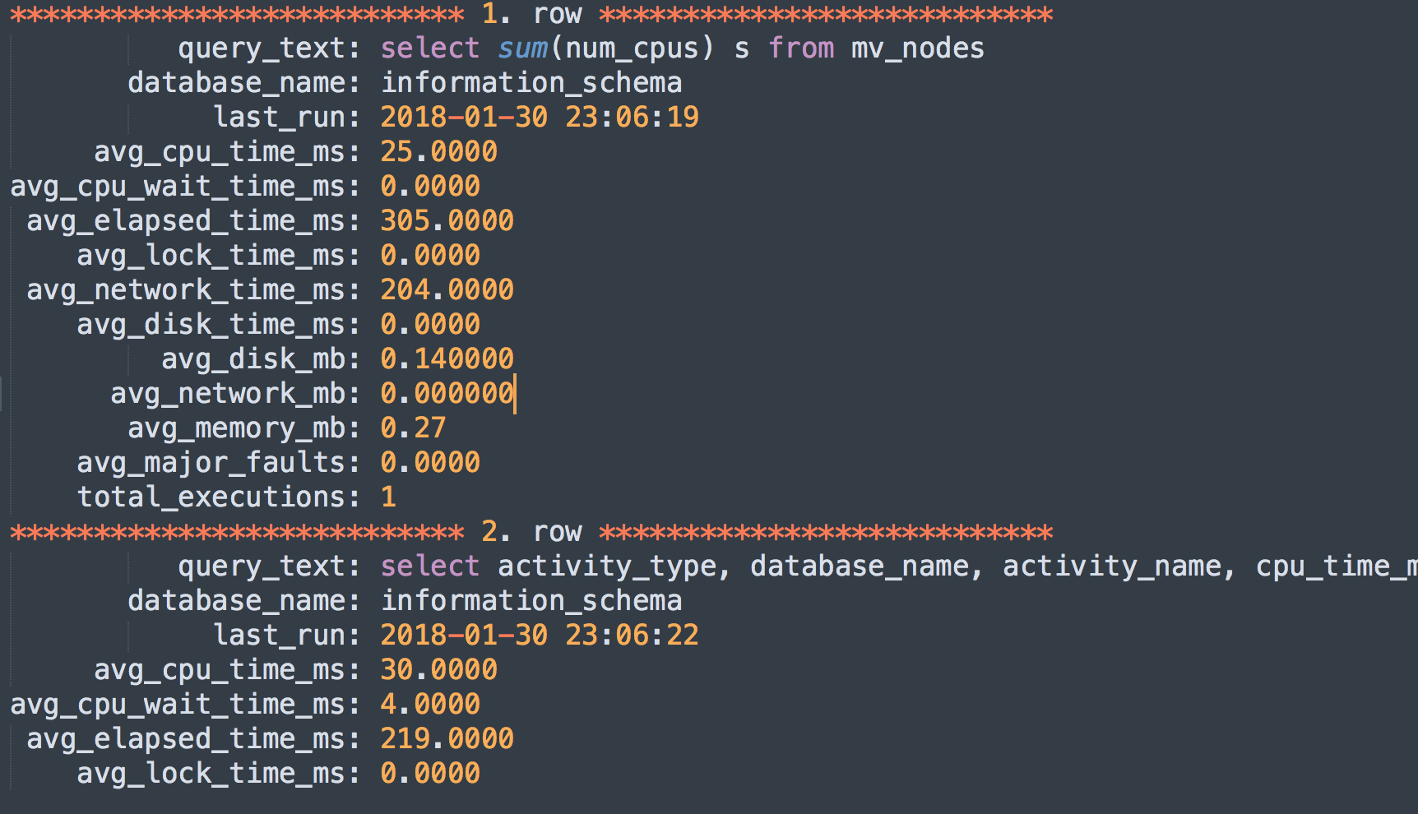
Top ten Queries… example output
Shows top ten queries
Shows various resources associated with each query
…..
......

