Slide 1
MemSQL DBA best practices

Slide 2
Agenda
Availability
Cluster HA and Replication
Backup and Restore
Monitoring
DB status
DB activity
Database size and table skew
Performance tuning
Row or Column tables
Query profile

Slide 3
Availability

Slide 4
Cluster Availability
High Availability option
All nodes are utilized
Async Partition-to-Partition replication
Availability groups used to separate physical location
Master
Agg
Aggregator
Aggregator
Leaf
Leaf
Leaf
Leaf
PARTITIONS
PARTITIONS
PARTITIONS
PARTITIONS

Slide 5
Partitions
With REDUNDANCY-2, each partion replicates to a partner on another leaf.
Master is active partition
Slave is inactive partner
Replication is either asynchronous or sychronous
Agg 1
Agg 2
Leaf 1
Leaf 2
Leaf 3
Leaf 4
Monitor with
SHOW PARTITIONS EXTENDED (for slave partitions)
SHOW CLUSTER STATUS
SHOW DATABASES EXTENDED
SHOW REPLICATION STATUS
Notes:
A leaf is a node consisting of multiple partitions.

Slide 6
Fine Grain Database Level Replication
Asia Cluster
Slave DB 1
Read Only
America Cluster
Master DB 2
Slave DB 3
Read / Write
Master DB 1
Slave DB 2
Slave DB 3
EU Cluster
Slave DB 1
Read Only
Slave DB 2
Master DB 3
Notes:
REPLICATE DATABASE db_name [ASYNC | SYNC] FROM master_user[:master_password]@master_host[:master_port][/master_db_name]
On slave-host, replicate ExampleDatabase and verify that replication is running:
memsql> REPLICATE DATABASE ExampleDatabase FROM root@master-host:3306;
memsql> SHOW REPLICATION STATUS;

Slide 7
Backup and Restore
BACKUP DATABASE <db_name> TO `<path>`
RESTORE DATABASE <db_name> FROM `<path>`
Creates 1 .backup file for each master partition in the cluster
.backup stored in the specified dest directory on each leaf
The user is responsible for moving .backup files from each leaf to a safe location
We recommend writing to a shared NFS directory
A RESTORE operation handles distribution and balancing of database partitions across the restored cluster
If you are restoring to a cluster with different hardware or configuration, you need to manually distribute partitions across the cluster before running RESTORE
Notes:
BACKUP and RESTORE are provided for creating and restoring from binary database backups
A BACKUP operation creates 1 .backup file for each master partition in the cluster, stored in the specified dest directory on each leaf
The user is responsible for moving .backup files from each leaf to a safe location - we recommend writing to a shared NFS directory
A RESTORE operation handles distribution and balancing of database partitions across the restored cluster
If you are restoring to a cluster with different hardware or configuration, you need to manually distribute partitions across the cluster before running RESTORE

Slide 8
Monitoring

Slide 9
Logging
Where logs live
Tracelog | /var/lib/memsql/master-3306-1/tracelogs/memsql.log
Ops log | /var/lib/memsql-ops/memsql-ops.log
Query log | /var/lib/memsql/master-3306-1/tracelogs/query.log
Plancache log | /var/lib/memsql/master-3306-1/tracelogs/command.log
To rotate log files
Move the log to a new location
Send SIGHUP to the memsqld process
This will trigger the server to reopen the log file and continue writing
Notes:
Explain each type of log, query and plancache are at log level 0 by default

Slide 10
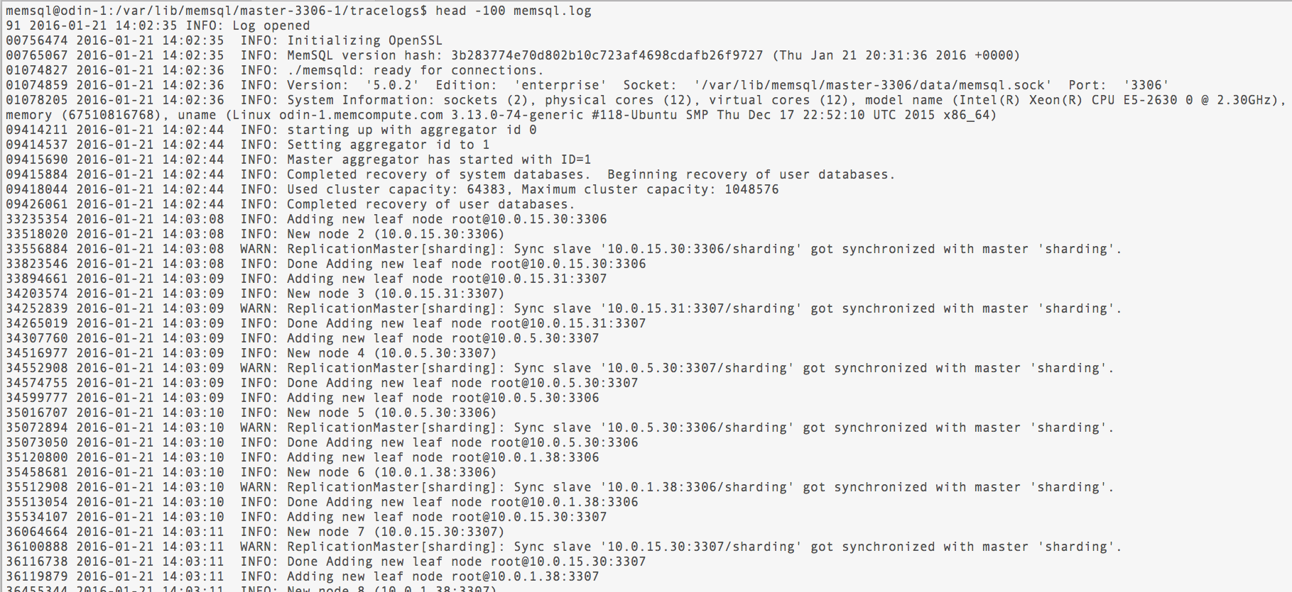
Reading the tracelog
Notes:
Initalize = start
shutdown...out of memory killed
trucnated line UMM killed you
stack file
tracelogs
splunk...
Porcesslist tail -f the og what it s doing

Slide 11
Monitoring (1)
Check | How to check | Alert Level
Memory Usage | Linux (e.g. free) | Depends on workload
Disk Usage | Linux (e.g. df) | 80%
CPU Usage | Linux (e.g. ps) | None, but keep record
Node Up? | select 1; query to every node | Any result but 1;
Long-running Queries | show processlist; on all nodes | Based on workload. E.g. any query taking more than 10 minutes.
Notes:
How r you monitoring..ngios, i dont know...
Follow-up sysadmin, what is monitoring..
dba...presage untored
memsql top you system
dtstat htop free
ngios
hypervisor in the VM

Slide 12
Monitoring
Check | How to check | Alert Level
Detailed Memory Use | show status extended; (all nodes) | None, but keep record
Table Memory | show status extended like 'alloc_table_memory'; | 90% of max_table_memory
Clustering | show leaves; show aggregators; on MA | Any leaf or aggregator not in online state.
Replication | show cluster status; on MA | Compare master and slave partition log positions. Determine “normal” lag for workload. Alert if outside band.
Krishna’s Excel doc….

Slide 13
SHOW PROCESSLIST
Returns detailed information about how currently running threads.
Column | Description
Id | Process ID
User | User associated with this process.
Host | Host name or IP address and port number
db | Name of MemSQL database.
Command | Type of command associated with this process
Time | Time
State | Process state
Info | Additional information about this process

Slide 14
SHOW PLANCACHE
Compiled and executed query statements with cumulative plan statistics
Database | Context database (use <dbname>) | LogBufferTime | Time waiting for transaction buffer
QueryText | Query with parameters tagged | LogFlushTime | Time waiting for changes to flush
Commits | Number of successful executions | RowLockTime | Time waiting to acquire row locks
Rollbacks | Number of unsuccessful executions | StreamedRows | Rows streamed from leaves
RowCount | Cumulative rows affected | LeafNetworkTime | Time waiting for leaf results
ExecutionTime | Cumulative time (in milliseconds)
Notes:
LogBufferTime, LogFlushTime, and RowLockTime will always be NULL for SELECT queries. StreamedRows and LeafNetworkTime are only applicable to distributed queries.
Commulative Time...OPS

Slide 15
SHOW PARTITIONS
memsql> SHOW PARTITIONS EXTENDED FROM mrdata;
+---------+----------------+------+--------+--------+------+--------------+------------+--------------+
| Ordinal | Host | Port | Role | Locked | Info | Last Command | Last Error | Last Message |
+---------+----------------+------+--------+--------+------+--------------+------------+--------------+
| 0 | 192.168.128.29 | 3306 | Master | 0 | | NULL | NULL | NULL |
| 1 | 192.168.128.30 | 3306 | Master | 0 | | NULL | NULL | NULL |
| 2 | 192.168.128.29 | 3306 | Master | 0 | | NULL | NULL | NULL |
| 3 | 192.168.128.30 | 3306 | Master | 0 | | NULL | NULL | NULL |
| 4 | 192.168.128.29 | 3306 | Master | 0 | | NULL | NULL | NULL |
| 5 | 192.168.128.30 | 3306 | Master | 0 | | NULL | NULL | NULL |
| 6 | 192.168.128.29 | 3306 | Master | 0 | | NULL | NULL | NULL |
| 7 | 192.168.128.30 | 3306 | Master | 0 | | NULL | NULL | NULL |
+---------+----------------+------+--------+--------+------+--------------+------------+--------------+
Execute on an aggregator node
If none specified, shows current database partitions
Locked column cannot accept new queries until unlocked
Notes:
Shows a database’s partitions and relevant information about them.
Execute on an aggregator node
Shows info for the current database if none specified
Locked column shows partitions that cannot accept new queries until unlocked
[TODO]: Change this pic to show master and slave

Slide 16
Query queuing with Workload Management
Monitor Queued queries
memsql> show global status extended like 'Workload%';
+----------------------------------------+-------+
| Variable_name | Value |
+----------------------------------------+-------+
| Workload_management_queued_queries | 10 |
| Workload_management_active_queries | 1 |
| Workload_management_active_threads | 360 |
| Workload_management_active_connections | 720 |
+----------------------------------------+-------+

Slide 17
Global Status useful values
+-----------------------------------------------------------+----------------+
| VARIABLE_NAME | VARIABLE_VALUE |
+-----------------------------------------------------------+----------------+
| Queries | 3136189 |
| Workload_management_queued_queries | 0 |
| Workload_management_active_queries | 0 |
| Workload_management_active_threads | 0 |
| Workload_management_active_connections | 0 |
| Columnstore_ingest_management_queued_queries | 0 |
| Columnstore_ingest_management_active_queries | 0 |
| Columnstore_ingest_management_estimated_segments_to_flush | 0 |
| Columnstore_ingest_management_estimated_memory | 0.000 MB |
| Query_compilations | 49 |
| Query_compilation_failures | 0 |
| Total_server_memory | 701.6 MB |
| Successful_read_queries | 214798 |
| Successful_write_queries | 4 |
| Failed_read_queries | 0 |
| Failed_write_queries | 0 |
| Rows_returned_by_reads | 89374 |
| Rows_affected_by_writes | 4 |
| Execution_time_of_reads | 68438 ms |
| Execution_time_of_write | 138 ms |
+-----------------------------------------------------------+----------------+
select * from information_schema.global_status
where variable_name like 'Workload%'
or variable_name like 'Successful%'
or variable_name like 'Columnstore%'
or variable_name like 'Query%'
or variable_name like 'Failed%'
or variable_name like 'Rows%'
or variable_name like 'Queries'
or variable_name like 'Execution_time%'
or variable_name = 'Total_server_memory';
Queries
Queued, active
total -> per second
Compilations vs exec
Memory
etc…

Slide 18
Current Queries... From MV tables
select Activity_NAME,
sum(ELAPSED_TIME_MS)/(RUN_COUNT+SUCCESS_COUNT+FAILURE_COUNT) ELAPSED_TIME_MS,
sum(CPU_TIME_MS)/(RUN_COUNT+SUCCESS_COUNT+FAILURE_COUNT) CPU_MS
from information_schema.MV_ACTIVITIES
group by 1
order by 3 desc limit 10;
+------------------------------------------------------------------+-----------------+---------+
| Activity_NAME | ELAPSED_TIME_MS | CPU_MS |
+------------------------------------------------------------------+-----------------+---------+
| Select_MV_ACTIVITIES_EXTENDED_CUMULATIVE__et_al_a2358ed2646aaff9 | 14.5000 | 18.0000 |
| Select_MV_ACTIVITIES_7cd0a153deefe481 | 1035.0000 | 3.0000 |
| IdleFlushThreadFn | 1036.0000 | 2.5000 |
| registrationRunner | 1035.5000 | 2.0000 |
| networkEventsThread | 1037.5000 | 2.0000 |
| consensusNotificationThread | 1037.0000 | 1.5000 |
| SHOW_DATABASES | 0.5000 | 1.0000 |
| ShardingGCThread | 1035.5000 | 1.0000 |
| ShardingPingLeavesThread | 1036.0000 | 1.0000 |
| NetworkAckThreadFn | 1036.0000 | 0.7500 |
+------------------------------------------------------------------+-----------------+---------+
Weight Queries
CPU %
Elapsed time
Network %
Memory %
etc…

Slide 19
Tuning

Slide 20
MemSQL Performance Considerations
What knobs can you turn??

Slide 21
Know your dataflow
How is data ingested?
DML activity?
SLAs?
Standard SQL
Insert
commit
BULK load
CSV files
LOAD DATA
Pipelines
Kafka
S3 buckets
File system
DW / Analytics
Write once
Read many
Calculate/materialize
OLTP
Write once
Update ~10%
Read some
UPSERT
Write once
Update all often
Read often
Ingest rate or batch window
Query response time requirements

Slide 22
Tuning Cycles
Iterative process
Tune
Measure
Repeat Until SLAs good
Adjust DDL
Distribution
Table structure
Row / Column Store
Tune
Ingest
SQL
Concurrency
Evaluate Performance
Tune Concurrency
Adjust Distribution (DDL)
Tune SQL
Tune Ingest

Slide 23
#1 – Create your Tables (Rowstore / Columnstore)
Rowstore
In-memory!!
OLTP style
IoT data, UPSERTs
Update heavy
Ingest
Small single row DML
Streaming
Columnstore
On Disk
DW analytics
Ingest
Bulk insert
Small single row DML is OK
Streaming
No UPDATE traffic
Small seldom corrections not a big issue
Watch background merger and deleted rows from segments metadata

Slide 24
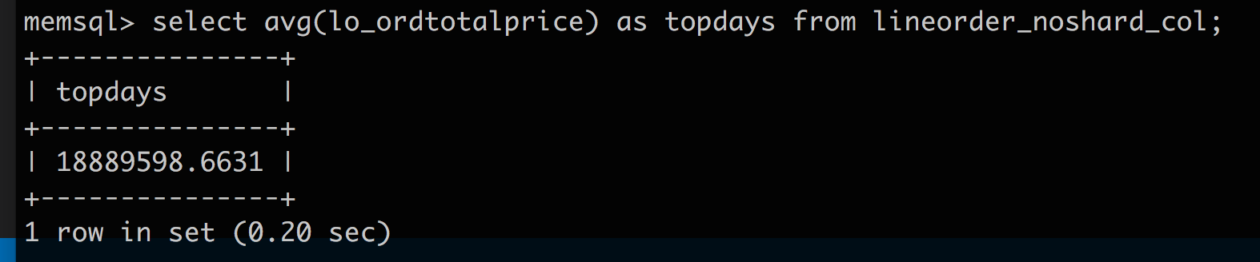
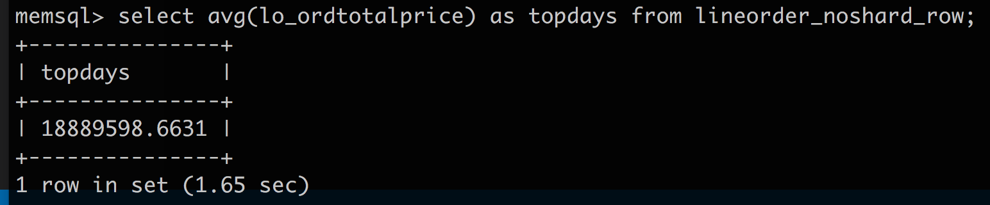
Which table type is faster?
Row or Column?
Row or Column?

Slide 25
Rowstore table
memsql> profile select avg(lo_ordtotalprice) as topdays from lineorder_noshard_row;
+---------------+
| topdays |
+---------------+
| 18889598.6631 |
+---------------+
1 row in set (1.66 sec)
memsql> show profile;
+-------------------------------------------------------------------------------------------------------------------------------------------------------------------------------------+
| PROFILE |
+-------------------------------------------------------------------------------------------------------------------------------------------------------------------------------------+
| Project [$0 / CAST(COALESCE($1,0) AS SIGNED) AS topdays] actual_rows: 1 exec_time: 0ms start_time: 00:00:01.652 network_traffic: 0.014000 KB |
| Aggregate [SUM(remote_0.s) AS $0, SUM(remote_0.c) AS $1] actual_rows: 32 exec_time: 0ms start_time: 00:00:00.634 |
| Gather partitions:all alias:remote_0 actual_rows: 32 exec_time: 0ms start_time: 00:00:00.000 end_time: 00:00:01.652 |
| Project [s, c] actual_rows: 32 exec_time: 0ms start_time: [00:00:00.634, 00:00:01.652] network_traffic: 0.800000 KB |
| Aggregate [SUM(lineorder_noshard_row.LO_ORDTOTALPRICE) AS s, COUNT(lineorder_noshard_row.LO_ORDTOTALPRICE) AS c] actual_rows: 600,037,902
exec_time: 238ms start_time: 00:00:00.000 |
| TableScan ssb.lineorder_noshard_row est_table_rows:600,037,902 est_filtered:600,037,902 actual_rows: 600,037,902
exec_time: 1,133ms start_time: 00:00:00.000 |
+-------------------------------------------------------------------------------------------------------------------------------------------------------------------------------------+
6 rows in set (0.00 sec)
Scan takes 1133ms
Agg takes 238ms
Total time ~1660ms

Slide 26
Columnstore table
memsql> profile select avg(lo_ordtotalprice) as topdays from lineorder_noshard_col;
+---------------+
| topdays |
+---------------+
| 18889598.6631 |
+---------------+
1 row in set (0.35 sec)
memsql> show profile;
+------------------------------------------------------------------------------------------------------------------------------------------------------------------------------------------------------------------------------------------------------------------------------+
| PROFILE |
+------------------------------------------------------------------------------------------------------------------------------------------------------------------------------------------------------------------------------------------------------------------------------+
| Project [$0 / CAST(COALESCE($1,0) AS SIGNED) AS topdays] actual_rows: 1 exec_time: 0ms start_time: 00:00:00.348 network_traffic: 0.014000 KB |
| Aggregate [SUM(remote_0.s) AS $0, SUM(remote_0.c) AS $1] actual_rows: 32 exec_time: 0ms start_time: 00:00:00.133 |
| Gather partitions:all alias:remote_0 actual_rows: 32 exec_time: 0ms start_time: 00:00:00.000 end_time: 00:00:00.348 |
| Project [s, c] actual_rows: 32 exec_time: 0ms start_time: [00:00:00.133, 00:00:00.348] network_traffic: 0.800000 KB |
| Aggregate [SUM(lineorder_noshard_col.LO_ORDTOTALPRICE) AS s, COUNT(lineorder_noshard_col.LO_ORDTOTALPRICE) AS c] actual_rows: 600,037,902
exec_time: 220ms start_time: 00:00:00.000 |
| ColumnStoreScan ssb.lineorder_noshard_col, KEY LO_ORDERDATE (LO_ORDERDATE) USING CLUSTERED COLUMNSTORE actual_rows: 600,037,902
exec_time: 77ms
start_time: 00:00:00.000 memory_usage: 4,194.304199 KB segments_scanned: 607 segments_skipped: 0 segments_fully_contained: 0 |
+------------------------------------------------------------------------------------------------------------------------------------------------------------------------------------------------------------------------------------------------------------------------------+
6 rows in set (0.00 sec)
Scan takes 77ms
Agg takes 220ms
Total time ~350ms
~5x faster from DISK????

Slide 27
Less is more…
memsql> select sum(compressed_size)/1024/1024 as table_sizeMB
from columnar_segments
where table_name = 'lineorder_noshard_col';
+----------------+
| table_sizeMB |
+----------------+
| 15202.52336216 |
+----------------+
1 row in set (0.33 sec)
memsql> select sum(compressed_size)/1024/1024 as column_sizeMB
from columnar_segments
where table_name = 'lineorder_noshard_col' and
column_name = 'lo_ordtotalprice';
+---------------+
| column_sizeMB |
+---------------+
| 1859.78750801 |
+---------------+
1 row in set (0.34 sec)
memsql> select sum(memory_use)/1024/1024 table_memory_MB
from table_statistics
where table_name = 'lineorder_noshard_row';
+-----------------+
| table_memory_MB |
+-----------------+
| 156444.07855225 |
+-----------------+
1 row in set (0.15 sec)
Columnar Compression ~10x
Columnar elimination for this query ~10x
100x less data to scan!

Slide 28
Column store improvements OrderedColumnStoreScan… efficient scanning
KEY for column store defines the sort order
Like an index scan for the column store
Sort order is improve AGGs ordered by the column store KEY
StreamingGroupBy more efficient than HashGroupBy
CREATE TABLE lineorder_noshard_col (
`LO_ORDERKEY` int(11) DEFAULT NULL,
…
`LO_ORDTOTALPRICE` int(11) DEFAULT NULL,
…
`LO_SHIPMODE` char(10) CHARACTER SET utf8 COLLATE utf8_general_ci DEFAULT NULL,
KEY (LO_ORDERDATE) USING CLUSTERED COLUMNSTORE ,
SHARD KEY ()
);
select avg(lo_ordtotalprice) as topdays, lo_orderdate
from lineorder_noshard_col
group by lo_orderdate
order by topdays desc limit 5;
memsql> show profile;
Project [$0 / CAST(COALESCE($1,0) AS SIGNED) AS topdays, remote_0.lo_orderdate] actual_rows: 5 exec_time: 0ms start_time: 00:00:00.669 network_traffic: 0.115000 KB
TopSort limit:[?] [SUM(remote_0.s) / CAST(COALESCE(SUM(remote_0.c),0) AS SIGNED) DESC] actual_rows: 5 exec_time: 1ms start_time: 00:00:00.665 memory_usage: 131.072006 KB StreamingGroupBy [SUM(remote_0.s) AS $0, SUM(remote_0.c) AS $1] groups:[remote_0.lo_orderdate] actual_rows: 2,406 exec_time: 1ms start_time: 00:00:00.665 memory_usage: 0.000000 KB GatherMerge [lineorder_noshard_col.LO_ORDERDATE] partitions:all alias:remote_0 actual_rows: 2,406 exec_time: 0ms start_time: 00:00:00.000 end_time: 00:00:00.669 Project [lineorder_noshard_col.LO_ORDERDATE AS lo_orderdate, s, c] actual_rows: 2,406
exec_time: 0ms start_time: [00:00:00.007, 00:00:00.013] network_traffic: 72.180000 KB ||
StreamingGroupBy [SUM(lineorder_noshard_col.LO_ORDTOTALPRICE) AS s, COUNT(lineorder_noshard_col.LO_ORDTOTALPRICE) AS c] groups:[lineorder_noshard_col.LO_ORDERDATE] actual_rows: 2,406
exec_time: 151ms start_time: 00:00:00.000 memory_usage: 0.000000 KB ||
OrderedColumnStoreScan ssb.lineorder_noshard_col, KEY LO_ORDERDATE (LO_ORDERDATE)
USING CLUSTERED COLUMNSTORE actual_rows: 600,037,902 exec_time: 509ms start_time: 00:00:00.000
memory_usage: 8,388.608398 KB segments_scanned: 607 segments_skipped: 0 segments_fully_contained: 0

Slide 29
Column store improvements Segment Elimination… less is more
memsql> profile select avg(lo_ordtotalprice) as topdays, lo_orderdate
from lineorder_noshard_col
where lo_orderdate between 19980717 and 19980718
group by lo_orderdate
order by topdays desc limit 5;
+---------------+--------------+
| topdays | lo_orderdate |
+---------------+--------------+
| 18860403.0236 | 19980717 |
| 18849595.9172 | 19980718 |
+---------------+--------------+
2 rows in set (0.01 sec)
memsql> show profile;
+------------------------------------------------------------------------------------------------------------------------------------------------------------------------------------------------------------------------------------------------------------------------------------+
| PROFILE |
+------------------------------------------------------------------------------------------------------------------------------------------------------------------------------------------------------------------------------------------------------------------------------------+
| Project [$0 / CAST(COALESCE($1,0) AS SIGNED) AS topdays, remote_0.lo_orderdate] actual_rows: 2 exec_time: 0ms start_time: 00:00:00.012 network_traffic: 0.046000 KB |
| TopSort limit:[?] [SUM(remote_0.s) / CAST(COALESCE(SUM(remote_0.c),0) AS SIGNED) DESC] actual_rows: 2 exec_time: 0ms start_time: 00:00:00.012 memory_usage: 0.000000 KB |
| StreamingGroupBy [SUM(remote_0.s) AS $0, SUM(remote_0.c) AS $1] groups:[remote_0.lo_orderdate] actual_rows: 2 exec_time: 0ms start_time: 00:00:00.012 memory_usage: 0.000000 KB |
| GatherMerge [lineorder_noshard_col.LO_ORDERDATE] partitions:all alias:remote_0 actual_rows: 2 exec_time: 0ms start_time: 00:00:00.000 end_time: 00:00:00.012 |
| Project [lineorder_noshard_col.LO_ORDERDATE AS lo_orderdate, s, c] actual_rows: 2 exec_time: 0ms start_time: [00:00:00.008, 00:00:00.012] network_traffic: 0.060000 KB |
| StreamingGroupBy [SUM(lineorder_noshard_col.LO_ORDTOTALPRICE) AS s, COUNT(lineorder_noshard_col.LO_ORDTOTALPRICE) AS c] groups:[lineorder_noshard_col.LO_ORDERDATE] actual_rows: 2
exec_time: 2ms start_time: [00:00:00.001, 00:00:00.004] memory_usage: 0.000000 KB |
| Filter [lineorder_noshard_col.LO_ORDERDATE >= ? AND lineorder_noshard_col.LO_ORDERDATE <= ?] actual_rows: 501,205 exec_time: 5ms start_time: 00:00:00.000 |
| [actual_rows: 501,205 | max:251,257 at partition_1, average: 15,662.656250, std dev: 60,661.427491] |
| OrderedColumnStoreScan ssb.lineorder_noshard_col, KEY LO_ORDERDATE (LO_ORDERDATE) USING CLUSTERED COLUMNSTORE actual_rows: 10,993,111
exec_time: 4ms start_time: 00:00:00.000 memory_usage: 4,325.375977 KB
segments_scanned: 15 segments_skipped: 592 segments_fully_contained: 0 |
| [actual_rows: 10,993,111 | max:1,044,452 at partition_1, average: 343,534.718750, std dev: 427,116.575536] |
+------------------------------------------------------------------------------------------------------------------------------------------------------------------------------------------------------------------------------------------------------------------------------------+
Segments are ordered by the KEY for column
Min/Max is metadata is stored as in-memory index
Only segments that match the predicate criteria are scanned
97% of the segment scans are skipped!!

Slide 30
Shard Keys and Performance Implications
The choice of the Shard Key affects data distribution. In turn, it affects
Loading performance.
Query performance (Joins, Filters, Group-by).

Slide 31
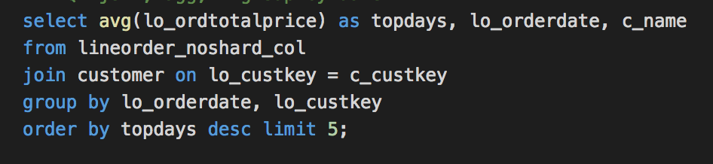
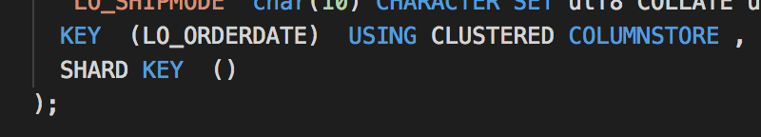
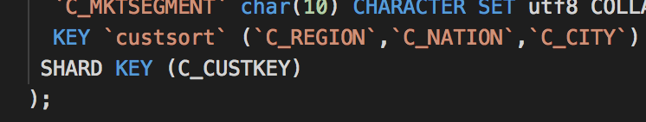
JOINs… the join criteria is key
Random shard key on lineorder table
Customer is sharded on C_CUSTKEY
Query can not be pushed down to the leaf nodes

Slide 32
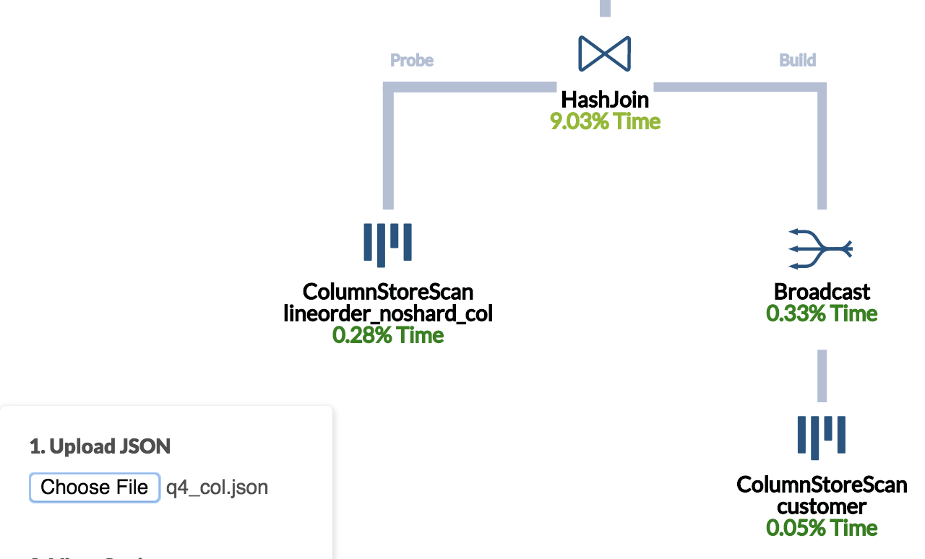
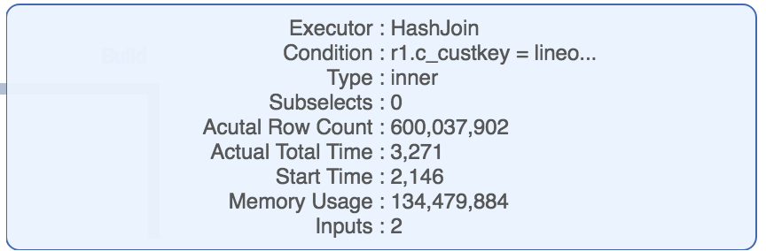
JOINs… BROADCAST join keys
Some data must be broadcast to complete the join
Customer table is smaller, so broadcast and a hash is built
Join takes 3.2 seconds

Slide 33
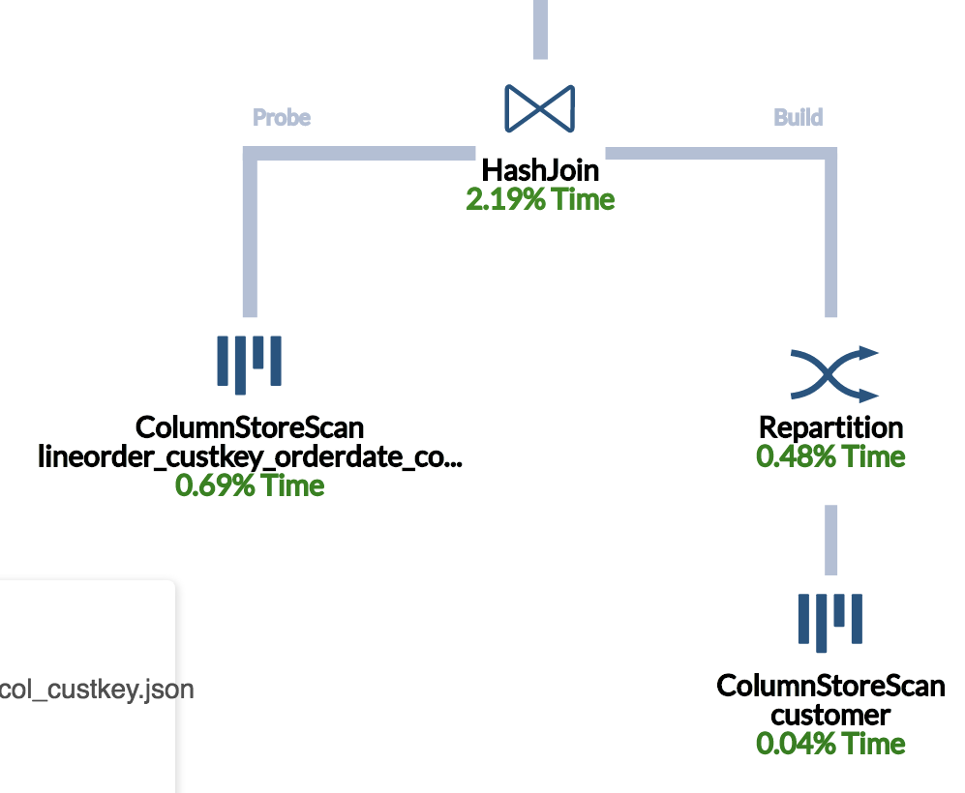
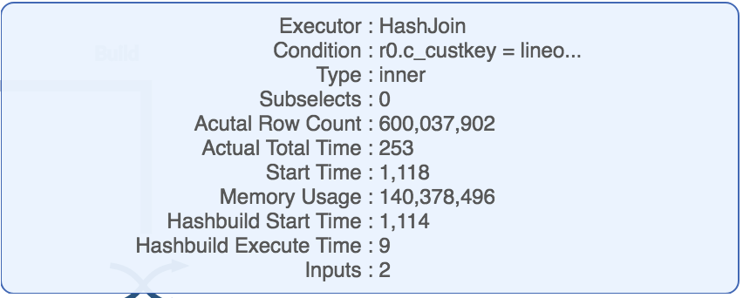
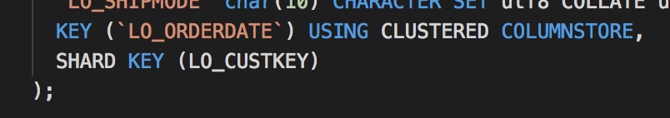
JOINs… no broadcast required!
Customer table repartitioned within each leaf node to by the c_name
Join is pushed down to the leaf nodes since the join criteria is shard key
No broadcasts!
Join time… 0.25 seconds 10x faster join!!

Slide 34
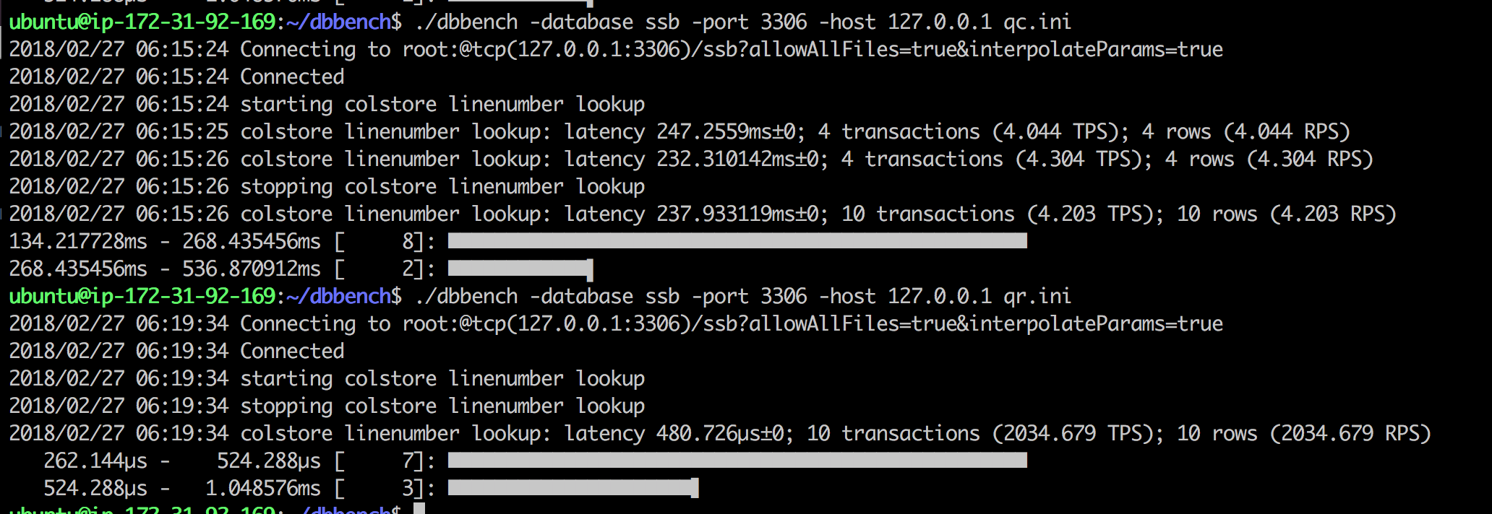
IoT and OLTP… Rowstore rules
Rowstore is the friend of OLTP and IoT
Small look ups
Upserts
~500x more efficient

Slide 35
Management Views and memsql-top
Polling the real-time

Slide 36
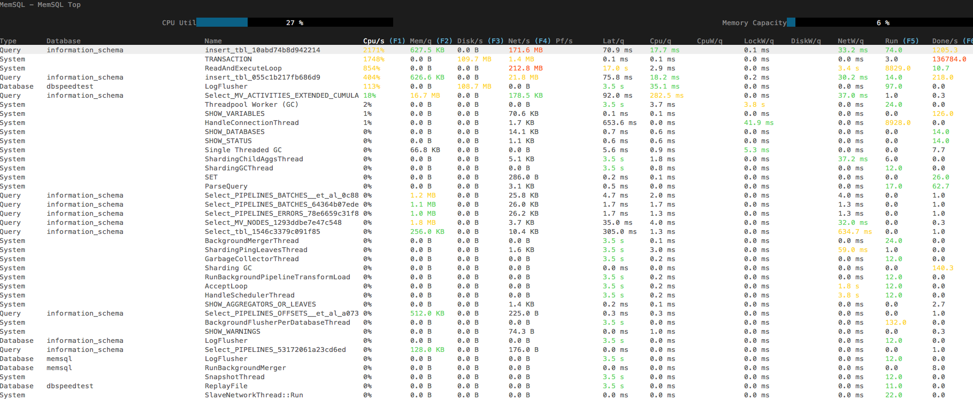
MemSQL Top
Notes:
Describe all columns
Mention sorting
Drill into queries
Powerful = Management views
Calculates recent resource use by computing the change in mv_activities_extended_cumulative over an interval of time

Slide 37
What are Management Views?
Set of tables in information_schema database
Show resource usage of recent activities across all nodes in MemSQL cluster
Activities are categorized into Query, Database, System
Query: Application or Person querying MemSQL
Database: Replication Activity, Log Flusher
System: Garbage Collector, Read and Execute Loops
Available in Versions 5.8 and greater - must set a global variable
read_advanced_counters = ‘ON’
memsql-ops memsql-update-config --set-global --key read_advanced_counters --value ‘ON’ --all
Notes:
All Nodes on the cluster, not individual nodes
It’s updated near-real time
Can do many cuts with the data, other tables in info_schema with node/partition information that can be joined on. (memory per partition)

Slide 38
Management Views Tables
SHOW tables in information_schema like "MV_%";
mv_activities | Profile of all activities that recently ran on the cluster and the activity resource usage over a time interval
mv_activities_extended | Profile of all activities that recently ran on the cluster and activity resource usage (plus extended statistic)
mv_nodes | All nodes in the cluster
mv_queries | All recent query activities and the associated query text
mv_activities_cumulative | Profile of any completed or currently running tasks on the cluster and the total resource usage of the activity
For more information, see: Management View Reference
Notes:
Mv- Activities – all tasks at a high level from any node in the cluster (All Nodes)
Mv_actiities extended
Mv_activities get’s updated from cumulative - the delta of resource usage over configurable time period is taken from cumulative
Queries mv_activities and

Slide 39
Management views insights
Statistics Gathered
Typical Workload Questions
CPU Time
CPU Wait Time
Memory Bytes
Disk Bytes (Read/Write)
Network Bytes (Send/Receive)
Lock Wait Time
Disk Wait Time
Network Wait Time
Failure Time
What queries are using the most CPU time?
Which partitions are using the most memory?
Which leaves are using the most network bandwidth? Memory?
What activities are using the most disk?
How many queries have recently failed?
What databases are using the most CPU?
For more information, see: Management View Reference
Notes:
You can review scenario: https://docs.memsql.com/v5.8/docs/workload-profiling-scenarios

Slide 40
What query activities are using the most CPU time?
Without query text:
select activity_name, cpu_time_ms
from mv_activities where
activity_type = 'Query'
order by cpu_time_ms limit 5;
With query text:
select activities.cpu_time_ms, activities.activity_name,
LEFT(query.query_text,20)
from mv_activities activities
inner join mv_queries query on query.activity_name= activities.activity_name where activity_type = 'Query'
order by cpu_time_ms limit 5;

Slide 41
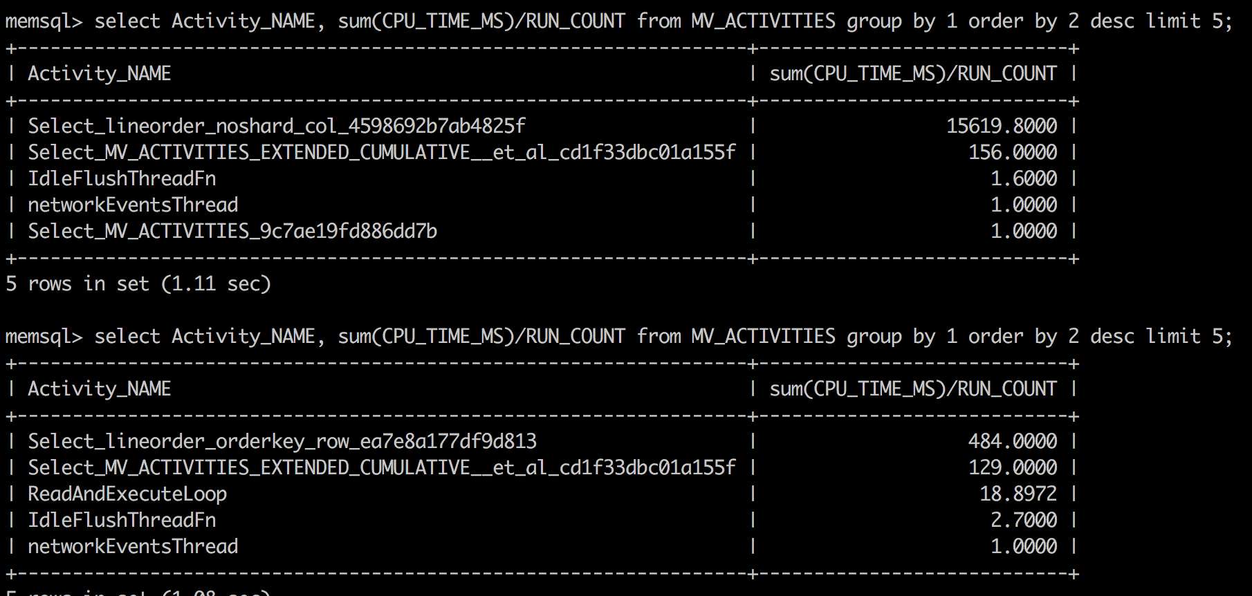
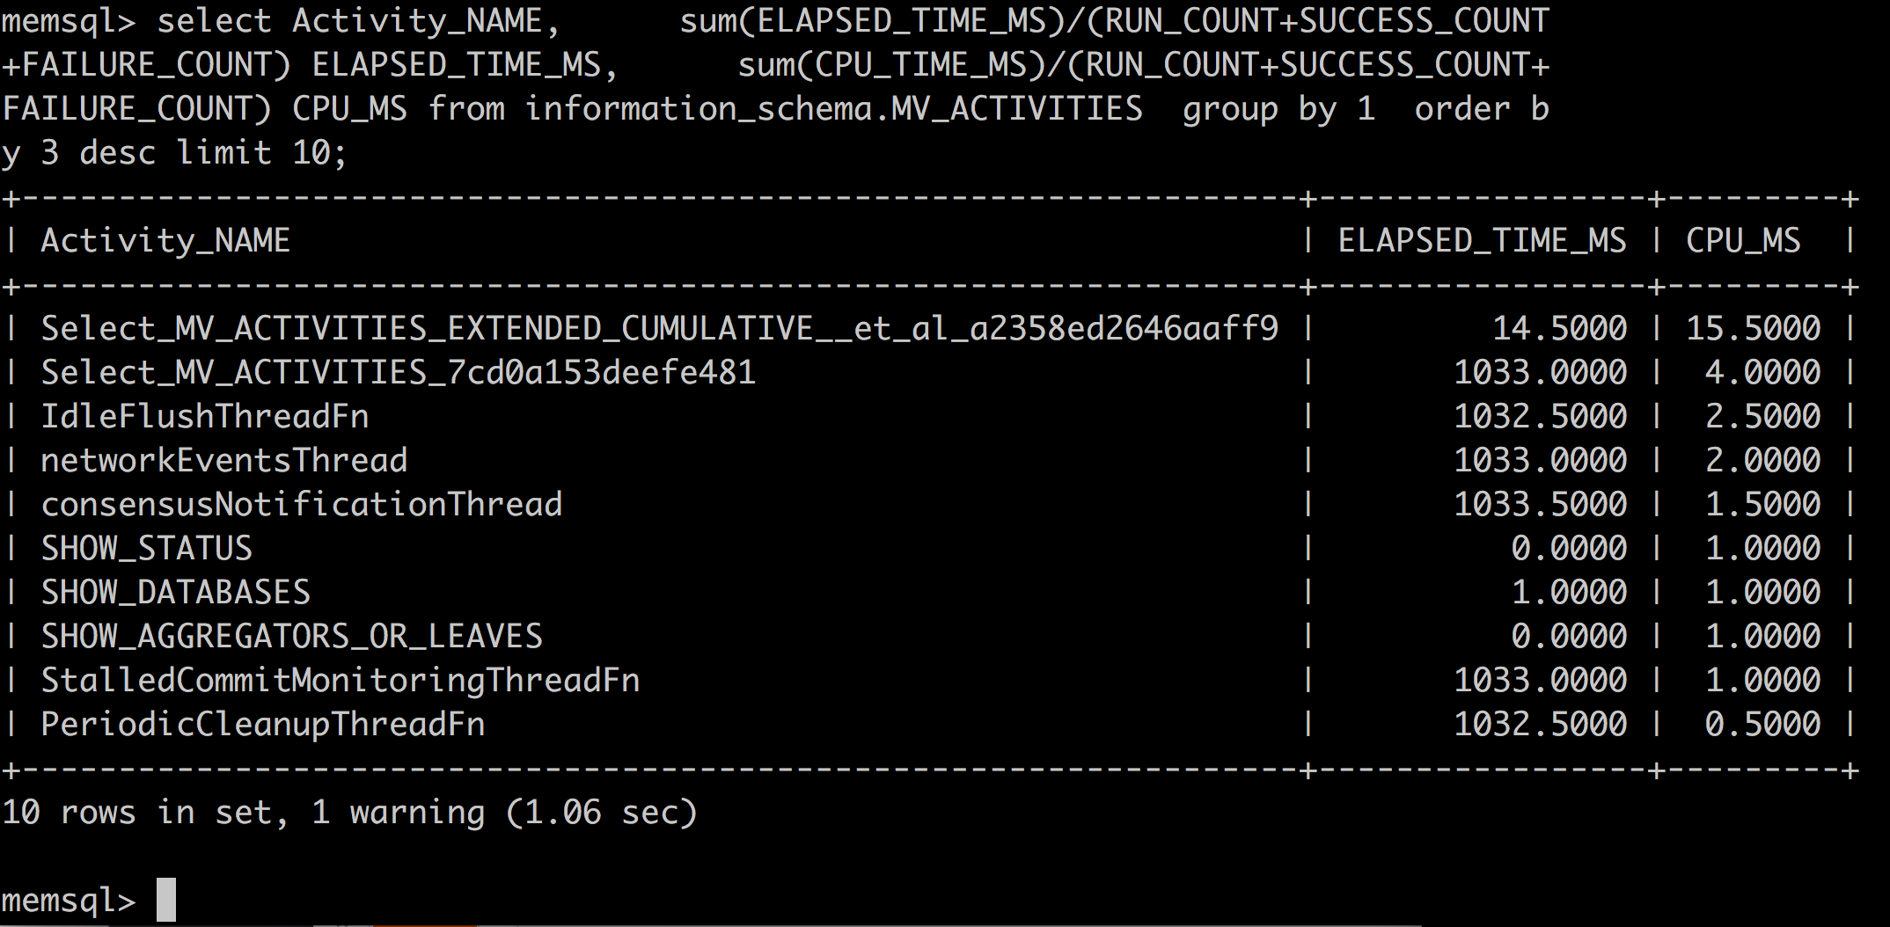
CPU usage per query
MV_ACTIVITIES
CPU_TIME
ELAPSED_TIME
NETWORK_TIME
DISK_TIME
Memory usage
Lock activity
Workload characteristics
Determine what needs to be tuned
Characterize workload for scaling your application

