Slide 1



2018-2019 Fall
CS319 Object Oriented Software Engineering
Term Project
Section: 01
Group: 2E
Group Name: ProCODERs
Lords in Halls
Group Members
Şamil İraz
Ateş Bilgin
Enes Emre Erdem
Gülnihal Muslu
Can Ozan Kaş
Supervisor: Eray Tüzün
Teaching Assistant: Gülden Olgun

Slide 2
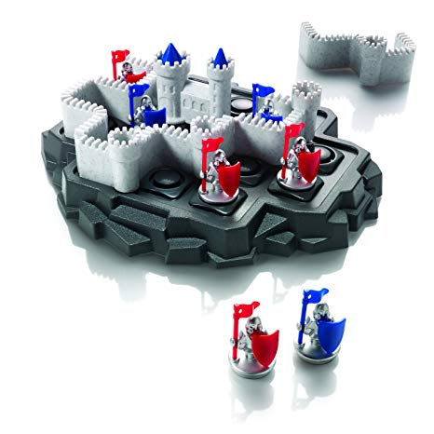
Walls & WarrIors
Original Walls & Warriors is a brain-testing board game, which includes a game board, 5 puzzle pieces, 7 warriors and a level booklet. Players start the game with placing the Warriors into the specified points on the level map. After that, players need to place the walls on the game board. Walls must be placed on the game board in such a way that, they will cover all the blue warriors inside the walls and leave the red Warriors out of the walls.

Slide 3
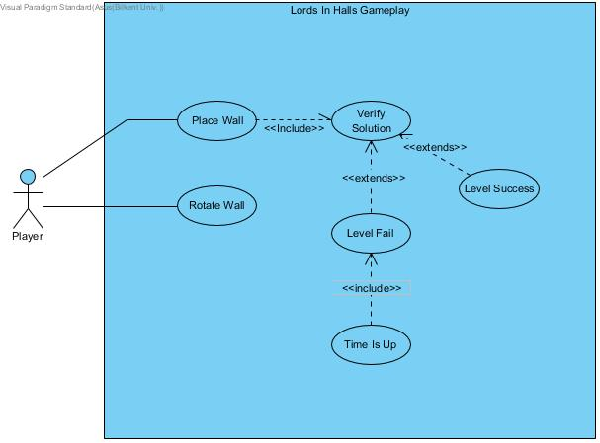
FunctIonal models – use cases

Slide 4
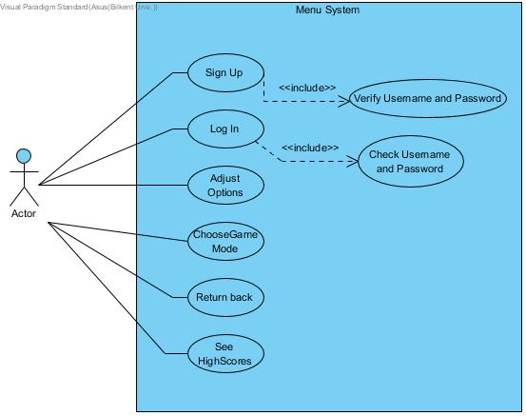
FunctIonal models – use cases

Slide 5
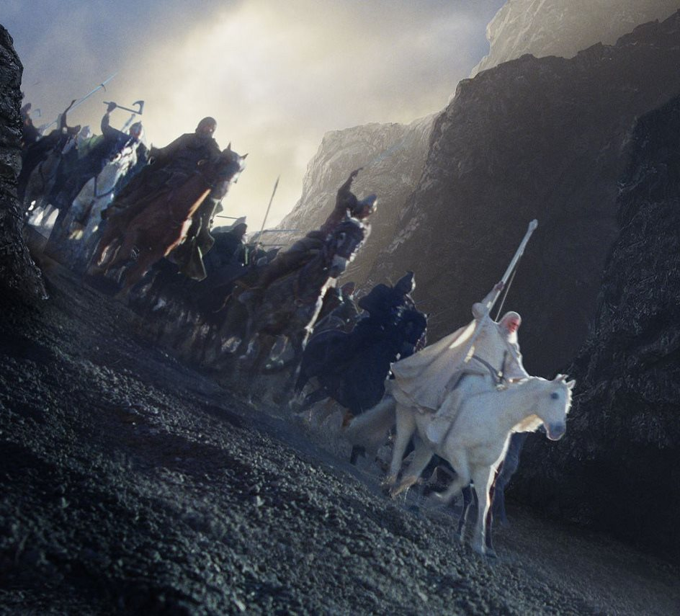
Lords In halls
White Knight
-gives extra point if it is enclosed within walls.
-created two game mode with white knight.
Time challenges
-apart from normal mode, there is time challenge mode
-Level fails when time is up.

Slide 6
Non-functIonal requIrements
Performance
-By decreasing complexity and increasing efficiency, the game will work faster.
Maintainability
-A random map generator will be implemented and by that way different map combinations can be added to game later. Also with different maps, different game mods can be created accordingly.
Security
-User names and passwords, basicly data containing user information will be protected. In future implementations, more information might be needed such as credit card information for payments.
User Interface and Usability
-Our application does not require any installation so it can be played in any environment which has an internet connection. The page configurations are easy to understand and follow.

Slide 7
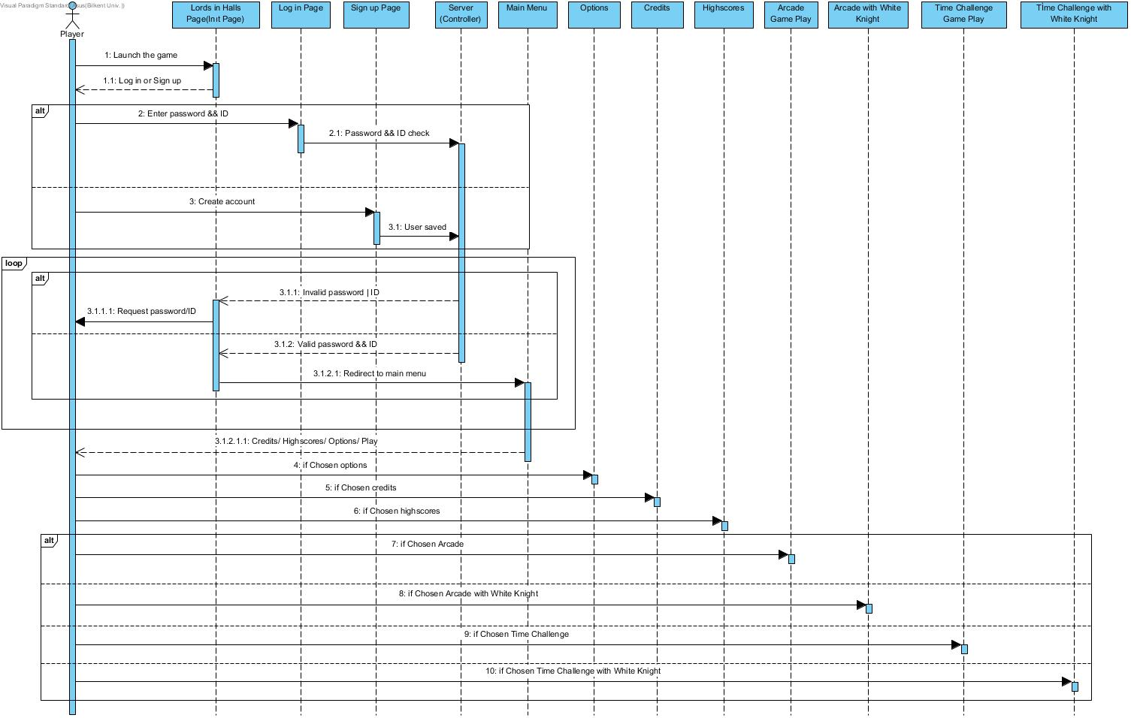

Slide 8
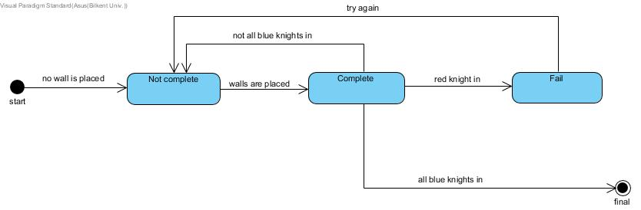
State chart dIagrams
Arcade Game Mod.

Slide 9
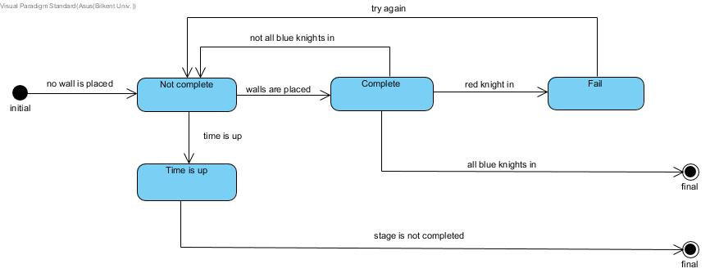
State chart dIagrams
Arcade Game Mod with Time Challenge.

Slide 10
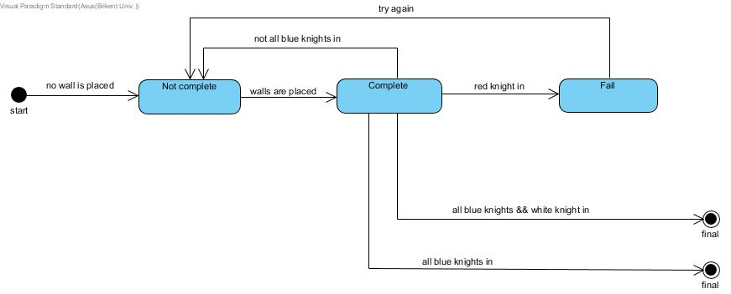
State chart dIagrams
White Knight mode.

Slide 11
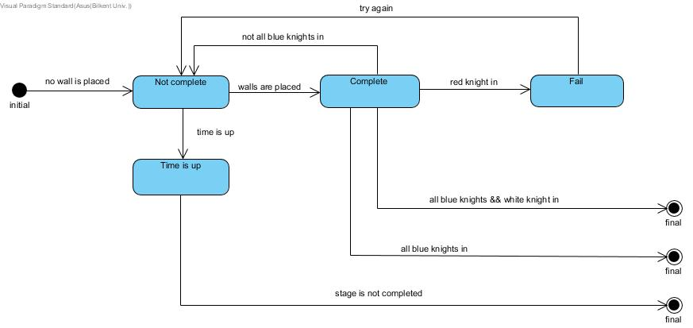
State chart dIagrams
White knight mode with time challenge.

Slide 12
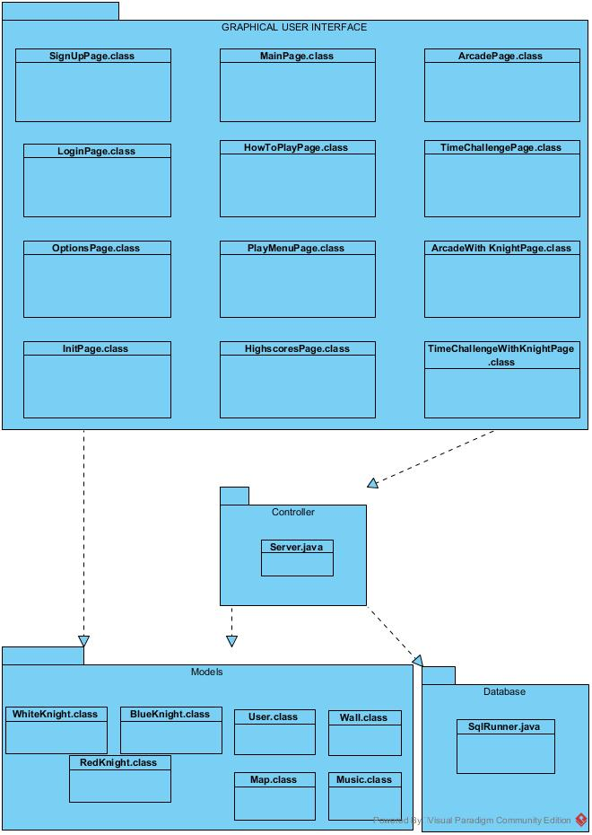
Subsystem decomposItIon

Slide 13
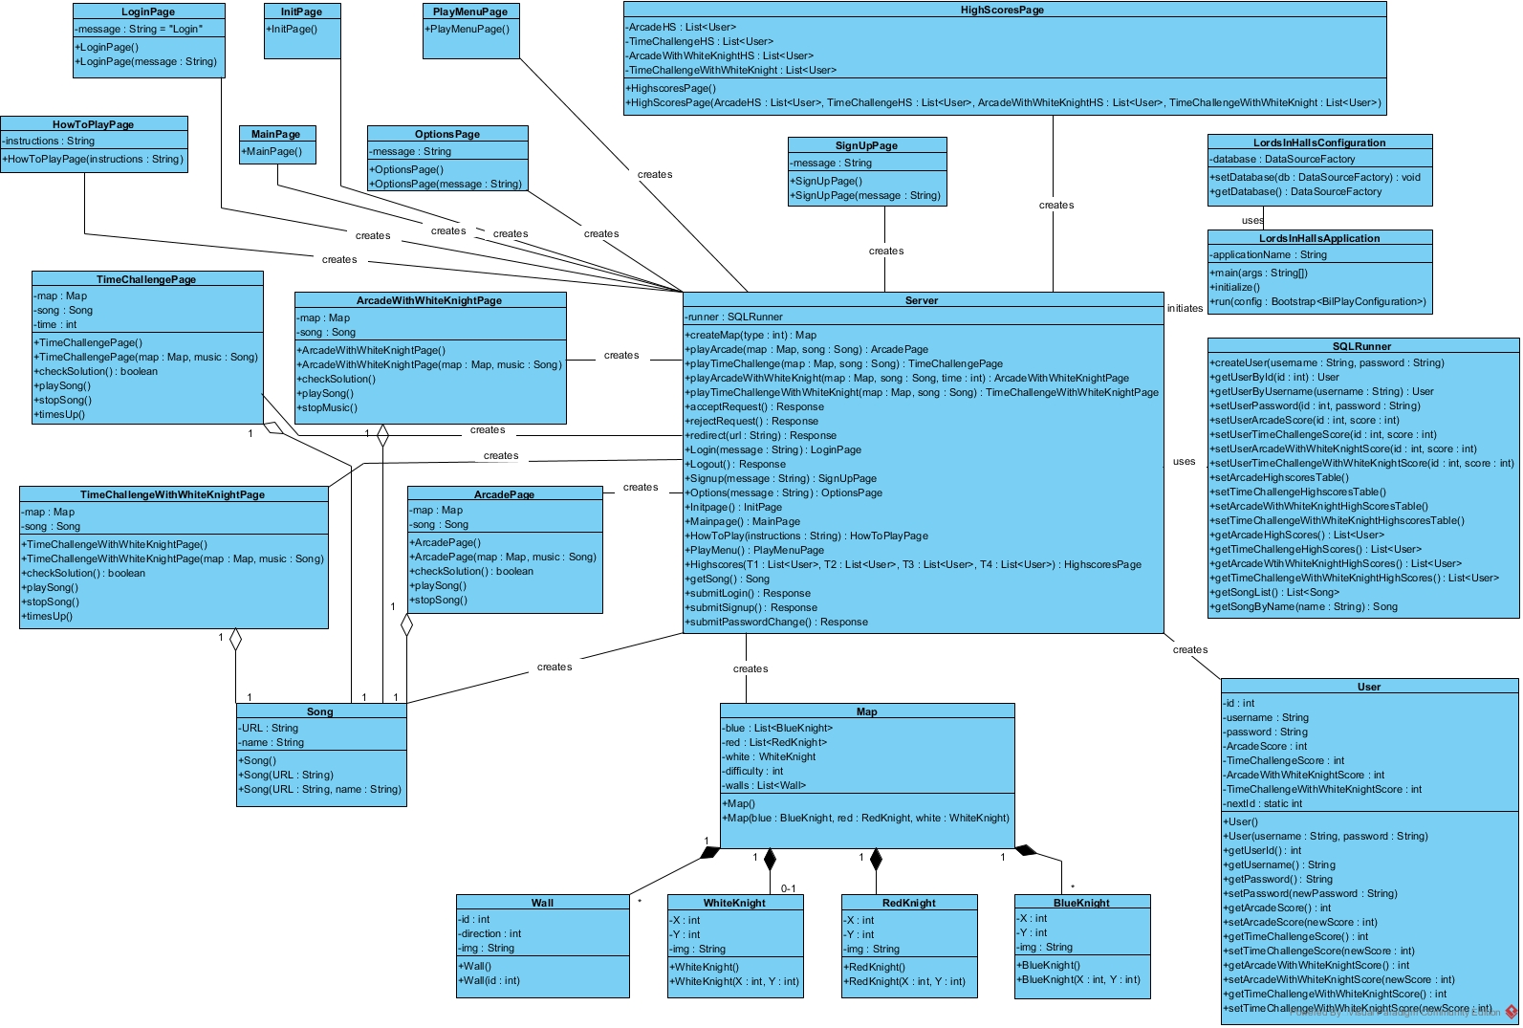

Slide 14
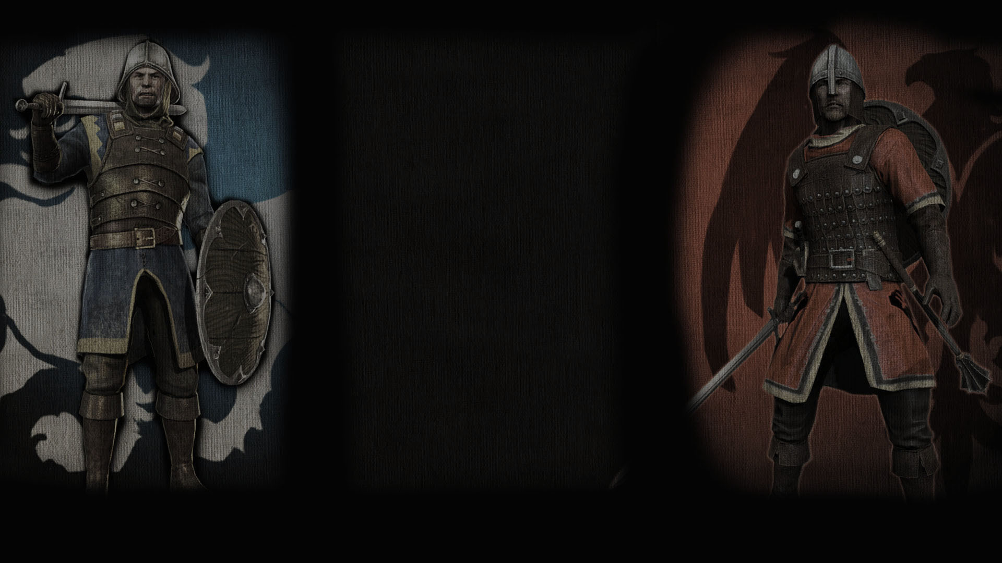
Thanks For LIstenIng

