Slide 2
Past, present, and future of computing
GEC101 Lecture

Slide 3
Lecture Plan
General theme: Modern State of Software Engineering
Oracle Corp.
Google Corp.
Summary

Slide 4
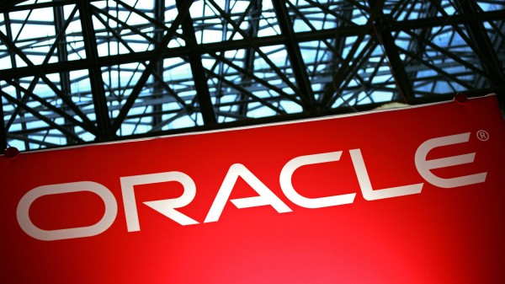

Slide 5
Oracle
Oracle is best known for its Oracle database – one of the best and most influential commercial databases
Oracle is an American multinational computer technology corporation;
Specializes in computer hardware and enterprise (business-level) software
Flagship product: Oracle Database Management System (Oracle DBMS)

Slide 6
Oracle
Oracle was founded in 1977 by Larry Ellison, Bob Miner and Ed Oates with a single goal to develop new software for managing computer databases

Slide 7
Oracle
The key point in the history of Oracle was an academic paper by Prof. Edgar Codd named “A relational model of data for large shared data banks”
The paper looked at the problem of organizing large volumes of data in computer systems

Slide 8
Oracle
The paper described new model for organizing data using many inter-connected tables (relational data model)
The paper also described the method for extracting data from such database using structured query language or SQL

Slide 9
Oracle
The founder of Oracle Larry Ellison wanted to create software using the principles for data organization described in that paper in real computer systems

Slide 10
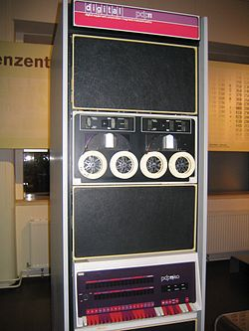
Oracle
The first version of Oracle database, Version 1, was created in 1978 and ran on PDP-11 microcomputer
Version 1 was completely written in Assembler machine language, and used just 128KB of memory

Slide 11
Oracle
The first official release of Oracle DBMS was Version 2, released in 1979
The first customer of Oracle Version 2 was Wright-Patterson Air Force Base
Wright-Patterson Air Force Base used Oracle on PDP-11 computers to manage its data

Slide 12
Oracle
The next version of Oracle database, Version 3, was released in 1983, and was the first Oracle DBMS completely written in C high-level programming language
Oracle rewrote its database using C for portability
Portability means that computer program can work on different computers

Slide 13
Oracle
Assembler, or machine code, is a program written using the commands from the command-language of a specific processor such as Pentium, Alpha, AMD
Therefore, assembler program can only work on one type of computers such as Pentium

Slide 14
Oracle
C uses abstract high-level language to describe computer program
C program is translated into machine code for a specific computer via the process called compilation by special compiler program
Therefore, C program can be compiled for any computer after compilation without having to make any changes in the program itself

Slide 15
Oracle
Version 3 also included new features – COMMIT and ROLLBACK
COMMIT and ROLLBACK allowed Oracle to work with large amounts of data more effectively and also to recover from errors such as computer shutdown or disk failure

Slide 16
Oracle
In 1984 Oracle released Version 4
Version 4 was the first Oracle version that worked on IBM-PC computers and MS-DOS operating system.
Oracle used 512KB of memory

Slide 17
Oracle
In 1985, Oracle released Version 5, which was one of the first DBMS to work in client-server mode
Client-server means that database is located on a separate computer and users connect to it via a network
This allows very large numbers of users to connect to the database at the same time
Today, all databases are client-server DBMS

Slide 18
Oracle
Oracle next Version 6 in 1988 included Oracle Forms
Oracle Forms allowed users to complete database tasks using a Visual Environment, such as you are used to today in Windows, instead of typing everything from keyboard
Apparently in 1988 it was a big deal

Slide 19
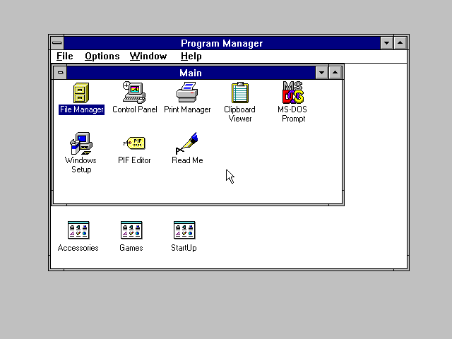

Slide 20
Oracle
In 1990 Oracle released its first non-database software product – Oracle Applications, later Oracle eBusiness Suite
Oracle Applications is a collection of business software for information management tasks in large organizations

Slide 21
Oracle
Oracle Applications included different software for accounting, human resources management, customer relations management, supply management, inventory management, project management, shipping, warehousing, etc

Slide 22
Oracle
All that software was different Visual Environment to solve specific business management tasks – such as human resources management or customer relations management – using Oracle database
Therefore, all of these were different Interfaces for an Oracle database Backend, or some type of extensions of the Oracle DBMS

Slide 23
Oracle HRM (Human Resources)
Oracle DBMS
Interfaces
Backend
Oracle CRM (Customers Relations)
Oracle PM (Project Management)

Slide 24
Oracle
In 1995 Oracle became one of the first large software companies to announce an Internet Strategy
Internet was the fastest growing segment of software in 1990-2000, therefore many companies wanted to create a good Internet product before the others

Slide 25
Oracle
Oracle released an “Oracle” Web Browser in 1996 (not very successful)

Slide 26
Oracle
In 2001, Oracle released Version 9, which allowed the database to be hosted on a cluster of computers, allowing it to work with VERY large numbers of users and VERY large volumes of data

Slide 27
Oracle
In 2003 Oracle released Version 10 with support for grid computing
Grid computing is a large scale distributed cluster of computers to solve a very large computational problem, such as storing data about 700 million Facebook users, for example (even though Facebook is not using Oracle DBMS for that)

Slide 28
Oracle
Oracle also set the world record with Oracle Version 10 in TPC-H 3000 GB test
TPC-H test is the Transaction Processing Council’s Benchmark test for performance of DBMS in managing very large databases
In TPC-H 3000 GB test, Oracle managed a database with 3000 GB of data.

Slide 29
Oracle
On of the other key strategic focuses of Oracle is Java
Oracle has been developer of Java Runtime Environment (JRE), that you download to your computer to make Jave work in browser, and Java Development Kit (JDK) since 1998
In 2010 Oracle acquired Sun Microsystems – the creator of Java programming language

Slide 30
Oracle
With Sun Oracle obtained,
Java programming language, Sun JRE and JDK
The most popular in the world free MySQL DBMS, (used by Facebook among many others)
Solaris (unix) Operating System
Solaris Cluster and Sun Grid Engine, very large scale cluster management software
Sun Studio – Integrated Development Environment and compilers for Linux
And many others…

Slide 31
Oracle
Oracle is the software company typical of 1980-2000
Focused on single flagship product (Oracle DBMS)
Gradually develop software product into best on the market
The product is regular software or software suite
Try to diversify into other software areas based on flagship product (eBusiness Suite and Java platform)

Slide 32
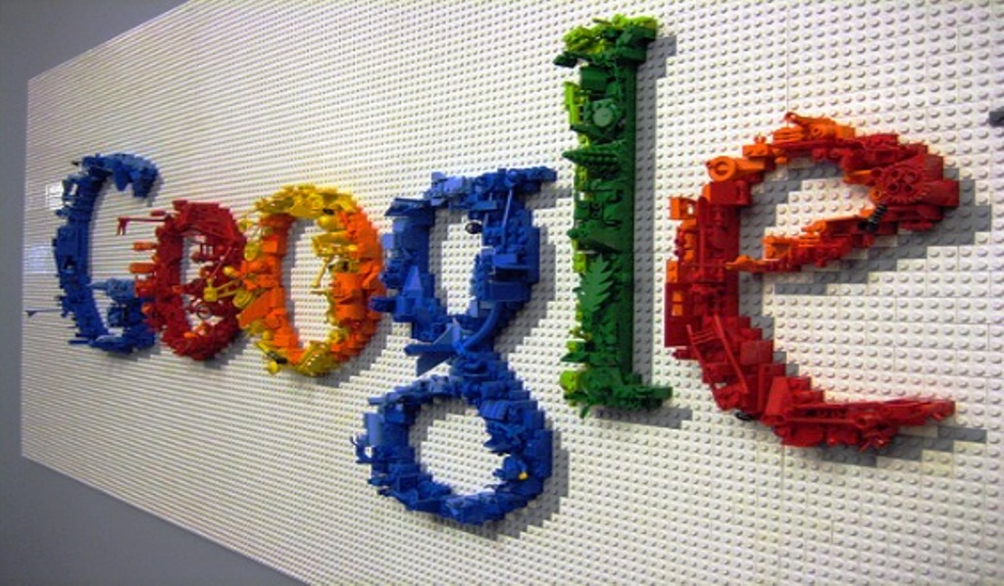

Slide 33
Google
Google is known for Google.com Internet Search Engine– currently the best Search Engine on the Internet
Google is an American computer technology corporation;
Specializes in Internet software and online advertising
Flagship product: Google search and AdWords targeted advertising services

Slide 34
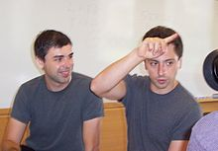
Google
Google was founded in 1998 by Larry Page and Sergey Brin – then PhD students at Stanford University– with a single goal to create a new Internet search engine

Slide 35
Google
The key point in the history of Google is Larry Page’s PhD project, in which he wanted to understand the structure of the Internet as a large network of web pages connected by HTML links

Slide 36
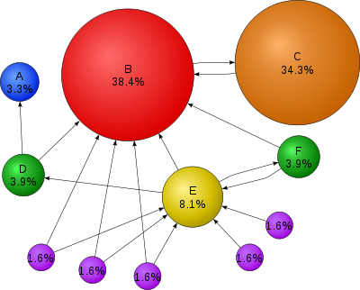
Google
Page’s main idea was that importance of different websites on the Internet is related to the number of links pointing to them (referring) from other websites as well as that websites importance

Slide 37
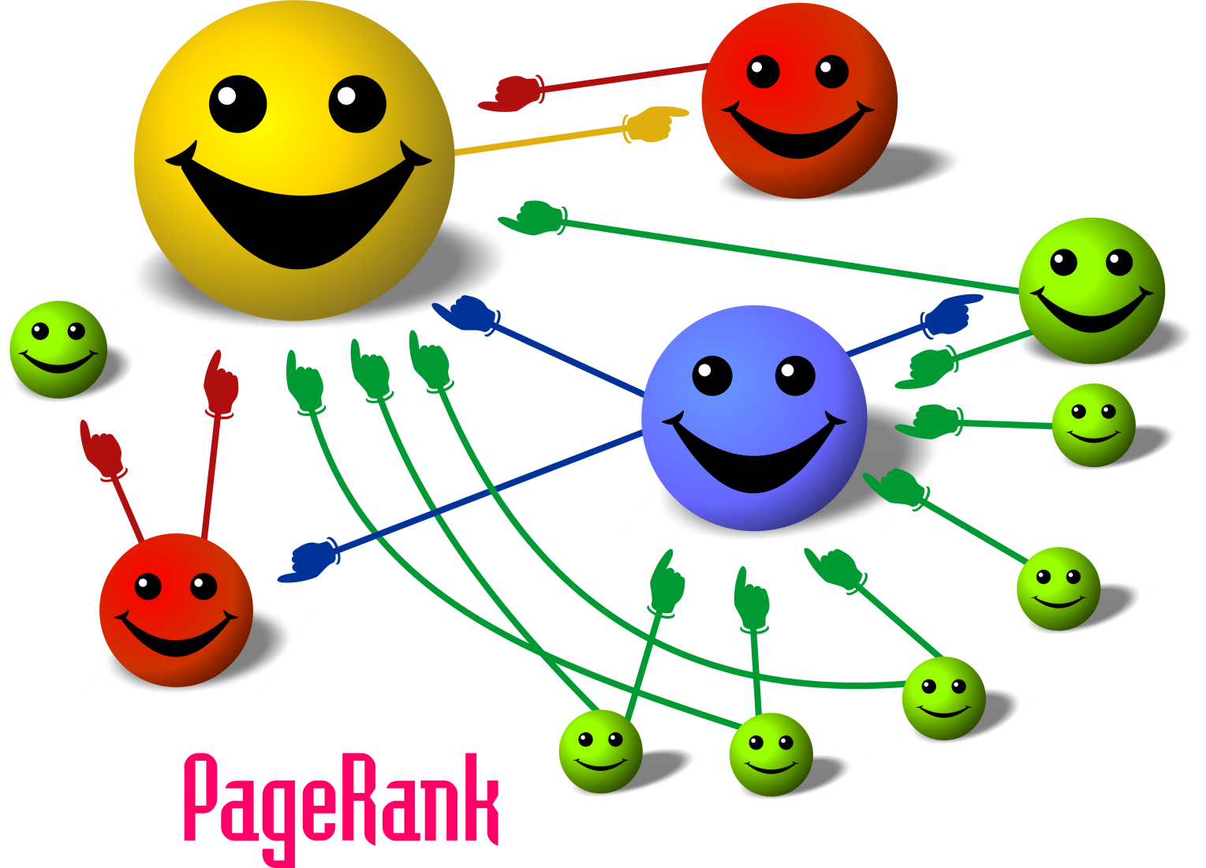
PageRank

Slide 38
Google
The idea of the PageRank – that people that have more other important people pointing to them are more important and have greater influence –is in fact a general property of professional and social networks

Slide 39
Google
Page and Brin created a web crawler computer program called BackRub – a software that visits different websites on the Internet by following the links from other webpages, and an Internet search engine that used PageRank from BackRub to rank web pages

Slide 40
Google
This is what BackRub’s home page wrote in early 1997:
BackRub is written in Java and Python and runs on several Sun Ultras and Intel Pentiums running Linux. The primary database is kept on an Sun Ultra II with 28GB of disk. Scott Hassan and Alan Steremberg have provided a great deal of very talented implementation help. Sergey Brin has also been very involved and deserves many thanks. -Larry Page pagecs.stanford.edu

Slide 41
Google
Google was officially founded in 1998, and named Google after a misspelling of the word "googol“ – the number one followed by one hundred zeros – which signified the volume of information that the web crawler looked at on the Internet

Slide 42
Google
Google is unique as a company in that it does not focus on single software product
Instead Google has created a large number of different projects
Google’s products usually begin as an experimental project and, if successful, are released on the Internet as Free Internet Software

Slide 43
Google
We will just focus on 4-5 of Google’s most important projects

Slide 44
Google
After Google search, probably the most known Google’s product is GMail
Gmail is an online email service
This means that the software is hosted on Google servers and is accessed via Internet
Therefore, Gmail is a software that is used via Internet Browser; user does not need to install any local program on their computer

Slide 45
Google
Gmail was launched by Google in 2004 as an innovative online email service
The main concept of Gmail is the email service built around Google’s search
That is, Gmail is focused on searching emails using keywords and tag or labels, instead of older organizing of emails into folders

Slide 46
Google
Gmail was also the first email to use threading of replies into conversations, similar to Internet forums, and has the best spam filter in the world based on Machine Learning
Gmail was also first to offer users up to 15GB of storage space and up to 25MB message attachments

Slide 47
Google
Another extremely popular Google’s products is Google Maps
Google Maps is online guide, map, and navigation software
Google Maps is also hosted directly on Google’s servers and is accessed via an Internet Browser

Slide 48
Google
Google Maps was launched by Google in 2005
Google Maps initially was a C++ program written by Lars and Jens Rasmussen at a Sydney-based company “Where 2 Technologies” (Australia), which was a regular stand-alone computer application

Slide 49
Google
Google acquired “Where 2 Technologies” in 2004 and released the application as Internet service Google Maps in 2005
Since 2005 Google had done a large amount of work on entering maps and geographical information from all around the world into Google Maps, making it the most used navigation software in the world

Slide 50
Google
Google Apps is an business productivity suite that includes a large number of Google’s online services in one package
Google Apps includes Internet applications such as Gmail, Google Groups, Google Calendar, Google Talk, Google Drive, Google Docs, Google News, Google Wallet and Google Sites

Slide 51
Google
Alls Google Apps applications are Internet applications
That is, they are hosted on Google servers and are accessed by the users via an Internet browser

Slide 52
Google
Google Apps launched in 2006, and offers features similar to MS Word, Excel, and Powerpoint in addition to Gmail, Calendar, Instant Messaging, discussion groups and websites
Google Apps also allow storing documents on Google’s servers at Google Drive, and for several people to work on one document at the same time (collaborate)
Google Apps are offered to businesses on subscription basis at $50/year

Slide 53
Google
In 2007, Google released one of its most significant products – Android operating system
Android is an open-source operating system for smartphones, intended as an alternative for Apple controlled iOS operating system

Slide 54
Google
As the market for smartphones expanded, the goal of Google with Android was to offer an alternative to iOS to new smartphone manufacturers such as Samsung and HTC
As we now know, this strategy was successful: today over 70% of all smartphones run on Android operating system

Slide 55
Google
Android is a custom operating system, with the system kernel developed by the Google’s Android project from linux kernel 2.6
System’s user interface in Android is written completely in Java, in special pre-compiled form called dalvik byte code

Slide 56
Google
Android is an open source OS with the source code available from source.android.com
Anyone can freely use and modify Android, and many smartphone manufacturers such as Samsung or HTC as well as many open source groups such as Cyanogen develop and release significantly modified version of Android

Slide 57
Google
Android also allows development of custom applications for smartphones, generally distributed via Google’s Play Store
Android applications are typically written in Java, and distributed as precompiled java bytecode in “apk” packages

Slide 58
Google
Google also has a number of hardware projects
Google driverless car is a project by Google to develop technology for self-driving car
Google self-driving cars began testing in 2012 and to date covered over 500,000 km real-life road testing without single accident

Slide 59
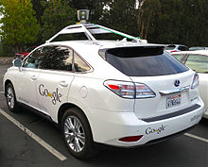
Google
Google’s drivereless cars use complex 64 beam laser radar system (LIDAR) to scan and produce 3D map of its surrounding

Slide 60
Google
LIDAR scans are combined with GPS map information, other scanners, and complex machine learning algorithms to make driving decisions

Slide 61
Google
The project is led by Sebastian Thrun, director of the Stanford Artificial Intelligence Laboratory, whose team at Stanford created the robotic vehicle “Stanley” that won the 2005 DARPA Autonomous Vehicle Grand Challenge from the United States Department of Defense.

Slide 62
Google
There are many other projects that I had to leave out because of time constraints
Google Glass Google Fiber Google+ Google Sites Google Reader Google Books Google Calendar Google Talk Google Code Google Groups Google Translate Google Disk Google Docs Google Checkout Google Wave Google Wallet Google AdWords Google X Google Analytics Google AdSense Google News Google Chrome Google Chrome OS ... …

Slide 63
Google
In another aspect of Google, today Google operates one of the largest server farms (that is data centers) in the world
Reportedly, Google’s server farms use more than 900,000 servers in its server farms, consume 500-700 MW of power and have processing power of 10¹⁶-10¹⁷ computational operations per second (FLOPS)

Slide 64
Google
Google server farms use regular x86 server computers running customized versions of Linux, containing two processors (each with 2 cores), full stack of RAM (8 DIMM slots), and two SATA hard drives
Google’s server farms are connected to the Internet via ~1000 Gbit/s custom-built network of fiber-optic connections

Slide 65
Google
Majority of Google’s server farms are custom build and run custom high-performance grid management software
This unique high-performance computign hardware and software is one of the most important “hidden” parts of Google

Slide 66
Google
Although Google is not a typical company by far, it is reflects well software industry in 2000-2010;
Try to develop different software projects and quickly achieve high impact or fail
Very Large Scale high-performance computing (grids and large clusters) is a routine part of everyday life
The product is Internet Software server to users via Internet Browser
Use of advanced mathematics, statistics, and machine learning technologies in software

Slide 67
A summary
If we are attentive, we can draw several important lessons from these examples:
Software is a unique industry in that it is very easy to become world-famous;
You don’t need to invest millions of $$$ into factory and supplies;
All you need is a good idea, a laptop, and a lot of persistence

Slide 68
A summary
If we are attentive, we can draw several important lessons from these examples:
The best software follows a scientific discovery allowing one to solve an extremely important general need: Oracle – data management, Google – information search
However, just as there had been many DBMS and Internet search software before Google and Oracle, it is the execution of that solution that matters

Slide 69
A summary
If we are attentive, we can draw several important lessons from these examples:
Software is an extremely dynamic field – there is a new software technology every 3-5 years and a complete change of direction every 10 years or so
1980-1990 – Early days
1990-2000 – Applications like Word and Excel
2000-2010 – Internet Applications, Social Networks, Search

Slide 70
A summary
If we are attentive, we can draw several important lessons from these examples:
Software also becomes increasingly mathematical, oriented at solving extreme problems in the area of Very Large Scale Computing and Data Analysis

Slide 71
A summary
If we are attentive, we can draw several important lessons from these examples:
As a result, one of the most important qualities of modern software engineer is the ability to learn
Whatever you will learn now is very likely to be nearly useless when you graduate in 2017
Instead it is important to stay current with the state of technology and trends in the market

Slide 72
A summary
What I can recommend are (best of all using daily RSS subscription)
Mashable – A leading blog on the developments in software and technology
TechCrunch – A leading blog on developments in software and technology
Slashdot newsletter – a well-known newsletter/forum website for programmers and other “geeks”

Slide 73
A summary
Where will the software be in 5 years, when you graduate?
1990th was all about applications like Word or Excell
In 2000th the software moved to Internet applications and large data processing and analysis
Today’s buzz word is Cloud and Mobile computing

Slide 74
A summary
Where will the software be in 5 years?
The answer is: No one knows for sure, my guess is - mobile (that is smartphones)

Slide 75
To end this lecture, I want to offer you a view on the modern software in the form of the 5 Fastest Growing Startups of 2012 as selected by Business Insider Magazine

Slide 76
The Fastest Growing Startups of 2012
Instagram; A mobile picture-sharing app with ability to edit and share photographs online
StartApp; The largest and the fastest growing in the world mobile search engine
Kaltura; An open source video platform for video-streaming over Internet
Dropbox; An especially easy cloud storage service for storing online and sharing files, music, and video
Fab.com; A fastest growing eCommerce website and mobile app for flash sale of custom designer products

