Slide 1
MIT504 Internet and Web Programming HTML Styling
Yrd. Doç. Dr. Yuriy Mishchenko

Slide 2
Div-based web page layout (“div” tabanlı tasarım)
Two approaches for web page layout :
Table-based layout
Div-based layout
Table-based layout is older, but simpler to learn and apply
Div-based layout is newer and the type of approach mostly used in modern times

Slide 3
Div-based web page layout
In div-based layout, the web page is designed using rectangular (dörtğen) boxes
Many HTML elements already are created as such rectangular areas (<p>, <table>)
If not, the HTML element is placed inside a “div” “container” element
<a> is inline (satıriçi) element; place it inside a div, then think about where to place that div !!! <div><a href=“git-oraya”>burdan git!</a></div>

Slide 4
Div-based web page layout
In this way, in div-based layout, all elements of a web page are placed in appropriate div-containers
Div-elements are then placed in correct positions in the web page using styling options (a little later)
== div tabanlı tasarım

Slide 5
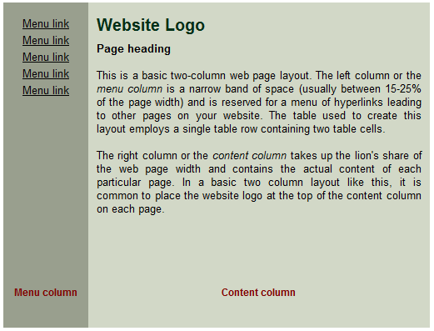
Div-based web page layout

Slide 6
Div-based web page layout
div
div
eg1.html

Slide 7
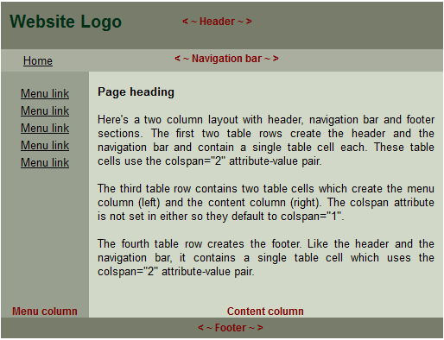
Div-based web page layout

Slide 8
Div-based web page layout
div
div
div
div
div
eg2.html

Slide 9
HTML styling:
As we learned before, HTML pages are created from HTML elements such as paragraphs, tables, images, etc.
The way different elements are shown by the browser in a web page is controlled by “style” parameter

Slide 10
What is HTML styling?
“style” parameter can be used with any HTML element
<a href=“http://google.com” style=“text-weight:bold”>
<p style=“text-family:Arial”>
<img src=“myimage.jpg” style=“height:100px”/>

Slide 11
What is HTML styling?
Using “style” parameter such properties of HTML elements as size, formatting or position can be changed

Slide 12
What is HTML styling?
“Style” definitions are always written in this form:
<ELEMENT style=“option:value; option:value; … “>
That is – a list of “option:value” pairs
“option” defines what property of the current HTML element is to be changed
“value” defines how that property is to be changed

Slide 13
What is HTML styling?
There is large number of style-options that can be changed for different HTML elements, we will review some of the options and below
In general, it is necessary to use a reference material to check available style options and its values – w3school.org: http://www.w3schools.com/cssref/

Slide 14
HTML styling basics
Main types of styling options:
Formatting (Biçimlendirme)
Position and visibility (Pozisyon ve gösterme)
Size and borders (Boyut ve çerçeveler)

Slide 15
HTML styling basics
Formatting (Biçimlendirme)
Text formatting; color, alignment, underlining, etc – for these we use text –styling options
Font formatting; color, font family, size, italic/bold, etc – for these we use font –styling options
List formatting; list-style –styling options
Background plan or image (arka plan rengi ya da resmi); background –styling options
These web-page formatting properties can be changed using the “style” parameter

Slide 16
HTML styling basics
Position and visibility (Pozisyon ve gösterme)
Normal positions: if no special instructions are given, web browser formats different HTML elements in the order they appear in the web page, in serial order as a normal text
First element comes at the top/left, then elements add from below/right
The specific order is determined by the browser

Slide 17
HTML styling basics
“absolute” positioning
Using “style” parameter, position of each HTML element may be defined explicitly
Position style-options are used for that

Slide 18
HTML styling basics
“absolute” positioning
position:absolute option in “style”-parameter says that the HTML element is to be placed by the browser at defined position in the browser window, out of order of the other HTML elements
position:relative option in “style”-parameter says that the HTML element placed by the browser at certain position relative to its normal in order of the other HTML elements position (where it would be placed by the browser without “absolute” positioning)

Slide 19
HTML styling basics
“absolute” positioning
top, right, left, bottom style-options are used to define the absolute position of the HTML element
Top/right/left/bottom define positions of corresponding (ilgili) edges of the element

Slide 20
HTML styling basics
left
top
right
bottom

Slide 21
HTML styling basics
<p style=“position:fixed;top:30px;right:5px;”>
<div style=“position:relative;left:-20px;”>
<h2 style=“position:absolute;left:100px; top:150px;”>
Fixed position in browser window
Left-edge -20px of “normal” position
At position (100,150) in the “parent” element

Slide 22
HTML styling basics
“float” positioning;
Floating element or “kayan eleman” is an element such that web page’s text or other elements “float” around it (yani metin ve diğer elemanları bu elemanın etrafında sarılıyor)
Floating elements are created using float style-option

Slide 23
HTML styling basics
“float” positioning;
Floating elements are created using float style-option
float:left – places the element to the left, and the text floats around it on the right (elemanı sola yerleştiriyor)
float:right – places the element to the right, and the text floats around it on the right (elemanı sağa yerleştiriyor)

Slide 24
HTML styling basics
“float” positioning;
Floating elements are placed by the browser “as long as it is possible”
This means that floating elements may be left “waiting” to be placed by the browser until it can find a suitable place for them
clear:left/right/both – is used to force place (zorunlu yerleştirmek) all “waiting” left, right, or all floating elements

Slide 25
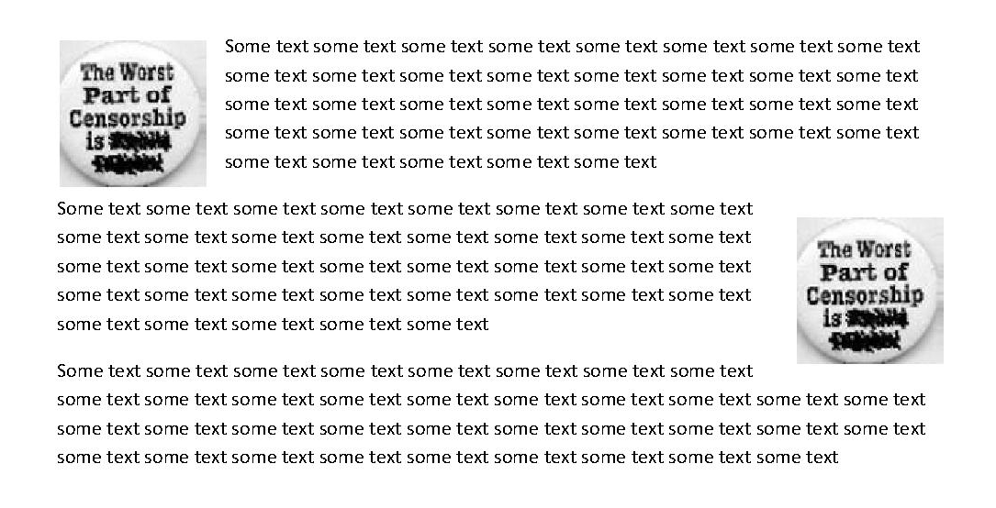
HTML styling basics
LEFT floating element
RIGHT floating element

Slide 26
HTML styling basics
Visibility (Gösterme)
display and visibility style-options are used to control visibility of HTML element
visibility:visible/hidden – makes HTML element be shown or not shown in the web page, but in either case preserves its place in the web page (elemanı gösteriyor veya saklıyor, ama sakladığında onun yerine boş yer bırakıyor)

Slide 27
HTML styling basics
Visibility (Gösterme)
display and visibility style-options are used to control visibility of HTML element
display:inline/block/none – controls display of the element – inline, as a block, or not shown; in the last case the element is completely removed from the web page (elemanı satır içi veya blok olarak gösteriyor, yada saklıyor; sakladığında eleman tamamen sayfadan kaldırılıyor)

Slide 28
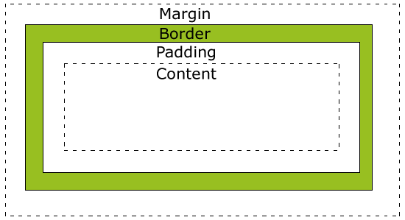
HTML styling basics
Size and borders (Boyut ve çerçeveler)
HTML element model (box – kutu)
Bu ve diğer elemanların arasındaki aralık
html element
çerçeve
Sınır ve metin arasındaki aralık
içerik

Slide 29
HTML styling basics
Borders and boundaries (Boyut ve çerçeveler)
height ve width style-options are used to define element’s size and width (yükseklik ve genişlik)
In HTML, the size of element means the size of its “CONTENTS” (elemanının boyutu içeriğin boyutu demektir), padding, border, and margin should be added on top of that (üzerine eklenmelidir)

Slide 30
HTML styling basics
the size of element means the size of its “CONTENTS” (elemanının boyutu içeriğin boyutu demektir), padding, border, and margin should be added on top of that (üzerine eklenmelidir)

Slide 31
HTML styling basics
This is different in Internet Explorer 8 and Earlier (cross-browser incompatibility, that is same web page may be shown differently in IE8 and say Firefox/Chrome)
In IE8, the size of HTML element means its entire size, that is containing padding, borders, and margins
To solve this and other cross-browser incompatibility issues, your HTML web pages should always begin with following line (Bu sorunu çözmek için, HTML belgesinizin başında “DOCTYPE” tanım-satırı eklenmesi gerekmektedir!)
<!DOCTYPE html PUBLIC "-//W3C//DTD XHTML 1.0 Transitional//EN" "http://www.w3.org/TR/xhtml1/DTD/xhtml1-transitional.dtd">

Slide 32
HTML styling basics
In IE8, the size of HTML element means its entire size, that is containing padding, borders, and margins

Slide 33
HTML styling basics
To solve this and other cross-browser incompatibility issues, your HTML web pages should always begin with following line (Bu sorunu çözmek için, HTML belgesinizin başında “DOCTYPE” tanım-satırı eklenmesi gerekmektedir!)
<!DOCTYPE html PUBLIC "-//W3C//DTD XHTML 1.0 Transitional//EN” "http://www.w3.org/TR/xhtml1/DTD/xhtml1-transitional.dtd">

Slide 34
HTML styling basics
Padding, margin and border:
To define padding and margin’s width, padding and margin style-options are used
Padding/margin width may be defined overall, or for right/left/top/bottom margin only padding-top/padding-left/padding-right/padding-bottom

Slide 35
HTML styling basics
Padding, margin and border:
To define border’s style and width, border style-options are used
Border may be defined overall or only for top/right/left/bottom borders, border-right/border-left/border-top/border-bottom
Example:
style=“border-top: solid 1px black;”
style=“border-color:black; border-width:1px; border-style:solid;”

Slide 36
HTML styling basics
HTML sizes
HTML size can be given in px, em, or percentile (yüzdesi, %)
px = pixel,
em = is relative size, 1em=font-size of the parent element (ana elemanın fontunun boyutuna bağlı bir boyut; 1em – ana elemanın fontunun boyutu demektir)
percentile – percentile of the parent element’s size (ana elemanın boyutuna bağlı bir boyut; 100% - ana elemanın boyutu demektir)

Slide 37
HTML styling basics
HTML styling basics:
Formatting (Biçimlendirme)
text, font, color, background, list-style options
Position and visibility (Pozisyon ve gösterme)
position, float, clear, top, left, right, bottom options
Size and borders (Boyut ve çerçeveler)
height, width, padding, margin, border options
http://www.w3schools.com/cssref/

Slide 38
Pratik
Ne aletler kullanacağız ?
Notepad++ ve Firefox/Chrome
Ne kaynaklar kullanacağız ?
http://www.w3schools.com/html/html_quick.asp
http://www.w3schools.com/tags/
http://www.w3schools.com/cssref/
http://www.w3schools.com/html/html_colors.asp
Örnek dosyalar
Çalışma – calisma.tr.txt OR calisma.en.txt

