Slide 1

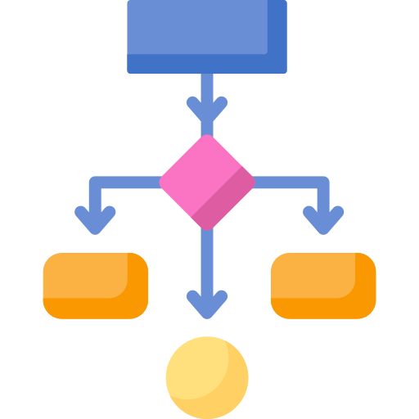






Empirical Software Engineering (ESE)
How to Strangle Systematically: An Approach and Case Study for the Continuous Evolution of Monoliths to Microservices
Shipping Service
Shopping Cart Service
Monolith
Valentin Seifermann
Final Presentation (Master Thesis)
Auth Service

Slide 2
Overview
Motivation
Goals
Research Questions
Study Execution
Results
Threats to Validity
Conclusion
How to Strangle Systematically: An Approach and Case Study for the Continuous Evolution of Monoliths to Microservices

Slide 3














Motivation
Monolithic & Microservice Architectures
Scope of Change
Monolith
Microservice Architecture
How to Strangle Systematically: An Approach and Case Study for the Continuous Evolution of Monoliths to Microservices
Notes:
Monolithic architectures have been the traditional way of developing applications for many years, which results in IT environments still consisting of
applications based on these types of architectures.
Monolithic systems are usually based on different layer, on the basis of which responsibilities are often separated.
Conway’s Law, which states that the organisation that designs the system will produce a system whose structure reflects the structure of the organization
Over the last decade, the design of enterprise applications based on microservice architectures has become a frequently applied software architecture model
Martin Fowler define the microservice architecture as an approach to develop a single system as a suite of small services, each running in its own process and communicating with lightweight mechanisms
The pace and dynamism in the evolution of container technologies and lightweight development frameworks which support the technical realization of independent service/applications, has also led to an increased popularity of the microservice architectural style.
To benefit from scalability, reliability, increase in agility and productivity, resilience to failure, ease of deployment and maintenance, and decrease in time to market.

Slide 4







Motivation
Microservice Migrations - Strangler Fig Pattern
Strangler Service
Strangler Application
Strangler Service
Strangler Service
Strangler Service
Strangler Service
Strangler Service
Strangler Service
Strangler Service
Strangler Service
Strangler Service
Monolith
Monolith
Monolith
How to Strangle Systematically: An Approach and Case Study for the Continuous Evolution of Monoliths to Microservices
Notes:
What is the strangler pattern?
The strangler pattern is a technique or a pattern which is frequently used when doing system rewrites or migrations.
The pattern is named after a plant which grows around a tree and finally envelopes or wrapps itself around the original tree. In the final stage the tree dies and rots away, leaving only the plant and theb asic structure of the original tree.

Slide 5



Motivation
How to strangle systematically?
- Many factors may impact the continuous migration process → Not only technical
- Need to take into account concerns and decisions of all stakeholders (new features vs. migration activity)
- No methodological guidance for software engineers
→ Need of a decision-making process (also at Adesso SE)
How to Strangle Systematically: An Approach and Case Study for the Continuous Evolution of Monoliths to Microservices
Notes:
All these approaches describe the gradual decomposition of the monolith in a technical manner. It lacks a coherent decision-making process
Software engineers at Adesso faced similar problems

Slide 6

Goals
- Develop an approach for a long-term continuous microservice migration
→ Focus on process-related guidance
→ Focus on the decision-making process
How to Strangle Systematically: An Approach and Case Study for the Continuous Evolution of Monoliths to Microservices

Slide 7
Research Questions
RQ 1: What are the influencing factors in a microservice migration?
RQ 2: What are the different steps of a microservice migration?
RQ 3: Which decisions are made based on the factors during a microservice migration?
RQ 4: What is feasible process for a systematic migration based on the strangler pattern?
Influencing
Factor
affects a decision
Relevant in a certain step
Taken in a step
Step
Decision
How to Strangle Systematically: An Approach and Case Study for the Continuous Evolution of Monoliths to Microservices
Notes:
In a first step, the factors that can influence a migration are identified. The factors serve as causes on the basis of which certain Defizienz are later made in the migration process.
This question focuses on identifying the different steps of migration process. Furthermore, the factors are assigned to the respective steps. This serves to chronologically assign the occurrence of the factors in the migration process.
This serves to identify the Defizienz which are made during the microservice migration. These Defizienz are based on the influencing factors that occur during the migration.
This question serves to systematically link the different decision points resulting in a decision guidance for a continuous evolution towards MSA.

Slide 8


Study Execution
Literature Review
Interviews [1] [2] [3]
Migration Approach
Semi - structured
Interview guide
→ 12 Main Questions
Analysis [4]
→ Transcription
→ Coding
Search String
Filter & merge results
→ 7 publications
-
Aggregate results
Recommendations for action
Prepare
Design
[1] S. Hove, B. Anda. “Experiences from conducting semi-structured interviews in empirical software engineering research”.
In: 11th IEEE International Software´Metrics Symposium (METRICS’05). 2005
[2] I. S. Rubin. Qualitative Interviewing: The Art of Hearing Data (3rd ed.) SAGE Publications
[3] M. Q. Patton. Qualitative research and evaluation methods
[4] J. Saldaña. The coding manual for qualitative researchers. English. SAGE London, 2009
How to Strangle Systematically: An Approach and Case Study for the Continuous Evolution of Monoliths to Microservices
Notes:
ACM Digital Library, IEEE Xplore and Google Scholar
Specific Search String, Filltering, Snowballing acitivity BUT NO SYSTEMATIC LITERATURE REVIEW
Recommendations of Saldaña et al. : First Cycle Coding (Process Coding -> Coding with gerunds, Descriptive Coding -> Nouns ) , Second Cycle Coding (Pattern Coding)
Prior to the first cycle coding, initial categories were derived from the research questions (Factors, Steps, Decisions)
Second cycle coding uses the material from first cycle coding and reorganizes the codes into a list of broader categories
Pattern coding is a method of grouping the excerpts and codes into a smaller sets of categories,

Slide 9




Results
Interview Participants & Migration System
- 2 Software Architects & Developer
- 1 Software Co-Architect & Developer
- 1 Project Manager & Requirements Engineer
- 3 Developer
Vehicle lifecycle management system
Processing of master data
Customer service measures
How to Strangle Systematically: An Approach and Case Study for the Continuous Evolution of Monoliths to Microservices
Notes:
The Participants took part in several migration projects
All together they worked in the same migration project over different perdiods

Slide 10
Results
Results
RQ 1 – Influencing Factors
Business Factors
Importance of migration
Scope of new requirements
Selection of microservice candidates
Importance of migration
Cost & effort calculation
Engagement of stakeholders
Customer-related restrictions
Technical Factors
Infrastructure limitations
Complexity of legacy system
Difference of data consistency
Organizational Factors
Limitation of organizational structure
How to Strangle Systematically: An Approach and Case Study for the Continuous Evolution of Monoliths to Microservices

Slide 11
Results
Microservice implementation
Migration Step
RQ 2 – Migration Steps
Difference of data consistency
Influencing Factor(s)
Refactor monolith
Complexity of legacy system
Infrastructure preparation
Deviation of release & deployment
Strategies
Infrastructure limitations
Concept Design
Consideration of extraction
feasibility
Engagement of stakeholders
Complexity of legacy system
Limitation of the organ. structure
Technical & architectural
knowledge
Refactor monolith
Identification of microservice
candidates
Analysis of legacy system
Cost & effort estimation
Importance of migration
Complexity of legacy system
Complexity of legacy system
Microservice implementation
Analysis of drivers
Analysis of new requirements
Validation of microservice
Composition of new features
How to Strangle Systematically: An Approach and Case Study for the Continuous Evolution of Monoliths to Microservices

Slide 12
Results
Development team
Project management
RQ 3 - Decisions
Technical & architecural
knowledge
Best practice
Complexitiy of legacy
system
Expert knowledge
Proof-of-Concept
Implementation of new requirements
All stakeholders
Development team
Project management
Cost & effort estimation
Microservices
Complexitiy of legacy
system
Modular Monolith
Create team or splitt up
Organizational structure
Engagement of
stakeholder
Not at all
Continue
Migration feasibility
Restructuring of the organization
Development team
Development team
Scope of new
requirement
Microservices
Complexitiy of legacy
system
Modularize
Complexitiy of legacy
system
Monolith
Continue
Composition of legacy system
Procedure of microservice implementation
How to Strangle Systematically: An Approach and Case Study for the Continuous Evolution of Monoliths to Microservices

Slide 13
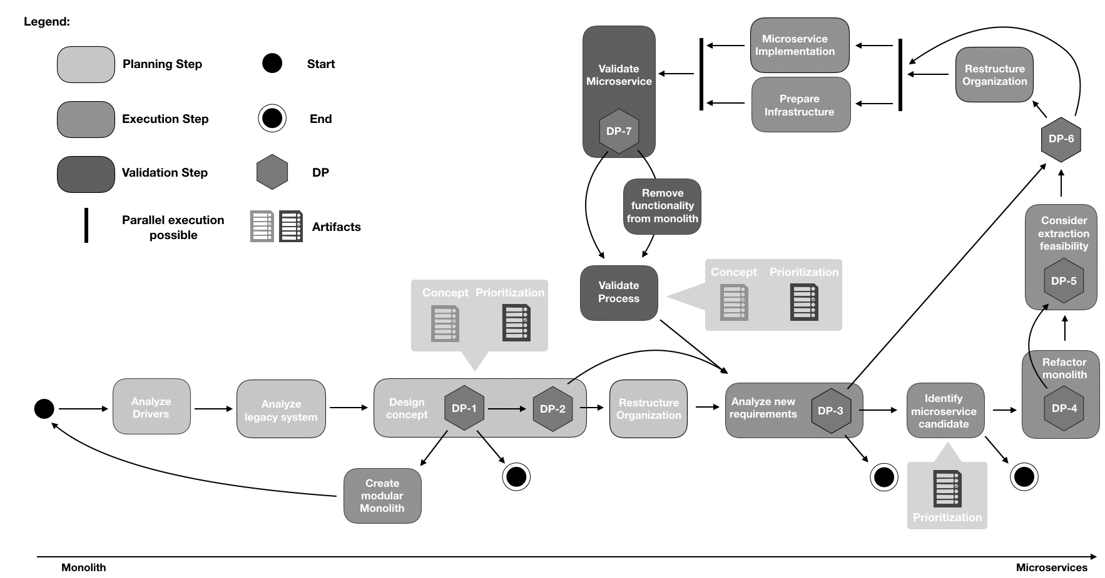
Results
RQ 4 – Migration Approach
How to Strangle Systematically: An Approach and Case Study for the Continuous Evolution of Monoliths to Microservices

Slide 14
Threats to Validity
Sample size
Sampling method
Experiences of participants
Memories of participants
How to Strangle Systematically: An Approach and Case Study for the Continuous Evolution of Monoliths to Microservices

Slide 15
Conclusion
- Approach for gradual microservice migration using the strangler pattern
→ interviews were conducted with various stakeholders
→ Influencing factors of a microservice migration were identified
→ Steps of a microservice migration were identified
→ Factors were assigned to the steps
→ Decisions of a microservice migration were identified
→The steps were linked through the various decision points resulting in a decision guidance
How to Strangle Systematically: An Approach and Case Study for the Continuous Evolution of Monoliths to Microservices

Slide 16


Empirical Software Engineering (ESE)
Valentin Seifermann
E-Mail
st108002@stud.uni-stuttgart.de
University of Stuttgart
M.Sc. Softwaretechnik

