Slide 1
Predicting Price Transaction
Database Report

Slide 2
What I have done
Abstract
Explain about Data Source
Create a conceptual schema
ER diagrams

Slide 3
Abstraction
The data we collected and stored concerns predicting housing transaction price which contains values of cities, floors, unit area households counts and parking capacity, rooms, heat fuel, heat type and front door structure. We separated and grouped data into different entities and attributes and build the one-to-many connections between them, which presented the data in more structured and organized way and allows us to query data, sort data, and manipulate data in various ways for the future performance.

Slide 4
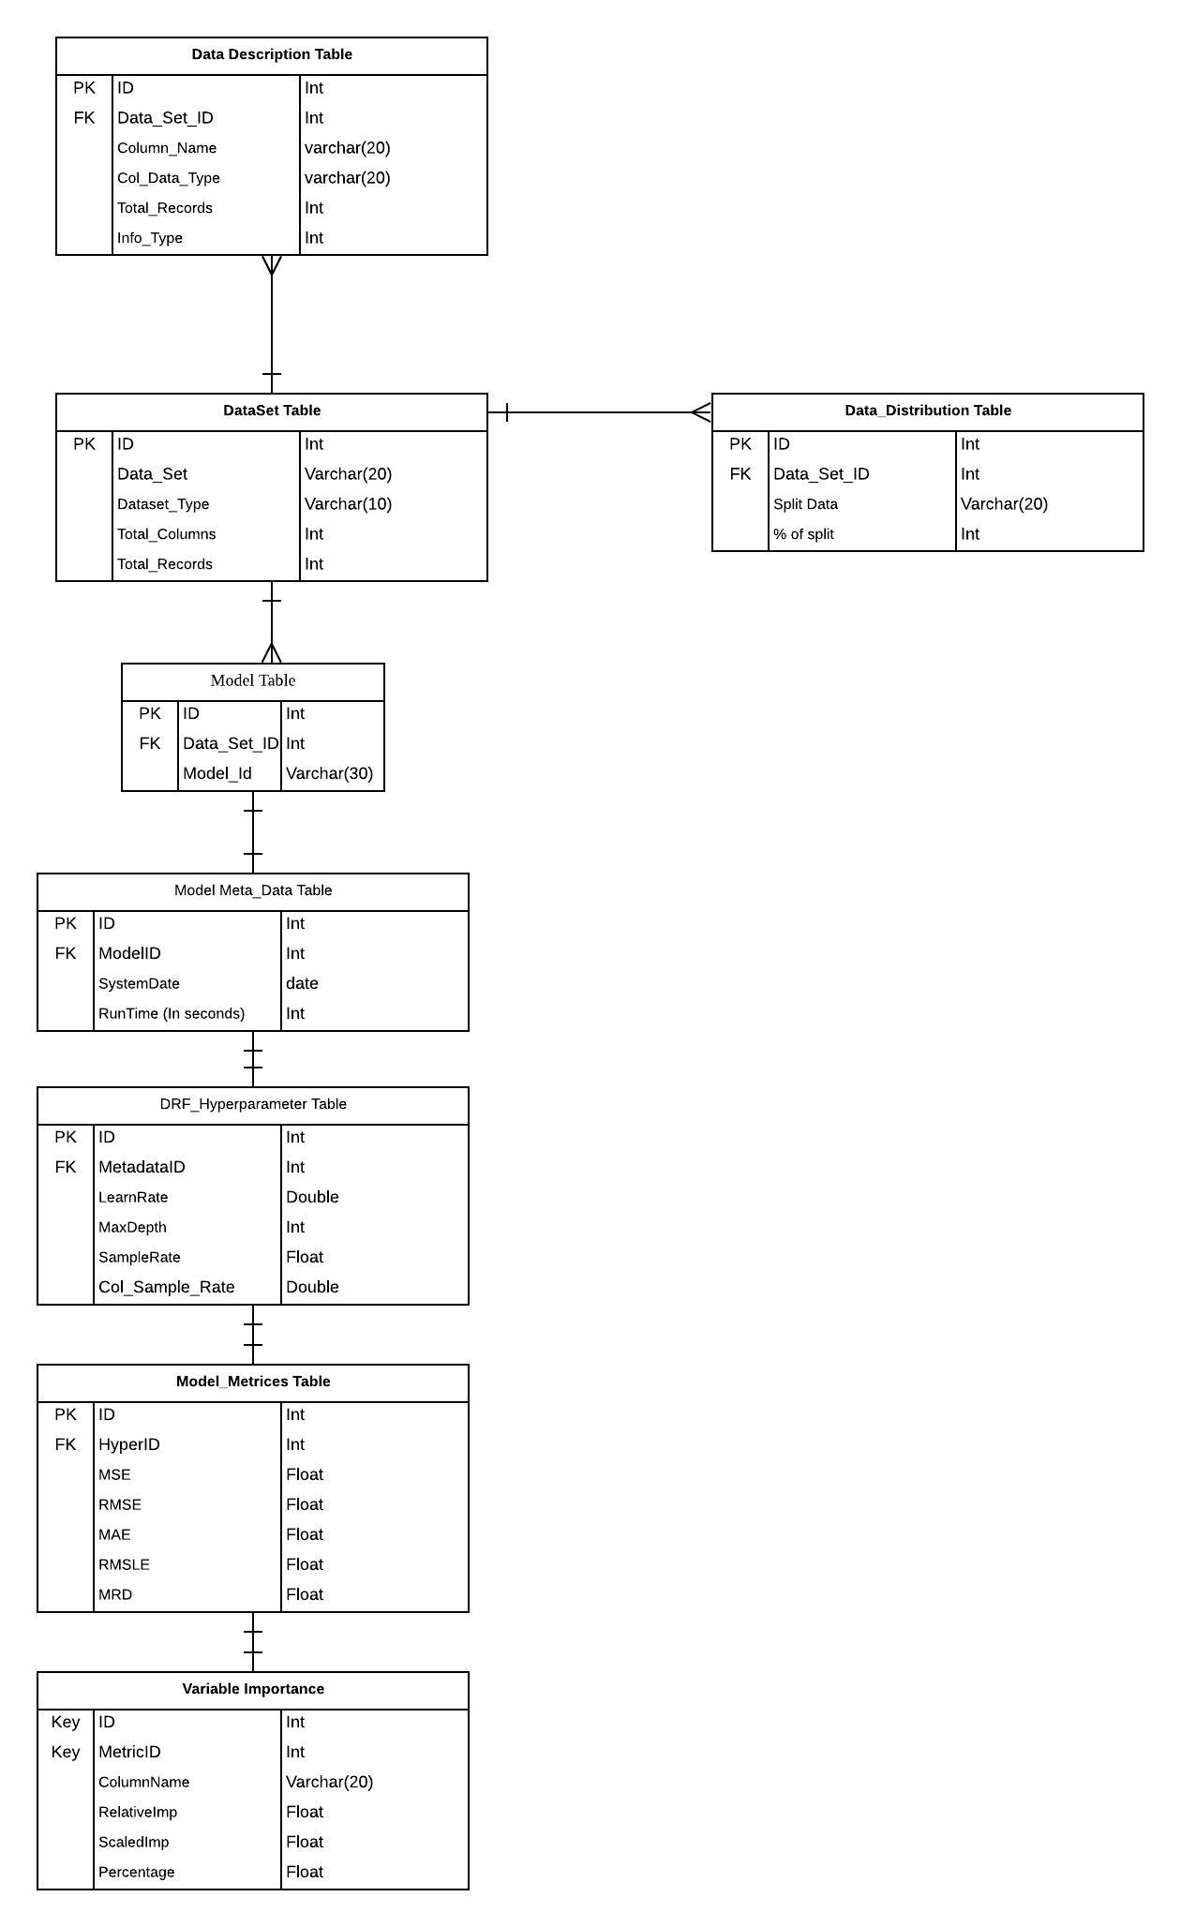
ERD

Slide 5
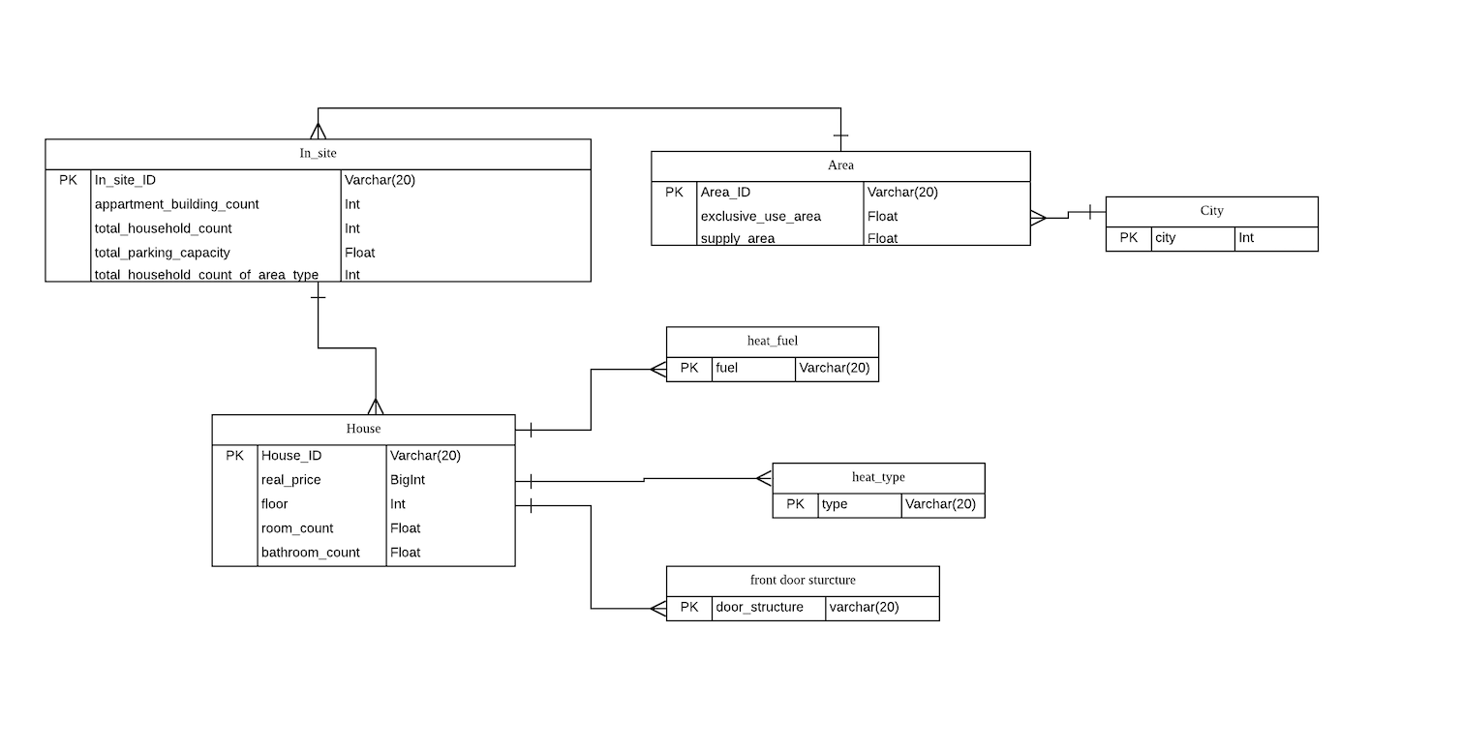

Slide 6
What is left to do
Generate the JSON file into python and normalize it
Physical model
Create 10 use cases, 5 views, 5 procedures, 5 functions, 5 indexes per person
Analytics
Conclusion
Professionalism and Report
Citations and References
License

