Slide 1

E-Portfolio – Kolja Groß

Slide 2
Introduction
to OpenGL

Slide 3
What is OpenGL?
Known as Graphics API
Actually just a specification
Maintained by Khronos Group
Makes use of graphics card‘s capabilities

Slide 4
Why OpenGL?
Open standard
Window- and operating system independent
Many free and available tutorials

Slide 5
Alternatives
DirectX
Windows specific
Also for Xbox One (DirectX 12)
Vulkan
„successor“ of OpenGL
Trades „titanic efforts“ for slight performance increases

Slide 6
Functionality
of OpenGL

Slide 7
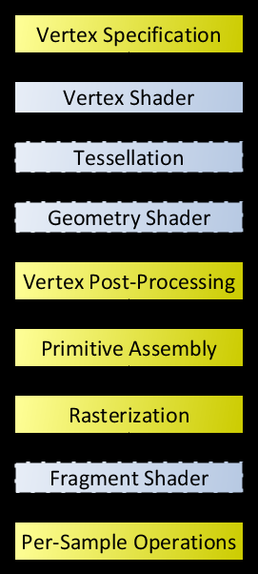
Functionality
Earlier: Fixed Function Hardware
Mixed Function Pipeline
Fixed function (yellow)
Programmable shader stages (blue)

Slide 8
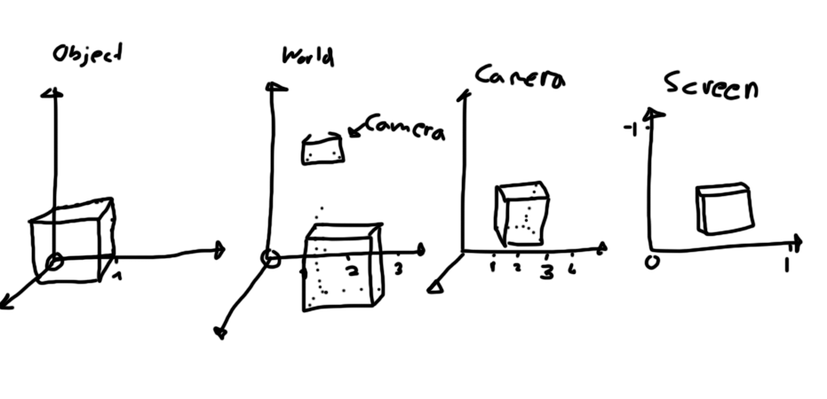
Vertex Shader
Called for every single vertex specified
Converts object space to world space to camera space to screen space
Simple animations can be made here

Slide 9
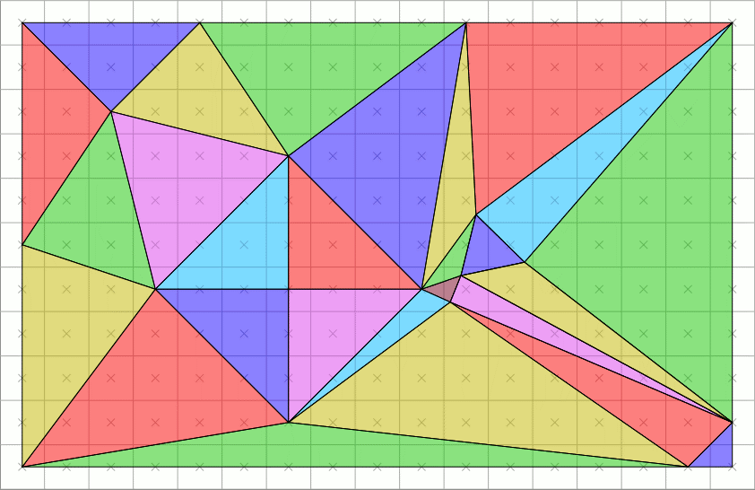
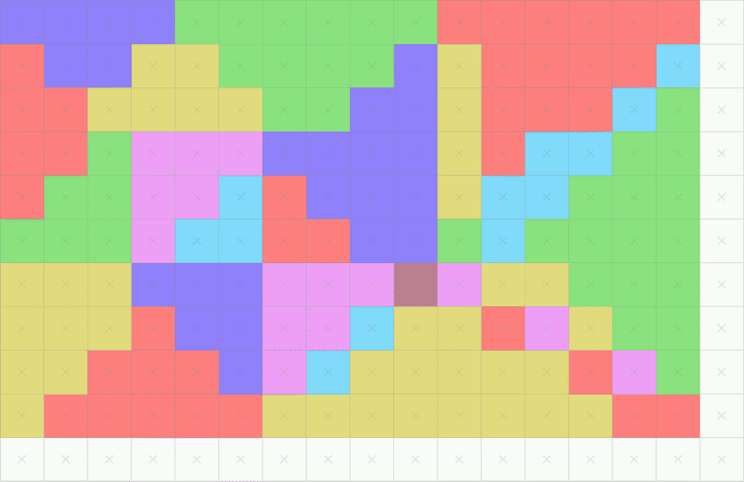
Rasterization
Produces Fragments (based on sample size)
Fragments hold interpolated information of vertices

Slide 10
Fragment Shader
Called for each fragment produced by rasterization process
May or may not correlate to a single pixel
Used to define color
Post-Processing
Anti-Aliasing

Slide 11
Thank you for listening

