Slide 1
Predicting Bay Area Travel Times: Is it possible?
By Greg Naifeh

Slide 2
In the beginning…
Problem trying to solve:
What time should I leave for work in the morning?
At that time, what is the optimal travel mode?
Should I drive, take the bus, or walk?
Goal: to save time

Slide 3
In the beginning…
Problem trying to solve:
What time should I leave for work in the morning?
At that time, what is the optimal travel mode?
Should I drive, take the bus, or walk?
Goal: to save time
These are simple questions…

Slide 4
In the beginning…
Problem trying to solve:
What time should I leave for work in the morning?
At that time, what is the optimal travel mode?
Should I drive, take the bus, or walk?
Goal: to save time
These are simple questions…
With a enormous level of complexity

Slide 5
Data Available
Right now, we have access to real time traffic:
Google Maps
Waze
Other applications
But no real (or free) access to historical traffic information
So I set out to create this data set

Slide 6
Data Collection
Pre-selected origins and destinations in the bay area
Residential neighborhoods:
Russian Hill, North Beach, Pacific Heights, Berkeley, Oakland, Outer Richmond, Outer Sunset, Mission, Noe Valley
Work neighborhoods:
Oakland, Financial District, Mountain View

Slide 7
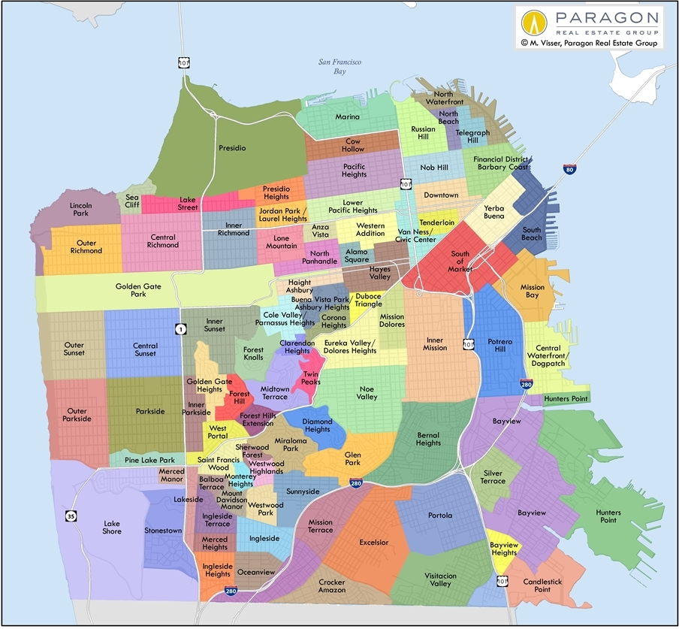
Data Collection

Slide 8
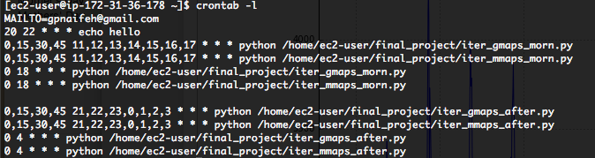
Data Collection
APIs:
Transit: Google Maps Distance Matrix API
2500 requests/day (for free)
Driving: Bing Maps REST Route API
125,000 requests/year (for free)
Storage: MySQL
Engine: cron running on EC2 instance

Slide 9
Results…

Slide 10
What did I learn?
Time of departure is not the most reliable source of a trip’s expected duration
That data munging is 99.99999999%
You don’t always find what you set out looking for
Leave for work early in the morning and head home late at night

Slide 11
What would I do differently?
There’s a python package called Statsmodels, part of which is designed around analyzing time series

