Slide 1





EnTiMid
A flexible component model
To integrate smart devices
In service-based applications
For Abient Assisted Living
Direction : Jean-Marc Jézéquel
Supervision : Olivier Barais
President : Daniel Thouroude
Member : Romain Rouvoy
Reviewer : Elisabetta Di Nitto
Reviewer : Dider Donsez

Slide 2
Agenda
Introduction
  AAL
  Home Automation
  Requirements
State-Of-The-Art
  Generic Tools
  Domain-Specific approaches
  Synthesis
Contributions
  Component Model
  Runtime environment
Validations
  Context and experimental setup
  Tests and Results
  Conclusion
Conclusion
  Summary
  Perspectives

Slide 3

Introduction :: State-Of-The-Art :: Contribution :: Validation :: Conclusion
Agenda - AAL - Home Automation - Requirements
Ambient Assisted Living
Origin and concepts
Home Automation
Technologies and Applications
Requirements
For the meeting of these domains

Slide 4
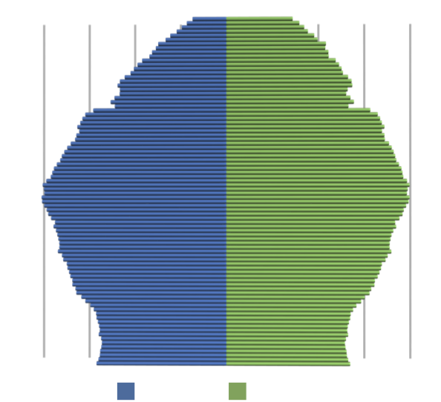
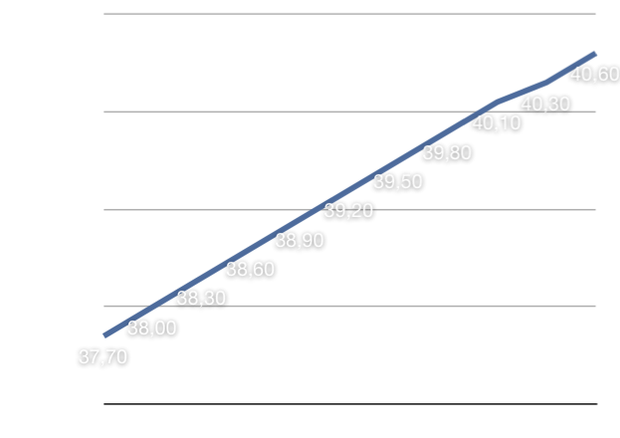
Introduction :: State-Of-The-Art :: Contribution :: Validation :: Conclusion
Agenda - AAL - Home Automation - Requirements
Evolution of the European Population’s median age
datasource : Eurostats extracted on March 15th 2011
The European Age Pyramid
datasource: Eurostats extracted on March 14th 2011

Slide 5
Introduction :: State-Of-The-Art :: Contribution :: Validation :: Conclusion
Agenda - AAL - Home Automation - Requirements
Ambient Assistend Living : The six dimensions
Autonomy
Activities
Assistance
Securisation
Support
Steamline

Slide 6
Introduction :: State-Of-The-Art :: Contribution :: Validation :: Conclusion
Agenda - AAL - Home Automation - Requirements
Media
Services and applications
Bus
Radio
UPnP
Mail
REST
Facebook
Infrared
PLC
Google Talk
Delta Dore (X2D)
Gateways
Android
Weather.com
Google Agenda
RS232
RS484
TCP/IP
Clé Icon Orange(SMS)
Konnex (EibKnx)
DPWS
Transport Protocols
Flickr
Nabztag
XMPP
Flickr
OWN
RTFE
SunSpot
IOBL
X2D
KNX
DALI
LonWork
Vigicrue
WiiMote
io-Homecontrol
X10
iPod
BackNet
Temper
Skype(SMS)
ZigBee
Zwave
6lowPan

Slide 7






Introduction :: State-Of-The-Art :: Contribution :: Validation :: Conclusion
Agenda - AAL - Home Automation - Requirements
Interoperability
Remote Control
Adaptation & Evolution
Distribution
Variability Management
Safety & Security
Acceptability and Accessibility

Slide 8
Introduction :: State-Of-The-Art :: Contribution :: Validation :: Conclusion
Agenda - Generic Tools - Domain-Specific Approaches - Synthesis
Generic Tools
Service-Oriented Architectures (SOA), Component Models, Component Models for SOA
Domain-Specific Approaches
Description, projects
Synthesis
Good properties identified, Points of contribution

Slide 9
Introduction :: State-Of-The-Art :: Contribution :: Validation :: Conclusion
Agenda - Generic Tools - Domain-Specific Approaches - Synthesis

Slide 10
Introduction :: State-Of-The-Art :: Contribution :: Validation :: Conclusion
Agenda - Generic Tools - Domain-Specific Approaches - Synthesis

Slide 11
Introduction :: State-Of-The-Art :: Contribution :: Validation :: Conclusion
Agenda - Generic Tools - Domain-Specific Approaches - Synthesis
 |  | Interoperability | Openness | Adaptation | Evolution | Variability Management | Safety & Security
 | OSGi |  | + | + | +
 | JBI | + | + |  | +
 | Darwin |  |  | + | + |  | +
 | Koala |  |  |  | + | + | +
 | Fractal |  |  | +
 | SCA |  | + |  | + |  | +
 | FraSCAti | + | + | + | + |  | +
 | uMiddle
 | Soprano |  |  | + | +
 | Gaïa | + |  | + | +
 | Dia Suite | + | + |  |  | + | +
 | Habitation | + |  |  |  | +
 | WADL | + |  | + | +
 | PervML | + | + | + | + | +
 | iPojo |  | + | +
 | Niagara | + | +
Generic Approaches
Domain-Specific Approaches

Slide 12
Introduction :: State-Of-The-Art :: Contribution :: Validation :: Conclusion
Agenda - Overview - Component Model - Runtime Environment
Overview
Global ideas,
Component Model
Priciples, description, example, link with code
Runtime Environment
Interoperability layer, model@runtime engine, service-oriented architecture, wrappers

Slide 13
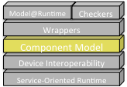
Introduction :: State-Of-The-Art :: Contribution :: Validation :: Conclusion
Agenda - Overview - Component Model - Runtime Environment
Leading ideas
Beaing inspired by electronics
Making it possible
Keeping end-users in mind

Slide 14
Introduction :: State-Of-The-Art :: Contribution :: Validation :: Conclusion
Agenda - Overview - Component Model - Runtime Environment
Beaing inspired by electronics
Making it possible
Keeping end-users in mind

Slide 15
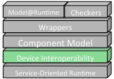
Introduction :: State-Of-The-Art :: Contribution :: Validation :: Conclusion
Agenda - Overview - Component Model - Runtime Environment

Slide 16
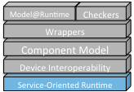
Introduction :: State-Of-The-Art :: Contribution :: Validation :: Conclusion
Agenda - Overview - Component Model - Runtime Environment

Slide 17
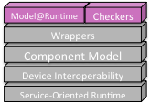
Introduction :: State-Of-The-Art :: Contribution :: Validation :: Conclusion
Agenda - Overview - Component Model - Runtime Environment

Slide 18
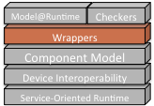




Introduction :: State-Of-The-Art :: Contribution :: Validation :: Conclusion
Agenda - Overview - Component Model - Runtime Environment
Device
Service
Action
Param
Embedded
Device
StateVar
UPnP
EnTiMid
Device
Port
Service
Message
Operation

Slide 19
Introduction :: State-Of-The-Art :: Contribution :: Validation :: Conclusion
Agenda - Context - Experimental Setup - Tests - Conclusion
Context
The Innovation Domicile Autonomie (IDA) project
The use case
Experimental Setup
mockups, devices
Tests
Interoperability, Evolution, Adaptation, Openness
Environments, protocols and results
Conclusion
Threats to validity, summary

Slide 20

Introduction :: State-Of-The-Art :: Contribution :: Validation :: Conclusion
Agenda - Context - Experimental Setup - Tests - Conclusion

Slide 21
Introduction :: State-Of-The-Art :: Contribution :: Validation :: Conclusion
Agenda - Context - Experimental Setup - Tests - Conclusion

Slide 22
Introduction :: State-Of-The-Art :: Contribution :: Validation :: Conclusion
Agenda - Context - Experimental Setup - Tests - Conclusion

Slide 23
Introduction :: State-Of-The-Art :: Contribution :: Validation :: Conclusion
Agenda - Context - Experimental Setup - Tests - Conclusion

Slide 24
Introduction :: State-Of-The-Art :: Contribution :: Validation :: Conclusion
Agenda - Summary - Contribution - Synthesis - Perspectives
Summary
Context, Requirements, State-of-the-art, Contribution
Contribution
Outline, Adequateness, Conservativeness
Synthesis
Benefits, limitations
Perspectives
Scientifiques, industrials

Slide 25
Introduction :: State-Of-The-Art :: Contribution :: Validation :: Conclusion
Agenda - Summary - Contribution - Synthesis - Perspectives

Slide 26
Introduction :: State-Of-The-Art :: Contribution :: Validation :: Conclusion
Agenda - Summary - Contribution - Synthesis - Perspectives

Slide 27
Introduction :: State-Of-The-Art :: Contribution :: Validation :: Conclusion
Agenda - Summary - Contribution - Synthesis - Perspectives

Slide 28
Introduction :: State-Of-The-Art :: Contribution :: Validation :: Conclusion
Agenda - Summary - Contribution - Synthesis - Perspectives

Slide 29
Publications
  Using MDE to Build a Schisophrenic Middleware for Home/Building Automation
  Grégory NAIN, Olivier BARAIS, Erwan DAUBERT, Jean-Marc JEZEQUEL
  In ServiceWave'08: Networked European Software & Services Initiative (NESSI) Conference, December 2008, Madrid, Spain
  EntiMid : un middleware aux services de la maison
  Grégory Nain, Olivier Barais, Régis Fleurquin, Jean-Marc Jézéquel
  In Conférence francophone sur les architectures logicielles : CAL 2009, March 2009, Nancy, France
Taming Dynamically Adaptive Systems with Models and Aspects.
Brice Morin, Olivier Barais, Grégory Nain, Jean-Marc Jézéquel
In 31st International Conference on Software Engineering (ICSE'09), Vancouver, Canada, May 2009.
Dynamic Software Product Lines for Service-Based Systems
Paul Istoan, Grégory Nain, Gilles Perrouin, Jean-Marc Jézéquel
In 9th IEEE International Conference on Computer and Information Technology, Xiamen, China, Oct 2009.
Leveraging Models From Design-time to Runtime. A Live Demo.
Brice Morin, Grégory Nain, Olivier Barais, and Jean-Marc Jézéquel.
In 4th International Workshop on Models@Run.Time (at MODELS'09), Denver, Colorado, USA, Oct 2009.
Integrating IOT and IOS with a component-based approach.
Grégory Nain, François Fouquet, Brice Morin, Olivier Barais, and Jean-Marc Jézéquel.
In Procedings of the 36th EUROMICRO Conference on Software Engineering and Advanced Applications (SEAA 2010), Lille, France, 2010.
F4Plan: An Approach to build Efficient Adaptation Plans
Francoise Andre, Erwan Daubert, Grégory Nain, Brice Morin, and Olivier Barais
In Procedings of the 7th International ICST Conference on Mobile and Ubiquitous Systems (MobiQuitous 2010), Sydney, Australia
Combining Aspect-Oriented Modeling with Property-Based Reasoning to Improve User Interface Adaptation
Arnaud Blouin, Brice Morin, Olivier Beaudoux, Grégory Nain, Patrick Albers and Jean-Marc Jézéquel
EICS'11: Proceedings of the 3rd ACM SIGCHI symposium on Engineering interactive computing systems

