Slide 1
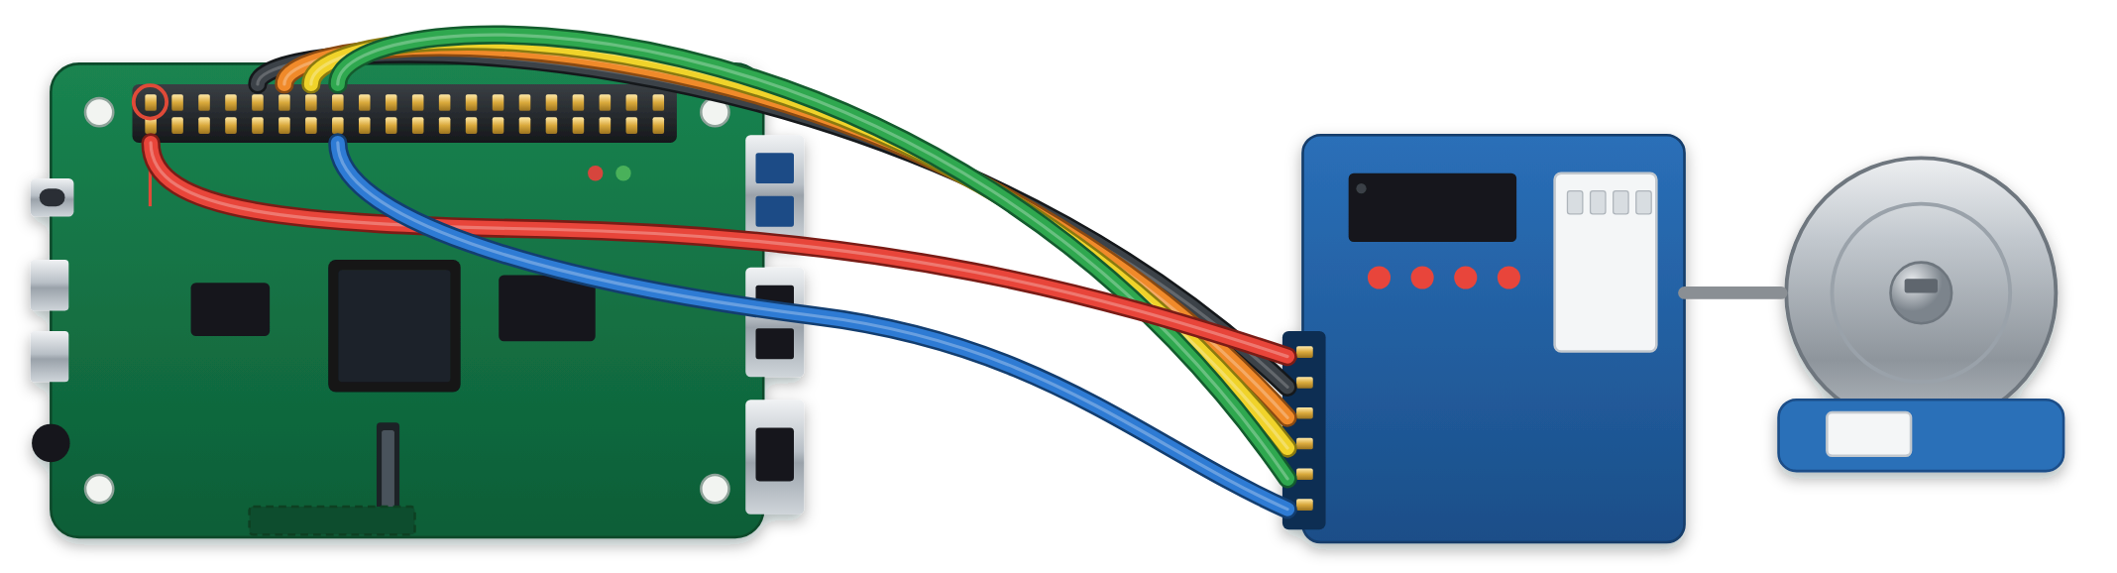
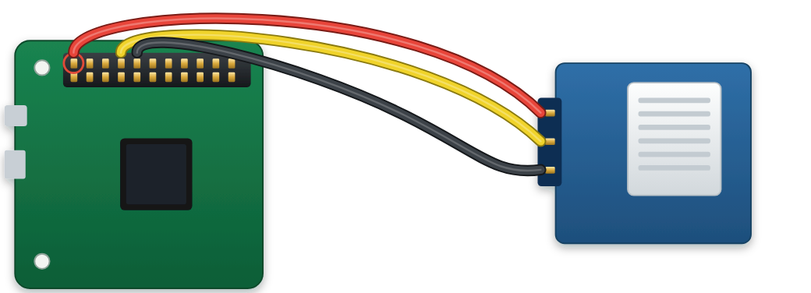
ABSTRACT
Seeing Failure Before It Shows
DISCUSSION
Brain-computer interface decoders lose accuracy as the recorded signal drifts. A monitor could warn before control is lost, but no accepted test shows whether such a warning comes early enough or is right often enough. This project builds that test. On archived recordings from two implanted arrays, with 1,850 planted faults whose start times were sealed in advance, the monitor detected faults that counting activity misses, yet warned a median 20 s after decoding failed and gave 3.41 false alarms per hour against a budget of 0.1. A preregistered optical test bench, specified but not yet built, will measure both quantities where failure times are known.
What the results mean
An early-warning monitor for brain-computer interface decoders, validated on archived brain recordings and on a purpose-built optical test bench
The monitor carries real information. It beats plain counting on exactly the faults counting cannot see, on both arrays (Fig. 10). It also does not mistake a change of task for a fault.
Gayathri Nair · Central Bucks High School South · [CATEGORY] · [FAIR AND YEAR]
A real signal is not yet a usable warning. It comes 20 s late and 34 times too often (Figs 11 to 13). The binding problem is not detection but silence: the risk score is never quiet during healthy use.
measured on archived recordings
planned on the bench
photo to add
The cause is measured, not guessed. One session holds about one independent measurement, so neither a different threshold nor averaging rescues it (Fig. 15).
COMPUTATIONAL VALIDATION
COMPLETE
RESULTS AND DATA
ARCHIVED RECORDINGS
INTRODUCTION
Archived recordings do not say when a failure began, so the failures were built: faults planted in real recordings at start times sealed before any detector existed, graded by a decoder that is never refitted.
0.71 to 0.79
20 s late
One question stays open. Deciding less often helps on one array and hurts on the other (Fig. 16). Two arrays cannot settle it.
A decoder that fails without saying so
1
Archived recordings
two implanted arrays, T11 and T5; public and de-identified [1]. No participants were recruited.
detection score on faults where counting activity scores 0.40 to 0.52
the typical warning arrives after decoding has already failed
Nearly 5.4 million people in the United States live with paralysis [3]. For some, an implanted brain-computer interface restores control of a cursor by intent. Software called a decoder translates the recorded activity, but the recording drifts, so decoders often need daily recalibration, and the device cannot be used freely while that happens [2].
34× too often
0 of 48
HOW THE TWO VALIDATIONS RELATE
2
Planted faults
1,850 episodes (1,073 + 777): four fault types, three rates, three severities; start times sealed with SHA-256.
3.41 false alarms per hour against a budget of 0.1
monitor configurations pass all five acceptance gates
Signal
Computational: done
Physical: planned
Frozen reference decoder
ridge regression, fitted once: 54.6° error against 90.7° chance (T11), 52.8° against 84.9° (T5). Grades only.
It sees faults that counting misses
Faults
two implanted arrays, 20 ms bins
384 screen patches at 50 frames a second
120
above the dashed line: failure
3
chance
monitor
count
planted in software: 4 types, 3 rates, 3 severities
optical or software: 4 types, 3 severities, plus faults nobody designed
(twice the day-1 error)
4
The monitor
sees only recorded activity; a risk score every 5 s from the last 30 s.
Signal loss
T11
0.61
0.80
Start time
sealed before any detector existed (1,850 episodes)
sealed with SHA-256 before each recording
80
total falls
T5
0.64
0.78
cursor error (°)
5
Scoring harness
lead time and false alarms as a pair; five gates; test data read once.
Dropout
T11
0.65
0.73
Fault-free record
17 + 15 episodes, about 1.4 h
101 sessions, about 8.4 h, 4 h held out
40
channels go silent
T5
0.75
0.77
0
Gain drift
T11
0.79
0.41
0
50
100
150
Fig. 4. The computational workflow (scripts/17 to scripts/22). The grading was built and committed before the monitor existed, so the measure could not be chosen to flatter it.
total unchanged
T5
0.73
0.40
Establishes
the monitor sees real faults, and is not deployable at the budget
whether that persists without biology, with known start times
days since the first session
Rotation
T11
0.76
0.52
Fig. 1. A real decoder left fixed for 142 days: median cursor error by session, array T11. Archived data [1].
scripts/21_score_report.py
total unchanged
T5
0.3
0.5
0.7
0.9
0.71
0.51
Cannot establish
a bounded false-alarm rate; agreement beyond two arrays
clinical performance: a camera is not an implant
# A warning raised before the fault even started is not
window-level AUC
Fig. 17. Each validation supplies what the other cannot. Held identical in both: the monitor, the 30 s window and 5 s step, the warning logic, the 0.1 per hour budget and the frozen decoder, so a difference between them cannot come from a retuned monitor.
prescience, it is a
Fig. 10. Detection score by fault type. Filled: the monitor. Open: counting activity. It wins where total activity is unchanged and loses on plain signal loss, as designed.
WHY IT MATTERS
# false alarm that happens to sit in a positive episode.
A warning helps only if it is early and rarely wrong
Counting it as a
# very early detection would be the most flattering possible
But the warning comes after the failure
WARNS EARLY
WARNS LATE
error.
Open until both are read together: whether the late warning belongs to brain recordings or to the method itself; how large the false-alarm rate is once there is enough fault-free recording to bound it; and whether deciding less often helps.
if warn_w < onset_w:
warning after the failure
warning first
RARELY
Useful
Too late
return {"false_alarm": True, "warn_w": warn_w, "lead_s":
median −20 s
WRONG
time to act before control is lost
the failure has already happened
np.nan, "detected": False}
OFTEN
Ignored
This monitor, so far
output
−180
−120
−60
0
+60
+120
HOW THE BENCH RESULT WILL BE JUDGED
WRONG
in hospitals, 72 to 99% of monitor
20 s late and 34× its false-alarm budget
$ python3 scripts/31_verify_claims.py
lead time (s); one dot per detected fault
alarms are false [4]
All 102 headline claims match the data files.
no
$ python3 poster/build_poster_data.py
Fig. 11. One dot per detected fault, array T11 (143 of 586). Median −20 s, 95% CI −25 to −10: 62% late, 25% early.
Median lead time above 0 s?
Not usable: too late
Alarms that cry wolf get switched off: nuisance alarms are the leading reason smoke alarms are disconnected [5]. Existing decoder research corrects drift automatically [2, 6], or scores it and reports a correlation with performance, r = 0.93 and 0.72 [1]. No published lead time or false-alarm rate was found for such a monitor.
PASS -- every recomputed value matches its stored headline.
yes
archived data: 20 s late
Fig. 5. Real code and real output. A warning before the fault begins is scored as a false alarm, never as an early catch. Every headline number is recomputed from the data files by script.
And it warns far too often
False-alarm upper bound within 0.1 per hour?
no
Not usable: too noisy
PHYSICAL VALIDATION
PREREGISTERED, NOT BUILT
T11
budget 0.1 /h
3.41 /h, 34× the budget
yes
PURPOSE
Archived data cannot supply a recorded start time or enough fault-free hours. A bench can: its faults begin at sealed moments and it records unattended. The apparatus is the subject; no person is measured.
T5
0.1
0.225 /h, 2.3×
1
10
Usable: hypothesis falsified
bench result:
To measure how early a decoder-health monitor warns, and how often it warns when nothing is wrong, on test beds where the moment of failure is known in advance.
false alarms per hour (log scale)
Fig. 18. Fixed before any recording. A result is read only after the five acceptance gates pass (Fig. 9).
sealed dark box
T11
fault-free episodes whose risk score trends
76.5% (13 of 17)
LIMITATIONS
HYPOTHESIS / ENGINEERING GOAL
1
screen
5
T5
gate: at most 10%
100.0% (15 of 15)
A camera in a sealed box is not an implanted array. A false-alarm rate measured on the bench is not an estimate of a clinical rate.
Primary hypothesis. Measured against failure times fixed in advance, with enough fault-free recording to bound the rate, the monitor's lead time and false-alarm rate fall outside what a deployed system could use. Falsified if the median lead time is above zero and the 95% upper bound on false alarms is within 0.1 per hour, at the threshold that detects 80% of faults.
2
Raspberry
Fig. 12. False alarms per hour against the budget, and how often the risk score drifts when nothing is wrong (17 + 15 fault-free episodes).
Matching the decoding difficulty makes the problem comparably hard. It does not make the noise, the drift or the failure modes the same.
filter
Pi 4
No threshold fixes both at once
Two arrays, which disagree on several questions; one bench, one room, one family of monitor.
camera
100
budget 0.1 /h
T11
T5
Secondary hypothesis. A monitor can reach the correlation with performance that the field reports as evidence (r above 0.7) while those two quantities say it is unusable. Inconclusive if no correlation measure reaches 0.70.
80
target: 80% detected
About 4 held-out fault-free hours cannot show a rate below 0.75 per hour. Reaching the 0.1 budget needs about 30 h.
1
Screen: 384 patches whose brightness encodes a known direction.
60
faults detected (%)
detected inside the budget:
2
Camera: films them at 50 frames a second, in the dark.
40
0.0% (T11), 0.8% (T5)
BROADER SIGNIFICANCE
3
Decoder: fitted once on fault-free sessions, then frozen.
20
Engineering goal. Build the monitor, the benchmark and the test bench that make both quantities measurable. Success is a trustworthy measurement, whatever the numbers are. It is not a claim that the monitor works.
4
Monitor: the same code as on the brain recordings.
0
0.1
1
10
The two questions, how early and how often wrong, are not specific to brain implants. They apply to any many-channel sensor that drifts and is watched by a statistic, and the bench is one instance of that class. What carries over is the test: failures whose start times are sealed in advance, and timing and false alarms reported together. No clinical benefit is claimed.
5
Fault: filter, rotation or software; begins at a sealed moment.
false alarms per hour (log scale)
6
Scoring: each warning against that sealed moment.
Fig. 13. Sweeping the warning threshold: detection is high only where false alarms run at several per hour.
Predictions and sample sizes were frozen on 24 September 2026, before any bench data existed (commit f4dda04).
Fig. 6. The optical test bench as specified. Nothing shown is built yet. Parts: Raspberry Pi 4, Camera Module 3, display, cardboard enclosure, ND 0.6 filter, stepper motor and driver, DHT22 sensor.
DATA
THE SYSTEM
Measured
Array T11
Array T5
Needed
FUTURE DIRECTIONS
One monitor, used unchanged in both validations
Faults detected
143 of 586
6 of 219
80%
Planned bench experiment
Sessions
Recording
Median lead time
−20 s
−35 s
above 0 s
P-1
calibration: match decoding difficulty
5 or more
25 min
level
silence
False alarms per hour
3.41
0.225
at most 0.1
P-2
false-alarm rate and silence, fault-free
101
8.4 h
384 channels
total activity has moved
channels have gone quiet
Risk score
Fault-free episodes drifting
76.5%
100%
at most 10%
P-3
lead time from a sealed start time
101
8.4 h
activity in
largest
Raspberry Pi 4
driver board
stepper motor
Session score (AUC)
0.673
0.742
0.990
P-4
correlation against usability
0
analysis
each 30 s
dispersion
profile
component,
pin 2 · 5 V →
+
pin 9 · GND →
−
pin 11 · GPIO 17 →
IN1
Risk autocorrelation, lag 1
0.995
0.980
near 0
P-5
faults nobody designed, by hand
10
50 min
window
channels drift apart, total unchanged
shape across channels has changed
cause named
pin 13 · GPIO 27 →
IN2
pin 15 · GPIO 22 →
IN3
pin 16 · GPIO 23 →
IN4
Fig. 14. Also measured: a change of task is not mistaken for a fault (15.6× and 70× separation), and accuracy by session ranges 0.32 to 0.97, tracking that day's decoder error (ρ = −0.720).
P-6
decision-rate curve, re-scored
0
analysis
Fig. 7. Breadboard view: wiring of the rotation stage. Pin numbers are read from rig/motor.py and checked on every run. The motor takes 5 V, never 3.3 V.
P-7
three more bench configurations
120
about 10 h
Fig. 2. The monitor, decoder-guard: four named components in place of one opaque number (scripts/22_decoder_guard.py).
ANALYSIS
All
none recorded yet
337
about 28 h
It is fitted on healthy windows only. It never sees the decoder output, the task, the performance number or a fault label.
Why: one measurement, 720 decisions
Fig. 19. The seven planned experiments, sizes frozen in advance. Changed: start time, fault present or absent, fault type, severity (0.25, 0.5, 1.0), decision rate. Measured: lead time, false-alarm rate, detection rate, silence, correlation with performance. Held fixed: window, decoder, camera exposure, screen brightness, modulation depth, ambient light, geometry.
It works in log space, so a uniform gain change becomes a shift and separates from a change in shape across channels.
PHOTO TO ADD
Risk scores within a session are near-copies of each other, so 720 decisions an hour rest on about one independent measurement. Deciding once per session would still need a score of 0.990.
Raspberry Pi 4
DHT22 sensor
Raspberry Pi 4, camera and wiring
A warning needs the risk score to stay above its threshold, not touch it once.
pin 7 · GPIO 4 →
DATA
Fig. 8. Left: breadboard view of the room-temperature sensor. Only the DATA pin is fixed by the repository (rig/logtemp.py); VCC and GND are a recommendation.
coin flip
T11
T5
needed
CONCLUSION
pin 1 · 3.3 V →
VCC
0.673
0.742
0.990
On archived recordings the monitor detects real faults, but it warns too late and too often to be relied on, and the cause is measured. The bench will show whether that belongs to brain recordings or to the method.
WHAT IS MEASURED
pin 9 · GND →
GND
0.5
0.6
0.7
0.8
the gap
0.9
1.0
120
A
B
C
lead time = −20 s
PHOTO TO ADD
PHOTO TO ADD
SCREENSHOT TO ADD
Fig. 15. Session score reached on each array against the score needed to stay inside the false-alarm budget.
Bench result, to be measured
the assembled bench, sealed
inside: screen and camera
a recording session
Deciding less often: the arrays disagree
median lead time
s, 95% CI
to
80
false alarms
per hour, upper bound
risk score
Gate
Must hold before any result is read
Measured
Result
100
T11
verdict (Fig. 18):
too late
too noisy
usable
40
warning threshold
G-a
light-tight: mean pixel below 2, max below 5 (of 255)
pass
fail
80
0
60
120
180
240
300
G-b
under 1% late frames, 5% dead channels, 1% clipped
pass
fail
faults detected (%)
time at the end of each 30 s window (s)
60
T5
REFERENCES
Fig. 3. One archived episode (array T11, day 692, gain drift), chosen by rule as the first whose lead time equals the median. A: the fault begins, at a time sealed in advance. B: decoding fails, its error 10° above the healthy baseline. C: the monitor warns. Lead time is B minus C, so a negative value means the warning came too late. Detection delay, C minus A, is what the bench adds.
G-c
screen-to-camera delay agrees over 3 runs
pass
fail
40
[1] Pun et al., Communications Biology 7 (2024)
G-d
sub-level signal on over 80% of channels
pass
fail
13
27
65
120
240
720
[2] Wilson et al., Nature Biomedical Engineering (2025)
G-e
margin within 6° of the neural value, 36.1°
pass
fail
decisions per hour (log scale; fewer to the left)
[3] Armour et al., Am. J. Public Health 106 (2016)
Fig. 9. Acceptance gates, blank until the bench exists. If G-e cannot be met the phase stops and reports that.
Fig. 16. Detection against how often the monitor decides, at a 10% false-flag rate. T11 +11.5 points (not established); T5 −18.2 points (established).
[4] Sendelbach & Funk, AACN Adv. Crit. Care 24 (2013)
[5] Ahrens, Smoke Alarms in U.S. Home Fires, NFPA (2015)
[6] Karpowicz et al., Nature Communications 16 (2025)
Notes:
Exported from the poster canvas by poster/pptx/build_pptx.py. Text is editable; each chart is one group (ungroup it to edit its parts). Fonts: IBM Plex Sans, IBM Plex Mono and Source Serif 4, free from Google Fonts. Without them PowerPoint substitutes other fonts and the text will shift.

