Slide 1
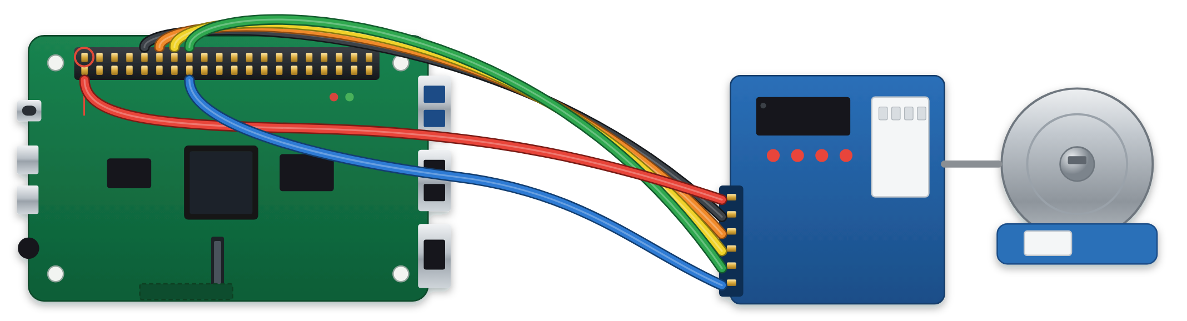
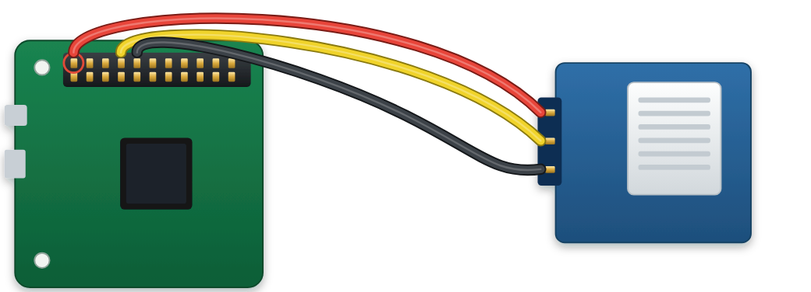
ABSTRACT
Seeing Failure Before It Shows
DISCUSSION
Brain-computer interface decoders lose accuracy as the recorded signal drifts. A monitor could warn before control is lost, but no accepted test shows whether such a warning comes early enough or is right often enough. This project builds that test. On archived recordings from two implanted arrays, with 1,850 planted faults whose start times were sealed in advance, the monitor detected faults that counting activity misses, yet warned a median 20 s after decoding failed and gave 3.41 false alarms per hour against a budget of 0.1. A preregistered optical test bench, specified but not yet built, will measure both quantities where failure times are known.
An early-warning monitor for brain-computer interface decoders, validated on archived brain recordings and on a purpose-built optical test bench
decoder
What the results mean
electrodes
cursor
The monitor carries real information. It beats plain counting on exactly the faults counting cannot see, on both arrays (Fig. 11). It also does not mistake a change of task for a fault.
Gayathri Nair · Central Bucks High School South · [CATEGORY] · [FAIR AND YEAR]
monitor
!
warning
Also measured: a change of task is not mistaken for a fault (15.6× and 70× separation), and accuracy by session ranges 0.32 to 0.97, tracking that day's decoder error (ρ = −0.720).
measured on archived recordings
planned on the bench
photo to add
INTRODUCTION: START HERE
NEARLY 5.4 MILLION PEOPLE IN THE UNITED STATES LIVE WITH PARALYSIS [3]
A decoder left unchanged worked for about two months, then failed (Fig. 1). This project tests whether such a failure can be seen coming, early enough and reliably enough to act on.
A real signal is not yet a usable warning. It comes 20 s late and 34 times too often (Figs 12 to 14). The binding problem is not detection but silence: the risk score is never quiet during healthy use.
PURPOSE
1
THE PROBLEM · ESTABLISHED SCIENCE
2
WHY IT MATTERS · NOT YET SHOWN
3
THIS PROJECT · SHOWN ON ARCHIVED DATA
The cause is measured, not guessed. One session holds about one independent measurement, so neither a different threshold nor averaging rescues it (Fig. 16).
To measure how early a decoder-health monitor warns, and how often it warns when nothing is wrong, on test beds where the moment of failure is known in advance.
A decoder tuned to yesterday
Three ways to time the repair
How early, and how often wrong
at fitting
weeks later
what changes [7]
on a schedule: every day, pausing use [2]
Earlier work corrects drift automatically [2, 6], or scores it and reports a correlation with performance, r = 0.93 and 0.72 [1]. No published lead time or false-alarm rate was found. This project plants 1,850 faults in real recordings at start times sealed in advance, then measures both.
array shifts
after failure: control is lost first
One question stays open. Deciding less often helps on one array and hurts on the other (Fig. 17). Two arrays cannot settle it.
tissue reacts
HYPOTHESIS / ENGINEERING GOAL
neurons change
when warned: before control is lost (goal)
Primary hypothesis. Measured against failure times fixed in advance, with enough fault-free recording to bound the rate, the monitor's lead time and false-alarm rate fall outside what a deployed system could use. Falsified if the median lead time is above zero and the 95% upper bound on false alarms is within 0.1 per hour, at the threshold that detects 80% of faults.
schematic, not to scale
parts wear
Deciding less often: the arrays disagree
120
cursor error (°)
WARNS EARLY
WARNS LATE
100
T11
60
failure level
RARELY
Useful
Too late
0
0
50
100
150
WRONG
0.71 to 0.79
20 s late
80
OFTEN
This monitor,
faults detected (%)
days with the same decoder
WRONG
Ignored
so far
detection score; counting scores 0.40 to 0.52
the typical warning follows the failure
60
T5
Secondary hypothesis. A monitor can reach the correlation with performance that the field reports as evidence (r above 0.7) while those two quantities say it is unusable. Inconclusive if no correlation measure reaches 0.70.
Fig. 1. Real data [1], array T11: median cursor error by session, one decoder kept for 142 days.
A warning would not stop the drift. It would let the repair happen only when needed, before control is lost. But a warning has to be trusted: in hospitals 72 to 99% of monitor alarms are false [4], and nuisance alarms are the leading reason smoke alarms are disconnected [5].
34× too often
0 of 48
40
13
27
65
120
240
720
In research trials, people with paralysis steer a cursor by intent: implanted electrodes record brain activity and software called a decoder translates it [1]. The recording keeps changing [7]. The decoder still expects the old pattern, so control degrades, and nothing tells the user.
3.41 false alarms per hour; the budget is 0.1
monitor configurations pass all five gates
decisions per hour (log scale; fewer to the left)
Engineering goal. Build the monitor, the benchmark and the test bench that make both quantities measurable. Success is a trustworthy measurement, whatever the numbers are. It is not a claim that the monitor works.
Not shown or claimed: a warning reliable enough to act on, or any benefit to a user.
Fig. 17. Detection against how often the monitor decides, at a 10% false-flag rate. T11 +11.5 points (not established); T5 −18.2 points (established).
HOW THE TWO VALIDATIONS RELATE
Signal
Computational: done
Physical: planned
Predictions and sample sizes were frozen on 24 September 2026, before any bench data existed (commit f4dda04).
PHYSICAL VALIDATION
PREREGISTERED, NOT BUILT
RESULTS AND DATA
ARCHIVED RECORDINGS
two implanted arrays, 20 ms bins
384 screen patches at 50 frames a second
Archived data cannot supply a recorded start time or enough fault-free hours. A bench can: its faults begin at sealed moments and it records unattended. The apparatus is the subject; no person is measured.
It sees faults that counting misses
Faults
planted in software: 4 types, 3 rates, 3 severities
optical or software: 4 types, 3 severities, plus faults nobody designed
THE SYSTEM
chance
monitor
count
One monitor, used unchanged in both validations
sealed dark box
Signal loss
T11
0.61
0.80
Start time
sealed before any detector existed (1,850 episodes)
sealed with SHA-256 before each recording
level
silence
screen
total falls
T5
0.64
0.78
384 channels
total activity has moved
channels have gone quiet
5
Dropout
T11
0.65
0.73
Fault-free record
17 + 15 episodes, about 1.4 h
101 sessions, about 8.4 h, 4 h held out
Risk score
1
channels go silent
T5
0.75
0.77
activity in
largest
2
Gain drift
T11
0.79
0.41
Establishes
the monitor sees real faults, and is not deployable at the budget
whether that persists without biology, with known start times
each 30 s
dispersion
profile
component,
Raspberry
total unchanged
T5
0.73
0.40
window
channels drift apart, total unchanged
shape across channels has changed
cause named
Pi 4
Rotation
T11
0.76
0.52
Fig. 2. The monitor, decoder-guard: four named components in place of one opaque number (scripts/22_decoder_guard.py).
filter
camera
total unchanged
T5
0.3
0.5
0.7
0.9
0.71
0.51
Cannot establish
a bounded false-alarm rate; agreement beyond two arrays
clinical performance: a camera is not an implant
window-level AUC
Fig. 18. Each validation supplies what the other cannot. Held identical in both: the monitor, the 30 s window and 5 s step, the warning logic, the 0.1 per hour budget and the frozen decoder, so a difference between them cannot come from a retuned monitor.
It is fitted on healthy windows only. It never sees the decoder output, the task, the performance number or a fault label.
1
Screen: 384 patches whose brightness encodes a known direction.
Fig. 11. Detection score by fault type. Filled: the monitor. Open: counting activity. It wins where total activity is unchanged and loses on plain signal loss, as designed.
It works in log space, so a uniform gain change becomes a shift and separates from a change in shape across channels.
2
Camera: films them at 50 frames a second, in the dark.
But the warning comes after the failure
Open until both are read together: whether the late warning belongs to brain recordings or to the method itself; how large the false-alarm rate is once there is enough fault-free recording to bound it; and whether deciding less often helps.
3
Decoder: fitted once on fault-free sessions, then frozen.
warning after the failure
warning first
4
Monitor: the same code as on the brain recordings.
median −20 s
A warning needs the risk score to stay above its threshold, not touch it once.
5
Fault: filter, rotation or software; begins at a sealed moment.
6
Scoring: each warning against that sealed moment.
WHAT IS MEASURED
Fig. 6. The optical test bench as specified. Nothing shown is built yet. Parts: Raspberry Pi 4, Camera Module 3, display, cardboard enclosure, ND 0.6 filter, stepper motor and driver, DHT22 sensor.
−180
−120
−60
0
+60
+120
LIMITATIONS
A
B
C
lead time = −20 s
lead time (s); one dot per detected fault
A camera in a sealed box is not an implanted array. A false-alarm rate measured on the bench is not an estimate of a clinical rate.
120
Fig. 12. One dot per detected fault, array T11 (143 of 586). Median −20 s, 95% CI −25 to −10: 62% late, 25% early.
Matching the decoding difficulty makes the problem comparably hard. It does not make the noise, the drift or the failure modes the same.
80
And it warns far too often
risk score
budget 0.1 /h
Two arrays, which disagree on several questions; one bench, one room, one family of monitor.
40
warning threshold
T11
3.41 /h, 34× the budget
0
60
120
180
240
300
T5
0.225 /h, 2.3×
About 4 held-out fault-free hours cannot show a rate below 0.75 per hour. Reaching the 0.1 budget needs about 30 h.
time at the end of each 30 s window (s)
Raspberry Pi 4
driver board
stepper motor
0.1
1
10
Fig. 3. One archived episode (array T11, day 692, gain drift), chosen by rule as the first whose lead time equals the median. A: the fault begins, at a time sealed in advance. B: decoding fails, its error 10° above the healthy baseline. C: the monitor warns. Lead time is B minus C, so a negative value means the warning came too late. Detection delay, C minus A, is what the bench adds.
pin 2 · 5 V →
+
pin 9 · GND →
−
pin 11 · GPIO 17 →
IN1
false alarms per hour (log scale)
BROADER SIGNIFICANCE
pin 13 · GPIO 27 →
IN2
pin 15 · GPIO 22 →
IN3
pin 16 · GPIO 23 →
IN4
fault-free episodes whose risk score trends
The two questions, how early and how often wrong, are not specific to brain implants. They apply to any many-channel sensor that drifts and is watched by a statistic, and the bench is one instance of that class. What carries over is the test: failures whose start times are sealed in advance, and timing and false alarms reported together. No clinical benefit is claimed.
Fig. 7. Breadboard view: wiring of the rotation stage. Pin numbers are read from rig/motor.py and checked on every run. The motor takes 5 V, never 3.3 V.
T11
76.5% (13 of 17)
COMPUTATIONAL VALIDATION
COMPLETE
T5
gate: at most 10%
100.0% (15 of 15)
Archived recordings do not say when a failure began, so the failures were built: faults planted in real recordings at start times sealed before any detector existed, graded by a decoder that is never refitted.
PHOTO TO ADD
Fig. 13. False alarms per hour against the budget, and how often the risk score drifts when nothing is wrong (17 + 15 fault-free episodes).
Raspberry Pi 4
DHT22 sensor
Raspberry Pi 4, camera and wiring
No threshold fixes both at once
FUTURE DIRECTIONS
1
Archived recordings
two implanted arrays, T11 and T5; public and de-identified [1]. No participants were recruited.
pin 7 · GPIO 4 →
DATA
Fig. 8. Left: breadboard view of the room-temperature sensor. Only the DATA pin is fixed by the repository (rig/logtemp.py); VCC and GND are a recommendation.
100
budget 0.1 /h
T11
T5
Planned bench experiment
Sessions
Recording
pin 1 · 3.3 V →
VCC
80
target: 80% detected
P-1
calibration: match decoding difficulty
5 or more
25 min
pin 9 · GND →
GND
60
P-2
false-alarm rate and silence, fault-free
101
8.4 h
2
Planted faults
1,850 episodes (1,073 + 777): four fault types, three rates, three severities; start times sealed with SHA-256.
faults detected (%)
detected inside the budget:
40
0.0% (T11), 0.8% (T5)
P-3
lead time from a sealed start time
101
8.4 h
PHOTO TO ADD
PHOTO TO ADD
20
P-4
correlation against usability
0
analysis
3
Frozen reference decoder
ridge regression, fitted once: 54.6° error against 90.7° chance (T11), 52.8° against 84.9° (T5). Grades only.
the assembled bench, sealed
inside: screen and camera
SCREENSHOT TO ADD
0
0.1
1
10
P-5
faults nobody designed, by hand
10
50 min
a recording session
false alarms per hour (log scale)
P-6
decision-rate curve, re-scored
0
analysis
Gate
Must hold before any result is read
Measured
Result
Fig. 14. Sweeping the warning threshold: detection is high only where false alarms run at several per hour.
P-7
three more bench configurations
120
about 10 h
4
The monitor
sees only recorded activity; a risk score every 5 s from the last 30 s.
G-a
light-tight: mean pixel below 2, max below 5 (of 255)
pass
fail
All
none recorded yet
337
about 28 h
5
Scoring harness
lead time and false alarms as a pair; five gates; test data read once.
G-b
under 1% late frames, 5% dead channels, 1% clipped
pass
fail
DATA
Fig. 19. The seven planned experiments, sizes frozen in advance. Changed: start time, fault present or absent, fault type, severity (0.25, 0.5, 1.0), decision rate. Measured: lead time, false-alarm rate, detection rate, silence, correlation with performance. Held fixed: window, decoder, camera exposure, screen brightness, modulation depth, ambient light, geometry.
Measured
Array T11
Array T5
Needed
Fig. 4. The computational workflow (scripts/17 to scripts/22). The grading was built and committed before the monitor existed, so the measure could not be chosen to flatter it.
G-c
screen-to-camera delay agrees over 3 runs
pass
fail
Faults detected
143 of 586
6 of 219
80%
G-d
sub-level signal on over 80% of channels
pass
fail
Median lead time
−20 s
−35 s
above 0 s
CONCLUSION
scripts/21_score_report.py
G-e
margin within 6° of the neural value, 36.1°
pass
fail
False alarms per hour
3.41
0.225
at most 0.1
# A warning raised before the fault even started is not
Fig. 9. Acceptance gates, blank until the bench exists. If G-e cannot be met the phase stops and reports that.
Fault-free episodes drifting
76.5%
100%
at most 10%
On archived recordings the monitor detects real faults, but it warns too late and too often to be relied on, and the cause is measured. The bench will show whether that belongs to brain recordings or to the method.
prescience, it is a
Session score (AUC)
0.673
0.742
0.990
# false alarm that happens to sit in a positive episode.
HOW THE BENCH RESULT WILL BE JUDGED
Risk autocorrelation, lag 1
0.995
0.980
near 0
Counting it as a
Fig. 15. The measured values behind Figs 11 to 14.
Bench result, to be measured
# very early detection would be the most flattering possible
Median lead time above 0 s?
no
Not usable: too late
ANALYSIS
median lead time
s, 95% CI
to
error.
Why: one measurement, 720 decisions
if warn_w < onset_w:
yes
archived data: 20 s late
false alarms
per hour, upper bound
return {"false_alarm": True, "warn_w": warn_w, "lead_s":
Risk scores within a session are near-copies of each other, so 720 decisions an hour rest on about one independent measurement. Deciding once per session would still need a score of 0.990.
verdict (Fig. 10):
too late
too noisy
usable
np.nan, "detected": False}
False-alarm upper bound within 0.1 per hour?
no
Not usable: too noisy
output
REFERENCES
$ python3 scripts/31_verify_claims.py
yes
coin flip
T11
T5
needed
[1] Pun et al., Communications Biology 7 (2024)
All 102 headline claims match the data files.
bench result:
0.673
0.742
0.990
[2] Wilson et al., Nature Biomedical Engineering (2025)
$ python3 poster/build_poster_data.py
Usable: hypothesis falsified
the gap
[3] Armour et al., Am. J. Public Health 106 (2016)
PASS -- every recomputed value matches its stored headline.
Fig. 10. Fixed before any recording. A result is read only after the five acceptance gates pass (Fig. 9).
0.5
0.6
0.7
0.8
0.9
1.0
[4] Sendelbach & Funk, AACN Adv. Crit. Care 24 (2013)
Fig. 5. Real code and real output. A warning before the fault begins is scored as a false alarm, never as an early catch. Every headline number is recomputed from the data files by script.
Fig. 16. Session score reached on each array against the score needed to stay inside the false-alarm budget.
[5] Ahrens, Smoke Alarms in U.S. Home Fires, NFPA (2015)
[6] Karpowicz et al., Nature Communications 16 (2025)
[7] Perge et al., J. Neural Eng. 10 (2013)
Notes:
Exported from the poster canvas by poster/pptx/build_pptx.py. Text is editable; each chart is one group (ungroup it to edit its parts). Fonts: IBM Plex Sans, IBM Plex Mono and Source Serif 4, free from Google Fonts. Without them PowerPoint substitutes other fonts and the text will shift.

