Slide 1

Project Review-2
(Literature Review / Applications Survey)
Front-End Development Frameworks
Project Title: ChronoFlow – Interactive Timeline with Custom Event Triggers CSE Department
Team Members:
2410030094 – Repala Gnana Lakshmi Prasanna
2410030397 – Jahnavi B
2410030466 – Rooprekha Bharde

Slide 2
Relevance to Project Title
We chose React.js because it lets us split a big, complicated app into small, reusable parts called components.
For ChronoFlow, we can make separate parts like:
Timeline (shows events in order)
Filter Sidebar (lets you filter events)
Reminder Popup (shows reminders)
We use Tailwind CSS to style these parts quickly and make sure the app looks good on phones, tablets, and computers.
This combo helps us build a clean, interactive, and easy-to-use timeline tool that works anywhere.
From our research, most modern interactive applications use component-based frameworks like React for better performance and scalability. Studies also show that utility-first CSS (like Tailwind) speeds up design without sacrificing customization which matches our goal to build an attractive, flexible, and fast timeline application.

Slide 3
Depth & Quality of Literature Review
We use React for fast event rendering and dynamic updates in our timeline
We use Tailwind to make our timeline mobile-friendly and quick to style
Type | Author / Source | Key Findings | Relevance to ChronoFlow | Link
Web App | ChronoFlo Calendar | Scrollable timeline, customizable, media support | Improves navigation and look | ChronoFlo Calendar
Research Paper | Timelines: Visualizing time in narrative research - ScienceDirect | Shows event patterns and relationships | Adds analytics and relationship mapping | Timelines: Visualizing time in narrative research - ScienceDirect
Web Tool | Knight Lab – TimelineJS | Google Sheets - interactive media-rich timeline | Easy event input and media support | Timeline JS

Slide 4
Critical Analysis, Synthesis & Gap Identification
React, Angular, Vue all make UI updates faster with virtual DOM or similar concepts.
Many timeline libraries (like Vis.js) show events clearly.
Limitations
Most timeline tools don’t allow custom event triggers like popups, and sounds for each event.
Some are not fully responsive on mobile.
Many require a backend to store data, which makes them harder to set up.
It is different from others as ChronoFlow will provide
Fully customizable event triggers.
Category filters for better navigation.
A responsive UI that works on any device without backend dependency.

Slide 5
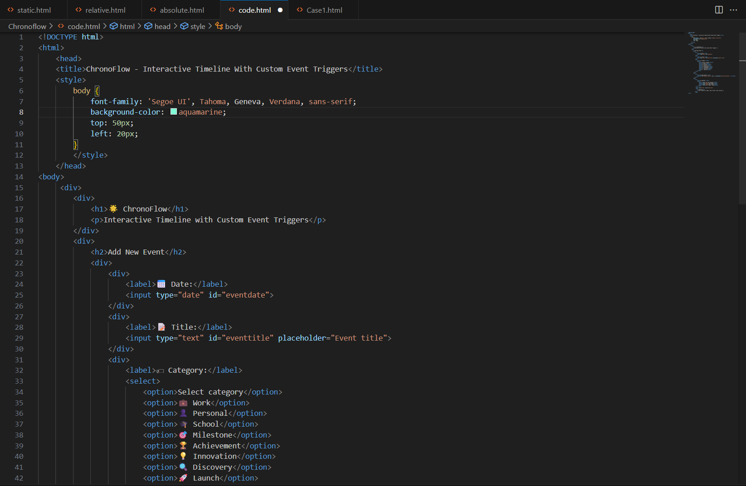
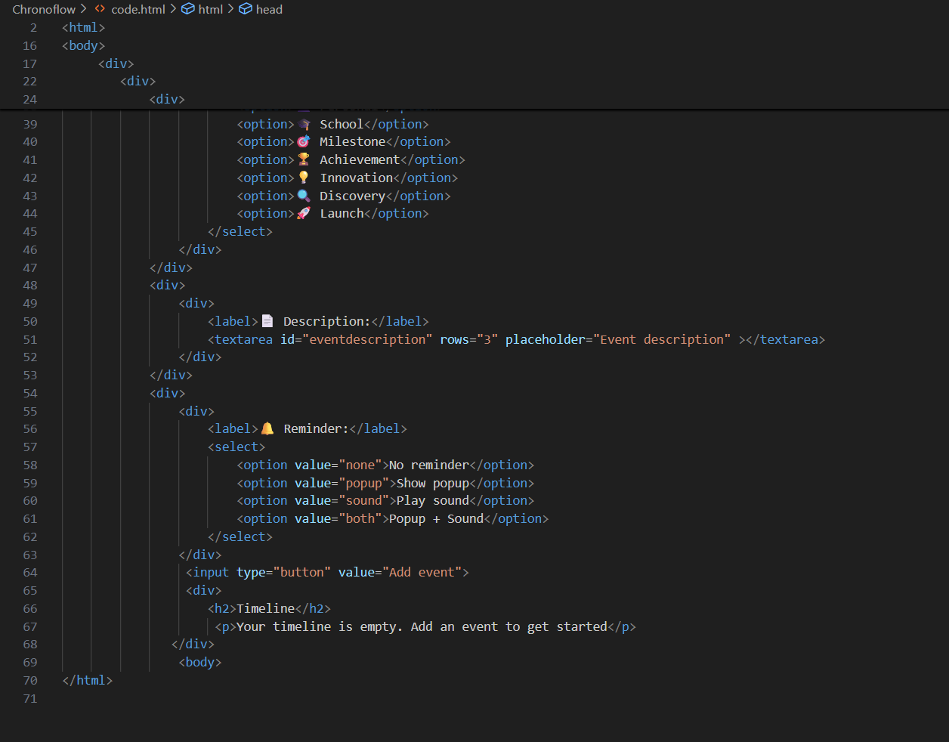
Project Implementation Started
Code snippets

Slide 6
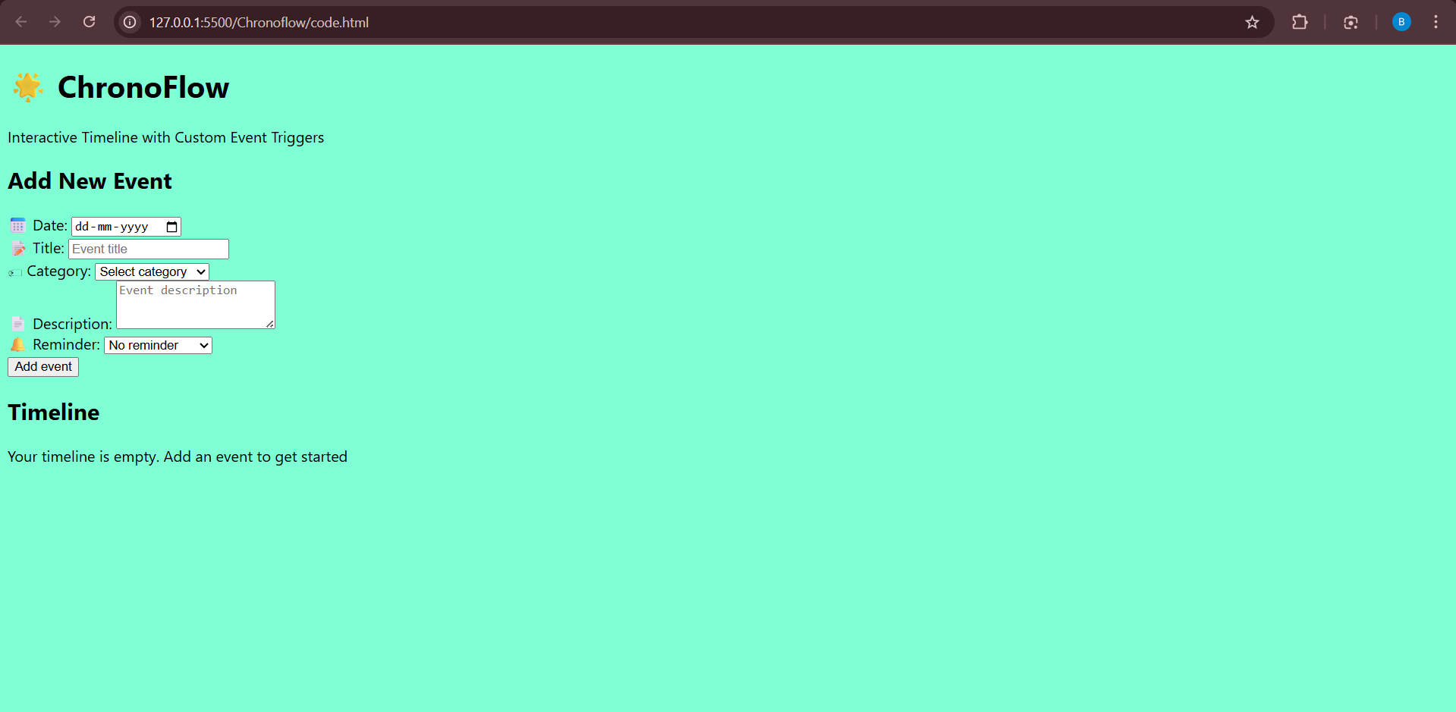
Expected milestones for the next review
By the next review, we will finish the main features like adding, viewing, and filtering events on the timeline.
The design will be responsive and neat for both mobile and desktop.
We will also start basic advanced features like saving data and editing events.

Slide 7
THANK YOU

