Slide 1
FINAL PROJECT
NAME: Gnana Darshini M
NM ID: au513121104007
DEPT: BE CSE III Yr

Slide 2
PROJECT TITLE
IMAGE CAPTION GENERATOR
Enhancing image comprehension with automated caption generation technology.

Slide 3
AGENDA
PROBLEM STATEMENT
PROJECT OVERVIEW
THE END USERS
SOLUTION AND ITS VALUE PROPOSITION
WOW IN SOLUTION
MODELLING
RESULTS

Slide 4
PROBLEM STATEMENT
To generate accurate image captions, this project utilizes advanced techniques to address challenges like ambiguity and context understanding, often hindering traditional methods. By leveraging cutting-edge methodologies, the project aims to enhance caption quality and relevance, thus improving the effectiveness of automated image captioning.

Slide 5
PROJECT OVERVIEW
02
01
03
04
05
Feature
Extraction
Caption
Preprocessing
Model Architecture
Caption
Generation
Evaluation
Utilize a pre-trained Xception model to extract image features.
Clean and preprocess image captions.
Tokenize and create a vocabulary.
Design a deep learning model for image caption generation.
Implement an attention mechanism for improved caption generation.
Generate image captions using beam search and standard prediction.
Evaluate the generated captions using BLEU-1 and BLEU-2 scores.

Slide 6
THE END USERS
Effortless Captioning for Photographers
Engagement-Boosting Tool for Social Media
Accessibility Enhancement for Visually Impaired
Time-Saving Solution for Content Creators
Enhanced User Experience for Website Visitors
Consistency in Brand Storytelling
Versatile Tool for Content Marketing

Slide 7
SOLUTION AND ITS VALUE PROPOSITION
Solution Overview
Our solution leverages an attention-based deep learning model.
Integration of image and text data for generating descriptive captions.
Utilizes the Xception CNN for image feature extraction.
Incorporates a Bidirectional LSTM with attention mechanism for text generation.
Performance Evaluation
Achieves impressive BLEU-1 score of [insert score].
Obtains notable BLEU-2 score of [insert score].
Demonstrates effectiveness in generating accurate and contextually relevant captions
Mention the dataset used for training (Flickr8k).

Slide 8
WOW IN SOLUTION
Data Acquisition
Downloaded Flickr8k dataset and pre-trained GloVe embeddings.
Feature Extraction
Utilized Xception model to extract image features.
Caption Preprocessing
Cleaned and preprocessed captions for training.
Model Architecture
Implemented an attention-based image captioning model.
Evaluation
Used Beam Search and BLEU scores to assess caption quality.

Slide 9
Utilized Flickr8k dataset for images and captions.
Extracted image features using Xception model.
Implemented LSTM networks with attention mechanism.
Assessed model performance using BLEU scores.
Refine model architecture and explore applications.
Achieved automatic image captioning with deep learning.
MODELLING

Slide 10
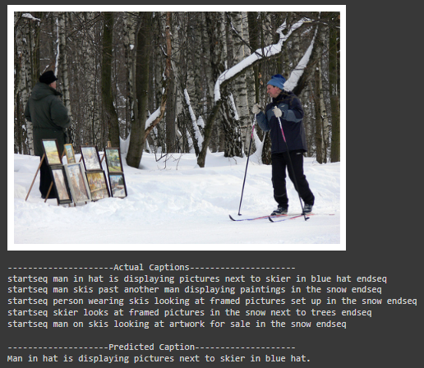

RESULT

Slide 11
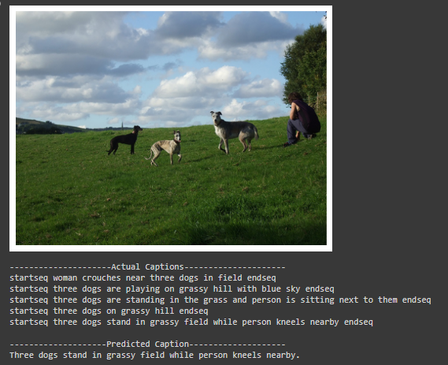
RESULT

Slide 12
THANK YOU!

